Slide 1
BCSE302P DATABASE SYSTEMS LAB
PROJECT PRESENTATION & DEMONSTRATION
1,500
Policy Intelligence for Agriculture
farmer interviews
22
A PostgreSQL database and NLP system for farmer feedback on government welfare schemes
PostgreSQL tables
Krish Singh
Register No. 24BDS0235
Under the guidance of Prof. Sangeetha S
Vellore Institute of Technology, Vellore
11
NLP models compared
Notes:
Good morning. I'm Krish Singh, 24BDS0235. My project, under the guidance of Prof. Sangeetha S, turns a survey of 1,500 farmers into a PostgreSQL database and uses NLP and LLMs to understand what farmers wrote about government schemes.

Slide 2
Problem Statement
PROBLEM
93
Many
1,214
0
spellings of one scheme name
answers packed in one cell
farmers' written feedback never analysed
rules stopping invalid data
THE QUESTION
Schemes are judged by satisfaction ratings, but farmers also explain in their own words what went wrong.
How can this survey be stored so it is clean, trustworthy and queryable — and how can the written feedback be analysed reliably enough to guide policy?
Policy Intelligence for Agriculture
2
Notes:
The survey was a single spreadsheet: inconsistent scheme names, lists inside cells, no validation, and over a thousand written answers nobody had analysed.

Slide 3






Objectives
OBJECTIVES
Design a normalised relational database (3NF) with keys and constraints
Load the raw survey cleanly and keep every record traceable
Analyse written feedback with NLP and store results with their model
Answer policy questions with SQL views and queries
Validate and compare NLP models and LLMs against human labels
Produce reports, a policy brief and a Q1 research paper
Policy Intelligence for Agriculture
3
Notes:
Six objectives, all completed: a clean database, traceable loading, an NLP layer, SQL answers, a proper model comparison, and the reports.

Slide 4


Project Scope
SCOPE
In scope
Out of scope
1,500 interviews, Chittoor district (AP)
Survey-collection app
PostgreSQL design, build, load, testing
Other districts or states
NLP: sentiment, aspects, topics, LLMs
Live / streaming data
SQL views, reports, policy brief
Cloud hosting
Human-labelled validation set
Sharing farmers' personal details
Policy Intelligence for Agriculture
4
Notes:
The scope is one district's survey, end to end: from the raw file to validated analysis. Data collection apps and other districts are out of scope.

Slide 5


Proposed Solution
SOLUTION
Store
Understand
Act
Normalised PostgreSQL database: 4 schemas, 22 tables, 26 foreign keys, rules that reject bad data
NLP + LLMs read 6,091 written answers; 11 models compared against human labels
SQL views answer policy questions; reports, dashboards and a research paper
Every number is traceable to an interview, and the whole system rebuilds from the raw file in ~14 seconds.
Policy Intelligence for Agriculture
5
Notes:
The solution has three parts: store the data properly, understand the written feedback with validated NLP, and act on it through SQL views and reports.

Slide 6



Database Technology Used: PostgreSQL 16
TECHNOLOGY
Which: PostgreSQL 16 — a relational (SQL) database
Why: Data is relational: farmers ↔ schemes ↔ aspects need joins and foreign keys
Suitable: CHECK rules, transactions, views, window functions, full-text search; free; works with Python and Power BI
Also considered | Type | Why not
MongoDB | Document | fixed survey structure needs joins
Neo4j | Graph | relationships are only 1–2 levels deep
Redis / BigQuery | Key-value / Cloud | no ad-hoc analysis / overkill for 1,500 rows
Policy Intelligence for Agriculture
6
Notes:
I chose PostgreSQL because the data is relational and I needed the database itself to enforce rules. Document, graph and key-value databases didn't fit a fixed survey.

Slide 7
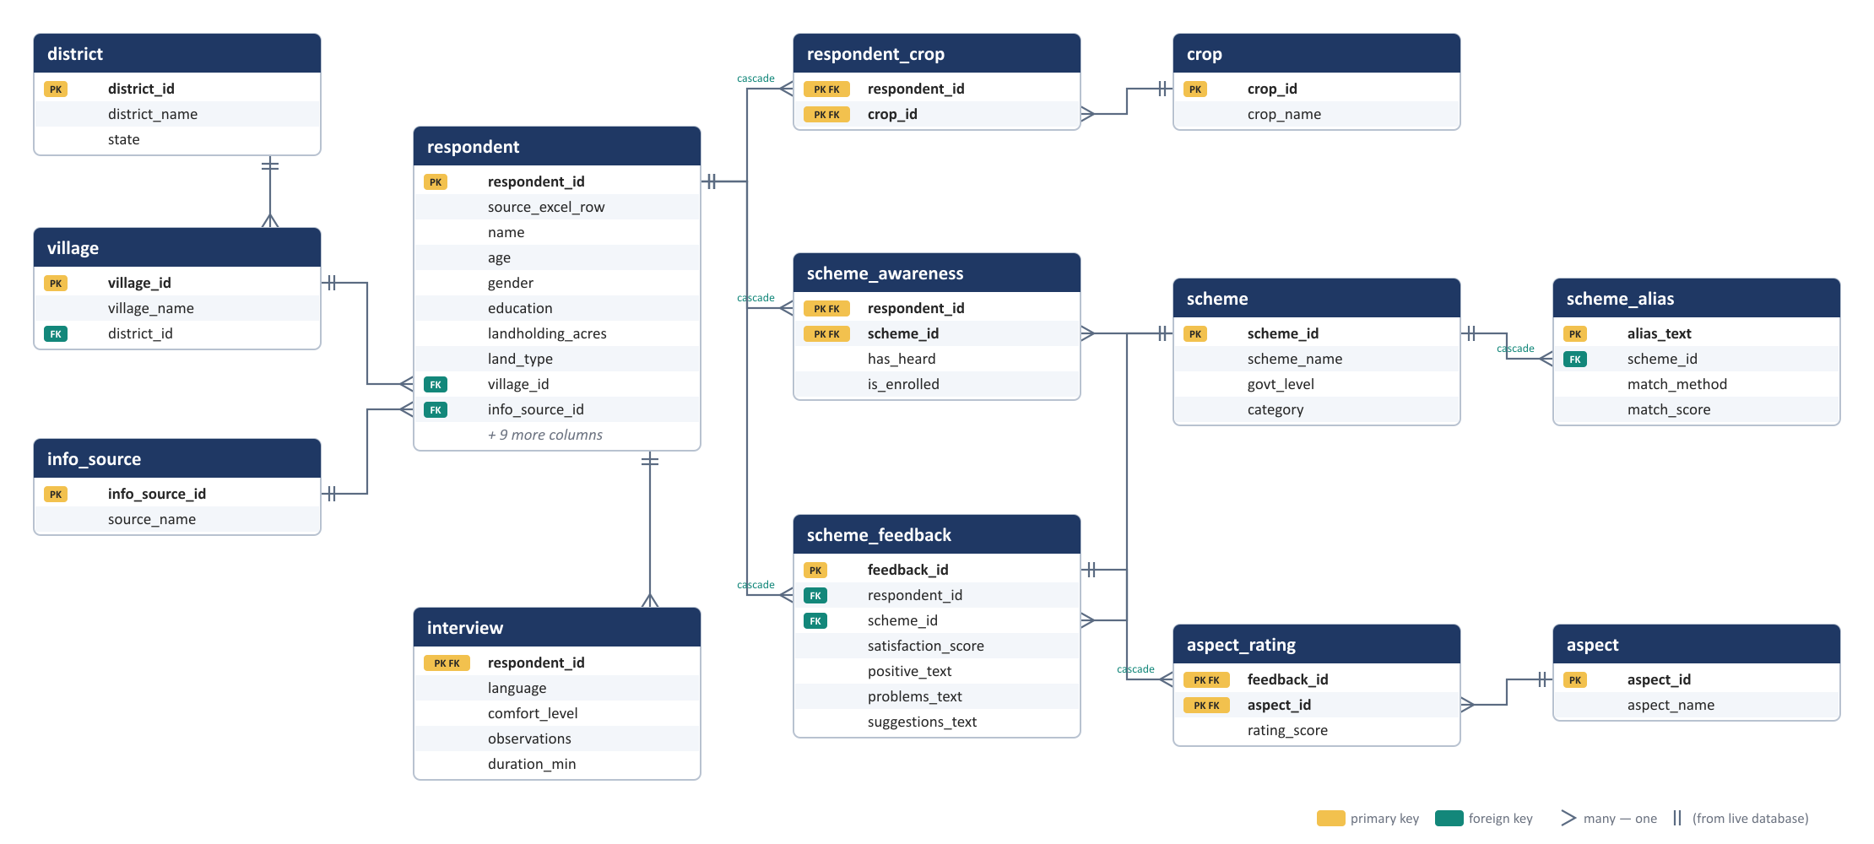
ER Diagram — Survey Schema (3NF)
DATA MODEL
Policy Intelligence for Agriculture
7
Notes:
Generated from the live database. Respondent is the centre; awareness, feedback and crops are link tables; the six rating columns became rows in aspect_rating. Crow's feet mark the many side.

Slide 8
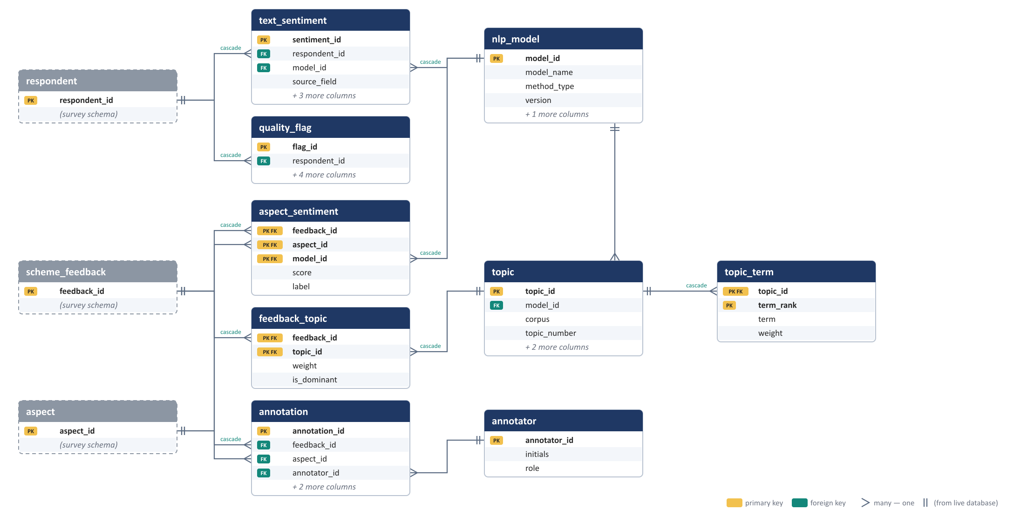
ER Diagram — Analytics Schema
DATA MODEL
Policy Intelligence for Agriculture
8
Notes:
The analytics schema stores every NLP result with the model that produced it, plus topics, quality flags and the human labels used for validation.

Slide 9
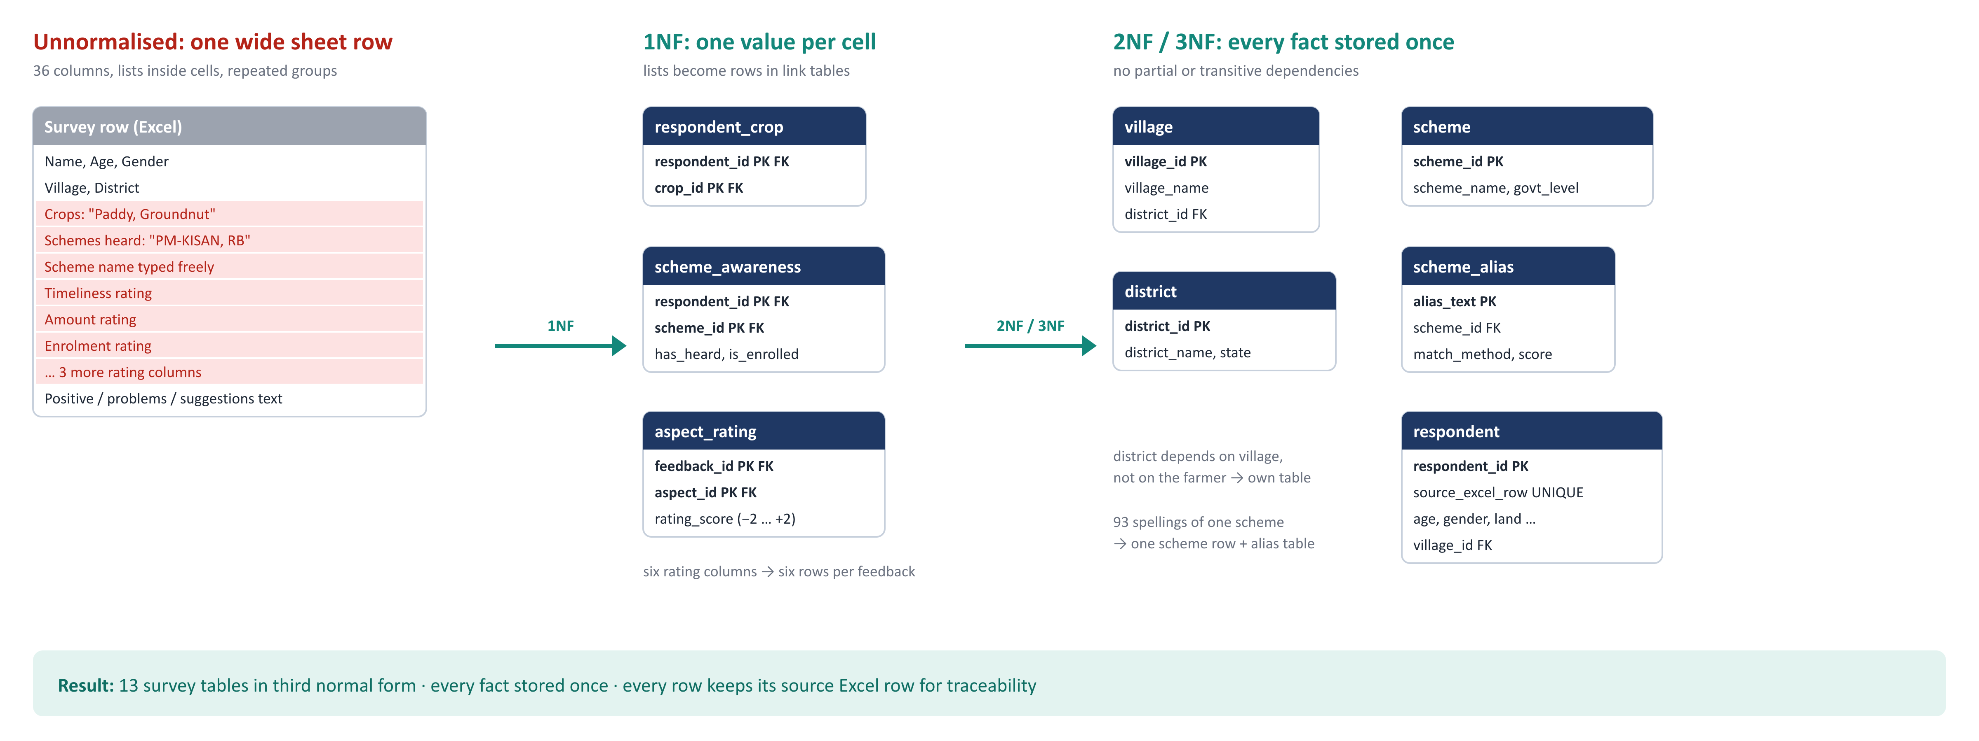
Normalisation: Spreadsheet → 3NF
DATA MODEL
Policy Intelligence for Agriculture
9
Notes:
Lists inside cells became link tables for 1NF. Village-to-district and scheme names moved to their own tables, removing transitive dependencies for 3NF.

Slide 10
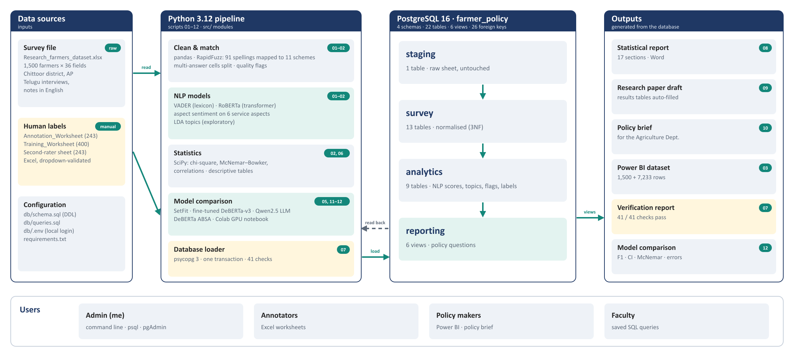
System Architecture
SYSTEM
Policy Intelligence for Agriculture
10
Notes:
Users to application to database to output. Python cleans the data, runs the models and loads PostgreSQL in one transaction; every output is generated from the database.

Slide 11
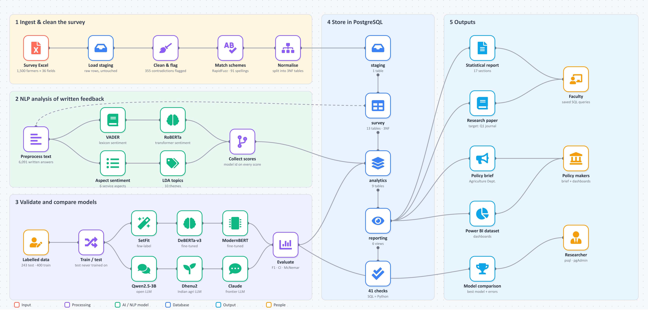
End-to-End Workflow
SYSTEM
Policy Intelligence for Agriculture
11
Notes:
The whole workflow as connected nodes: ingest and clean, NLP analysis, model validation, storage in four PostgreSQL schemas, and the outputs each user receives.

Slide 12






Tech Stack
SYSTEM
Database
Language
Data
NLP
PostgreSQL 16 · pgAdmin · psql
Python 3.12 · psycopg 3
pandas · openpyxl · RapidFuzz
NLTK · Transformers · SetFit · scikit-learn
LLM runtime
Statistics
Reporting
Tools
PyTorch CUDA · bitsandbytes 4-bit · RTX 2050
SciPy · bootstrap CI · McNemar
python-docx · Power BI
VS Code · Git / GitHub · Colab
Policy Intelligence for Agriculture
12
Notes:
PostgreSQL for the database, Python for everything else; Hugging Face Transformers and SetFit for NLP; PyTorch with 4-bit quantisation to run 3-billion-parameter LLMs on a laptop GPU.

Slide 13
Data Modules (12 scripts, run in order)
IMPLEMENTATION
Ingest & clean
Labelling
Database
Evaluation
Reporting
01 run_pipeline
04 annotation sheets
07 load_database
05 evaluate_models
03 Power BI
02 run_analysis
11 training sheets
+ 41 checks
12 compare_models
06 statistics
08 · 09 · 10 reports
src/ 21 reusable modules — cleaning · scheme matching · sentiment · ABSA · topics · statistics · evaluation · worksheets · active learning · model comparison
data/ (raw, never modified) → scripts/ → db/ (PostgreSQL) → output/ and reports/
Policy Intelligence for Agriculture
13
Notes:
Twelve numbered scripts in five groups. Running them in order rebuilds the whole project from the raw Excel file.

Slide 14
Types of NLP Used
NLP
NLP type | Model(s) | What it does
Lexicon-based sentiment | VADER + agri word list | adds up the sentiment of known words
Pretrained transformer | RoBERTa (Twitter) | neural sentiment, used as-is
Aspect-based sentiment | Keyword ABSA · DeBERTa ABSA | sentiment per service aspect (timeliness, amount …)
Topic modelling | LDA | recurring themes in complaints and suggestions
Few-label learning | SetFit (mpnet) | learns from a few hundred labels
Fine-tuning | DeBERTa-v3 · ModernBERT | whole transformer trained on farmer answers
LLM zero / few-shot | Qwen2.5-3B · Dhenu2 · Claude | follows the labelling guide, with 0 or 3 examples
Policy Intelligence for Agriculture
14
Notes:
Seven kinds of NLP, from simple word lists to large language models, so the comparison covers the whole range of techniques.

Slide 15




LLMs and Models Compared
NLP
Dhenu2 (KissanAI)
Qwen2.5-3B
Claude (Anthropic)
Indian agriculture LLM · Llama-3.2-3B
open LLM · 4-bit on RTX 2050
frontier LLM · zero-shot
DeBERTa-v3
ModernBERT
SetFit
Microsoft · fine-tuned × 5 seeds
2024 encoder · fine-tuned × 5
few-label · × 5 seeds
+ baselines: VADER · RoBERTa · TF-IDF logistic regression
Policy Intelligence for Agriculture
15
Notes:
I compared an Indian agriculture LLM, Dhenu2, with a general open LLM of the same size, a frontier LLM, and fine-tuned encoders — plus three standard baselines.

Slide 16
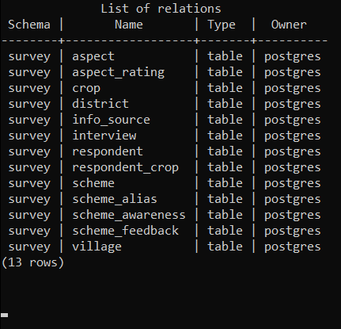
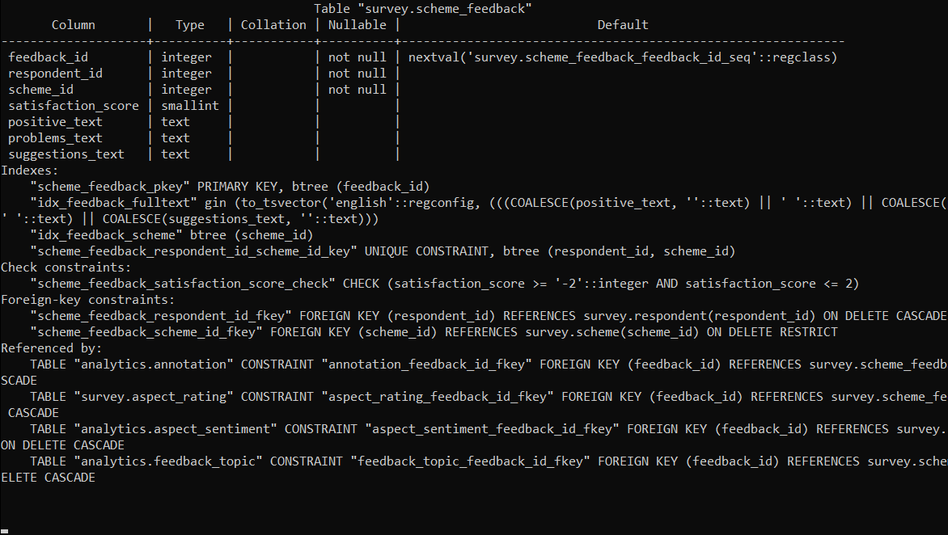
Implementation — Database
IMPLEMENTATION
psql · keys, CHECK rule and foreign keys
psql · survey tables
26
25
43
foreign keys
CHECK rules
indexes
Policy Intelligence for Agriculture
16
Notes:
The live database in psql: the survey tables, and one table's structure with its primary key, unique key, CHECK rule and foreign keys.

Slide 17
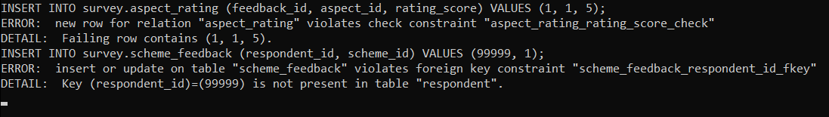
Implementation — Constraints in Action
IMPLEMENTATION
psql · invalid inserts rejected
Bad input | Stopped by | Result
Rating of 5 (allowed −2 … +2) | CHECK | Rejected
Respondent 99999 (does not exist) | FOREIGN KEY | Rejected
Duplicate id | PRIMARY KEY | Rejected
Label 'Happy' | CHECK | Rejected
Policy Intelligence for Agriculture
17
Notes:
I tried to insert bad data on purpose; PostgreSQL rejected every attempt. Genuine but contradictory answers are flagged, not rejected.

Slide 18
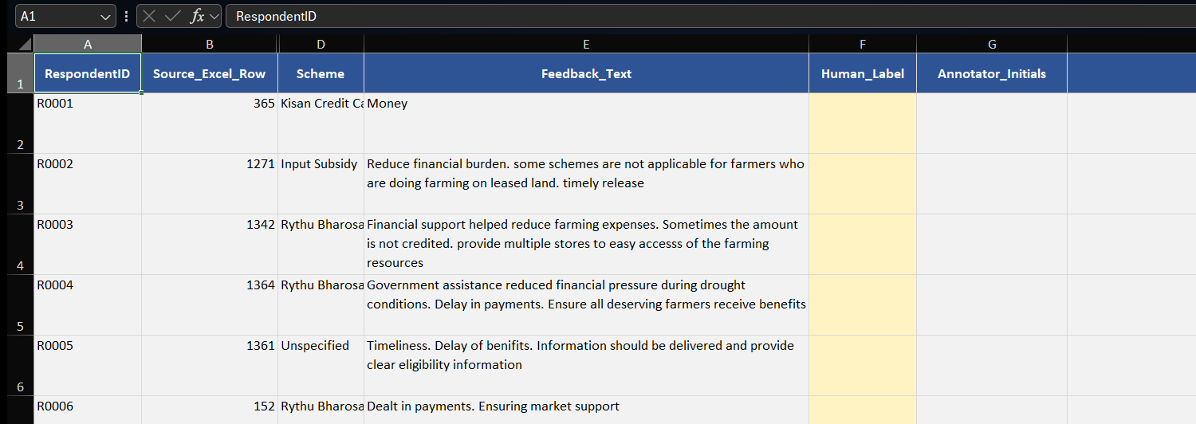
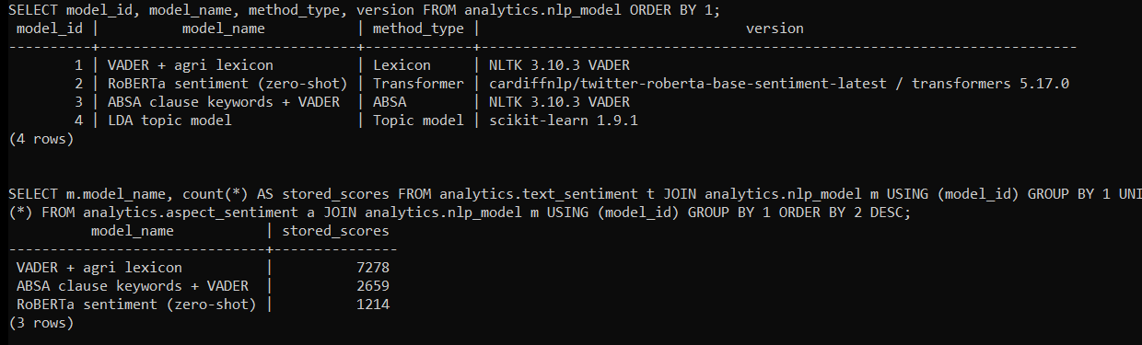
Implementation — Application & Interface
IMPLEMENTATION
psycopg 3, parameterised queries
Login in .env, never in code
One transaction per load
Excel labelling worksheet (names hidden)
1 / 2 / 3 keyboard labelling
Every score linked to its model
psql · registered NLP models
Policy Intelligence for Agriculture
18
Notes:
Python connects with psycopg using parameterised queries in a single transaction. Annotators label in Excel with one-key shortcuts; every model score is stored with its model id.

Slide 19
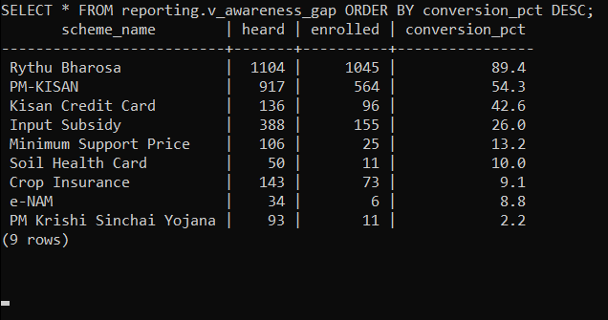
Demonstration — Live Queries
DEMONSTRATION
psql · awareness view on the live database
Full-text search finds 32 farmers complaining about delays with documents — impossible on the original spreadsheet.
Policy Intelligence for Agriculture
19
Notes:
Live demo: run the awareness view and a full-text search in psql. Every reporting query runs in milliseconds.

Slide 20
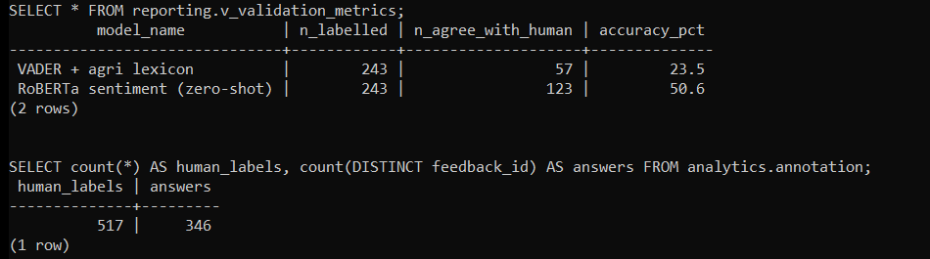
Demonstration — Validation Inside PostgreSQL
DEMONSTRATION
517 human labels in analytics.annotation
A SQL view joins labels to model scores
Accuracy computed by the database itself
psql · reporting.v_validation_metrics
VADER 23.5% · RoBERTa 50.6%
Off-the-shelf sentiment tools misread farmer feedback — so models must be validated before their numbers are trusted.
Policy Intelligence for Agriculture
20
Notes:
The labels live in the database, and a SQL view computes each model's accuracy. VADER agrees with humans only 23.5% of the time, RoBERTa 50.6%. That is why the model comparison matters.

Slide 21
Results — Model Comparison
RESULTS
BEST MODEL
Fine-tuned ModernBERT-base
0.765
macro-F1 · 83.5% accuracy
VADER lexicon: only 0.22
Dhenu2 best 0.70 vs Qwen 0.39
Trained on farmer labels ≫ generic
Policy Intelligence for Agriculture
21
Notes:
All 11 models were scored on the same human-labelled test set. Fine-tuned ModernBERT-base was best with macro-F1 0.765. The VADER lexicon, still common in papers, scored only 0.223.

Slide 22
Results — Policy Findings
RESULTS
89.4% vs 9.1%
Rythu Bharosa vs Crop Insurance — awareness does not become enrolment
Scheme | Weakest aspect | % negative
Input Subsidy | Enrolment | 53.8%
Kisan Credit Card | Enrolment | 50.0%
PM-KISAN | Enrolment | 47.6%
Rythu Bharosa | Enrolment | 40.6%
Ratings and comments disagree ~28% of the time on timeliness and enrolment (p < 0.001)
Policy Intelligence for Agriculture
22
Notes:
Finding 1 comes straight from survey answers: knowing about a scheme does not mean joining it. Enrolment is the weakest aspect for every major scheme, and ratings often contradict what farmers write.

Slide 23
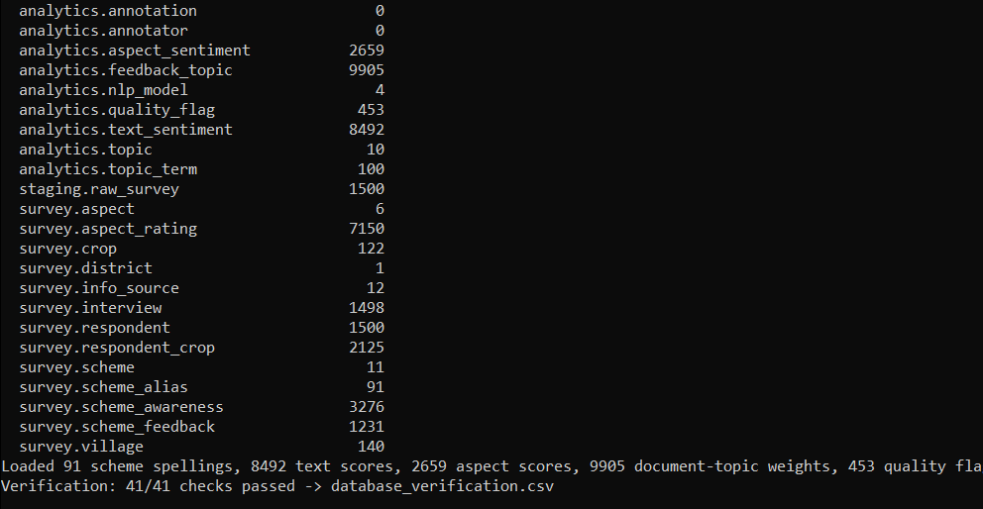
Testing & Verification
RESULTS
41 / 41
SQL-vs-Python checks pass
4 / 4
invalid inserts rejected
13.7 s
PowerShell · database load, 41/41 checks pass
full rebuild from Excel
16 MB
database size
Policy Intelligence for Agriculture
23
Notes:
Every load verifies itself: 41 checks compare the database with the Python analysis, and all pass.

Slide 24
Challenges and Learning Outcomes
REFLECTION
Challenge | Solution
93 spellings of one scheme | fuzzy matching + alias table
Lists inside cells | link tables (1NF)
355 contradictory farmers | flagged, not deleted
SQL vs Python drift | 41 automatic checks
LLMs too big for laptop | 4-bit quantisation on GPU
Long model runs | cached predictions, resumable
WHAT I LEARNED
Normalising messy real data
Keys, CHECKs, views, windows
Safe Python ↔ PostgreSQL
Fair model evaluation
Running LLMs efficiently
Policy Intelligence for Agriculture
24
Notes:
Most challenges came from messy real data; each became a design decision. I also learned how to evaluate models properly and run LLMs on modest hardware.

Slide 25
Conclusion and Future Scope
CONCLUSION
Achieved
Limitations
Future scope
Research
22-table 3NF database
One district
Live Power BI on PostgreSQL
Q1 journal paper in progress
11 models compared
Telugu → English notes
More districts, cloud DB
Guided by Prof. Sangeetha S
Policy answers in SQL
Joint labelling
Telugu-language models
Code on GitHub
GitHub: https://github.com/singhkrish2006/farmer-scheme-policy-intelligence
Thank you — questions?
Policy Intelligence for Agriculture
25
Notes:
To conclude: a clean, verified database, a fair comparison of NLP models and LLMs, and policy answers in SQL. The research paper is being prepared for a Q1 journal under Prof. Sangeetha S. Thank you.

