Slide 1
Frontend & the APIs
Building and Deploying a Full-Stack MERN App on Azure by Gurjot Singh

Slide 2
TABLE OF CONTENTS
01
03
02
04
Data in URL
APIs: Read, Update & Delete
Postman Testing
Setting up Frontend

Slide 3
01
Traditional Websites vs Modern Web Apps

Slide 4
Traditional Websites vs Modern Web Apps
Older websites
Modern web apps
Page reloads after every action
Server sends a full HTML page
Only parts of the page update
Faster user experience

Slide 5
What is React?
Used while Coding
Fast Refresh
Not Optimized
Includes debugging tools

Slide 6
How Data Reaches Backend?
URL Params
Query Params
Request Body
Used when identifying something specific
Used for filtering or optional values
Used for sending data

Slide 7
URL Params
Used when identifying something specific
Example:
PATCH /api/todos/123
Route: router.patch("/:id", updateTodo);
Access it using:
req.params.id
But these won’t work without:
app.use(express.json());

Slide 8
Query Params
Used for filtering or optional values
Example:
GET /api/todos?completed=true
Access it using:
req.query.completed

Slide 9
Request Body
Used for sending data
Example:
{
"title": "Learn Docker",
"isCompleted": false
}
Access it using:
req.body

Slide 10
02
APIs: Read, Update & Delete

Slide 11
Backend APIs
Create (POST)
Read (GET)
CRUD
Update (PATCH/PUT)
Delete (DELETE)
/api/todos
/api/todos
To do app’s APIs
/api/todos/:id
/api/todos/:id

Slide 12
03
Postman Testing

Slide 13
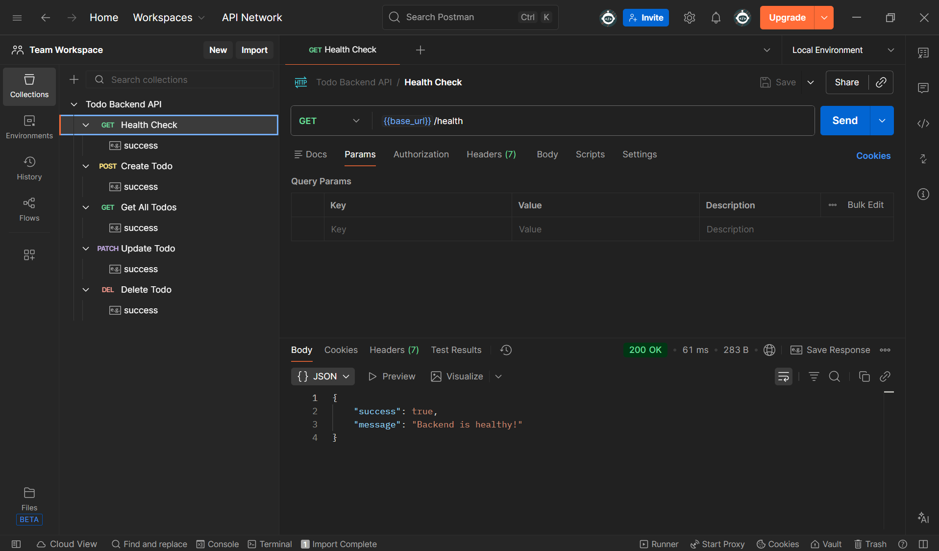

Slide 14
04
Setting up Frontend

Slide 15
EXERCISE
1. pnpm create next-app frontend
2. Select option 2
3. cd frontend ; pnpm dev
4. Open http://localhost:3000/

Slide 16
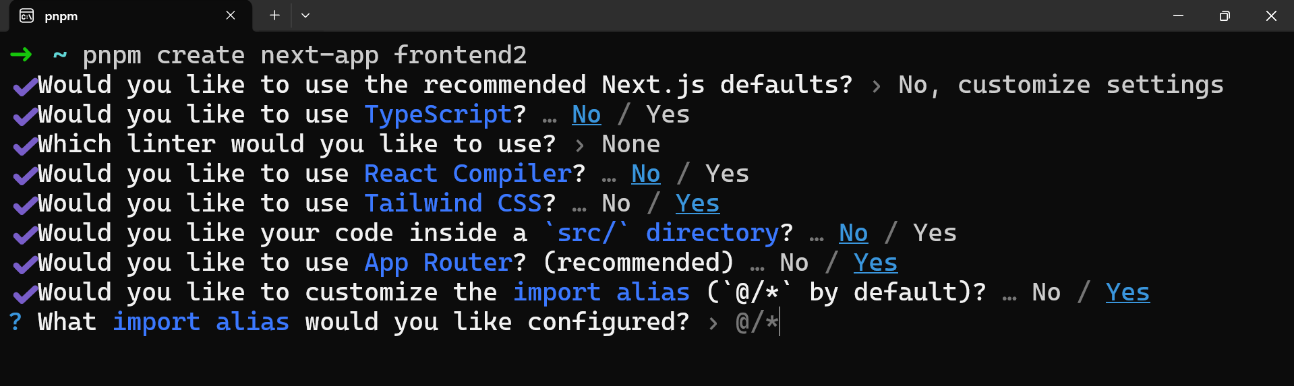

Slide 17
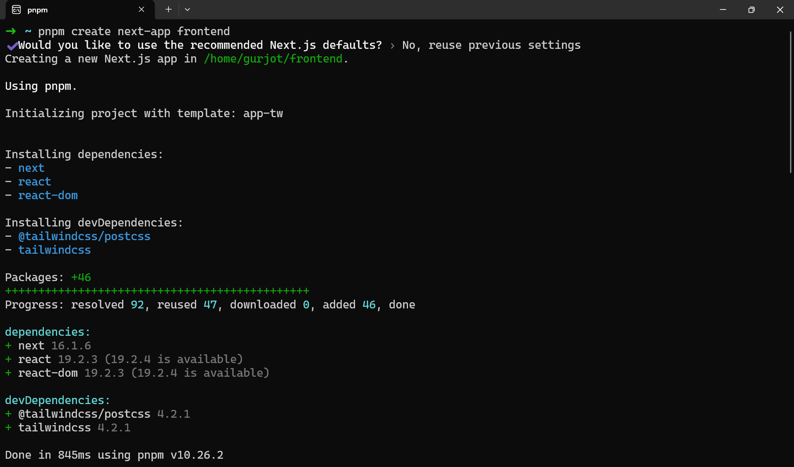

Slide 18
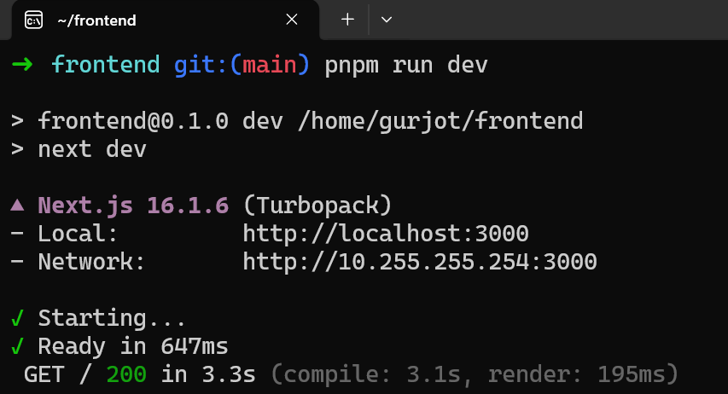

Slide 19
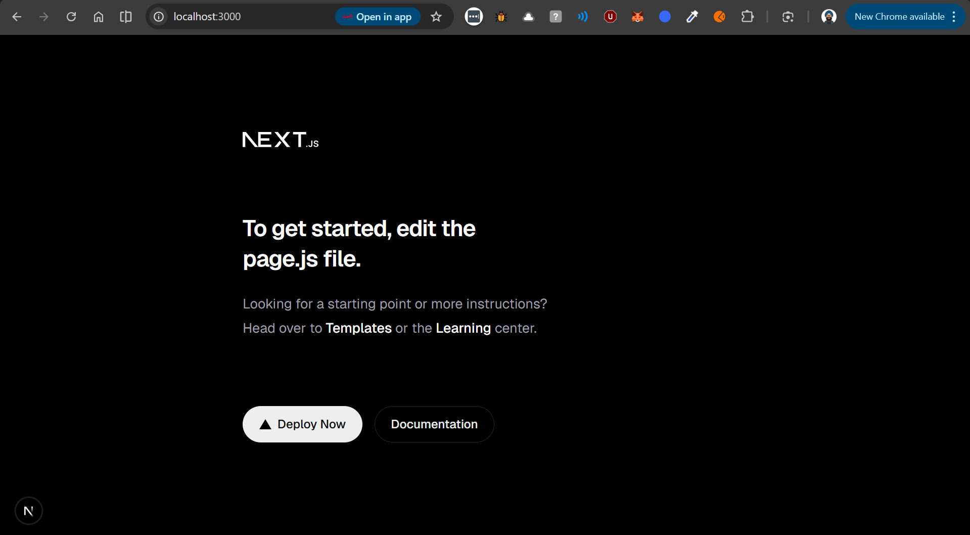

Slide 20
Development Mode in Next.js
pnpm dev
Used while Coding
Fast Refresh
Not Optimized
Includes debugging tools

Slide 21
Production Build in Next.js
pnpm build
Optimizes Code
Minifies JavaScript
Removes unused code
Creates a .next folder that has the final compiled code

Slide 22
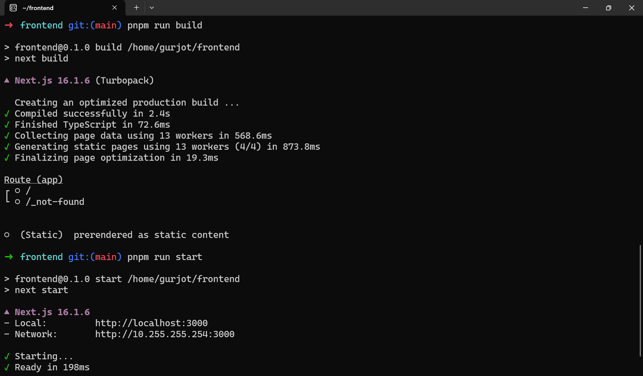

Slide 23
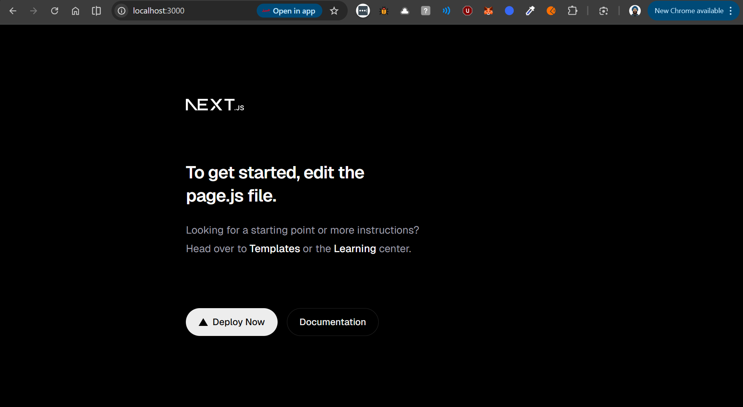

Slide 24
THANKS!

