Slide 1
Finalising our Backend
Building and Deploying a Full-Stack MERN App on Azure by Gurjot Singh

Slide 2
TABLE OF CONTENTS
01
03
02
04
Data in URL
APIs: Read, Update & Delete
Postman Testing
Setting up Frontend

Slide 3
01
Data in URL

Slide 4
How Data Reaches Backend?
URL Params
Query Params
Request Body
Used when identifying something specific
Used for filtering or optional values
Used for sending data

Slide 5
URL Params
Used when identifying something specific
Example:
PATCH /api/todos/123
Route:
router.patch("/:id", updateTodo);
Access it using:
req.params.id
But these won’t work without:
app.use(express.json());

Slide 6
Query Params
Used for filtering or optional values
Example:
GET /api/todos?completed=true
Access it using:
req.query.completed

Slide 7
Request Body
Used for sending data
Example:
{
"title": "Learn Docker",
"isCompleted": false
}
Access it using:
req.body

Slide 8
02
APIs: Read, Update & Delete

Slide 9
Backend APIs
Create (POST)
Read (GET)
CRUD
Update (PATCH/PUT)
Delete (DELETE)
/api/todos
/api/todos
To do app’s APIs
/api/todos/:id
/api/todos/:id

Slide 10
03
Postman Testing

Slide 11
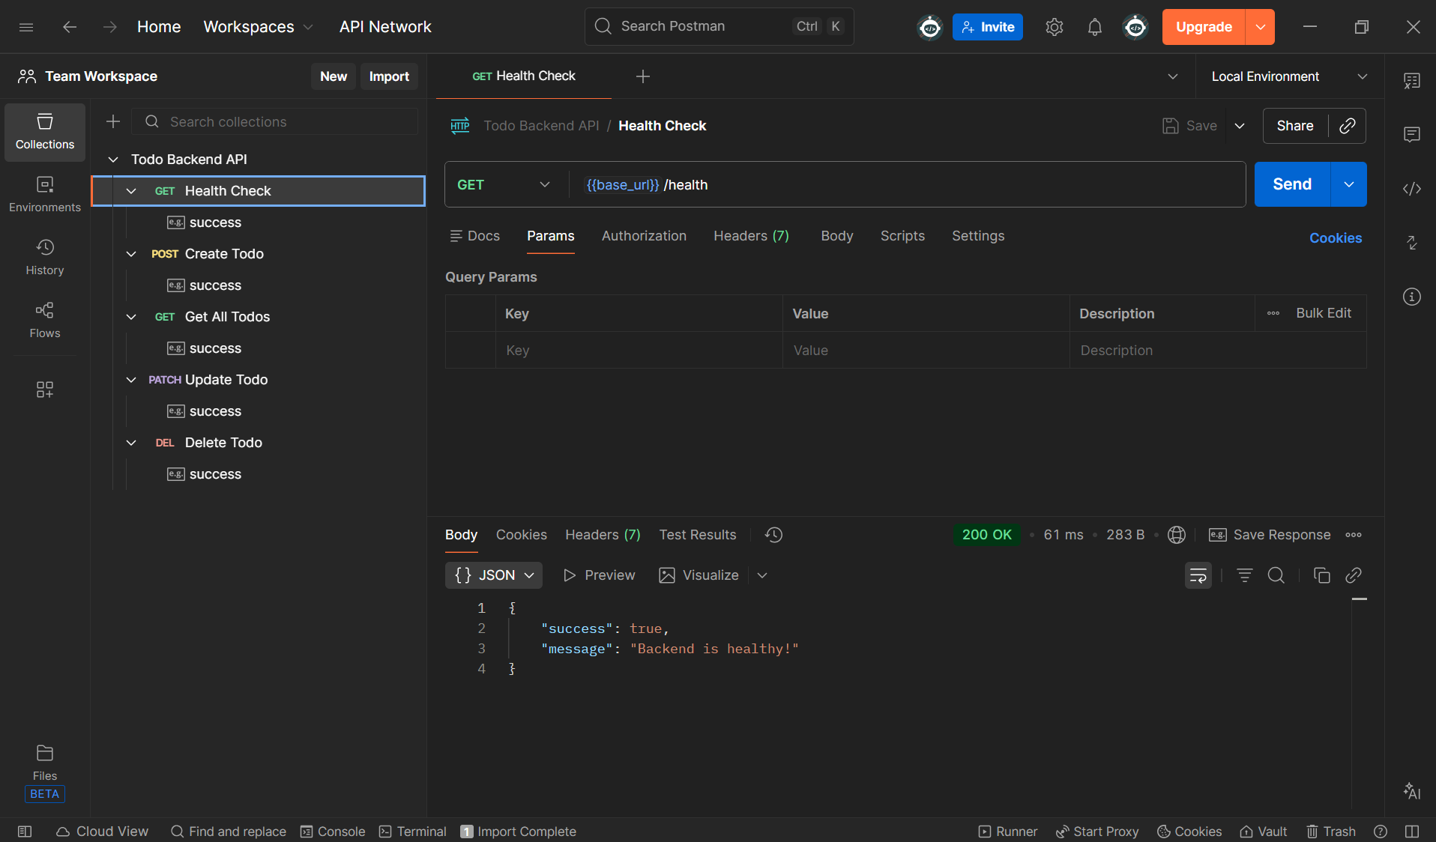

Slide 12
04
Setting up Frontend

Slide 13
EXERCISE
1. pnpm create next-app frontend
2. Select option 2
3. cd frontend ; pnpm dev
4. Open http://localhost:3000/

Slide 14
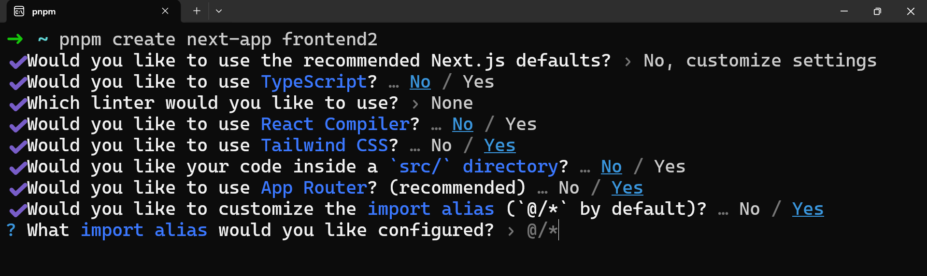

Slide 15
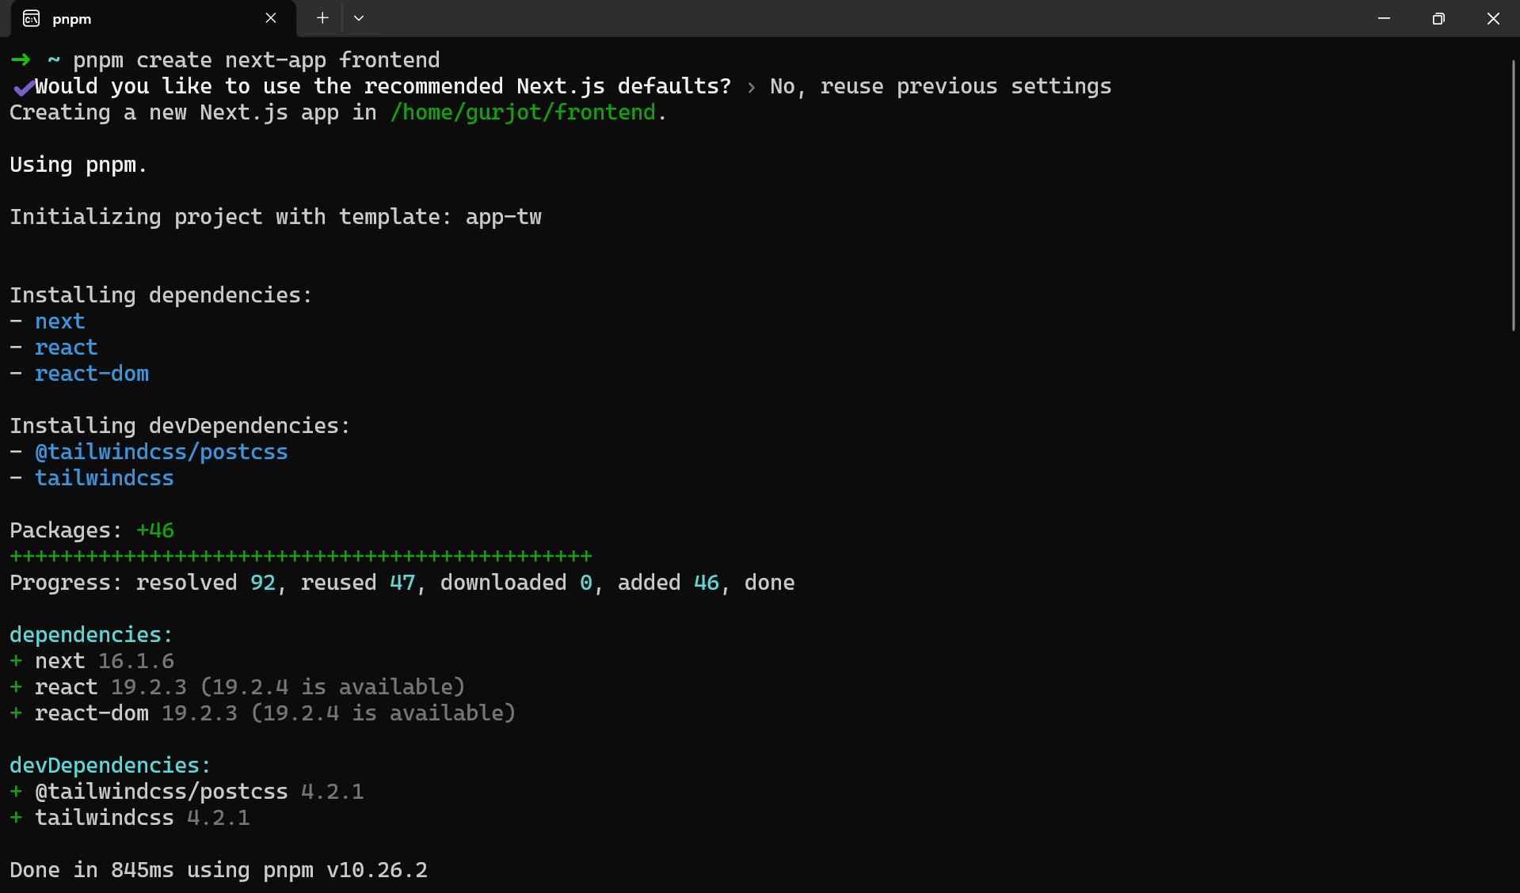

Slide 16
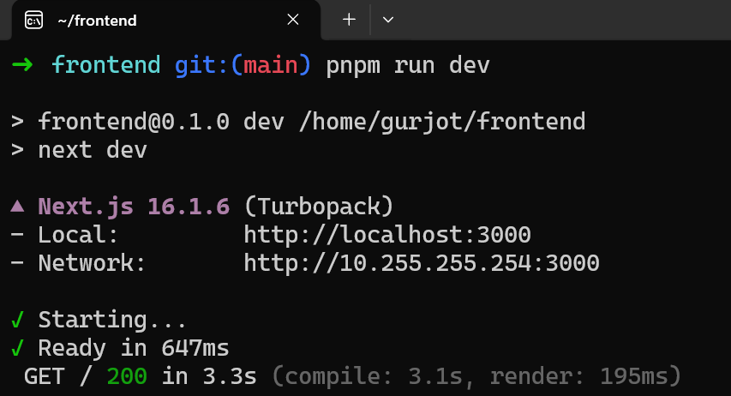

Slide 17
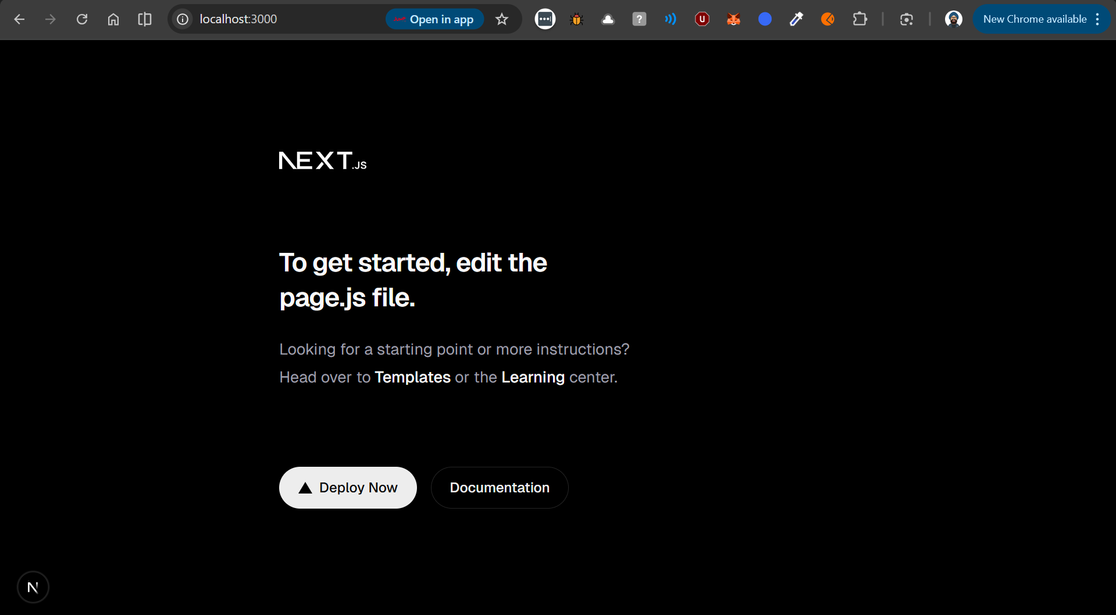

Slide 18
Development Mode in Next.js
pnpm dev
  Used while Coding
  Fast Refresh
  Not Optimized
  Includes debugging tools

Slide 19
Production Build in Next.js
pnpm build
  Optimizes Code
  Minifies JavaScript
  Removes unused code
  Creates a .next folder that has the final compiled code

Slide 20
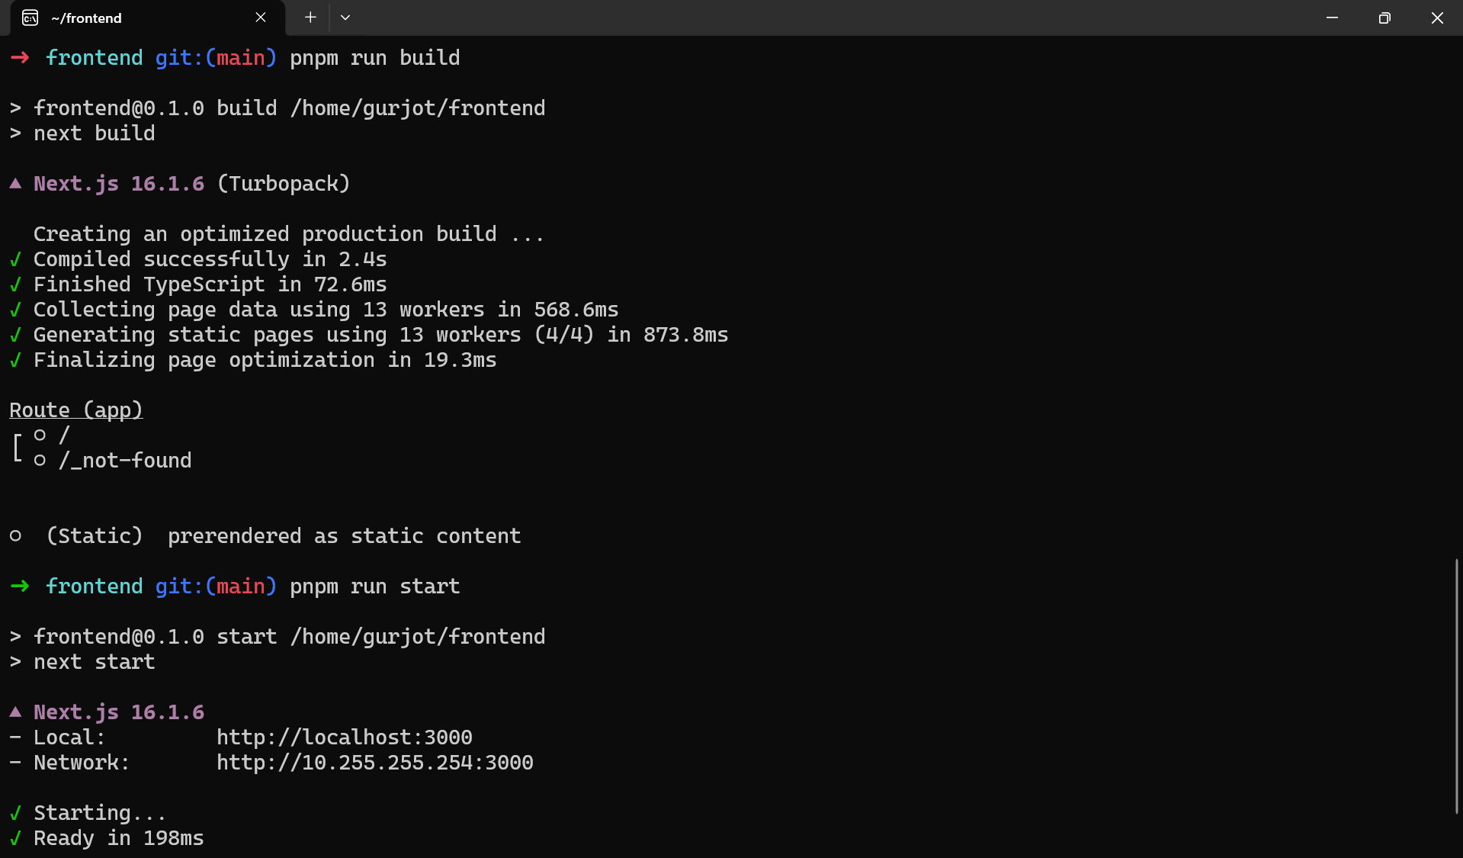

Slide 21
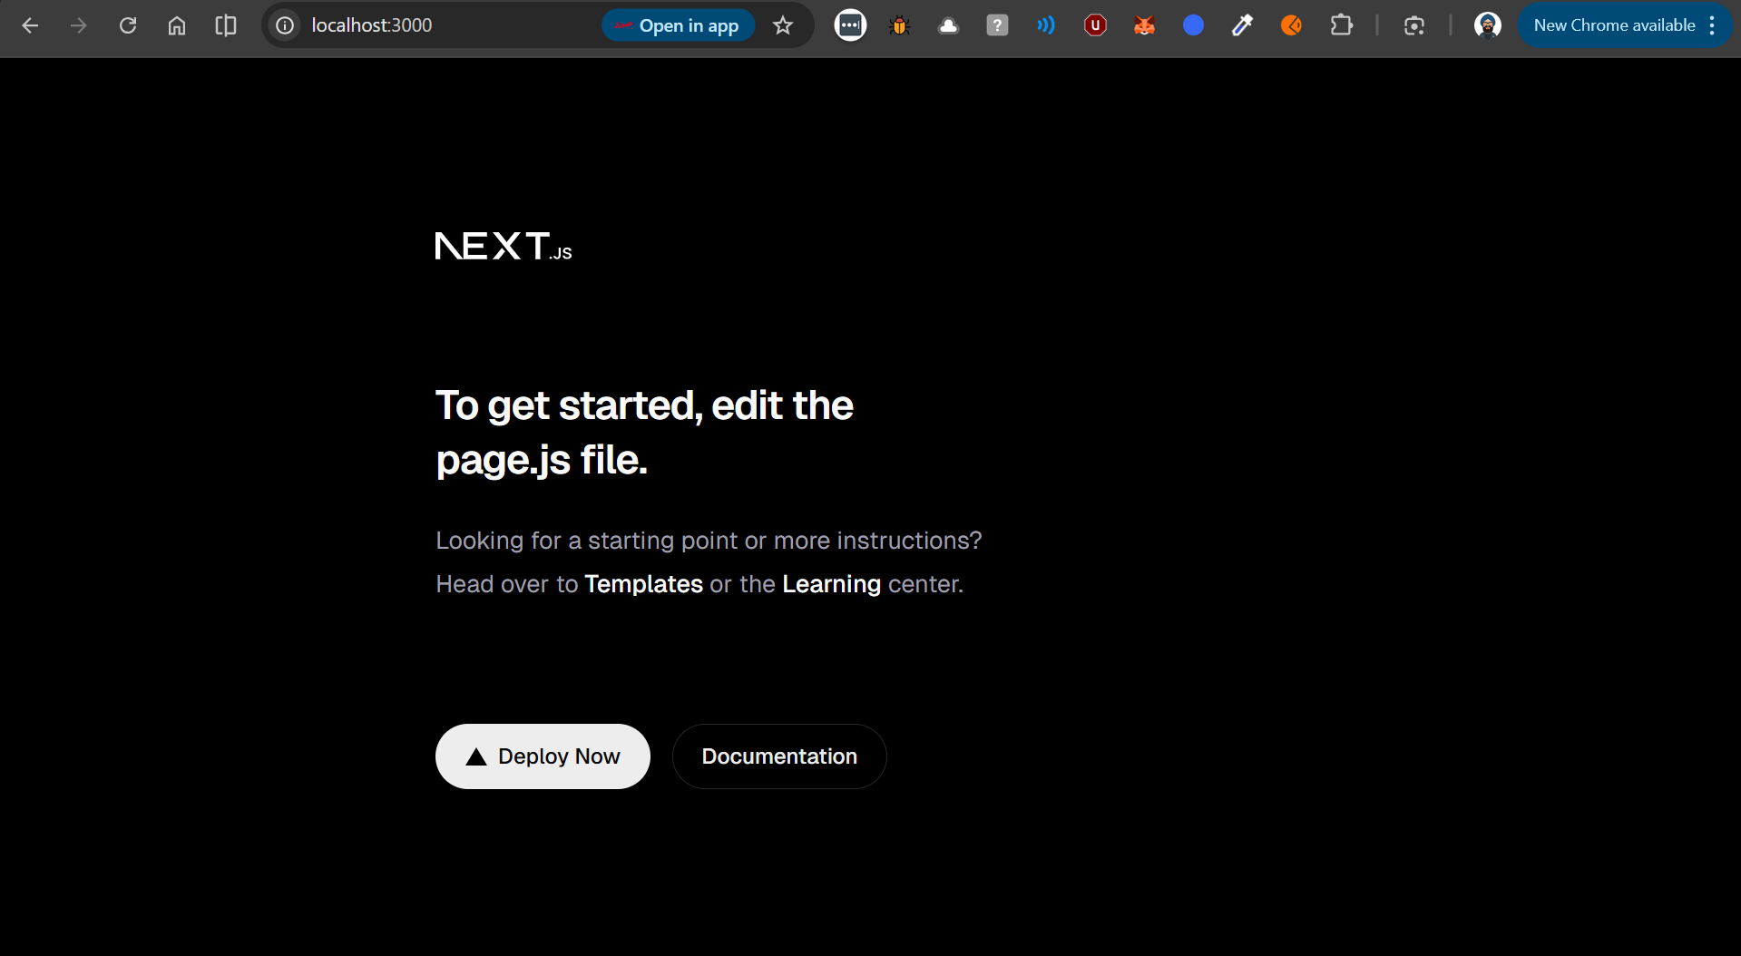

Slide 22
THANKS!

