Slide 1
Project Foundations & Environment Setup
Building and Deploying a Full-Stack MERN App on Azure by Gurjot Singh

Slide 2
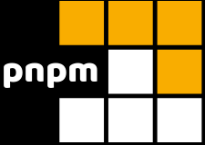
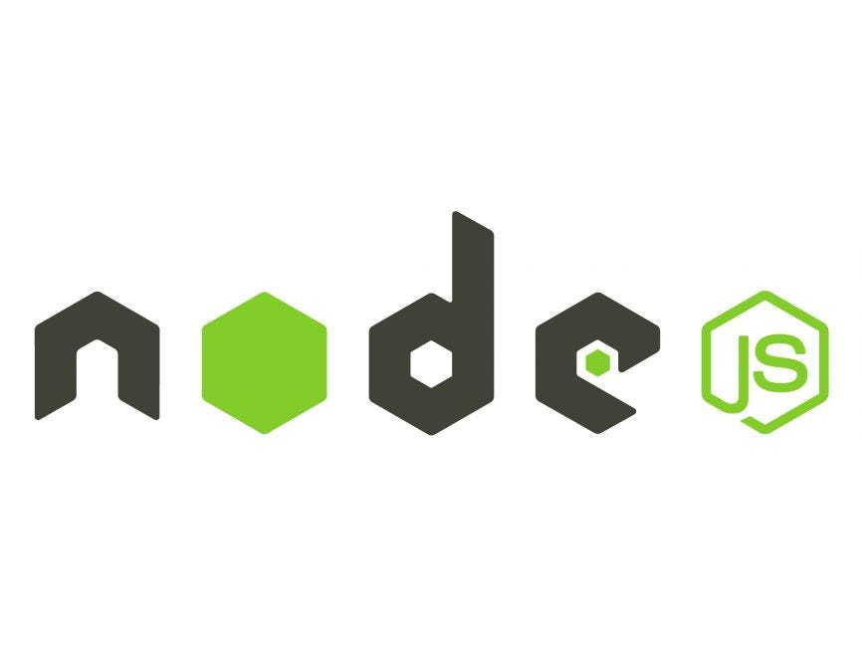
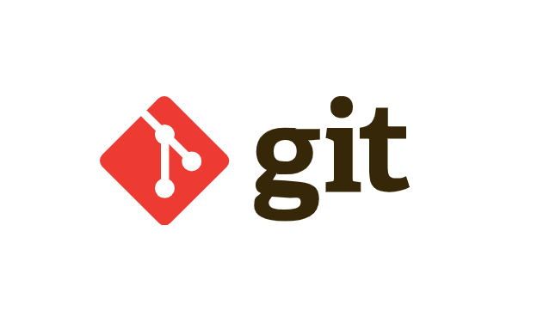
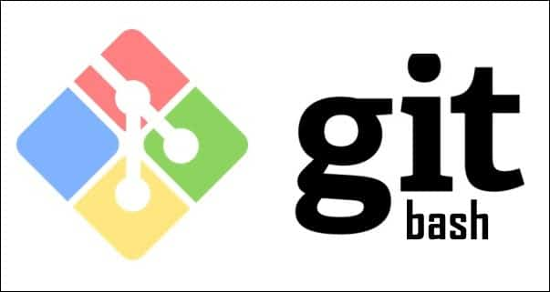
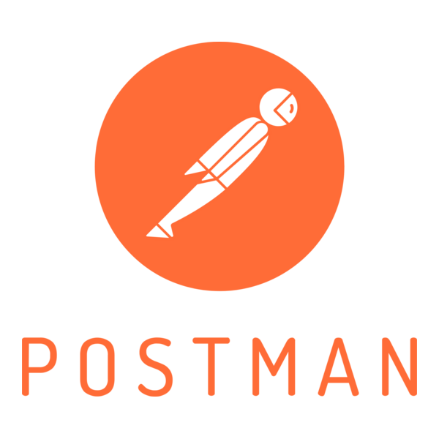
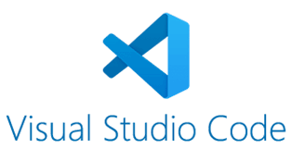
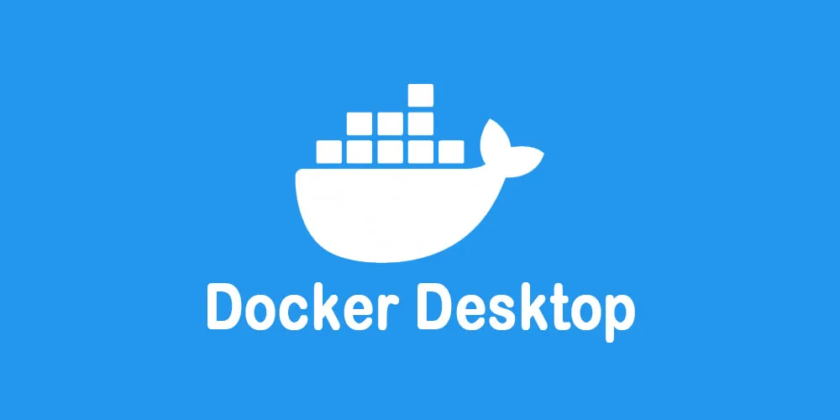

Slide 3
Agenda
01
03
02
04
Recap
Backend APIs
MongoDB Atlas
Backend Testing

Slide 4
01
Recap

Slide 5
NodeJS
Lets us run JavaScript on the server instead of the browser
Used in our app to start the backend server and handle requests
Allows the backend to talk to the database and APIs efficiently

Slide 6

ExpressJs
A simple framework built on Node.js to create our backend easily
Used in our app to define routes like /health and /api/todos
Helps us handle requests, send responses, and keep code organized

Slide 7
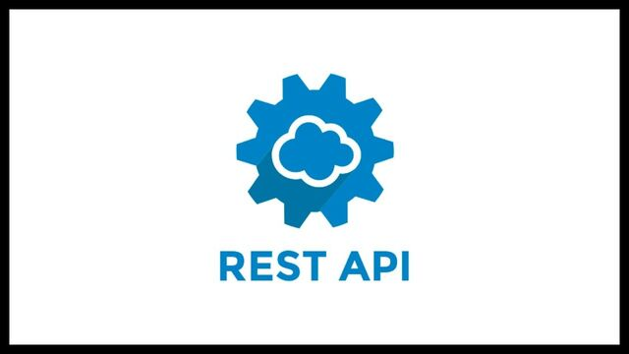
REST APIs
A standard way for the frontend to communicate with the backend
Use in our app to create, read, update, and delete todos
Uses clear HTTP methods (GET, POST, PUT/PATCH, DELETE) so everyone knows what each API does

Slide 8
02
MongoDB Atlas

Slide 9
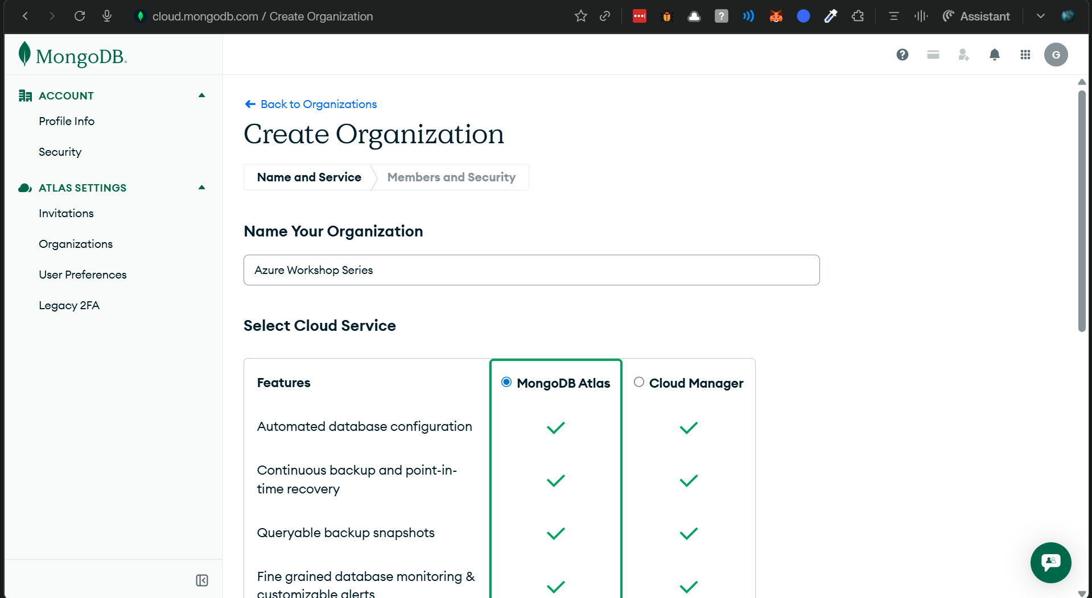

Slide 10
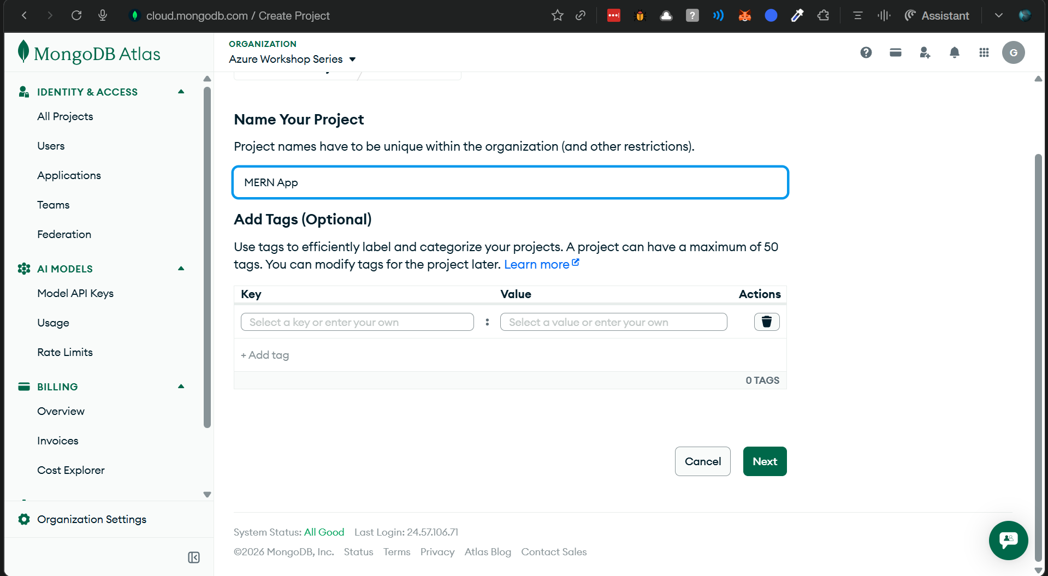

Slide 11
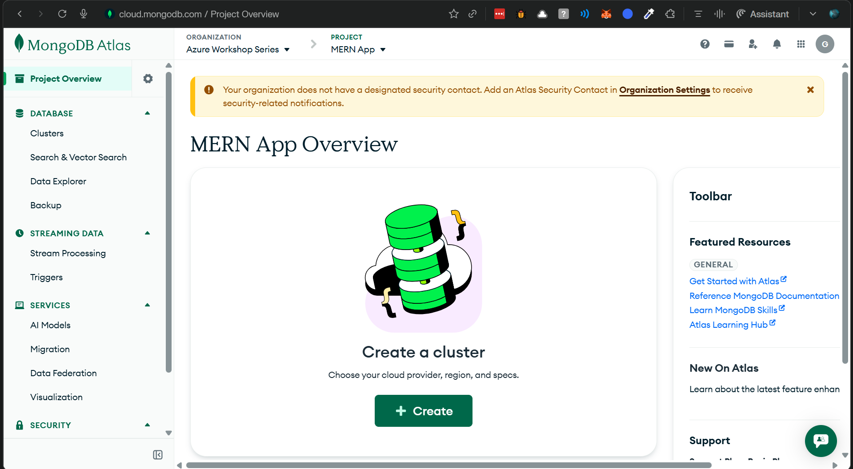

Slide 12
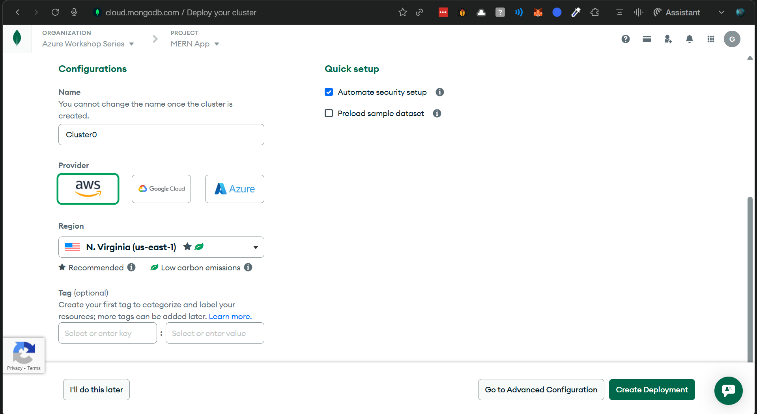

Slide 13
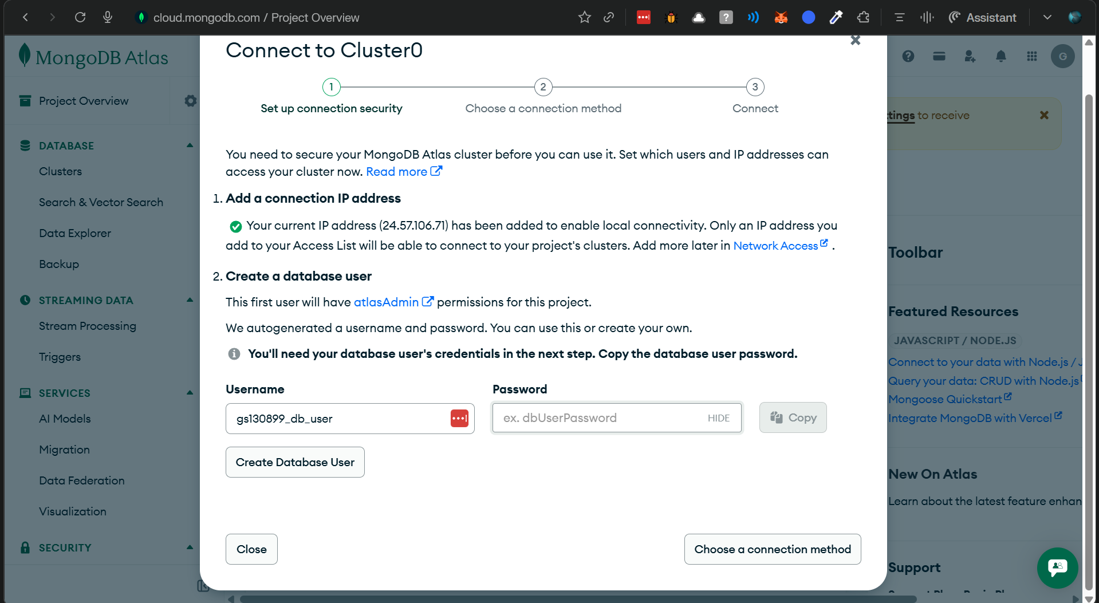

Slide 14
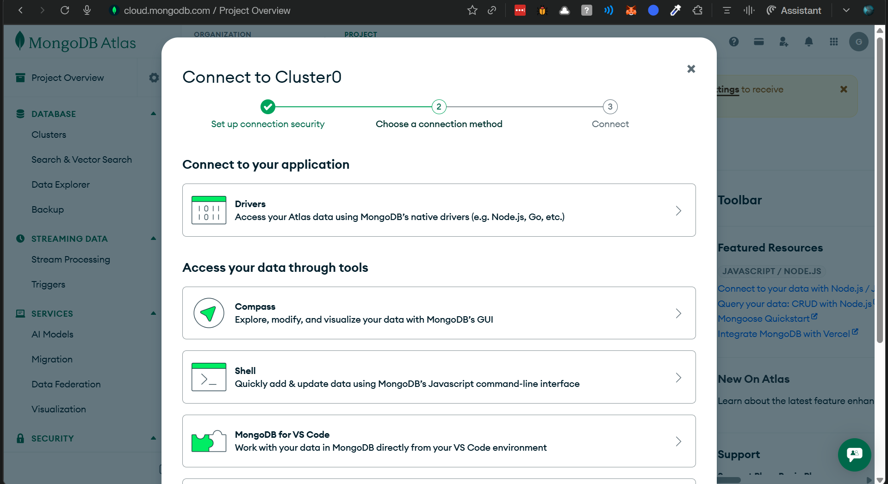

Slide 15
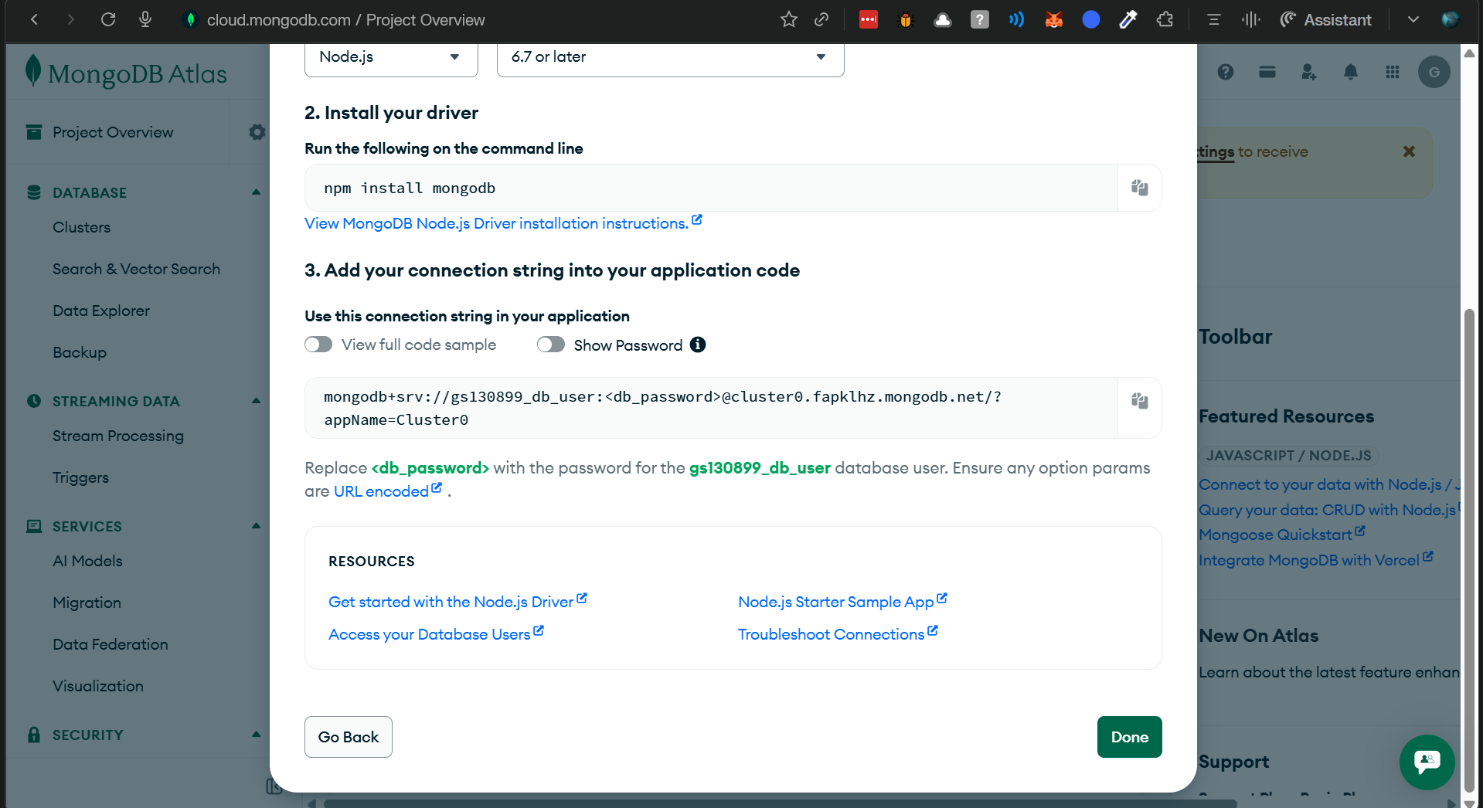

Slide 16
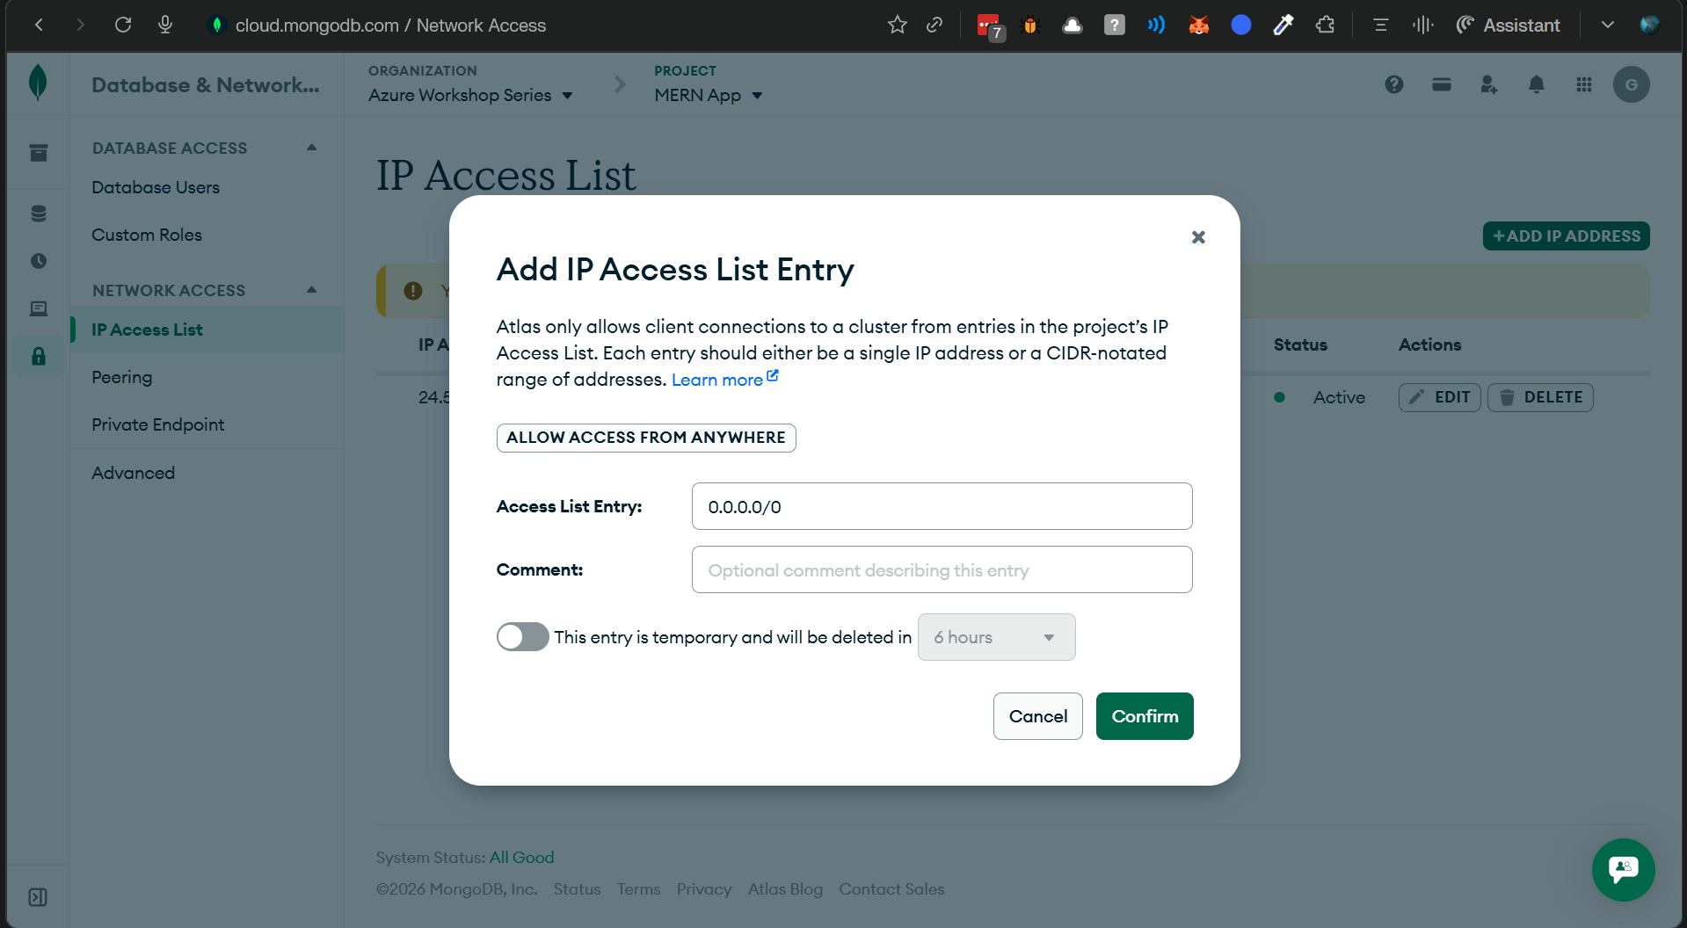

Slide 17
03
Backend APIs

Slide 18
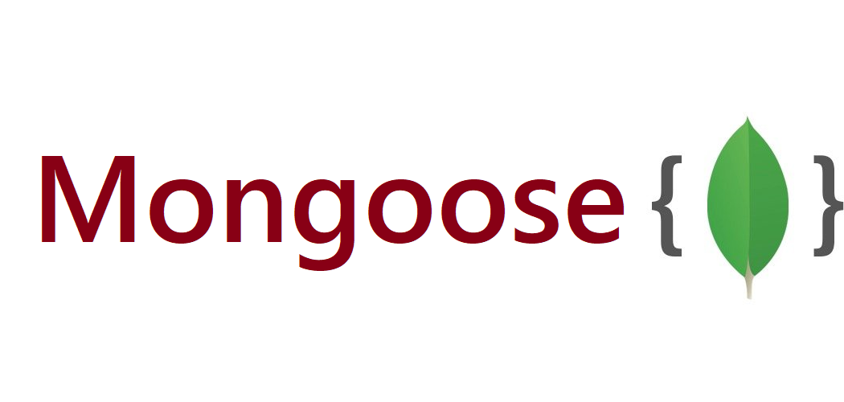
Mongoose
Helps our backend connect to MongoDB Atlas easily
Lets us define a Todo schema (required title, default values, timestamps)
Makes database operations simple using methods like create, find, update, and delete

Slide 19
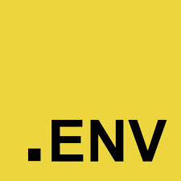
dotenv
Loads environment variables from the .env file into our app
Keeps secrets like database URLs out of the code
Makes it easy to use different settings for local and cloud environments

Slide 20
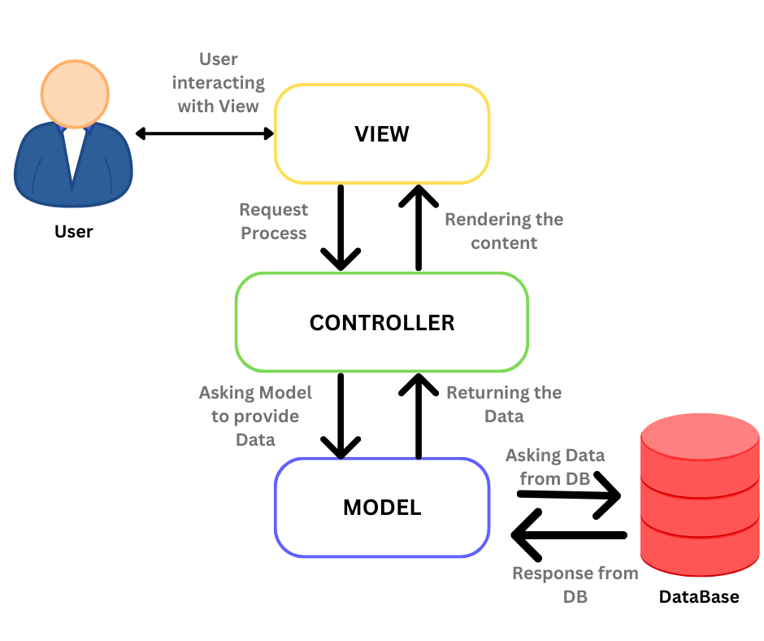
MVC Architecture
Model: defines how our Todo data looks and its rules (Todo schema)
View: in our case, this will be the frontend that talks to the APIs
Controller: contains the logic for creating, reading, updating, and deleting todos

Slide 21
04
Backend Testing

Slide 22
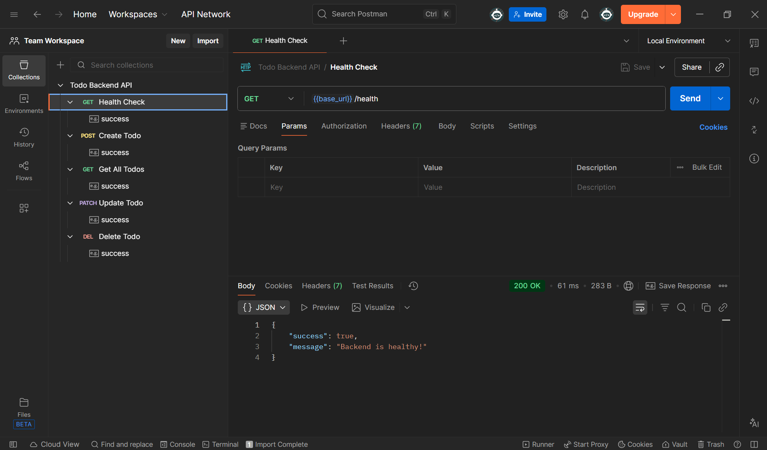

Slide 23
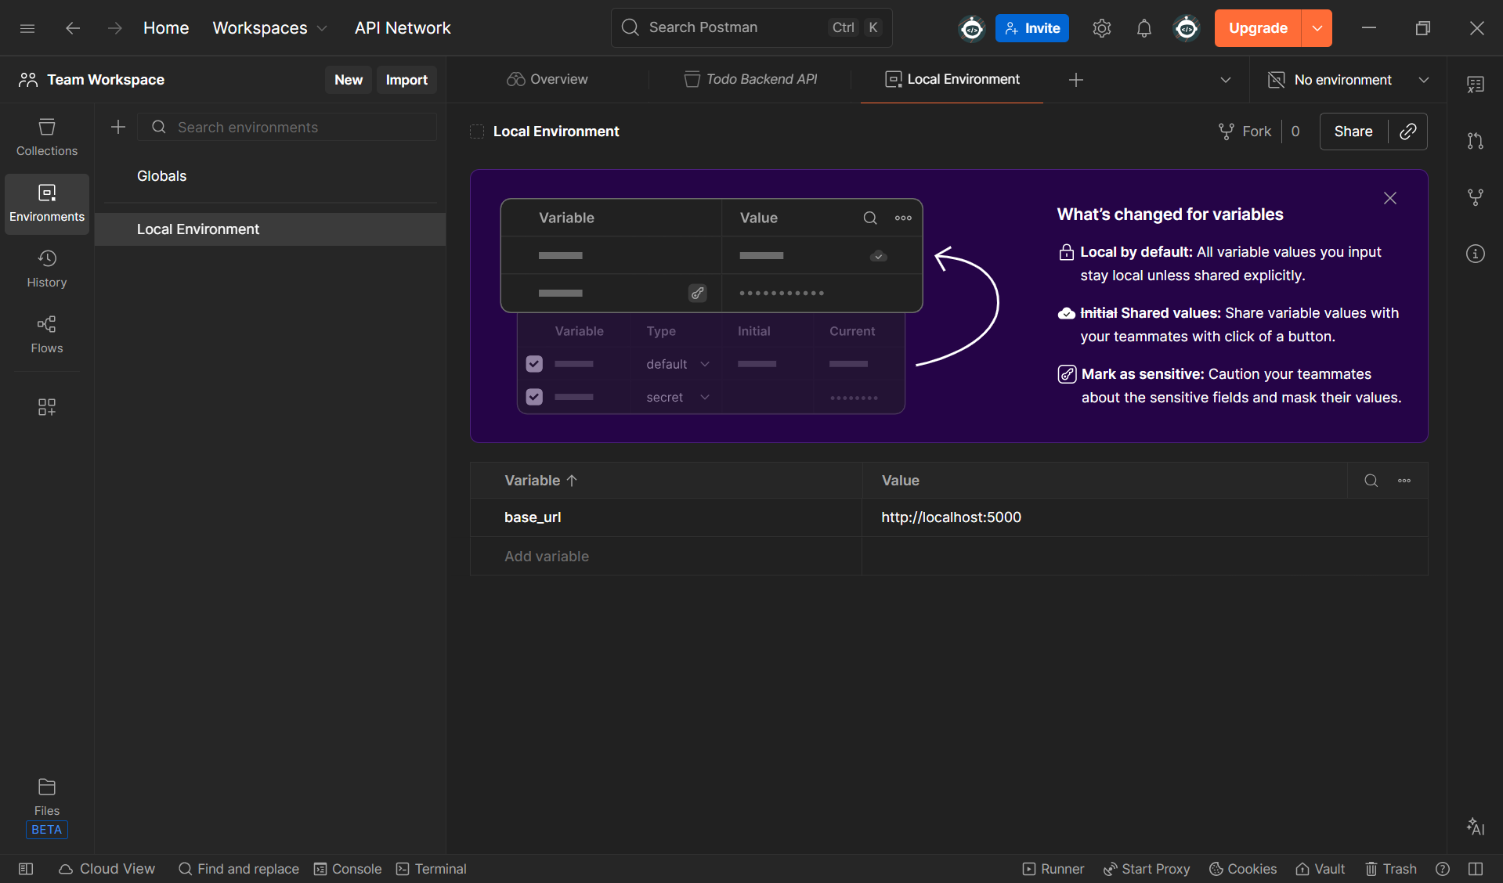

Slide 24
00
Azure DevOps Parallelism Request Form??

Slide 25
THANKS!

