Slide 1
Sales Prediction using Machine Learning
Objective: Predicting Retail Sales
Presenter: Nidhi singh

Slide 2
Project Overview
Objective: The project aims to predict daily sales for stores using historical sales data, employing Python, Pandas, XGBoost, data preprocessing and feature engineering.
Tools & Techniques: Python, Pandas, numpy,onehotencoder, matplotlib, seaborn,evaluation matrices, xgboost

Slide 3
Data Description
Dataset: sales and stores datasets
Key Features: Date, StoreType, Assortment, StateHoliday, PromoInterval, Sales, Customers, competitionDistance.
Target Variable: Sales

Slide 4
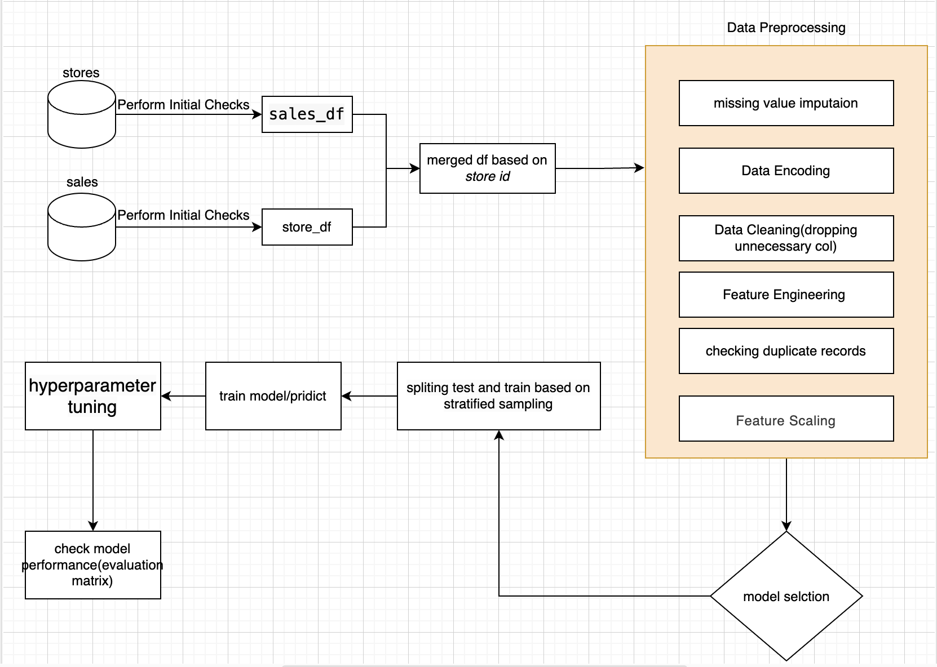
Modelling Approach

Slide 5
Data Preprocessing
Date Conversion: Convert date strings to datetime objects.
Categorical Encoding: Encode categorical variables using onehotencoding and labelencoder.
Scaling: Scale numerical features using StandardScaler.
Feature Engineering: Extract Year, Month, Day, WeekOfYear, DayOfWeek from Date.

Slide 6
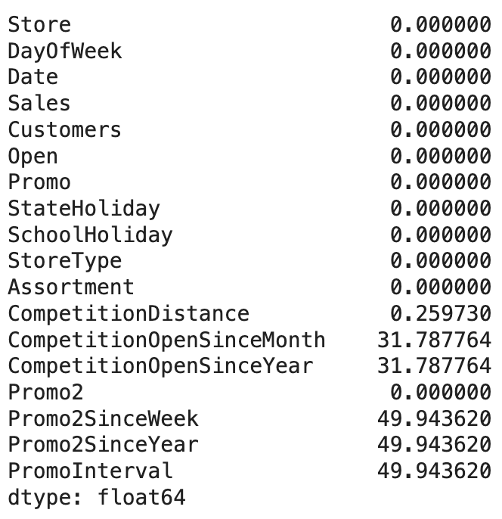
Data Preprocessing:
Handling Missing Values

Slide 7
Data Preprocessing:
Handling Missing Values:
CompetitionDistance: Missing values in CompetitionDistance can be filled with the median value because it’s a continuous variable and median is less affected by outliers.
CompetitionOpenSinceMonth and CompetitionOpenSinceYear: These can be filled with the most frequent value (mode), as these fields represent categorical information about the month and year when competition started.
Promo2SinceWeek, Promo2SinceYear, and PromoInterval: These can also be filled with 0 indicating no promotion

Slide 8
Missing values Treatment
On building first model columns with ~50% missing values are dropped
On building second model mean mode and median imputation was used
Analysis of Feature Importance
Random Forest
Customers: >0.8
Other features: <0.1
XGBoost
Customers: ~0.45
StoreType_b: ~0.25
StoreType_d: ~0.12
Promo: ~0.05
Other features: <0.02

Slide 9
Model selection
Random Forest model is showing high importance for the Customers column (greater than 0.8)
XGBoost model shows a more distributed feature importance with Customers, StoreType_b, StoreType_d, and Promo contributing more significantly
It suggests that the Customers feature is the most influential predictor for sales in both models, but XGBoost is able to capture additional significant relationships.

Slide 10
Model Training
Model: XGBoost Regressor
Training Data Split: Splitting data into testing and training set
Hyperparameters: Learning Rate, Max Depth, Alpha, Number of Estimators.

Slide 11
Model Evaluation
Metrics:
Mean Squared Error (MSE),
Mean Absolute Error (MAE),
Root Mean Squared Error (RMSE),
R-squared (R2)

Slide 12
Interpretation
Model Fit (R-squared Values):
The R-squared value for the training set is 0.9249, which indicates that the model explains approximately 92.49% of the variance in the training data. This is a very high value, suggesting a good fit.
The R-squared value for the test set is 0.9155, which indicates that the model explains approximately 91.55% of the variance in the test data. This is also a high value, suggesting that the model generalizes well to unseen data.
Error Metrics (MSE and MAE):
Both the MSE and MAE values are reasonably low for the training set, indicating that the model predictions are close to the actual values.
The MSE and MAE values for the test set are slightly higher than those for the training set but still relatively low, indicating good predictive performance.
Model Evaluation:
The slight increase in error metrics from the training set to the test set suggests that the model is not overfitting significantly. The model performs well on both the training and test sets, implying that it has learned the underlying patterns in the data effectively and is capable of making accurate predictions on new, unseen data.
The high R-squared values and low error metrics on both the training and test sets demonstrate that the model is well-tuned and performs reliably.

Slide 13
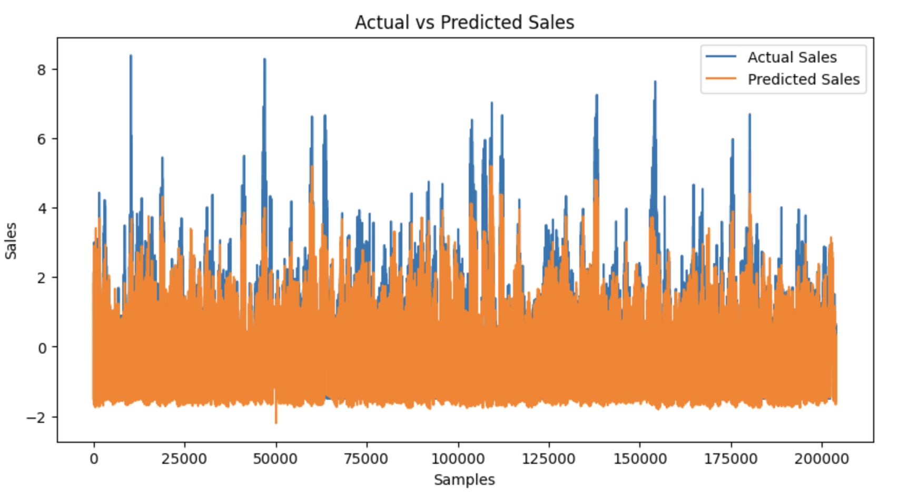
Results Visualization
Plot: Predicted vs. Actual Sales

Slide 14
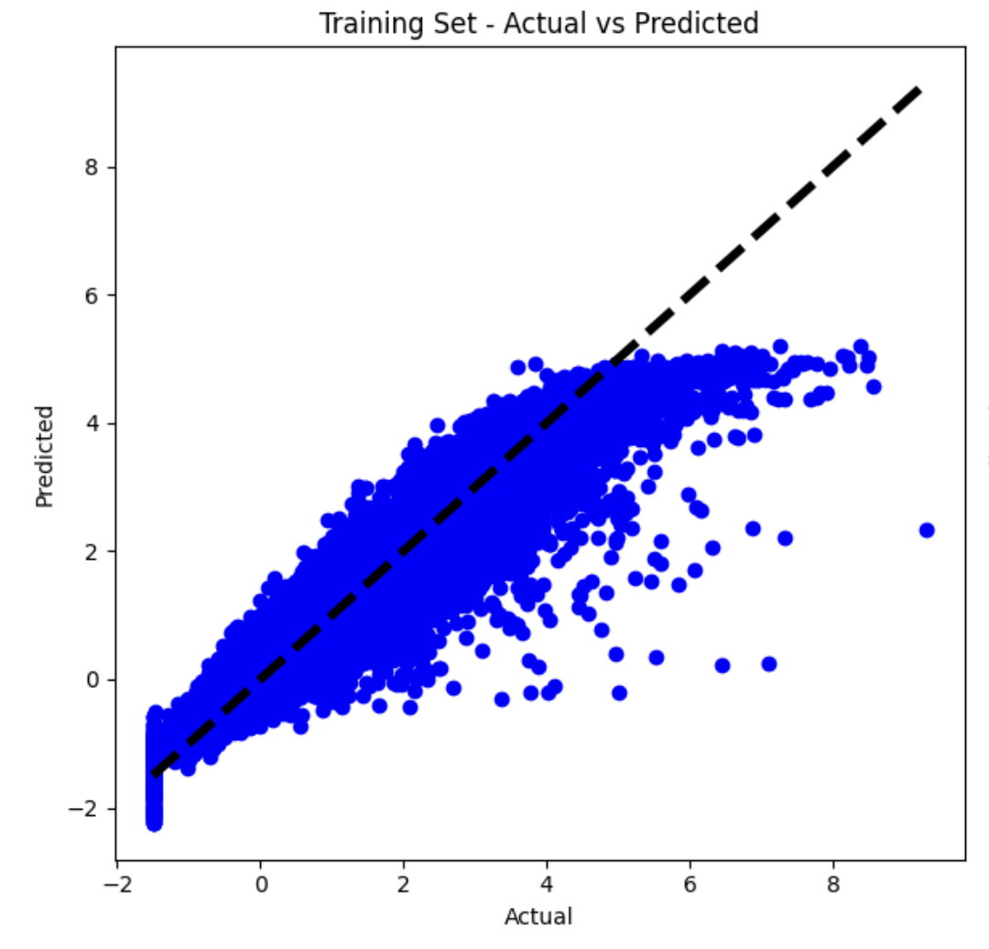
Results Visualization
Plot: Training Set Predicted vs. Actual Sales

Slide 15
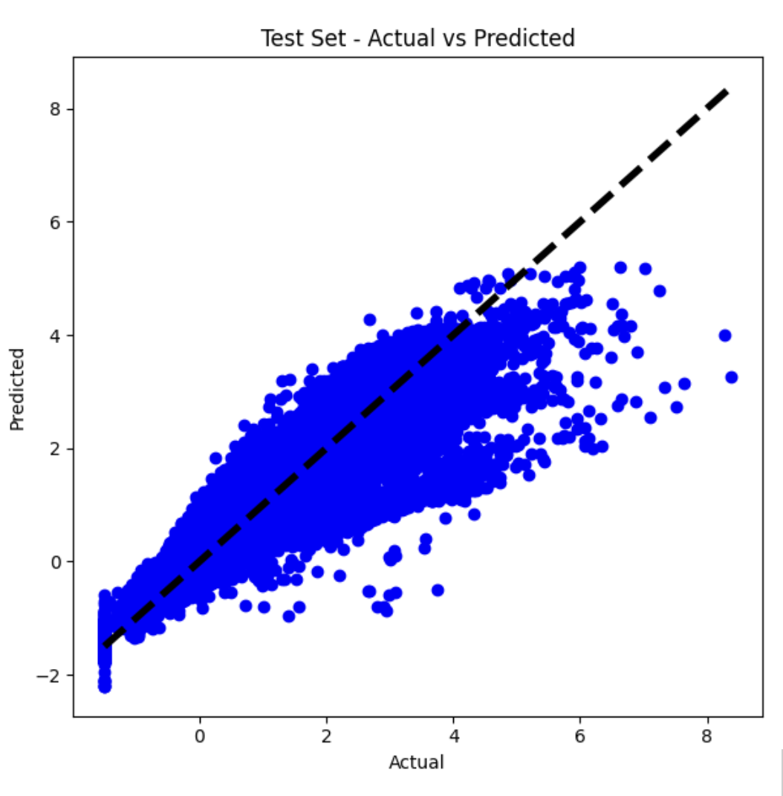
Results Visualization
Plot: Test Set Predicted vs. Actual Sales

Slide 16
Conclusion
Summary: Successful implementation of sales prediction using XGBoost.
Key Takeaways: Accurate predictions, effective preprocessing, and feature engineering.

Slide 17
Future Work
The model is well-fitted and generalizes well to new data. While there might still be room for minor improvements, the current performance metrics indicate that the model is robust and accurate for predicting sales.
Further improvements could include fine-tuning hyperparameters, experimenting with different feature engineering techniques, or incorporating additional data sources to enhance predictive accuracy.

