Slide 1
AI & DATA SCIENCE MINI-PROJECT
Audience
Fit
VENTURE
COUNCIL
Negoti-
ation
Engage-
ment
VERDICT
Five AI agents debate every creator-brand deal. Fixed rules make the final call.
Risk
Pricing
5
649
179
AI agents
creators
tests
Niharika Singh · Shubham Singh · Rohit Swami · Akash Warde | Guide: Prof. Megha Jain
Notes:
VentureCouncil evaluates creator-brand sponsorship deals for Nitrix Talent Media. Five specialised AI agents each judge one side of the deal, and a supervisor combines them into Accept, Negotiate or Reject. The key idea: the final decision is made by fixed rules, not by the AI.

Slide 2
THE PROBLEM
FROM GUT FEEL TO A COUNCIL
Gut-feel picks
THE COUNCIL
✕
No consistent way to judge audience fit
5 specialised AI agents judge every deal. Fixed rules, not the AI, make the final call.
Opaque prices
✕
Is ₹35,000 fair for this creator?
✓
Accept / Negotiate / Reject + score
✓
A plain-English "why"
Risky contracts
Find creators inside a budget
✕
✓
Perpetual rights and exclusivity slip through
Notes:
Today brands pick creators by gut feel, creator prices are opaque, and risky contract clauses slip through unnoticed. VentureCouncil replaces that with a council of agents that gives a verdict, a score and a plain-English reason, and can also find creators that fit a budget.

Slide 3
THE PIPELINE
HOW THE COUNCIL DECIDES
Audience Fit
Engagement
ACCEPT
DEAL
creator + offer
Negotiation
Supervisor
weighted score
≥ 50
NEGOTIATE
Pricing
45–50
GATE
REJECT
< 45
Risk
Veto a "high risk" label makes Accept impossible.
in parallel
Notes:
A deal comes in. Four agents run in parallel: audience fit, engagement ranked against same-platform peers, pricing against similar past deals found by vector search, and risk including contract clauses. A gate waits for all four, then Negotiation runs, then the Supervisor takes a weighted score. 50 or above is Accept, 45 to 50 Negotiate, below 45 Reject, and a high-risk label blocks Accept.

Slide 4
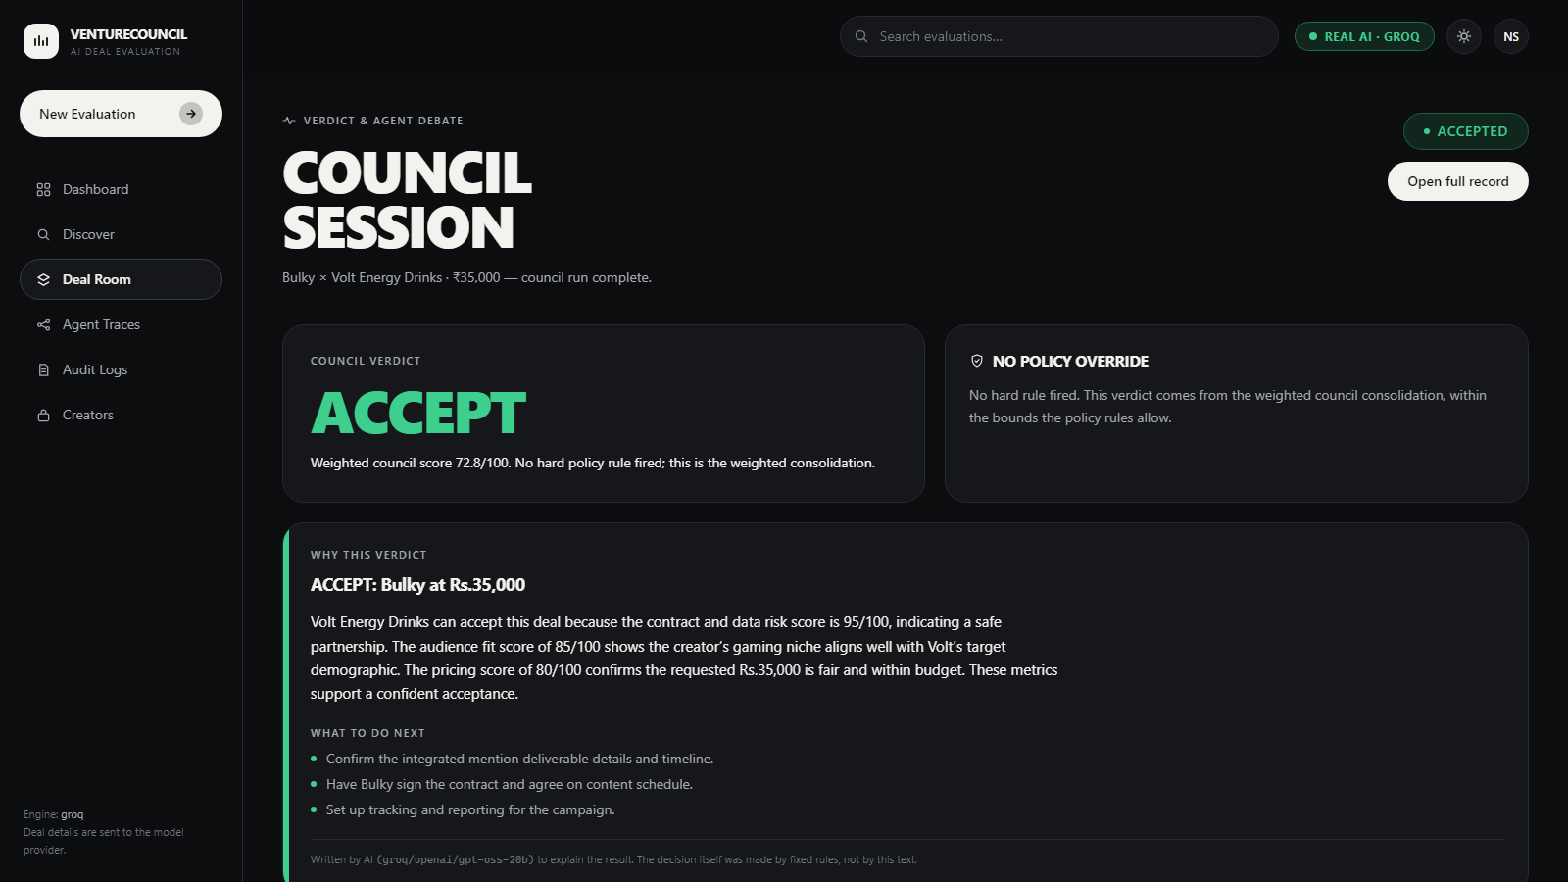
DATA AND STACK
BUILT AND RUNNING
649
18
creators
brands
52
384
past deals
dim vectors
LIVE · 72.8
React 19
→
FastAPI
→
LangGraph
→
Groq LLM
→
pgvector
Notes:
The database is Supabase Postgres with pgvector: 649 creators, 18 brands and 52 past deals, each embedded locally with sentence-transformers. The screenshot is a real run: Bulky at Rs.35,000 for Volt Energy Drinks scored 72.8 and was accepted. The stack runs from a React frontend through FastAPI and LangGraph to the agents; the LLM layer is provider-agnostic.

Slide 5
SAFETY AND KEY DECISIONS
WHAT WE LEARNED THE HARD WAY
1
Contract veto
2
AI explains, never decides
3
Better search
Perpetual rights + 24 months unpaid exclusivity: the AI said "medium risk" and the deal was accepted.
Now a fixed rule forces "high risk".
The verdict headline is built in code.
The AI only writes the "why", with a safe fallback.
Brand brief rewritten in the creator-embedding format.
Similarity 0.274 → 0.654.
Same deal, only the contract changed:
→
ACCEPT
NEGOTIATE
Notes:
Three decisions. First, the LLM called a terrible contract only medium risk, so a fixed-pattern scanner now forces high risk and Accept becomes Negotiate. Second, the explanation is written by the AI but the headline verdict is built in code, with a template fallback. Third, rewriting the brand query into the same template used to embed creators lifted similarity from 0.274 to 0.654.

Slide 6
VALIDATION
RESULTS
Groq vs Gemini, same deal
Bulky
→
Accept 79.9
Negotiate 69.2
Chirag
→
Negotiate 69.3
Reject 40.2
Gemini → Groq (pinned)
179 automated tests, no DB or network
Next: real contract upload · more past deals · live creator metrics
Thank you · Questions?
Notes:
We calibrated the thresholds on eleven labelled deals: the old 70 and 45 got 9 right, the new 50 and 45 get all 11 with no severe errors. The sample is small and we say so. Groq scores harsher than Gemini and was often more correct, so all reported numbers are from Groq. There are 179 automated tests that need no database or network. Thank you.

