Slide 1

Voting System Using Blockchain
Mentor : Mr Malay Tripathi
(Assistant Professor)
25_CS_IOT_4A_05

Slide 2
CONTENT
Introduction
Problem Statement
Aim
Objective
Goals
Methodology(Flow Chart)
Modules
Advantages and Disadvantages
Conclusion
Cost Benefit Analysis
References

Slide 3
INTRODUCTION
What is Blockchain?
Blockchain is a decentralized digital ledger that securely stores records across a network of computers in a way that is transparent, immutable, and resistant to tampering.
Consists of several blocks associated with each other and in sequence.
Problem Statement:
By adopting blockchain in the distribution of databases on e-voting system can reduce one of the cheating sources of database manipulation.
Blockchain technology is one of solutions, because it embraces a distributed system and the entire database are owned by many users.

Slide 4
AIM
Aims to building voting system that satisfies the legal requirements of legislators has been a challenge for a long time.
Distributed ledger technologies are an exciting new area of technology.
Also aims to evaluate the application of blockchain as service to implement distributed electronic voting systems

Slide 5
PROJECT WORK PLAN
OBJECTIVE:
The objective is to create a secure, transparent e-voting platform using blockchain, preventing fraud and ensuring voter anonymity. It streamlines voting for efficiency and cost-effectiveness, complies with regulations, and fosters trust through transparency. The system supports scalability and aims to enhance democratic processes with reliability and inclusivity.
GOALS:
Design and develop a user-friendly e-voting interface.
Implement a secure and transparent blockchain network for vote recording and storage.
Ensure the integrity and immutability of the voting data.
Deploy the e-voting system for a pilot test in a controlled environment.

Slide 6
EFFECTIVE UTILIZATION OF TOOL
Blockchain Platforms: Ethereum, Hyperledger, Binance Smart Chain.
Use these platforms for secure and transparent vote recording.
Smart Contract Development: Solidity.
Write smart contracts for voting rules and validation.
Development IDEs: Visual Studio Code, Ganache, Meta mask Wallet.
Develop and test smart contracts and front-end interfaces.
Version Control: Git, GitHub.
Track changes in code and collaborate with the team.
Front-end Frameworks: HTML, CSS, Javascript, React.js, Angular.
Create user-friendly interfaces for voters and administrators.
Back-end Technologies: Node.js, Python, MySQL.
Implement server-side logic and backend processing.
These tools enable efficient development, testing, deployment, and management of the e-voting system, ensuring transparency, security, and usability.

Slide 7
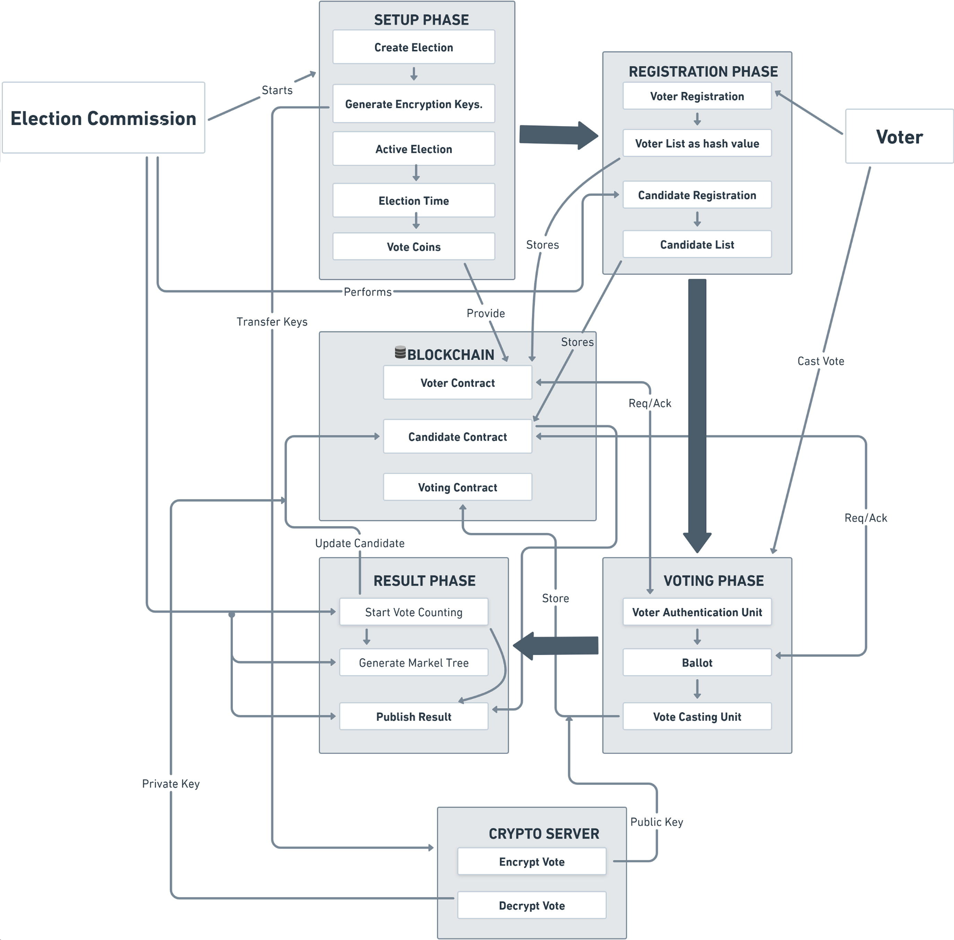
PROPOSED METHODOLOGY ( Flow Chart)

Slide 8
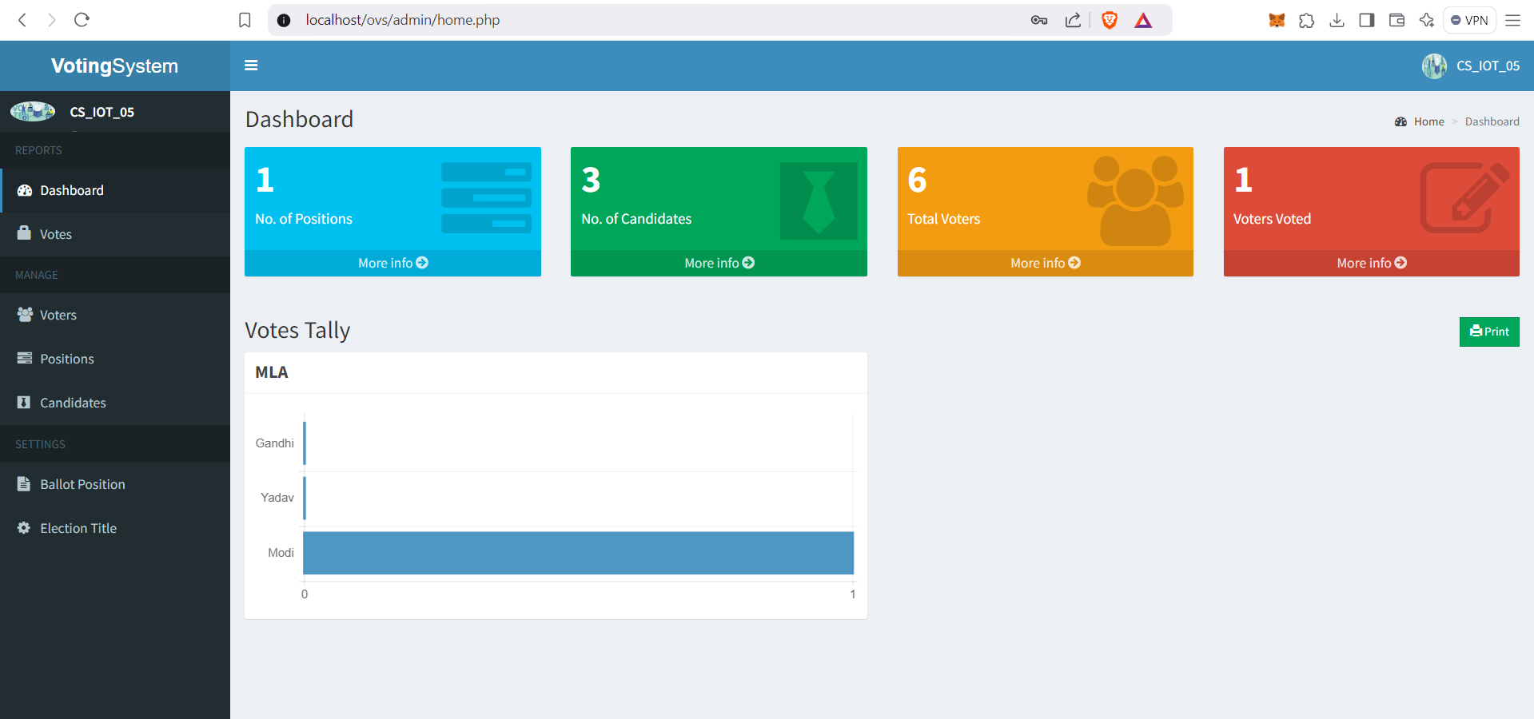
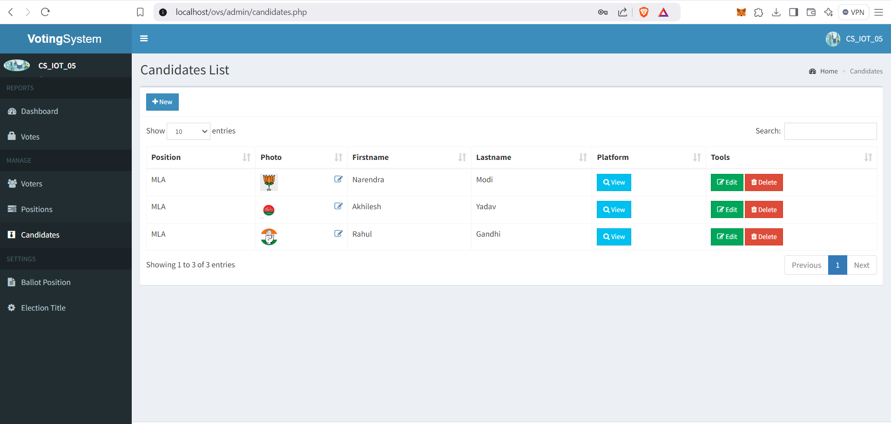
Website Overview
Dashboard
Add Candidates

Slide 9
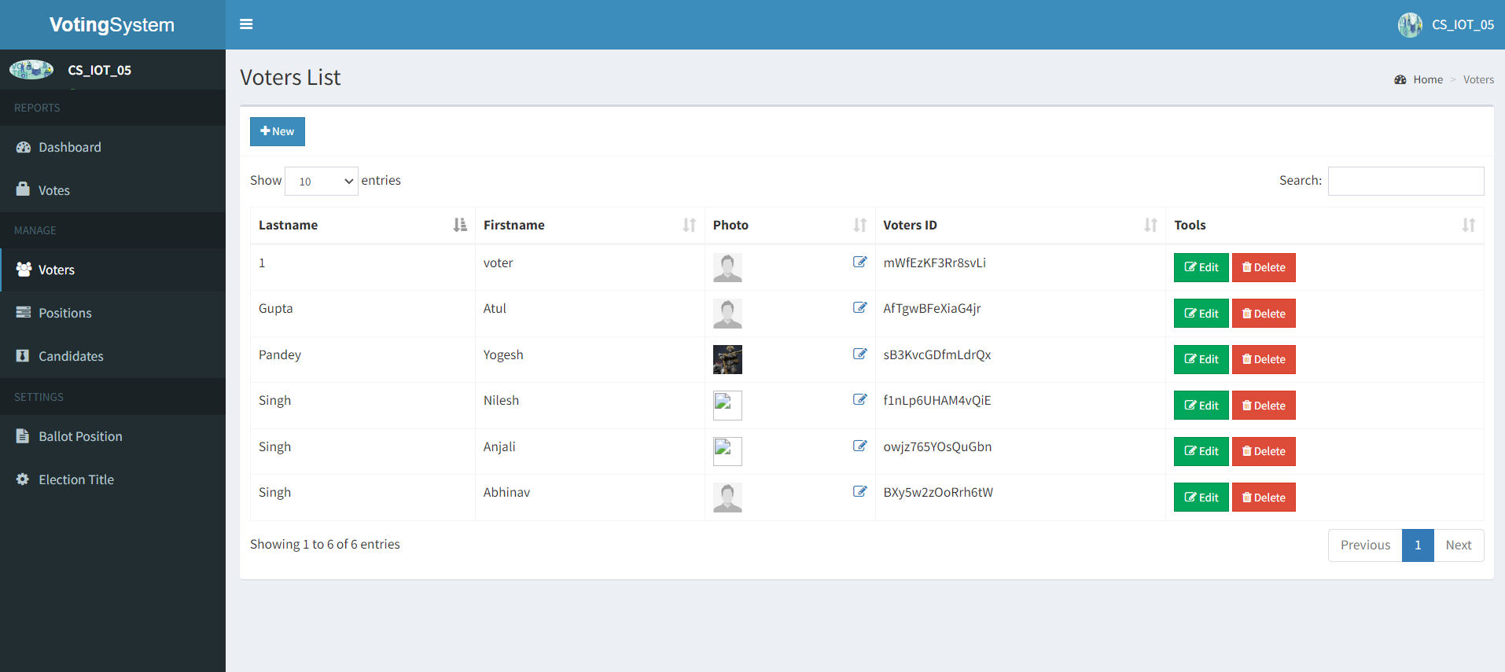
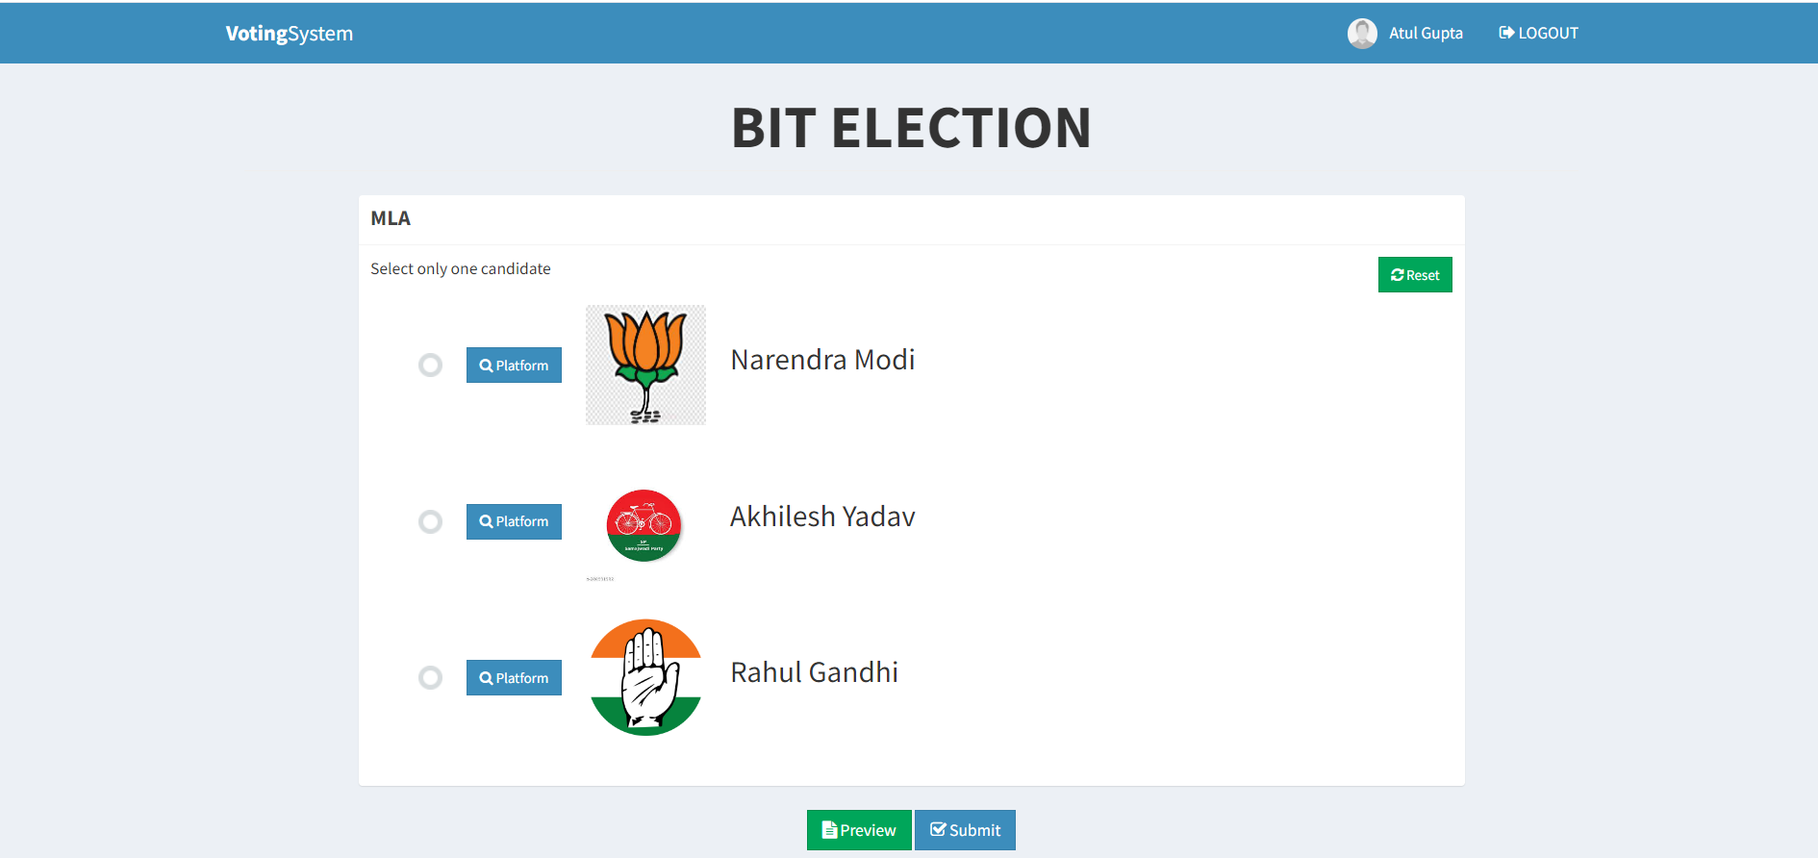
Website Overview
Add Voters
Ballot(Vote Casting)

Slide 10
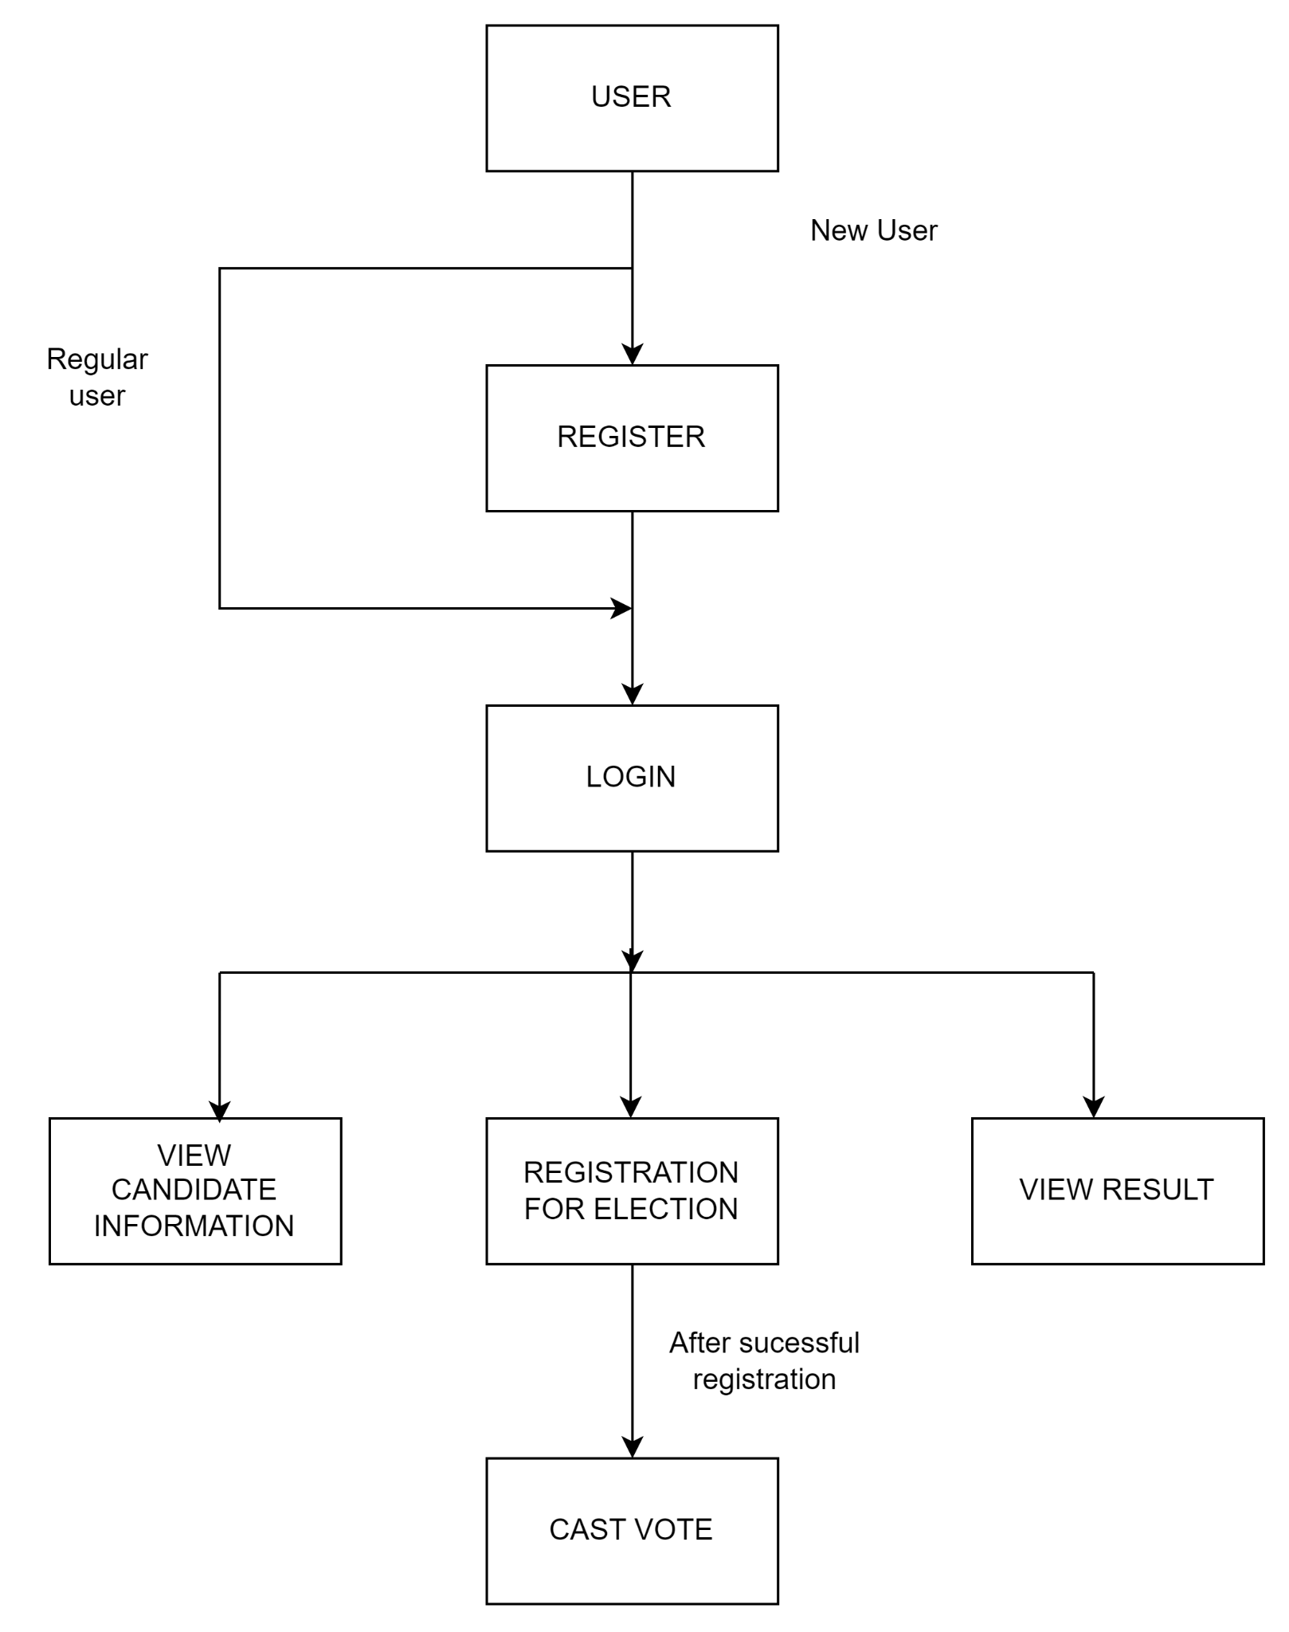
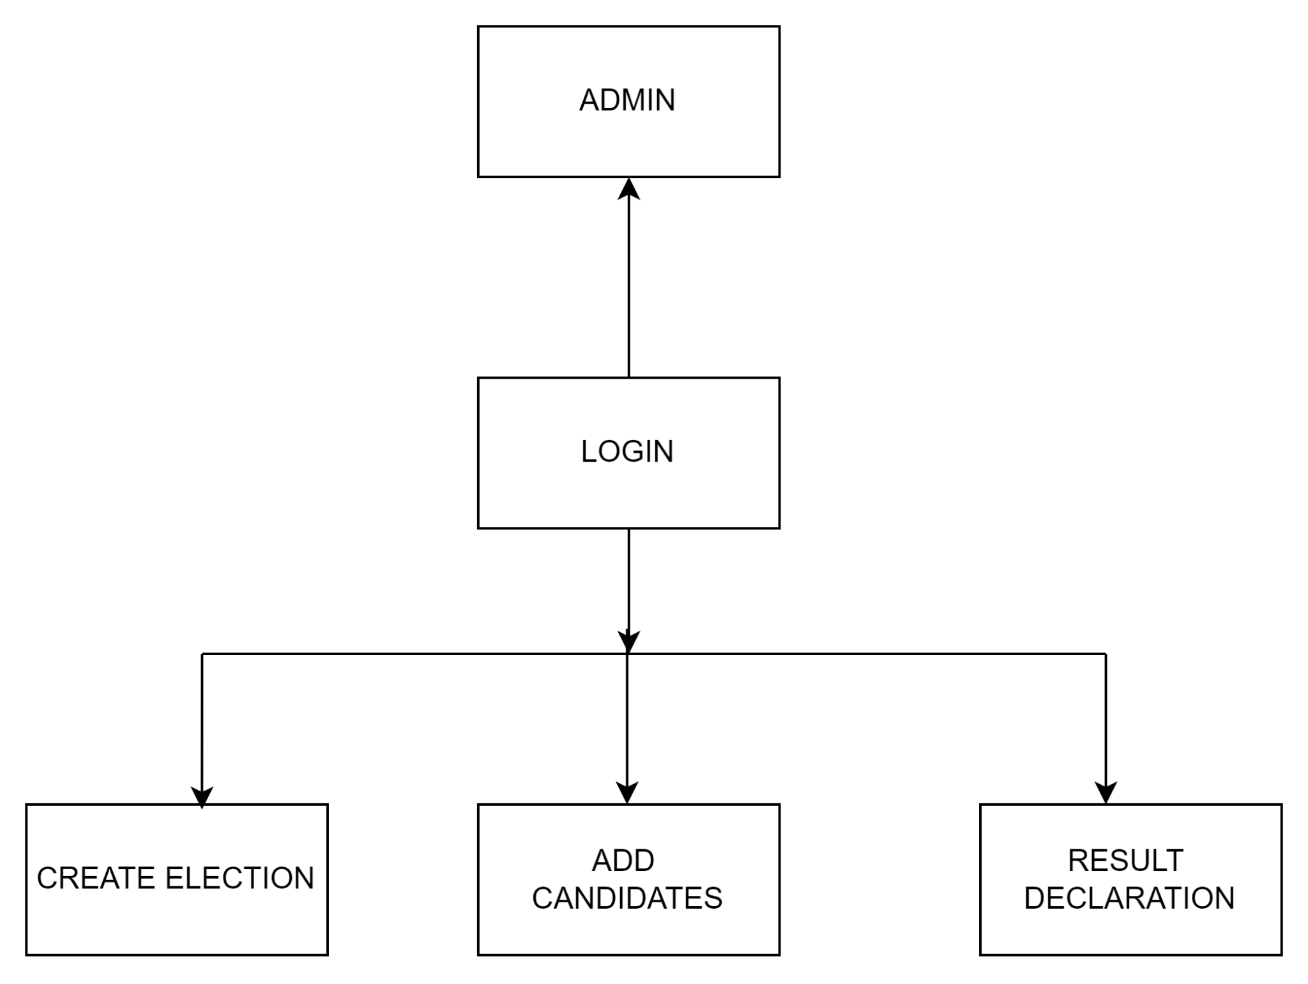
PROPOSED METHODOLOGY ( Flow Chart)

Slide 11
MODULES
Security Measures:
Robust measures against tampering.
Encryption for data security.
Admin Dashboard:
Monitoring and management tools.
Tracks voter turnout and results.
User Management:
Role-based access control.
Easy user addition and removal.
Accessibility Features:
Interfaces for voters with disabilities
5. Voter Registration:
Secure blockchain-based registration.
Unique cryptographic keys for voters.
6. Ballot Creation:
Admins create ballots with rules.
Encrypted data storage on blockchain.

Slide 12
MODULES
7.Voting Interface:
User-friendly voting interface.
Identity verification for each vote.
8.Blockchain Integration:
Connects system to blockchain network.
Smart contracts for tallying votes.
9.Results Tabulation:
Real-time vote counting.
Transparent results on blockchain.
10.Auditing and Transparency:
Stakeholders can audit blockchain.
Access to transaction verification.

Slide 13
ADVANTAGES AND DISADVANTAGES
ADVANTAGES:
Enhanced Transparency
Improved Security
Reduced Fraud and Manipulation
Accessibility
Cost Savings
Global Scalability
Efficiency and Accuracy
DISADVANTAGES:
Technological Barriers
Security Concerns
Complexity of Implementation
Resistance to Change

Slide 14
CONCLUSION
We have proposed an online polling system based on the Blockchain technology. The system is decentralized and does not rely on trust. Any registered voter will have the ability to vote using any device connected to the Internet. The Blockchain will be publicly verifiable and distributed in a way that no one will be able to corrupt it.

Slide 15
COST BENEFIT ANALYSIS
Development Costs:
Hiring developers, blockchain experts.
Software licenses (IDEs, blockchain platforms).
Smart contract development.
Deployment Costs:
Network setup, user training.
Testing, security audits.
Initial infrastructure investment.
Operational Costs:
Maintenance, support.
Blockchain network fees.
Upgrades, enhancements.
Security Costs:
Security tools, consultants.
Incident response plans.
Ongoing monitoring expenses.

Slide 16

REFERENCES ( Journal Papers/ Books/ Website References )
Journal
Benny, Albin, Blockchain based E-voting System (July 11, 2020). Available at SSRN: https://ssrn.com/abstract=3648870 or http://dx.doi.org/10.2139/ssrn.3648870
Electronic voting systems have been the subject of active research for decades, with the goal to minimize the cost of running an election, while ensuring the election integrity by fulfilling the security, privacy and compliance requirements [1].
Ricardo Lopes Almeida, Fabrizio Baiardi, Damiano Di Francesco Maesa, Laura Ricci, "Impact of Decentralization on Electronic Voting Systems: A Systematic Literature Survey", IEEE Access, vol.11, pp.132389-132423, 2023.
Website
https://papers.ssrn.com/sol3/papers.cfm?abstract_id=3648870

