Slide 1

IILM University
Greater Noida, Uttar Pradesh
SQL and Database Management Systems
AICTE – EduSkills Virtual Internship | April – June 2026
Student Name
Prateek Singh
Enrollment Number CS-2341315
Program & Semester B.Tech CSE AIML & 7th Semester
Organization
EduSkills Academy (AICTE)

Slide 2
Internship Overview
8 Weeks
Virtual
Intern
SQL & DBMS
Apr – Jun 2026
AICTE – EduSkills
Role
Domain
Organization Profile
Evaluation Structure
EduSkills Academy
Domain: EdTech & Skill Development
Supported by AICTE; under the patronage of the National Internship Portal
ISO certified | Great Place To Work certified
Week-wise structured learning plan
Weekly assessments
Project documentation & assignments
Final Assessment Test in the last week
Grade from overall performance
2

Slide 3
Problem Statement & Objectives
Objectives
Problem Statement
1
Design relational databases and write advanced SQL
Organizations generate large volumes of data. It must be stored in well-designed databases, queried efficiently, secured, integrated with applications through APIs, and presented as insights. This internship connects all of these steps, ending with a data-driven business analytics dashboard.
2
Work with NoSQL (MongoDB) and ETL
3
Visualize data with Power BI
4
Build APIs with Node.js/Express & FastAPI
5
Apply performance, security & backup practices
3

Slide 4
8-Week Learning Roadmap
1
Week 1
2
Week 2
3
Week 3
4
Week 4
Database Foundations & Relational Design
Advanced SQL & MongoDB
Aggregation, ETL & Power BI
Data Modeling & Node.js Integration
ER modeling, normalization, DDL/DML
Joins, subqueries, GROUP BY, CRUD
ETL, transformations, first dashboards
DAX, PostgreSQL, Express CRUD APIs
5
Week 5
6
Week 6
7
Week 7
8
Week 8
Backend APIs with FastAPI
Performance, Security & Backup
Scalability & High Availability
Advanced NoSQL & Capstone
SQLAlchemy, REST APIs, requests
Indexing, roles, SQL injection, backup
Replication, sharding, case studies
Aggregation pipeline, time series, dashboard
4

Slide 5
Technologies & System Architecture
Data Sources
ETL
Databases
API Layer
Power BI
›
›
›
›
Datasets, files, REST APIs
Extract, clean, transform, load
PostgreSQL (SQL) | MongoDB (NoSQL)
Node.js/Express, FastAPI/SQLAlchemy
Data model, DAX, dashboard
Tools & Concepts
SQL
PostgreSQL
MongoDB
Power BI & DAX
Node.js & Express
Python & FastAPI
SQLAlchemy
REST APIs
Indexing
Replication & Sharding
5

Slide 6
Capstone: Business Analytics Dashboard
1
Collect & Clean Extract data with SQL and ETL, fix quality issues
Security & Performance
2
Store & Combine Load into databases; merge API and other datasets
Indexing & query optimization
Roles and permissions
SQL injection prevention
Backup & recovery
Replication, sharding, clustering
3
Model Power BI relationships and DAX measures
4
Visualize Interactive dashboard for decision-making
5
Extend with NoSQL MongoDB aggregation, indexing, time series
6

Slide 7
Learning Outcomes
1
Database Design
2
Querying
3
Data Analytics
Normalized relational schemas with ER modeling and SQL
Advanced SQL and MongoDB aggregation pipelines
ETL, Power BI data models, DAX and dashboards
4
Integration
5
Security & Scale
6
End-to-End Delivery
RESTful CRUD APIs with Node.js/Express and FastAPI
Performance tuning, access control, backup, high availability
A data-driven analytics dashboard as capstone
7

Slide 8
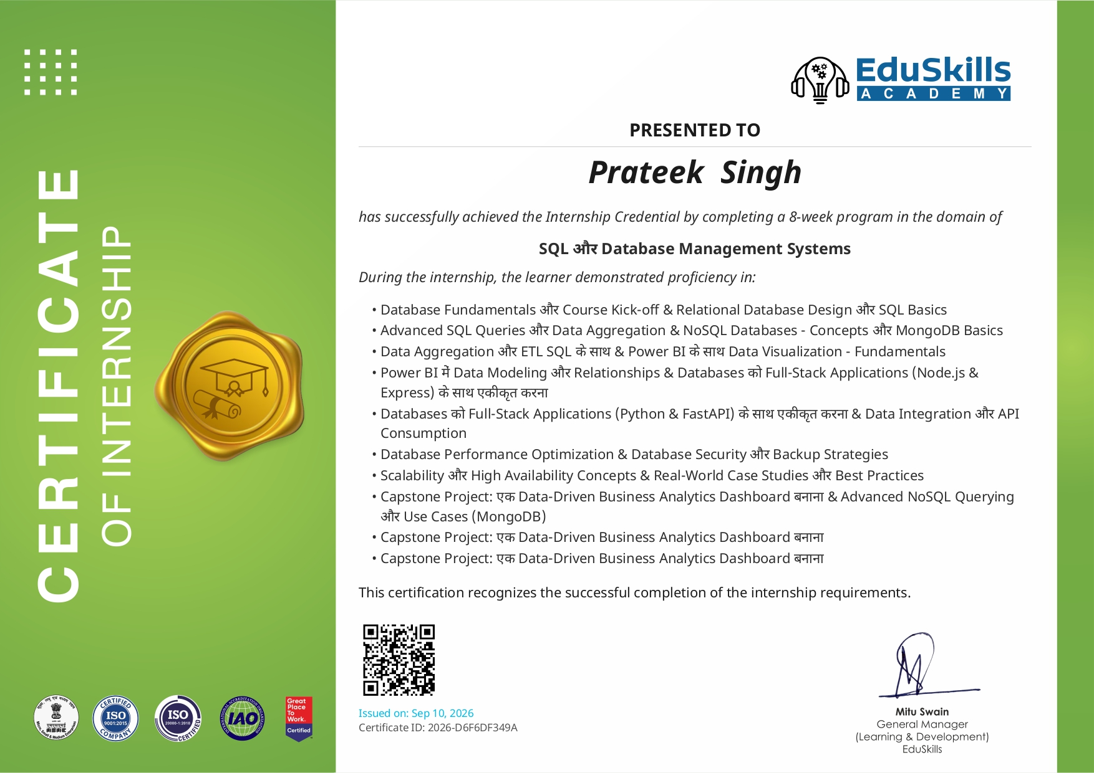
Conclusion & Future Scope
The internship gave a complete view of database management: from designing a relational schema to delivering business insights through a dashboard, using both SQL and NoSQL systems.
Future Scope
Cloud-hosted and real-time data pipelines
Automated ETL with scheduled dashboard refresh
Production-style replication, sharding and backup
Thank You

