Slide 1

School of Computer Science and Engineering
Department of Computer Engineering and Technology (DCET)
Full Stack Development Project: CampusShield
1032211384 : Pratham Singh

Slide 2


Problem Statement & Proposed Solution
The problem
Cyber incidents on campus, like phishing and hacked accounts, have no single place to be reported
Reports spread across emails and calls, so cases can get lost
Students cannot see what is happening with their case
Evidence can be changed with no way to prove it
CampusShield: the solution
One web portal to report and track incidents
Separate student and admin access
Clear case status from New to Closed
A SHA-256 hash proves evidence was not altered
An audit log records important actions

Slide 3

Key Features
Secure login
Registration and login with hashed passwords and JWT
Role-based access
Students see their own cases. Admins see all of them
Incident reporting
Title, type, severity, description and an evidence file
Case tracking
Status updates and investigation notes from the admin
Evidence integrity
Verify button that detects any change to a stored file
Audit log and dashboard
A record of actions, plus charts by type, severity and status

Slide 4
Process Flow Diagram
Student
Register or log in
Fill in the report form
Upload evidence (optional)
Submit the incident
System
Write to the audit log
Calculate SHA-256 hash
Save the case as New
Admin
Review on the dashboard
Open the case
Verify evidence
Add notes and close
Case status:
New
In progress
Resolved
Closed

Slide 5

System Architecture
Client: browser
HTML, CSS and JavaScript
React pages and components
React Router for navigation
Keeps the JWT in the browser
Server: Node.js and Express
REST API under /api
JWT login check on private routes
Multer for evidence uploads
SHA-256 hashing with Node crypto
Serves the built React app
MongoDB
users
incidents
auditlogs
JSON
Uploads folder
Evidence files on the server disk

Slide 6
Technical Stack with Reasoning
Layer | Technology | Why it was chosen
Structure | HTML5 | Standard page structure that React renders into
Styling | CSS3 | Responsive layouts using media queries, with no extra library
Logic | JavaScript | One language for both the front end and back end
User interface | React with Vite | Reusable components, state and fast builds
Navigation | React Router | Moves between pages without reloading
Server | Node.js and Express | Simple REST API with middleware for login checks
Database | MongoDB with Mongoose | Flexible documents suit cases with notes and evidence
Security | JWT, bcryptjs, SHA-256 | Secure login, hashed passwords and evidence integrity
File upload | Multer | Handles evidence files with type and size limits

Slide 7

Front End: HTML, CSS, JavaScript, React
HTML and CSS
index.html is the single page React fills
index.css styles every screen
Media queries at 768px adapt the layout
React concepts used
Components: each page is a function
Props: isAdmin decides what a page shows
useState: holds form values and data
useEffect: loads data when a page opens
React Router: Routes map URLs to pages
Pages
Login and register
Incidents list
Report an incident
Incident details
Dashboard and audit log (admin)
JavaScript
api.js sends every server request
It adds the JWT automatically
Errors from the server are shown on screen

Slide 8
Back End: Node.js and Express
How a request is handled
Request with JWT
express.json reads data
requireLogin checks JWT
requireAdmin checks role
Route uses MongoDB
JSON response
Method | Endpoint | Purpose | Access
POST | /api/auth/register, /login | Create an account or log in | Public
GET | /api/incidents | List incidents | Logged in
POST | /api/incidents | Report an incident with evidence | Logged in
GET | /api/incidents/:id/verify | Check evidence integrity | Owner, admin
PUT | /api/incidents/:id/status | Change the status | Admin
POST | /api/incidents/:id/notes | Add a note | Admin
GET | /api/admin/stats, /audit | Dashboard numbers and audit log | Admin

Slide 9

Database: MongoDB Collections
users
name
email (unique)
passwordHash
role: student or admin
incidents
title, type, severity
description, status
reporter (links to users)
notes: list inside the case
evidence: name, size, sha256
auditlogs
user
action
incidentTitle
time of the action
Why it fits: notes and evidence details sit inside the incident document, so one read returns the whole case. Mongoose adds schemas and validation.

Slide 10
Workflow: Login and Access Control
User registers
bcrypt hashes the password
User logs in
Server signs a JWT
Role decides access
Server verifies it
JWT sent with each request
Browser stores the JWT
Student
Own cases only
Can report and verify
Admin
All cases, status and notes
Dashboard and audit log
Blocked
No login: 401
Student on admin route: 403
Another student’s case: 404

Slide 11
Workflow: Evidence Integrity
At upload
File uploaded
Saved to uploads
SHA-256 calculated
Hash saved in MongoDB
At verification
Press Verify integrity
Read the stored file
Calculate hash again
Compare both hashes
Hashes match
Shows Intact
The file is unchanged
Hashes differ
Shows Tampered
Even a one-letter change alters the hash
Every result is logged
The audit log records who checked and the result

Slide 12
Challenges Faced during development if Any
Challenge | How it was solved
Proving evidence was not changed | Save a SHA-256 hash at upload and recalculate it on every check
Keeping cases private | The server checks the owner and hides cases from other students
Stopping users making themselves admin | Registration ignores any role sent by the browser
Accepting file uploads safely | Allow only set file types up to 5 MB, and store them under random names
Avoiding leftover files | Delete the uploaded file if saving the incident fails
Working on phones and laptops | Use media queries and one flexible layout

Slide 13


Limitation and scope of the project with future projection extension
Current limitations
Runs on a local computer, not a public server
Only two roles: student and admin
Evidence is stored on disk without encryption
No email alerts when a case changes
The audit log sits in the same database
Future scope
Deploy online with HTTPS and MongoDB Atlas
Add analyst and department head roles
Encrypt evidence files in storage
Send email alerts and reminders
Make the audit log tamper-evident
Sign in with college accounts

Slide 14
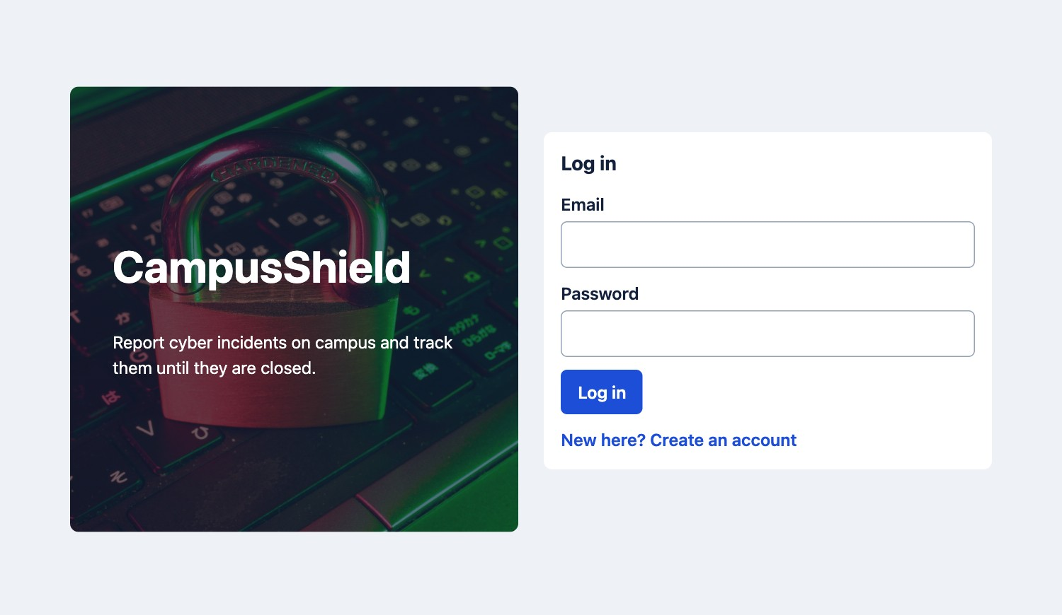
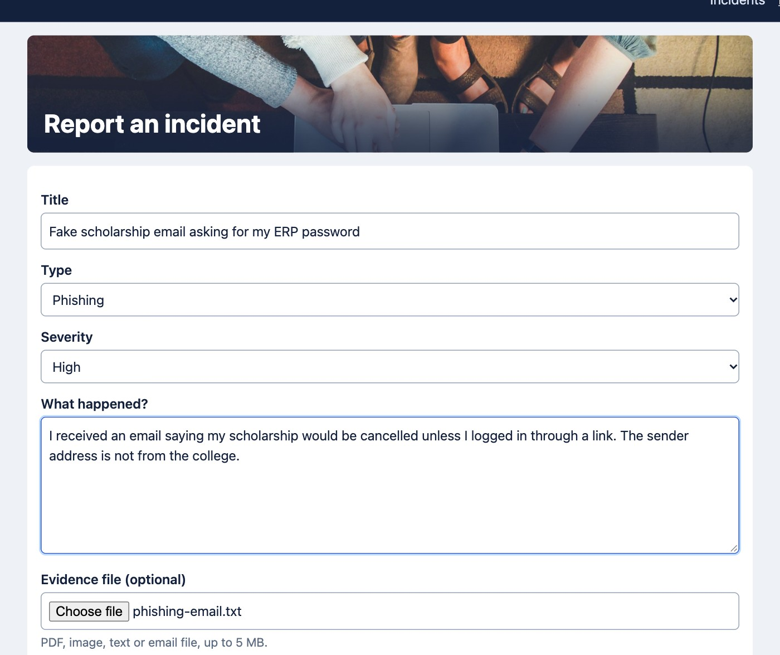
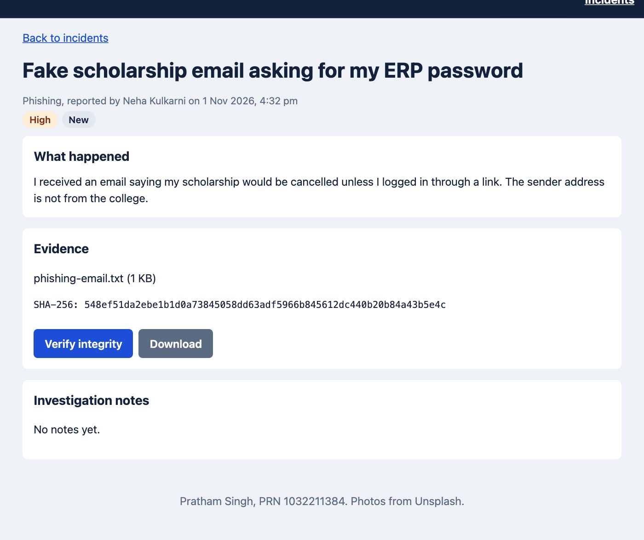
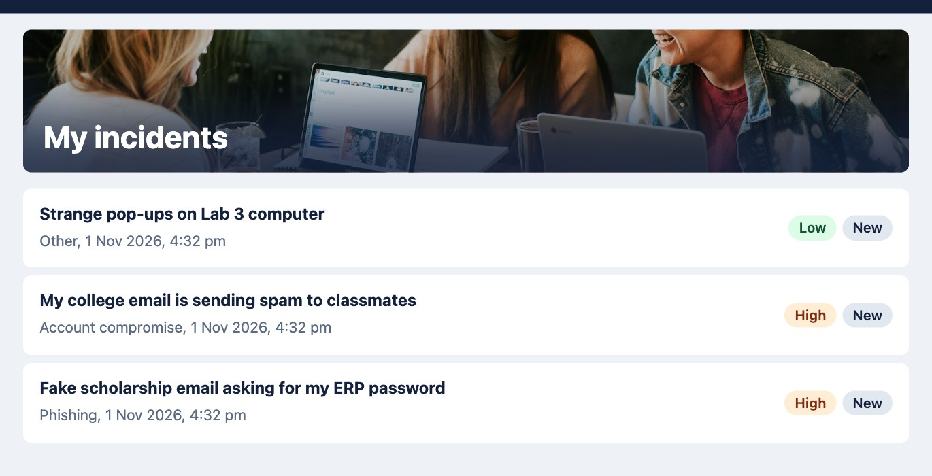
Working Demo: Student
Login page
Report form with evidence upload
Case with its SHA-256 hash
Student sees only their own cases

Slide 15
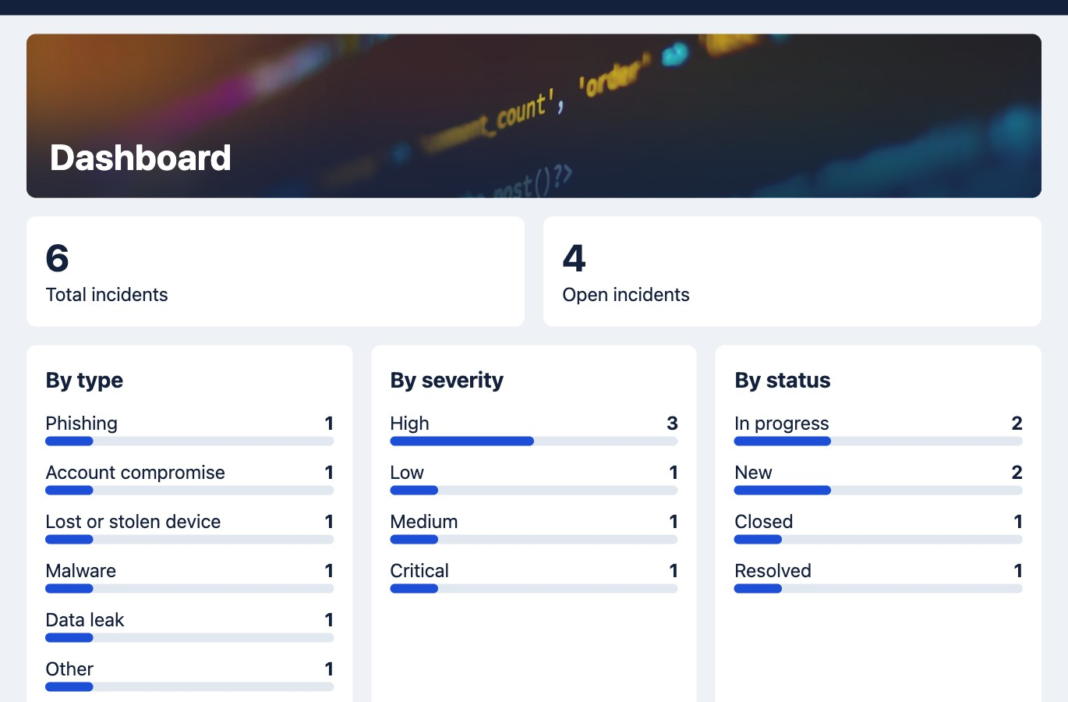
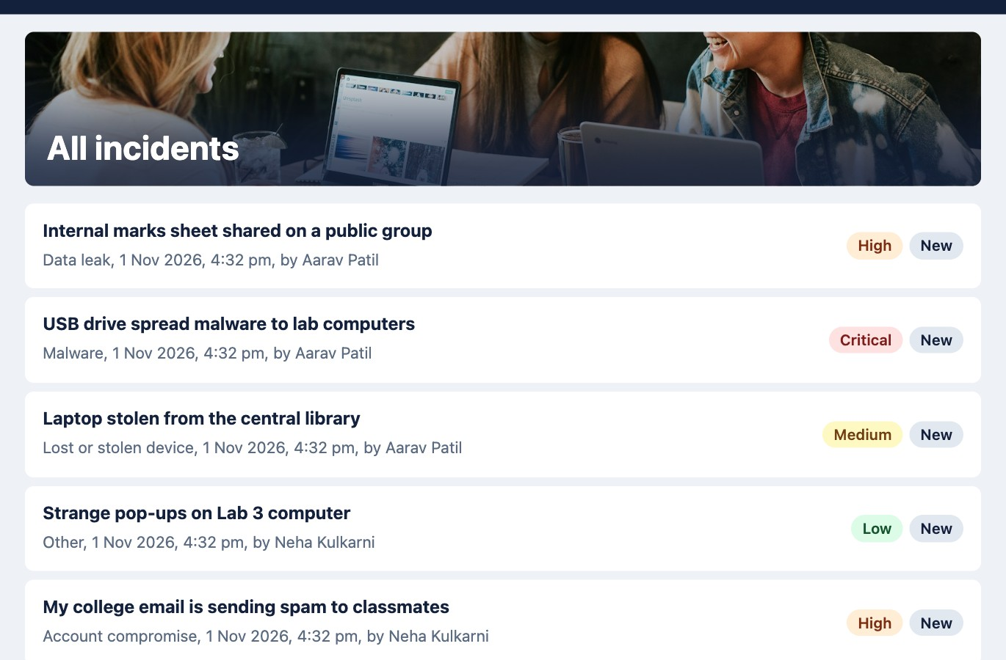
Working Demo: Admin
Dashboard with counts by type, severity and status
All incidents from every student
The dashboard shows 6 sample incidents, with 4 still open. Admins can open any case, change its status and add investigation notes.

Slide 16
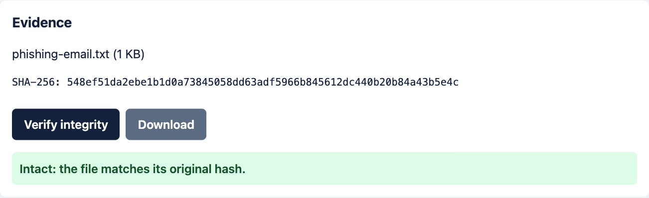
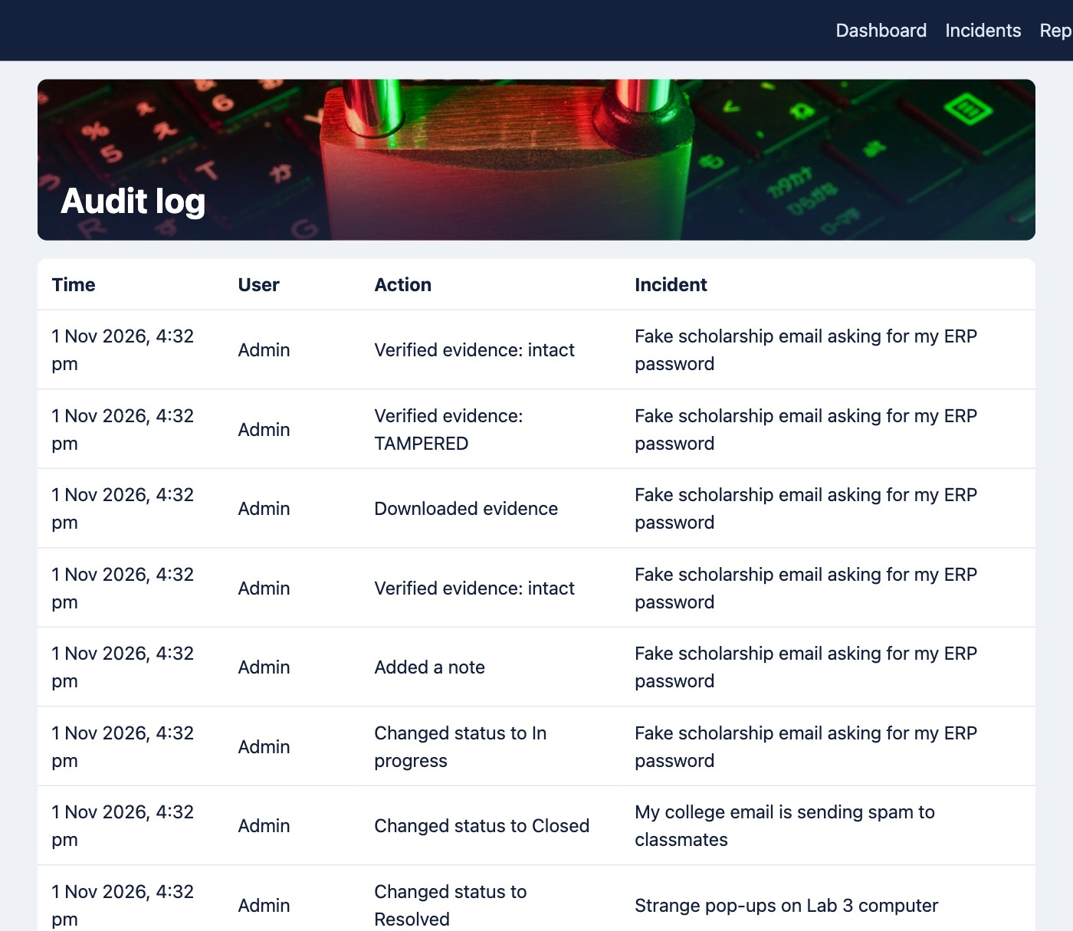
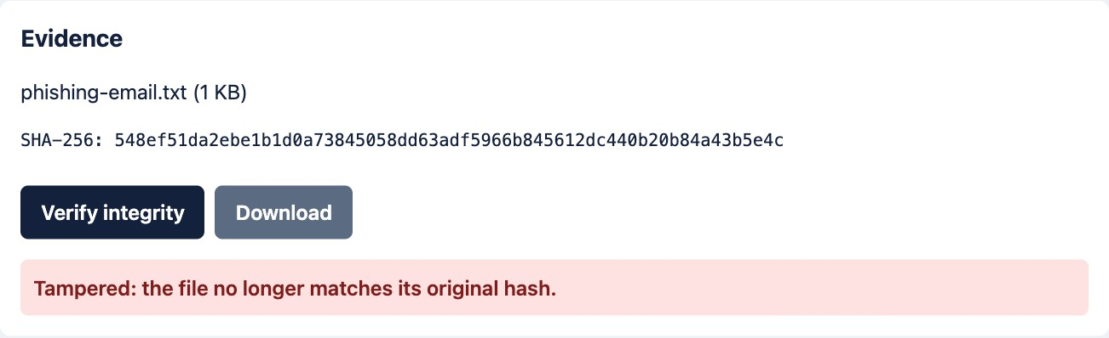
Working Demo: Tamper Detection
Before: the stored file matches its hash
After changing one stored file: tampering is detected
Audit log showing the check and its result

Slide 17
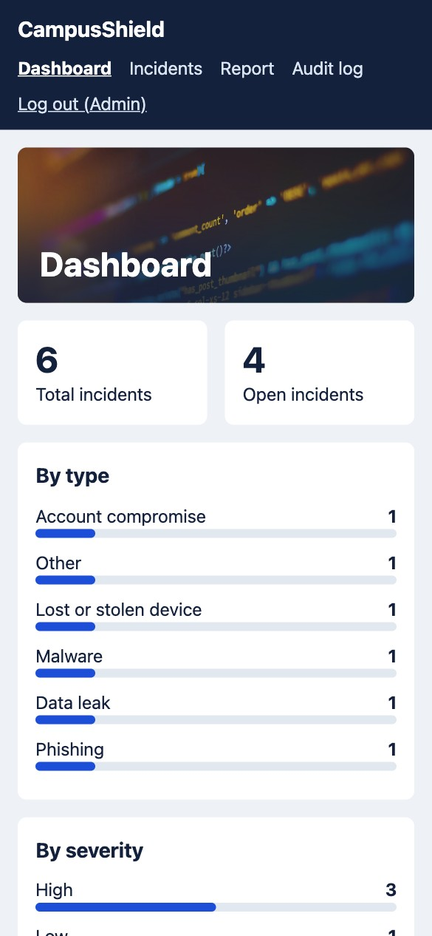
Testing and Results
24
12
0
Objectives met
One place to report and track incidents
Role-based access
Evidence integrity proof
Responsive on phone and laptop
API checks passed
Browser checks passed
Checks failed
Confirmed working
Tampered file detected, restored file passes
Other students’ cases are blocked
Students cannot use admin routes
Wrong file types and 6 MB file rejected
No sideways scrolling at phone width
Phone view

Slide 18

Q/A
Thank you
Photos from Unsplash: FlyD, Brooke Cagle, John and Shahadat Rahman

