Slide 1

School of Computer Science and Engineering
Department of Computer Engineering and Technology (DCET)
Mini Project: Parkwise
1032211384 : Pratham Singh

Slide 2
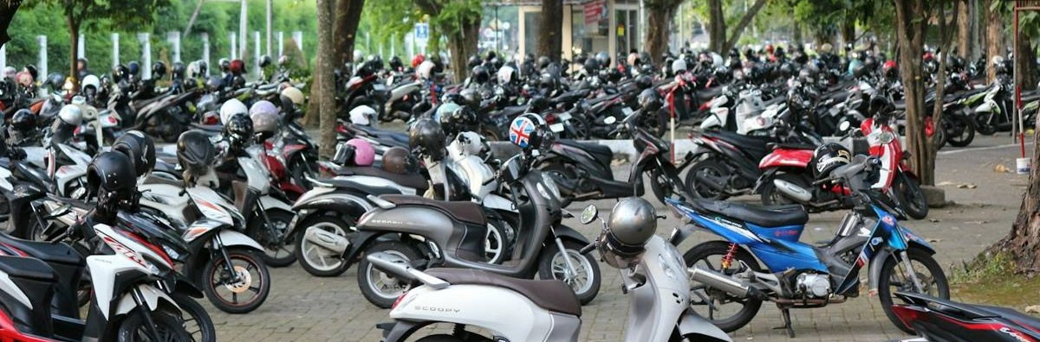

Problem Statement & Proposed Solution
The problem
Manual records make double-booking easy
Charges can be calculated wrongly
Hard to see which vehicles are on site
Parkwise: the solution
One dashboard for five parking slots
Checks for time conflicts before booking
Calculates charges automatically
Keeps records behind a secure sign-in

Slide 3

Key Features
Availability check
See free slots and the estimated charge
Slot booking
Book 1 to 5 hours, starting on a whole hour
Search
Find by registration, booking ID or slot
Check-in and check-out
Track vehicles through each status
Extend and cancel
Change bookings, with rules for each action
Dashboard and receipt
See counts and print a booking receipt

Slide 4
Login and User Management
Secure sign-in
Every data route needs a signed-in user
Two roles
Administrator manages users; staff handle bookings
User CRUD
Create, view, edit and delete accounts
Hashed passwords
Salted PBKDF2, never stored as text
Lockout
Five wrong passwords lock a name for a minute
Instant removal
Deleting a user ends their session at once

Slide 5
Process Flow Diagram
Browser
Enter vehicle, time and duration
Find available slots
Choose a free slot
Confirm booking
Java server
Calculate the price
Recheck slot and vehicle
Validate all fields
Result
Save as BOOKED
Return the booking
Show confirmation
Refresh the dashboard
If the slot was taken after the availability check, the server refuses the booking.

Slide 6
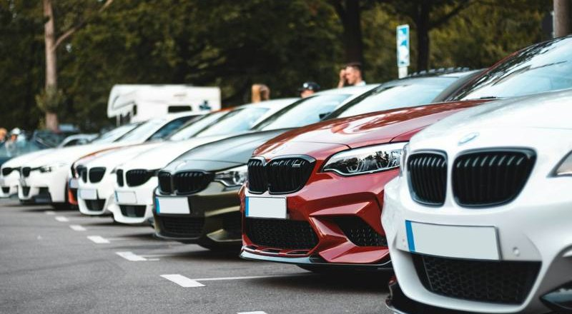
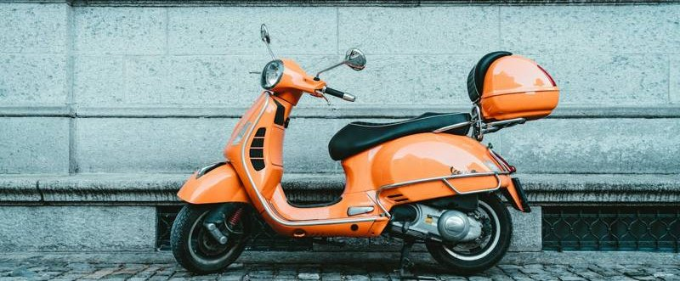
System Architecture
Client: browser
index.html
style.css
app.js with Fetch API
Five local photos
Server: Java and Spring Boot
Embedded Tomcat
REST API under /api
AuthFilter and two controllers
Validation and pricing
JdbcTemplate SQL
SQLite database
parking.db file
bookings and users tables
11 and 6 fields
HTTP
SQL
JSON

Slide 7
Technical Stack with Reasoning
Layer | Technology | Why it is used
Language | Java 17 | Main back-end language of the project
Framework | Spring Boot 3.2.5 | Starts the server and handles REST routes and JSON
Web server | Embedded Tomcat | Included in the jar, so no separate server is needed
Data access | Spring JDBC, JdbcTemplate | Runs parameterized SQL statements
Database | SQLite | Simple local database stored in one file
Front end | HTML, CSS, JavaScript | One page with no framework
Testing | JUnit 5 | Tests the controller with in-memory SQLite
Build | Maven | Manages dependencies and builds the runnable jar

Slide 8
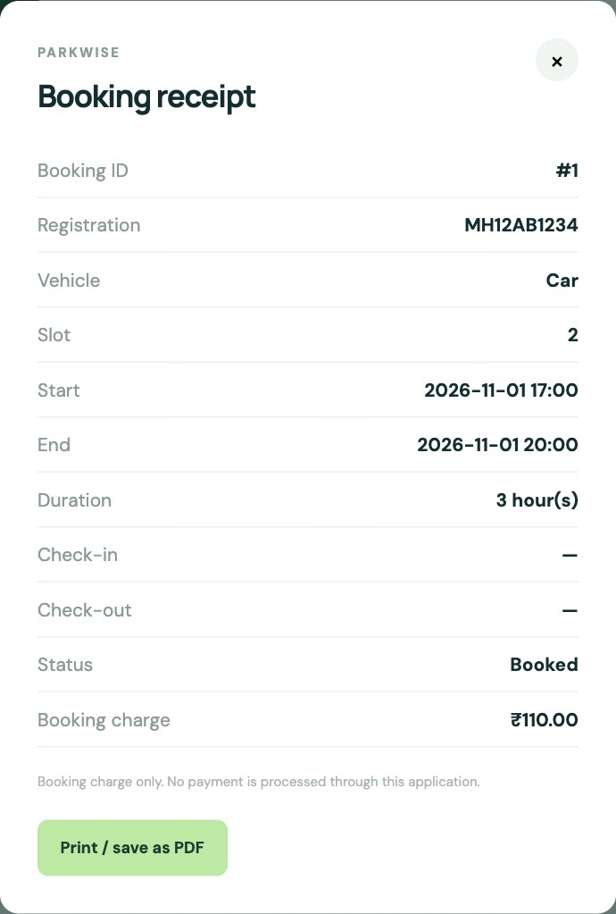
Front End: HTML, CSS and JavaScript
HTML and CSS
index.html holds the one page
style.css handles the layout
Five photos are stored locally
Main JavaScript functions
api(): every server request
loadBookings(): builds the table
loadStats(): fills the dashboard
refreshAll(): reloads both
showReceipt(): opens the receipt
escapeHtml(): keeps page text safe
Page areas
Dashboard cards
Booking form and rates
Records, users and receipt
Receipt dialog

Slide 9
Back End: Java and Spring Boot
How a request is handled
Browser request
REST method in controller
Validate input
Check rules
Run SQL
JSON response
Method | Endpoint | Purpose | Java method
GET | /api/availability | Check slots and estimate price | availability()
POST | /api/bookings | Create a booking | book()
GET | /api/bookings | List or search bookings | bookings()
GET | /api/bookings/{id} | Get one booking | booking()
POST | /api/bookings/{id}/{action} | Cancel, check in or check out | action()
POST | /api/bookings/{id}/extend | Extend a booking | extend()
GET | /api/statistics | Dashboard totals | statistics()

Slide 10
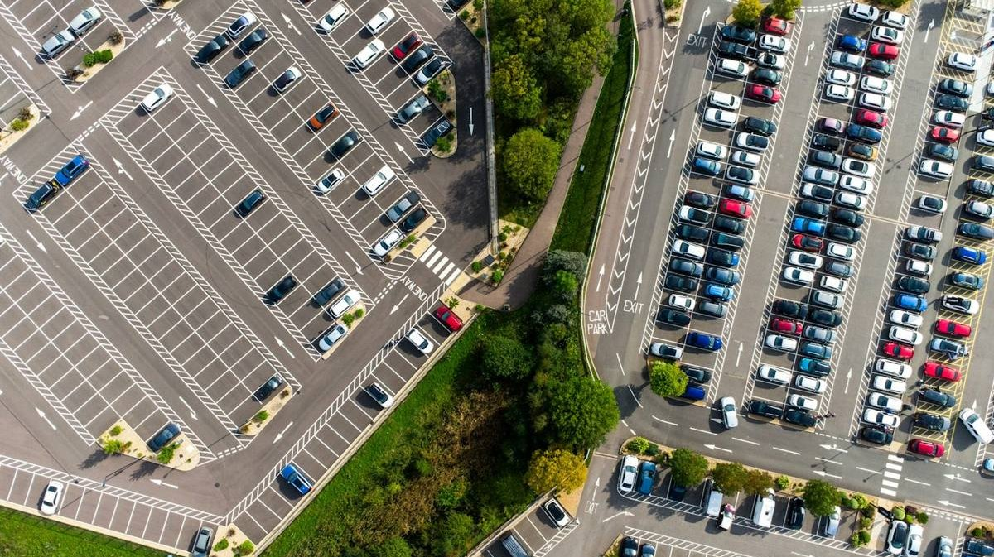
Database: bookings and users Tables
Field | Type | Purpose
id | INTEGER | Unique booking number
car_number | TEXT | Vehicle registration
slot | INTEGER | Slot 1 to 5
start_time, end_time | TEXT | Reserved period
hours | INTEGER | Total hours, 1 to 5
price | REAL | Booking charge
status | TEXT | Current booking state
vehicle_type | TEXT | CAR or TWO_WHEELER
checked_in_at | TEXT | Check-in time
checked_out_at | TEXT | Check-out time
Design
bookings: the 11 fields shown
users: 6 fields, password hashed
Booking records are never deleted

Slide 11
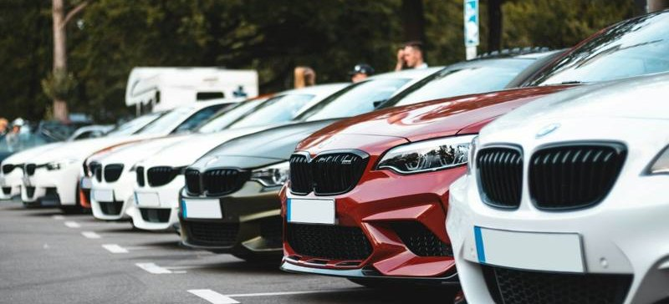
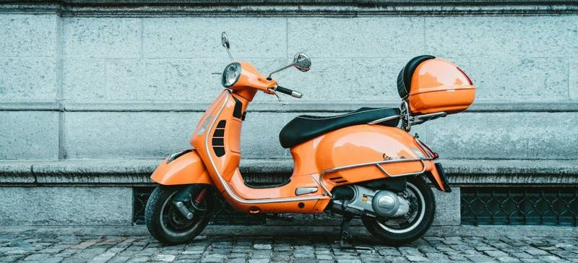
Workflow: Pricing
Rules
Peak is 09:00 up to 18:00
Each hour uses the rate when it starts
10% off for 4 or 5 hours
No payment is collected
Car
Peak: Rs. 50 per hour
Off-peak: Rs. 30 per hour
Two-wheeler
Peak: Rs. 30 per hour
Off-peak: Rs. 20 per hour
Example, confirmed by testing | Hourly rates | Discount | Charge
Car, 08:00, 2 hours | 30 + 50 | None | Rs. 80
Two-wheeler, 17:00, 4 hours | 30 + 20 + 20 + 20 | 10% | Rs. 81
Car, 16:00, 5 hours | 50 + 50 + 30 + 30 + 30 | 10% | Rs. 171

Slide 12
Workflow: Check-in, Check-out, Extension
BOOKED
Check in
CHECKED_IN
Check out
CHECKED_OUT
Cancel before start
CANCELLED
Check-in
Any time after booking
Slot must not be occupied
Check-out
Frees the slot immediately
The charge does not change
Extension
Total of 5 hours at most
Added time must be free

Slide 13
Challenges Faced during development if Any
Challenge | How the code solves it
Preventing overlapping bookings | available() counts conflicting bookings for the same slot
Slot taken after the availability check | book() checks again before saving and returns 409
Vehicle staying past its end time | A checked-in overstay blocks the slot until check-out
Price after an extension | The whole charge is recalculated from the original start
Storing passwords safely | Only a salted PBKDF2 hash is stored, never the password
Unsafe text in the page | escapeHtml() shows typed HTML as plain text

Slide 14

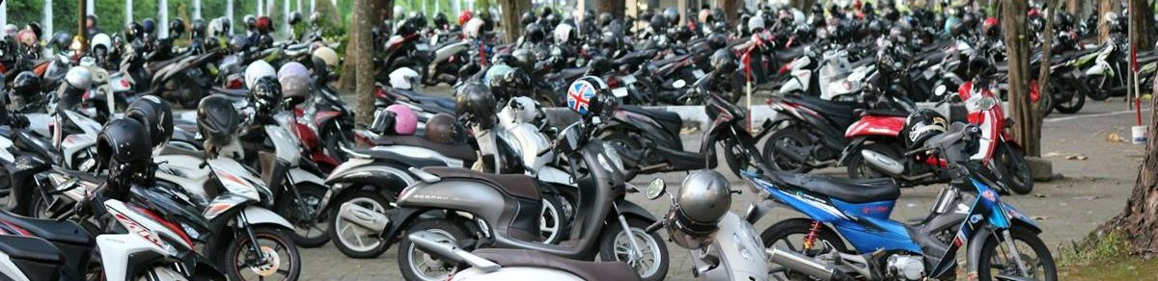
Limitation and scope of the project with future projection extension
Current limitations
No online payment
Five fixed slots, shared by all vehicles
One computer, over plain HTTP
No refund or late fee
No-shows stay BOOKED
Future scope
Add password reset by email
Move rates and slots into settings
Split the controller into layers
Add database constraints and indexes
Handle no-shows automatically
Add online payment

Slide 15
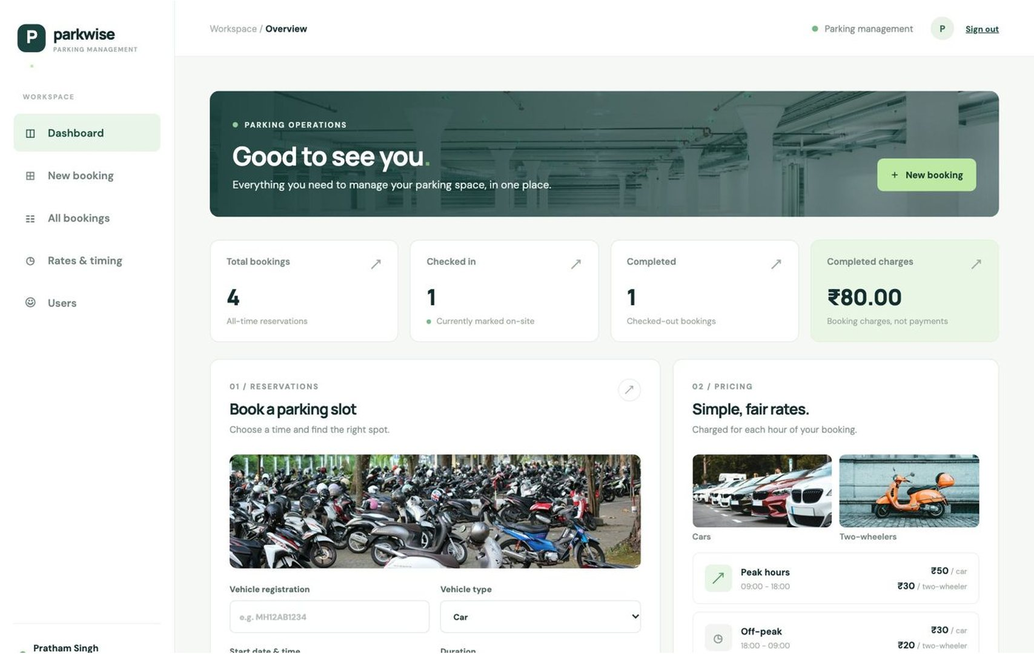
Working Demo: Dashboard
Dashboard shows
Total bookings
Vehicles checked in
Completed bookings
Completed charges
Booking form
Hourly rates
Dashboard with counts, booking form and rates

Slide 16
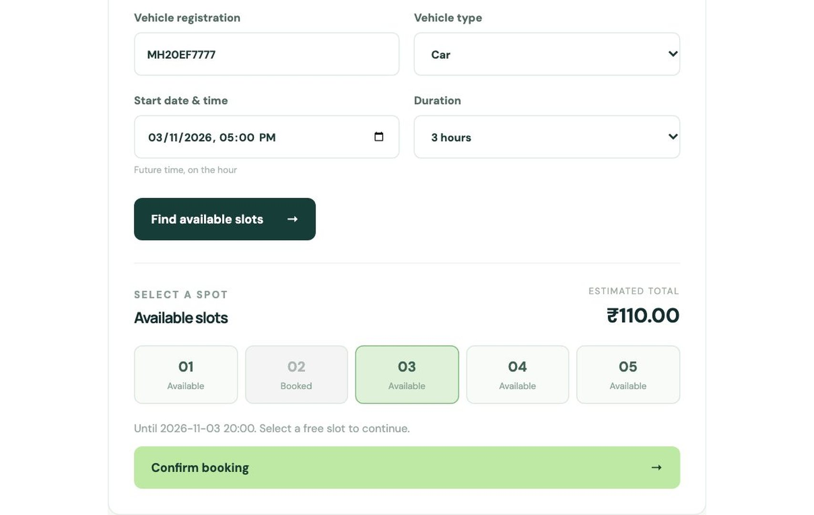
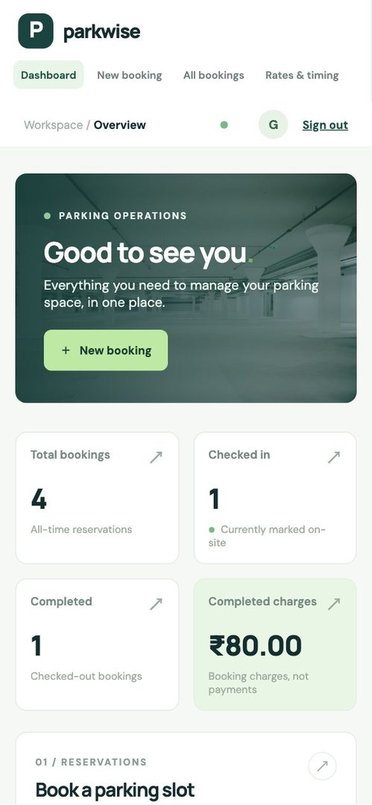
Working Demo: Booking
Steps
Fill the form
Find slots
Choose a slot
Confirm
Choosing a free slot, with the estimated total
Phone view

Slide 17
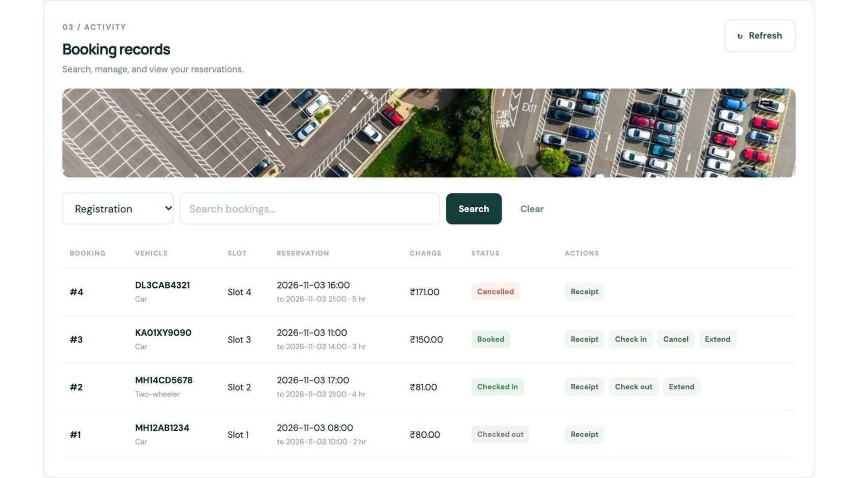
Working Demo: Booking Records
Search bar, status badges and the actions allowed for each booking

Slide 18
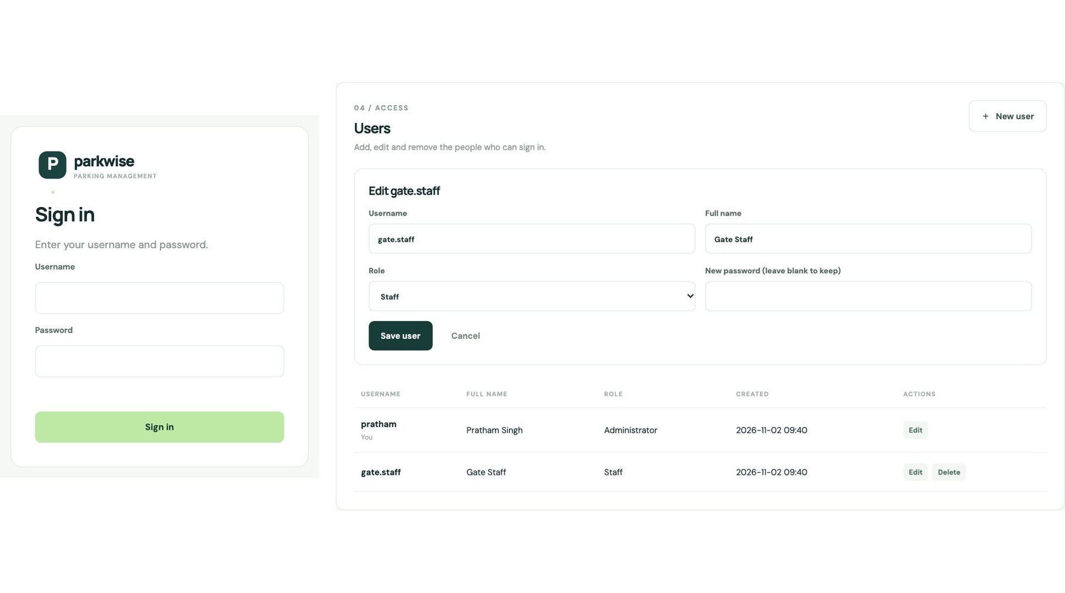
Working Demo: Sign-in and Users
Sign-in screen, and the Users page with its edit form

Slide 19
Testing and Results
77
94
34
0
Login and access checks
Booking API checks
Screen checks
Final failures
Confirmed working
Overlapping bookings are refused
Prices match the worked examples
Check-in, check-out and extension rules
Login, roles and user CRUD work
Other websites are refused
Not tested
Many users at the same time
Large numbers of bookings
Other browsers
JUnit on the final build
Maven build commands

Slide 20
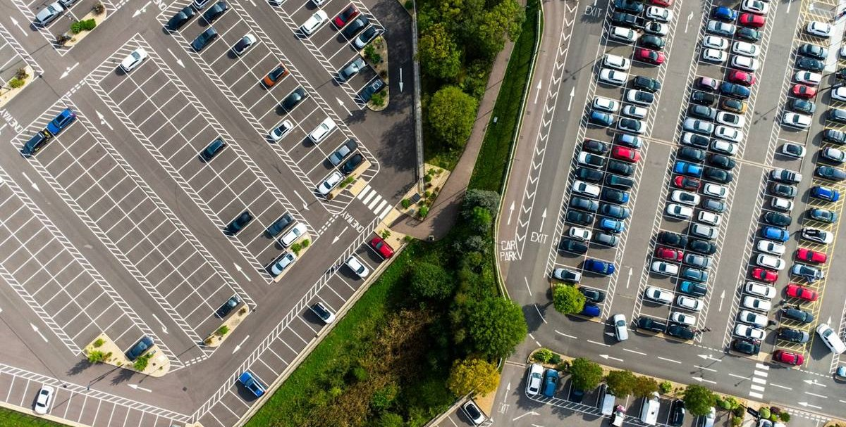
Q/A
Thank you
Photos from Unsplash: Claudio Schwarz, Benjamin Cheng, Sara Kurfess and Deski Jayantoro

