Slide 1
MapReduce

Slide 2
MapReduce Outline
MapReduce Architecture
MapReduce Internals
MapReduce Examples
JobTracker Interface

Slide 3


MapReduce: A Real World Analogy
Coins Deposit
?

Slide 4
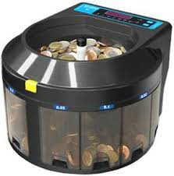
MapReduce: A Real World Analogy
Coins Deposit
Coins Counting Machine

Slide 5
MapReduce: A Real World Analogy
Coins Deposit
Mapper: Categorize coins by their face values
Reducer: Count the coins in each face value in parallel

Slide 6
MapReduce Architecture: Master-Slaves
Job Client
Task Trackers
Job Tracker
Idea: Bring Computation to Data!
Map
Reduce
Name Node
Inputs
Outputs
HDFS
Job Client: Submit Jobs
Task Tracker: Execute Jobs
Job Tracker: Coordinate Jobs
(Scheduling, Phase Coordination, etc.)
Job: MapReduce Function+ Config

Slide 7
MapReduce Architecture: Workflow
1
Job Client
Task Trackers
1
6
3
Job Tracker
2
4
Map
Reduce
Name Node
Inputs
Outputs
5
HDFS
Client submits job to Job Tracker and copy code to HDFS
Job Tracker talks to NN to find data it needs
Job Tracker creates execution plan and submits work to Task Trackers
4. Task trackers do the job and report progress/status to Job Tracker
5. Job Tracker manages task phases
6. Job Tracker finishes the job and updates status

Slide 8
MapReduce Paradigm
Implement two functions:
Map (k1,v1) -> list (k2, v2)
Reduce(k2, list(v2)) -> list (v3)
Framework handles everything else
Value with the same key go to the same reducer

Slide 9
MapReduce Internal
Input
Data Node 1
Input
Data Node 1
Split
Split
Split
Split
Split
Split
Map
Map
Map
Map
Map
Map
Shuffle
Shuffle
Sort
Sort
Reduce
Reduce
HDFS
Output
Output

Slide 10
MapReduce Example: Word Count
Input
Split
Map
Shuttle/Sort
Reduce
Output
Deer, 1
Beer, 1
River, 1
Beer, 1
Beer, 1
Beer, 2
Dear Beer River
Beer, 2
Car, 3
Deer, 2
River, 2
Deer Beer River
Car Car River
Deer Car Beer
Car Car River
Car, 1
Car, 1
River, 1
Car, 1
Car, 1
Car, 1
Car, 3
Deer Car Beer
Deer, 1
Car, 1
Beer, 1
Deer, 1
Deer, 1
Deer, 2
River, 1
River, 1
River, 2
Similar Flavor of Coins Deposit ? ☺

Slide 11
MapReduce Example: Word Count
Input
Split
Map
Shuttle/Sort
Reduce
Output
Deer, 1
Beer, 1
River, 1
Beer, 1
Beer, 1
Beer, 2
Dear Beer River
Beer, 2
Car, 3
Deer, 2
River, 2
Deer Beer River
Car Car River
Deer Car Beer
Car Car River
Car, 1
Car, 1
River, 1
Car, 1
Car, 1
Car, 1
Car, 3
Deer Car Beer
Deer, 1
Car, 1
Beer, 1
Deer, 1
Deer, 1
Deer, 2
River, 1
River, 1
River, 2
Q: What are the Key and Value Pairs of Map and Reduce?
Map: Key=word, Value=1
Reduce: Key=word, Value=aggregated count

Slide 12
Mapper and Reducer of Word Count
Map(key, value){
// key: line number
// value: words in a line
for each word w in value:
Emit(w, "1");}
Reduce(key, list of values){
// key: a word
// list of values: a list of counts
int result = 0;
for each v in values:
result += ParseInt(v);
Emit(key, result);}
Combiner is the same as Reducer

Slide 13
MapReduce Example: Word Count
Input
Split
Map
Shuttle/Sort
Reduce
Output
Deer, 1
Beer, 1
River, 1
Beer, 1
Beer, 1
Beer, 2
Dear Beer River
Beer, 2
Car, 3
Deer, 2
River, 2
Deer Beer River
Car Car River
Deer Car Beer
Car Car River
Car, 1
Car, 1
River, 1
Car, 1
Car, 1
Car, 1
Car, 3
Deer Car Beer
Deer, 1
Car, 1
Beer, 1
Deer, 1
Deer, 1
Deer, 2
River, 1
River, 1
River, 2
Q: Do you see any place we can improve the efficiency?
Local aggregation at mapper will be able to improve MapReduce efficiency.

Slide 14
MapReduce: Combiner
Combiner: do local aggregation/combine task at mapper
Q: What are the benefits of using combiner:
Reduce memory/disk requirement of Map tasks
Reduce network traffic
Q: Can we remove the reduce function?
No, reducer still needs to process records with same key but from different mappers
Q: How would you implement combiner?
It is the same as Reducer!
Car, 1
Car, 1
River, 1
Car, 2
River, 1
Car, 2
Car, 1
Car, 3

Slide 15
MapReduce WordCount 2
New Goal: output all words sorted by their frequencies (total counts) in a document.
Question: How would you adopt the basic word count program to solve it?
Solution:
Sort words by their counts in the reducer
Problem: what happens if we have more than one reducer?

Slide 16
MapReduce WordCount 2
New Goal: output all words sorted by their frequencies (total counts) in a document.
Question: How would you adopt the basic word count program to solve it?
Solution:
Do two rounds of MapReduce
In the 2nd round, take the output of WordCount as input but switch key and value pair!
Leverage the sorting capability of shuffle/sort to do the global sorting!

Slide 17
MapReduce WordCount 3
New Goal: output the top K words sorted by their frequencies (total counts) in a document.
Question: How would you adopt the basic word count program to solve it?
Solution:
Use the solution of previous problem and only grab the top K in the final output
Problem: is there a more efficient way to do it?

Slide 18
MapReduce WordCount 3
New Goal: output the top K words sorted by their frequencies (total counts) in a document.
Question: How would you adopt the basic word count program to solve it?
Solution:
Add a sort function to the reducer in the first round and only output the top K words
Intuition: the global top K must be a local top K in any reducer!

Slide 19
MapReduce In-class Exercise
Problem: Find the maximum monthly temperature for each year from weather reports
Input: A set of records with format as:
<Year/Month, Average Temperature of that month>
- (200707,100), (200706,90)
- (200508, 90), (200607,100)
- (200708, 80), (200606,80)
Question: write down the Map and Reduce function to solve this problem
Assume we split the input by line

Slide 20
Mapper and Reducer of Max Temperature
Map(key, value){
// key: line number
// value: tuples in a line
for each tuple t in value:
Emit(t->year, t->temperature);}
Reduce(key, list of values){
// key: year
//list of values: a list of monthly temperature
int max_temp = -100;
for each v in values:
max_temp= max(v, max_temp);
Emit(key, max_temp);}
Combiner is the same as Reducer

Slide 21
MapReduce Example: Max Temperature
(200707,100), (200706,90)
(200508, 90), (200607,100)
(200708, 80), (200606,80)
Input
Map
(2007,100), (2007,90)
(2005, 90), (2006,100)
(2007, 80), (2006, 80)
Combine
(2007,100)
(2005, 90), (2006,100)
(2007, 80), (2006, 80)
Shuttle/Sort
(2005,[90])
(2006,[100, 80])
(2007,[100, 80])
Reduce
(2005,90)
(2006,100)
(2007,100)

Slide 22
MapReduce In-class Exercise
Key-Value Pair of Map and Reduce:
Map: (year, temperature)
Reduce: (year, maximum temperature of the year)
Question: How to use the above Map Reduce program (that contains the combiner) with slight changes to find the average monthly temperature of the year?

Slide 23
Mapper and Reducer of Average Temperature
Map(key, value){
// key: line number
// value: tuples in a line
for each tuple t in value:
Emit(t->year, t->temperature);}
Reduce(key, list of values){
// key: year
// list of values: a list of monthly temperatures
int total_temp = 0;
for each v in values:
total_temp= total_temp+v;
Emit(key, total_temp/size_of(values));}
Combiner is the same as Reducer

Slide 24
MapReduce Example: Average Temperature
(200707,100), (200706,90)
(200508, 90), (200607,100)
(200708, 80), (200606,80)
Input
Real average of 2007: 90
Map
(2007,100), (2007,90)
(2005, 90), (2006,100)
(2007, 80), (2006,80)
Combine
(2007,95)
(2005, 90), (2006,100)
(2007, 80), (2006,80)
Shuttle/Sort
(2005,[90])
(2006,[100, 80])
(2007,[95, 80])
Reduce
(2005,90)
(2006,90)
(2007,87.5)

Slide 25
MapReduce In-class Exercise
The problem is with the combiner!
Here is a simple counterexample:
(2007, 100), (2007,90) -> (2007, 95)
(2007,80)->(2007,80)
Average of the above is: (2007,87.5)
However, the real average is: (2007,90)
However, we can do a small trick to get around this
Mapper: (2007, 100), (2007,90) -> (2007, <190,2>)
(2007,80)->(2007,<80,1>)
Reducer: (2007,<270,3>)->(2007,90)

Slide 26
MapReduce Example: Average Temperature
(200707,100), (200706,90)
(200508, 90), (200607,100)
(200708, 80), (200606,80)
Input
Map
(2007,100), (2007,90)
(2005, 90), (2006,100)
(2007, 80), (2006,80)
Combine
(2007,<190,2>)
(2005, <90,1>),
(2006, <100,1>)
(2007, <80,1>), (2006,<80,1>)
Shuttle/Sort
(2005,[<90,1>])
(2006,[<100,1>, <80,1>])
(2007,[<190,2>, <80,1>])
Reduce
(2005,90)
(2006,90)
(2007,90)

Slide 27
Mapper and Reducer of Average Temperature
Map(key, value){
// key: line number
// value: tuples in a line
for each tuple t in value:
Emit(t->year, t->temperature);}
Combine(key, list of values){
// key: year
// list of values: a list of monthly temperature
int total_temp = 0;
for each v in values:
total_temp= total_temp+v;
Emit(key,<total_temp,size_of(values)>);}
Reduce (key, list of values){
// key: year
// list of values: a list of <temperature sums, counts> tuples
int total_temp = 0;
int total_count=0;
for each v in values:
total_temp= total_temp+v->sum;
total_count=total_count+v->count;
Emit(key,total_temp/total_count);}

Slide 28
MapReduce In-class Exercise
Functions that can use combiner are called distributive:
Distributive: Min/Max(), Sum(), Count(), TopK()
Non-distributive: Mean(), Median(), Rank()
Gray, Jim*, et al. "Data cube: A relational aggregation operator generalizing group-by, cross-tab, and sub-totals." Data Mining and Knowledge Discovery 1.1 (1997): 29-53.
*Jim Gray received Turing Award in 1998

Slide 29
Map Reduce Problems Discussion
Problem 1: Find Word Length Distribution
Statement: Given a set of documents, use Map-Reduce to find the length distribution of all words contained in the documents
Question:
What are the Mapper and Reducer Functions?
12: 1
7: 1
6: 1
4: 4
3: 2
2: 1
1: 1
This is a test data for
the word length distribution problem
MapReduce

Slide 30
Mapper and Reducer of Word Length Distribution
Map(key, value){
// key: document name
// value: words in a document
for each word w in value:
Emit(length(w), w);}
Reduce(key, list of values){
// key: length of a word
// list of values: a list of words with the same length
Emit(key, size_of(values));}

Slide 31
Map Reduce Problems Discussion
Problem 1: Find Word Length Distribution
Mapper and Reducer:
Mapper(document)
{ Emit (Length(word), word) }
Reducer(output of map)
{ Emit (Length(word), Size of (List of words at a particular length))}

Slide 32
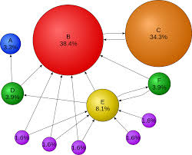
Map Reduce Problems Discussion
Problem 2: Indexing & Page Rank
Statement: Given a set of web pages, each page has a page rank associated with it, use Map-Reduce to find, for each word, a list of pages (sorted by rank) that contains that word
Question:
What are the Mapper and Reducer Functions?
MapReduce
Word 1: [page x1, page x2, ..]
Word 2: [page y1, page y2, …]
…

Slide 33
Mapper and Reducer of Indexing and PageRank
Map(key, value){
// key: a page
// value: words in a page
for each word w in value:
Emit(w, <page_id, page_rank>);}
Reduce(key, list of values){
// key: a word
// list of values: a list of pages containing that word
sorted_pages=sort(values, page_rank)
Emit(key, sorted_pages);}

Slide 34
Map Reduce Problems Discussion
Problem 2: Indexing and Page Rank
Mapper and Reducer:
Mapper(page_id, <page_text, page_rank>)
{ Emit (word, <page_id, page_rank>) }
Reducer(output of map)
{ Emit (word, List of pages contains the word sorted by their page_ranks)}

Slide 35
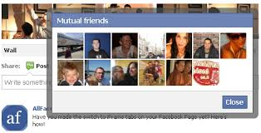
Map Reduce Problems Discussion
Problem 3: Find Common Friends
Statement: Given a group of people on online social media (e.g., Facebook), each has a list of friends, use Map-Reduce to find common friends of any two persons who are friends
Question:
What are the Mapper and Reducer Functions?

Slide 36
Map Reduce Problems Discussion
Problem 3: Find Common Friends
Simple example:
Input:
A -> B,C,D
B-> A,C,D
C-> A,B
D->A,B
A
C
MapReduce
Output:
(A ,B) -> C,D
(A,C) -> B
(A,D) -> ..
….
B
D

Slide 37
Mapper and Reducer of Common Friends
Map(key, value){
// key: person_id
// value: the list of friends of the person
for each friend f_id in value:
Emit(<person_id, f_id>, value);}
Reduce(key, list of values){
// key: <friend pair>
// list of values: a set of friend lists related with the friend pair
for v1, v2 in values:
common_friends = v1 intersects v2;
Emit(key, common_friends);}

Slide 38
Map Reduce Problems Discussion
Problem 3: Find Common Friends
Mapper and Reducer:
Mapper(friend list of a person)
{ for each person in the friend list:
Emit (<friend pair>, <list of friends>) }
Reducer(output of map)
{ Emit (<friend pair>, Intersection of two (i.e, the one in friend pair) friend lists)}

Slide 39
Map Reduce Problems Discussion
Problem 3: Find Common Friends
Mapper and Reducer:
Input:
A -> B,C,D
B-> A,C,D
C-> A,B
D->A,B
Map:
(A,B) -> B,C,D
(A,C) -> B,C,D
(A,D) -> B,C,D
(A,B) -> A,C,D
(B,C) -> A,C,D
(B,D) -> A,C,D
(A,C) -> A,B
(B,C) -> A,B
(A,D) -> A,B
(B,D) -> A,B
Reduce:
(A,B) -> C,D
(A,C) -> B
(A,D) -> B
(B,C) -> A
(B,D) -> A
Suggest Fiends ☺

Slide 40
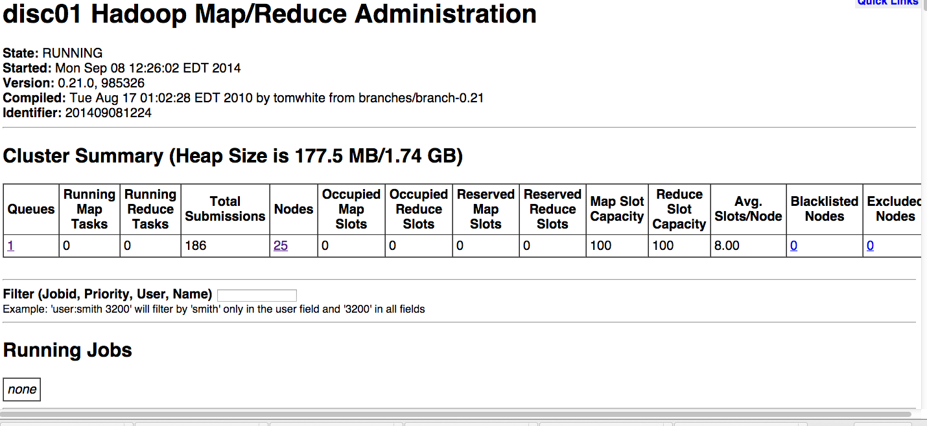
JobTracker UI
Tools to see running/completed/failed jobs

Slide 41
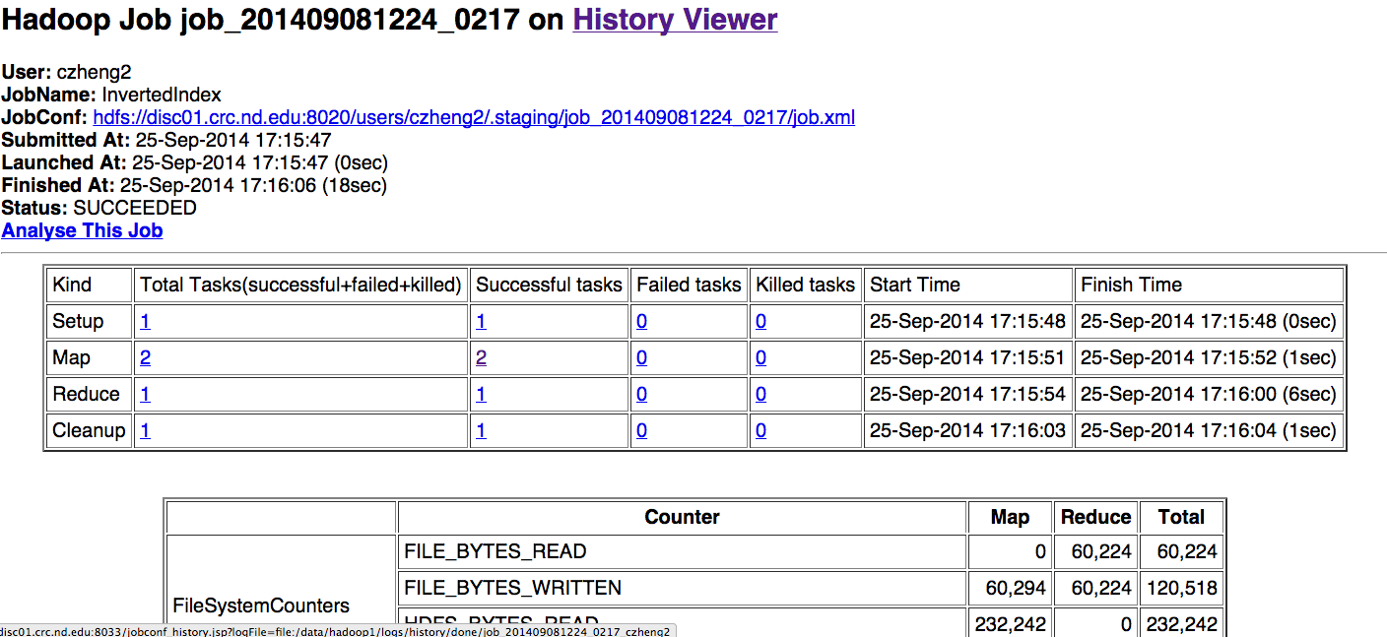
JobTracker UI
Tools to see running/completed/failed jobs

Slide 42
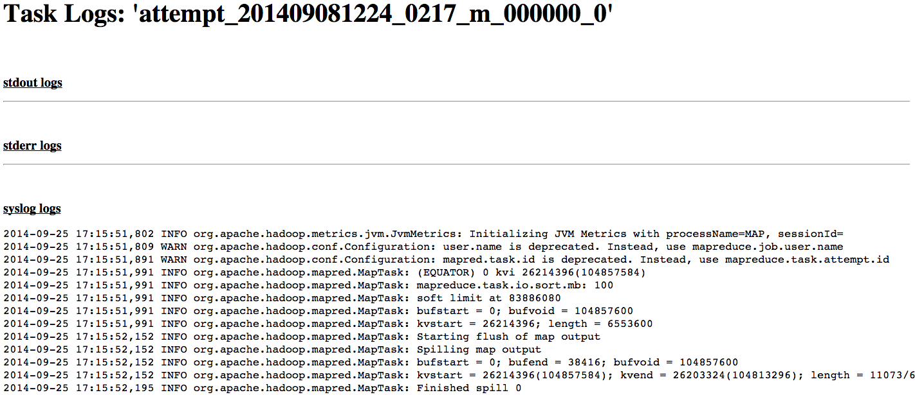
JobTracker UI
Tools to see running/completed/failed jobs

Slide 43

Enjoy MR and Hadoop☺

