Slide 1
A comparative study of Manual,Testing And Automation Testing in Software QualityAssurance
Supervised By
Dr. Gurpreet Singh
Prince Kumar Singh (2210992091)
Department of Computer Science and Engineering, Chitkara University, Punjab

Slide 2
Abstract
This project focuses on providing a comparative study of Manual Testing and Automation Testing in Software Quality Assurance to improve software reliability.
Various testing methodologies, including Manual Testing and Automation Testing tools such as Selenium and JUnit, are used for analysis and comparison.
The project analyzes and compares Manual Testing and Automation Testing techniques to evaluate software quality, efficiency, accuracy, and overall testing performance.
Different testing approaches are compared to identify the most effective method for improving software quality, speed, reliability, and overall testing efficiency.
Results show high accuracy and practical applications in real life.

Slide 3
Introduction
Manual Testing and Automation Testing are compared to analyze their advantages, limitations, performance, cost-effectiveness, and impact on Software Quality Assurance.
Software Quality Assurance (SQA) is a process used to ensure that software applications meet required quality standards through different testing approaches such as Manual Testing and Automation Testing.
Testing tools and methodologies such as Selenium, JUnit, and Manual Testing techniques are used to evaluate software performance, functionality, and reliability.
By using machine learning, we can train systems to automatically recognize these activities.
This study is widely useful in software development industries for improving application quality, reducing testing time, increasing reliability, and enhancing overall software performance.

Slide 4
Tools and Technology
Programming Language: ,Java,Python
Libraries: Selenium, Postman, Manual Testing.
Platform: Github,vs code, Jupyter Notebook
Testing Approaches: Manual Testing, Automation Testing

Slide 5
Implementation
Conducted detailed research on Manual Testing and Automation Testing..
Analyzed different software testing methodologies and tools.
Compared testing approaches based on speed, accuracy, cost, and reliability..
Studied the advantages and limitations of both testing techniques.
Generated graphs for visualization.

Slide 6
Objective
The main goal of this project is to compare Manual Testing and Automation Testing techniques to improve software quality, efficiency, reliability, and overall Software Quality Assurance processes..
We aim to analyze and compare different testing techniques and tools to identify the most effective approach for ensuring high-quality and reliable software applications..
Another objective is to compare different models and find out which one performs best.
Ultimately, we want a system that is reliable, efficient, and easy to use.

Slide 7
Problem Statement
Observing and recording human activities manually is time-consuming and not always accurate.
The data collected from sensors can be complex and noisy.
So, the challenge is to create a system that can:
Automatically detect activities
Work efficiently in real-time
Maintain high accuracy without human effort

Slide 8
Methodology
First, we studied different Software Testing methodologies, including Manual Testing and Automation Testing, along with popular testing tools and techniques used in Software Quality Assurance.
Then, we clean and process this data to remove noise and make it usable.
After that, we extract important features such as average values and variations in movement
Next, we analyzed various testing tools and frameworks such as Selenium, JUnit, and Postman to understand their role in improving software testing efficiency and reliability..
Finally, we compared manual testing on factors such as accuracy ,speed ,software reliability and evaluate their performance

Slide 9
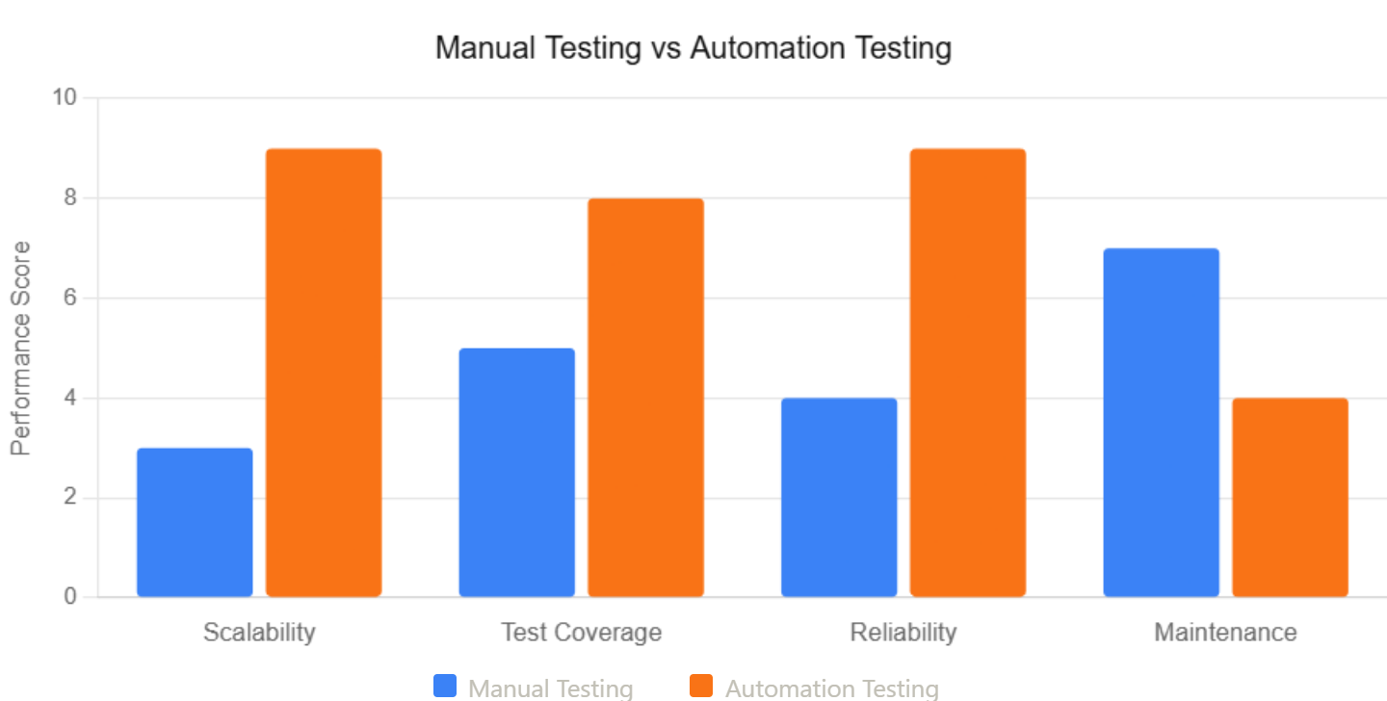
Choosing the Right Testing Strategy

Slide 10
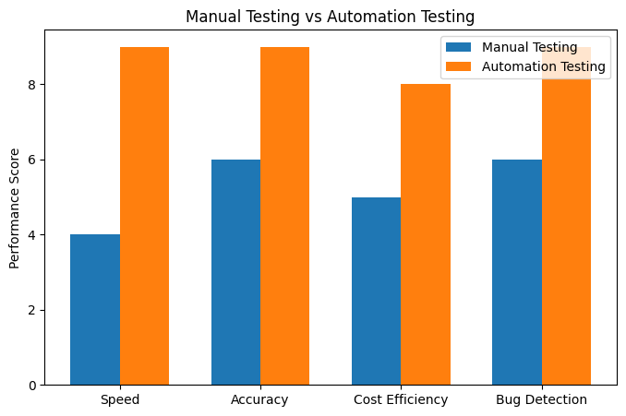
Testing comparison

Slide 11
Results & Discussion
The models were tested, and we achieved high accuracy (around 90–95%, depending on the model).
Manual Testing performed the best in most cases.
Using multiple sensors together improved the results.
However, certain testing scenarios still require manual intervention as automation testing may not handle usability exploratory and user experience testing.

Slide 12
Conclusion and Future scope
Manual and automation testing improve software quality and reliability.
Automation testing helps detect bugs faster and increases testing efficiency.
A mix of manual and automation provides the best software testing result.
Future Scope:
Use advanced automation testing tools and to improve software quality
Develop real-time testing mobile applications
Improve software reliabilty through smarter testing

Slide 13
Conclusion
1. This project shows that smartphones can effectively recognize human activities.
2. Automation testing plays a key role in making this possible.
3. Manual and automation testing are both essential for software testing.
4. In the future, we can improve this system using advanced learning techniques and real-time testing solutions.

Slide 14
References Research papers on MANUAL AND AUTOMATION Testing Activity Recognition UCI HAR Dataset Scikit-learn Documentation Online tutorials and study materials

Slide 15
Appendices
Sample dataset details
Additional graphs and charts
Code snippets (if required)

Slide 16
Thank You
3

