Slide 1
PROJECT
ON
CAFE
MANAGEMENT SYSTEM
Presented
by
PRASHANT KUMAR DAS
PRINCE KUMAR SINGH
Under the supervision
of
Anu Priya mam Nabnita roy mam Assistant Professor Engineering and Technology
Chitkara University, Punjab

Slide 2
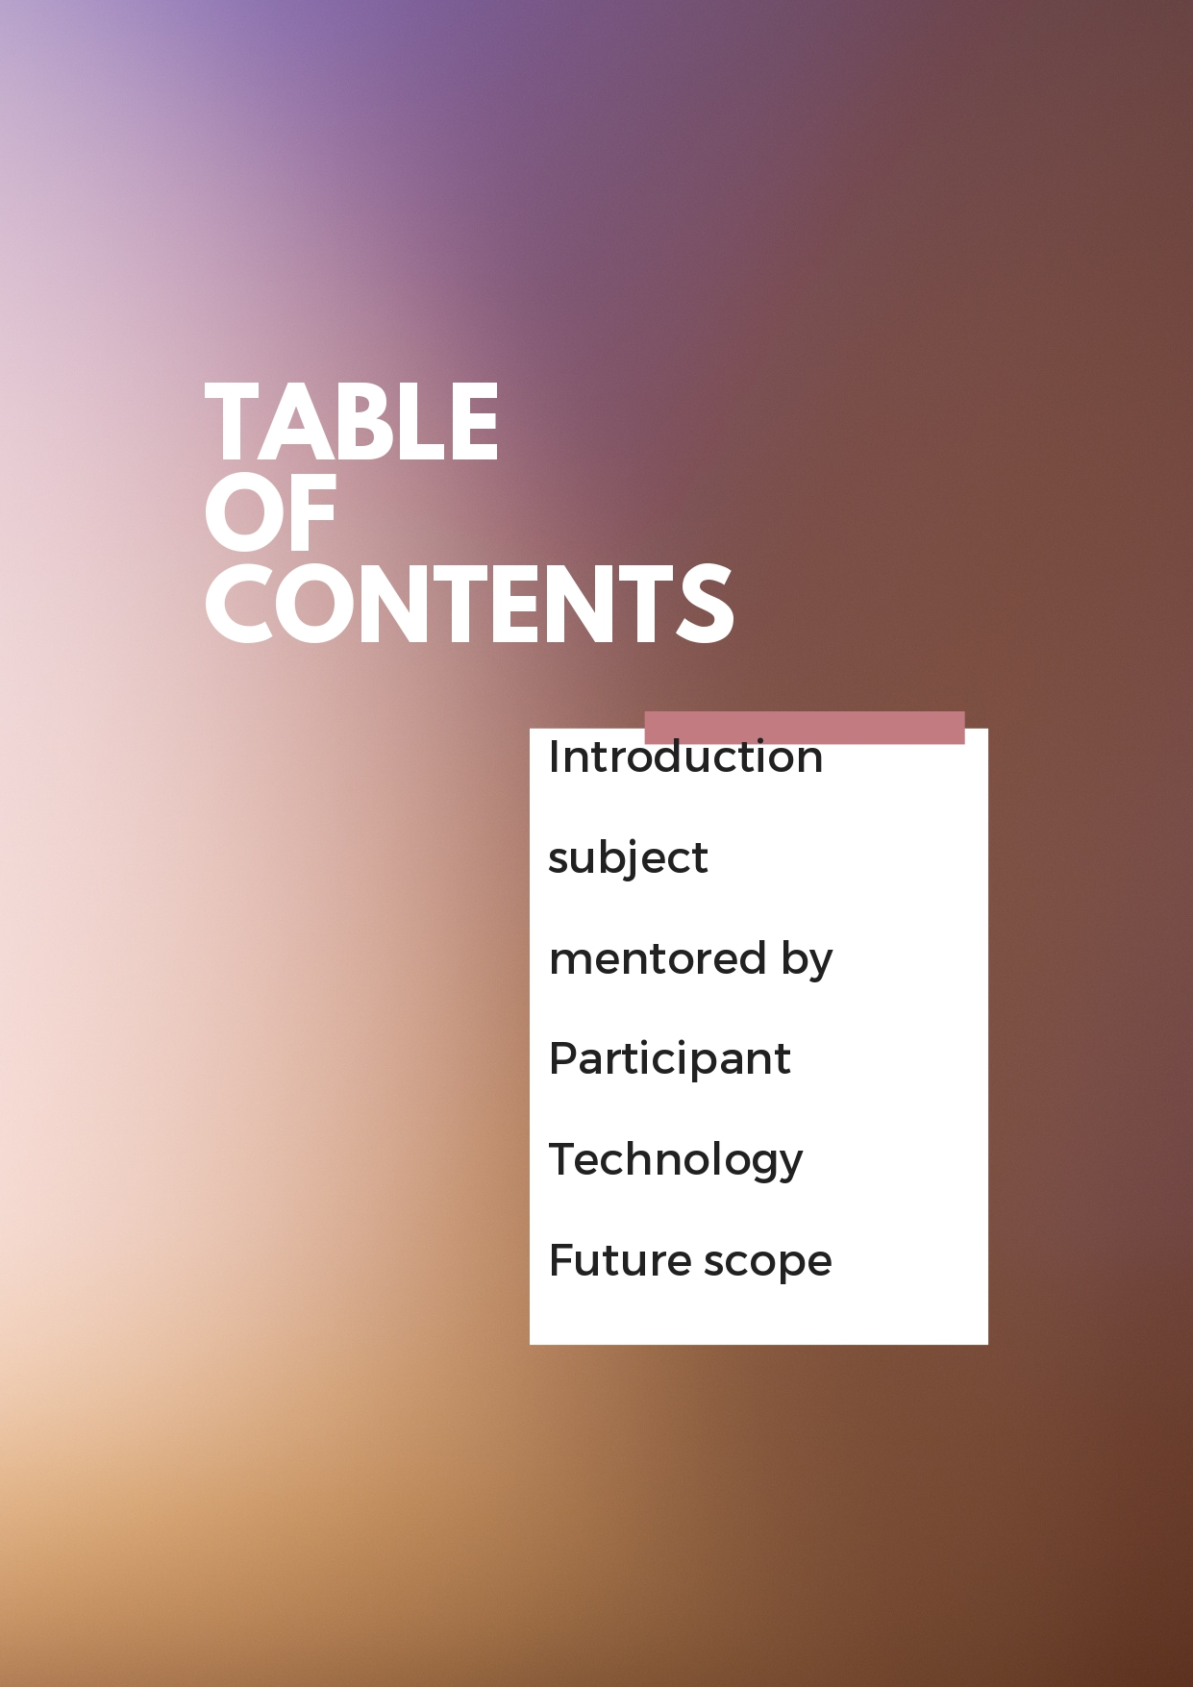

Slide 3
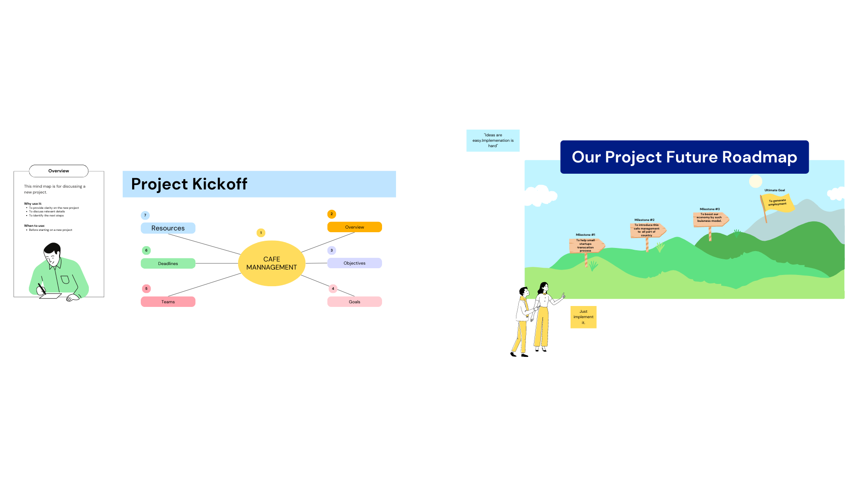
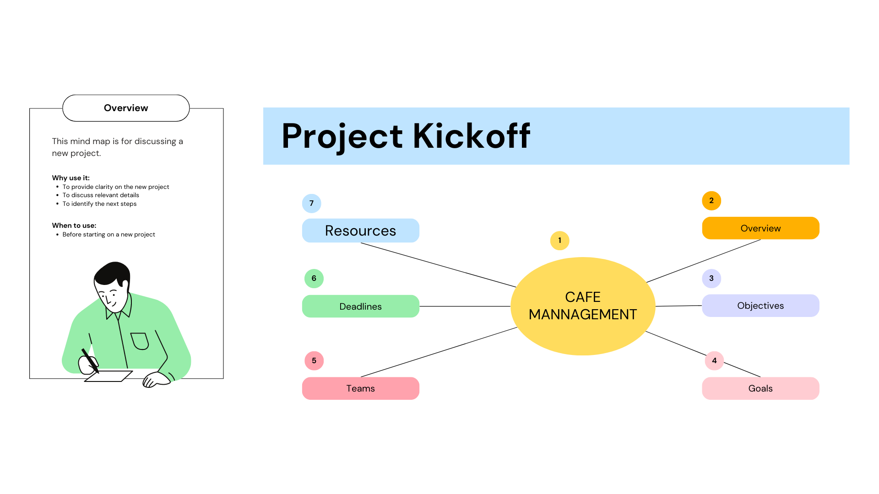
INTRODUCTION TO PROJECT

Slide 4
Description of project- This project mainly run on simple code.This can be handled by single person.

Slide 5
Description
This project will help many small scale startup to take their startup in online mode.
This project have data of many customer
So it will help us to reach them easily.
This project will run on simple code
So it is affordable for us to manage.

Slide 6
INTRODUCTION TO PYTHON
What is Python??
Python is a high-level object-oriented programming language that was created by Guido van Rossum. It is also called general-purpose programming language as it is used in almost every domain we can think of as mentioned below:
Web Development
Software Development
Game Development
AI & ML
Data Analytics
Python data types
Python data types are divided in two categories, mutable data types and immutable data types.
Immutable Data types in Python 1. Numeric 2. String 3. Tuple
Mutable Data types in Python 1. List 2. Dictionary 3. Set
1. Numeric Data Type in Python
Integer – In Python 3, there is no upper bound on the integer number which means we can have the value as large as our system memory allows.
.

Slide 7
INTRODUCTION TO PYTHON
Float – Values with decimal points are the float values, there is no need to specify the data type in Python. It is automatically inferred based on the value we are assigning to a variable. For example here fnum is a float data type.
2. Python Data Type – String
String is a sequence of characters in Python. The data type of String in Python is called “str”.
Strings in Python are either enclosed with single quotes or double quotes. In the following example we have demonstrated two strings one with the double quotes and other string s2 with the single quotes. To read more about strings, refer this article: Python Strings.
3. Python Data Type – Tuple
Tuple is immutable data type in Python which means it cannot be changed. It is an ordered collection of elements enclosed in round brackets and separated by commas. To read more about tuple, refer this tutorial: Python tuple.
4. Python Data Type – List
List is similar to tuple, it is also an ordered collection of elements, however list is a mutable data type which means it can be changed unlike tuple which is an immutable data type.
5. Python Data Type – Dictionary
Dictionary is a collection of key and value pairs. A dictionary doesn’t allow duplicate keys but the values can be duplicate. It is an ordered, indexed and mutable collection of elements. To read more about it refer: Python dictionary.
6. Python Data Type – Set
A set is an unordered and unindexed collection of items. This means when we print the elements of a set they will appear in the random order and we cannot access the elements of set based on indexes because it is unindexed.

Slide 8
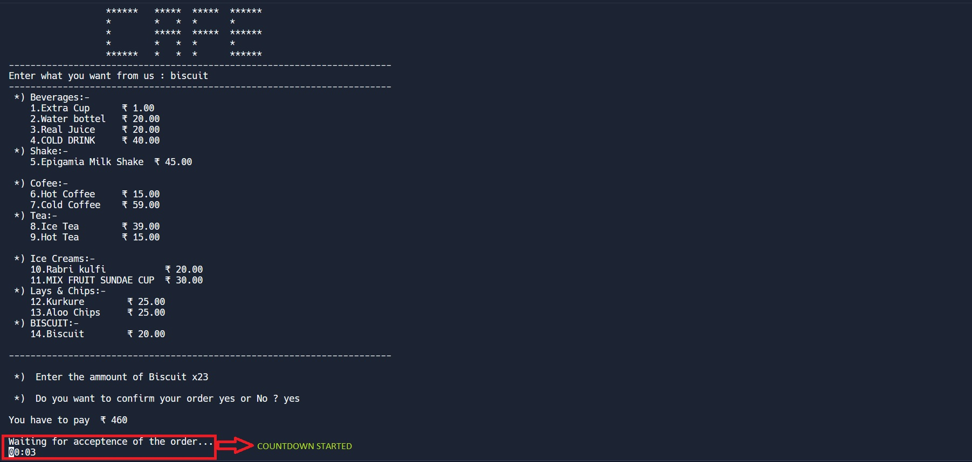
SCREERN SHOT

Slide 9
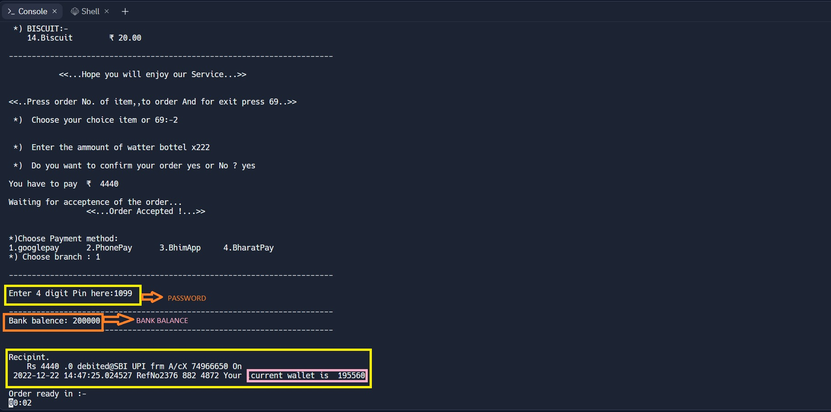
SCREENSHOT

Slide 10
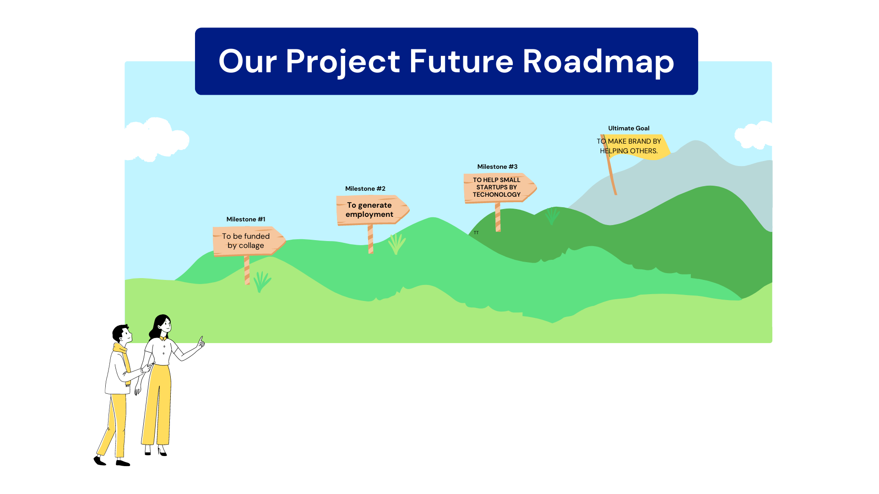
FUTURE SCOPE
THANK YOU

Slide 11
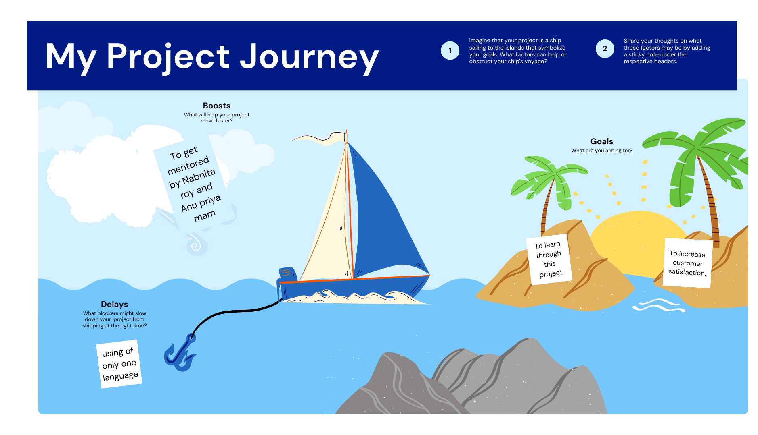
CONCLUSION

