Slide 1
C Programming

Slide 2
Why
C?

Slide 3
If the person had learned driving on a manual car,
he could have easily driven the automatic car as well.
Similarly, if a person learns C programming first,
it will help him to learn
any modern programming language as well.

Slide 4
What is C?

Slide 5
What is C?
C is a general purpose programming language and was originally developed by Dennis Ritchie.
C takes a middle path between low-level assembly language and a high-level programming language like Java.
C is not object oriented.
C has only 32 keywords or instruction set.

Slide 6
Application Areas Of C
Desktop Application Development
Embedded System And Robotics
PLC Programming For Industrial Automation
Games Development
Drivers Development
Operating System Development
Antivirus Development

Slide 7
Prerequisites For C
C Compiler
Execution scenario of a C program
C Keywords
Header Files
Variables
Steps to develop a C program
Program structure

Slide 8
Compiler
Compiler is a type of translator which converts the source code to machine code. TurboC,
Dev C++, Borland C are some popular compilers for C programming language.

Slide 9
Execution Scenario Of C Program
Compile
Execute
Source
Code
Machine
Code
Output

Slide 10
C Keywords
Keywords are reserved words. Meaning of keywords is pre-defined into compiler. In C
Programming Language there are 32 keywords.

Slide 11
C Keywords
int | If | Do | Struct
float | else | While | Union
char | Switch | For | Sizeof
double | Case | Const | enum
long | Break | Static | Typedef
short | Default | Auto | Void
signed | Goto | Register | Return
unsigned | Continue | Extern | Volatile

Slide 12
Header Files
The header files are those files which contain built-in functions. E.g. stdio.h, conio.h, math.h, string.h, dos.h, process.h, stdlib.h….etc. We can use header file functions directly.

Slide 13
Variables
Variables:- The Variables are value container they create space in memory.
Syntax:-
datatype variablename;
E.g.
int a;
float b;
char c;

Slide 14
Steps To Create A Basic C Program
Think how many variables are required initially?
Declare those variables with suitable data types.
Take input from user if required.
Apply mathematical or logical operation to calculate output.
Display the output.

Slide 15
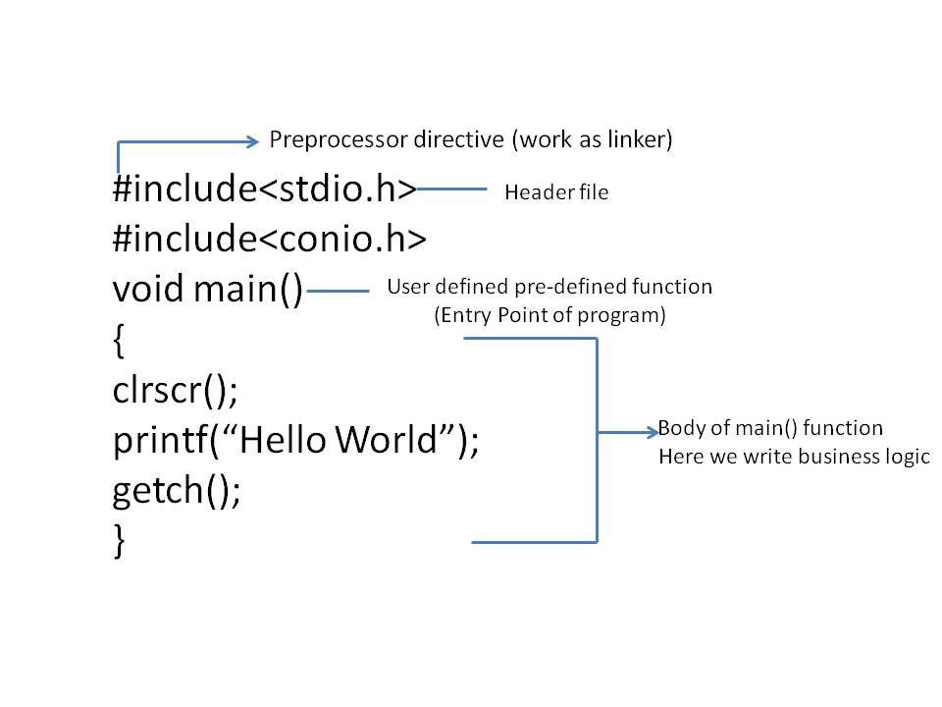
Program Structure

Slide 16
Format Specifiers
Data Type | Format Specifier | Memory Required
Int | %d | 2 bytes
Float | %f | 4 bytes
Char | %c | 1 byte
Double | %lf | 8 bytes
long int | %ld | 4 bytes
long float | %lf | 8 bytes

Slide 17
LET’S START OUR
JOURNEY
WITH C !!!!

