Slide 1
Web Mapping
Using OpenLayers
PS Singh Scientist/Engineer-SE

Slide 2
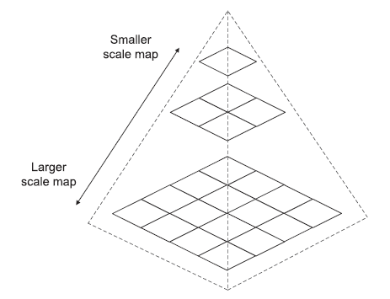
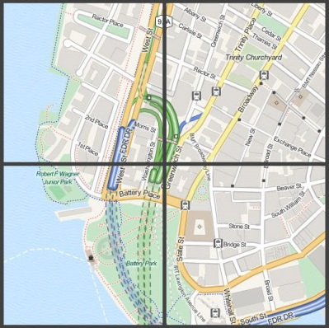
Definition of a Web Mapping
Initial Attempts on web mapping:
Mapserver and
ArcIMS
The two matrices on which dynamically drawn web maps have challenges are:
Speed and
Scalability (the ability to handle many simultaneous users/adapt or extend application based on future requirements).
Example Solution: Tiling and Caching using Asynchronous JavaScript and XML (AJAX)
Pyramid Tiles
Tiles from OpenStreetMap data, rendered by MapQuest
Presently most of the webmaping scenarios are based on the concept of Web Service

Slide 3
Definition of a web services
A web service as a focused task that a specialized computer (the server) knows how to do and allows other computers to invoke.
You work with the web service like this:
You invoke the web service by making a request from an application (the client). To make this request, you use HTTP, a standard protocol that web browsers use for communicating between clients and servers. The request contains structured pieces of information called parameters. These give specific instructions about how the task should be executed.
The server reads the request and runs its web service code, considering all the parameters while doing so. This produces a response, which is usually a string of information or an image.
The server sends you the response, and your application uses it.

Slide 4
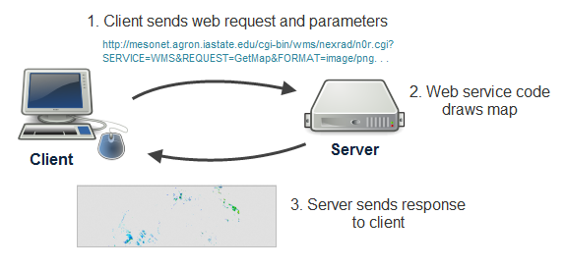
Sample web services Request
NEDRP Layers on ISRO Bhuvan Portal : https://bhuvan-app1.nrsc.gov.in/state/AS
http://mesonet.agron.iastate.edu/cgi-bin/wms/nexrad/n0r.cgi?SERVICE=WMS&REQUEST=GetMap&FORMAT=image/png&TRANSPARENT=TRUE&STYLES=&VERSION=1.3.0&LAYERS=nexrad-n0r&WIDTH=877&HEIGHT=276&CRS=EPSG:900913&BBOX=-15252263.28954773,2902486.4758432545,-6671748.242369267,5602853.811101243

Slide 5
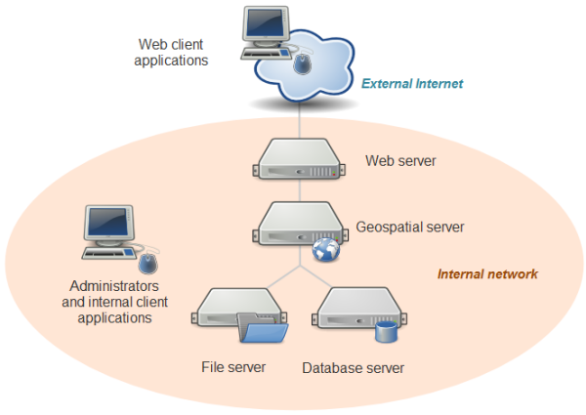
System architecture for web mapping

Slide 6
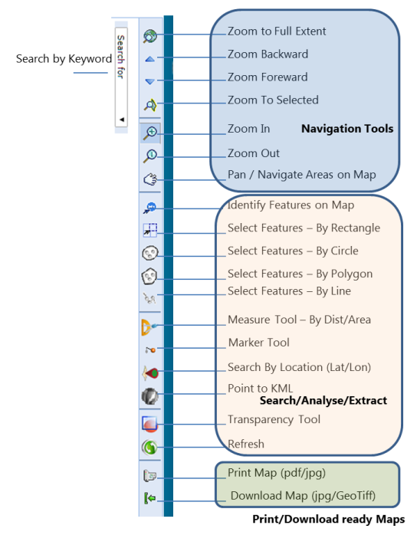
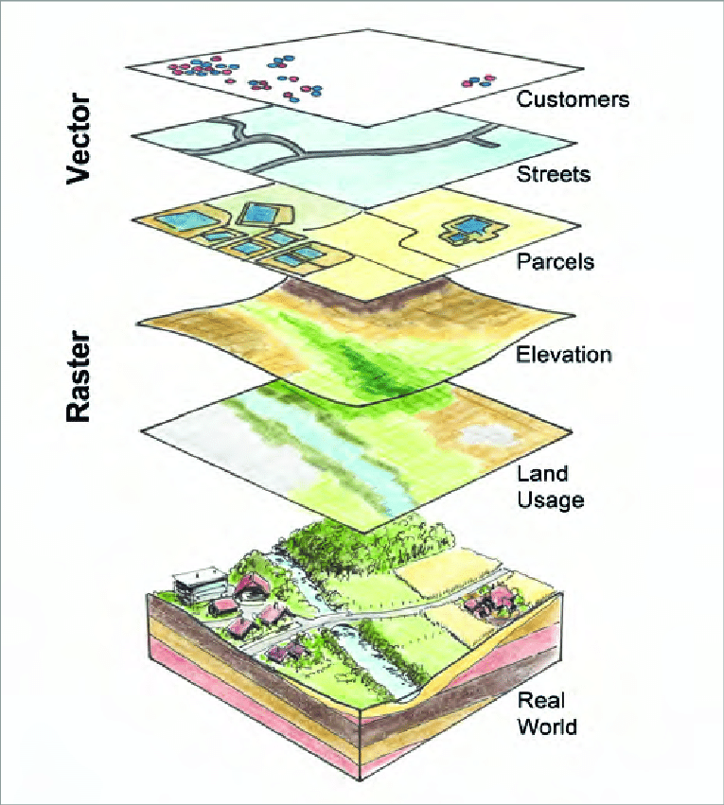
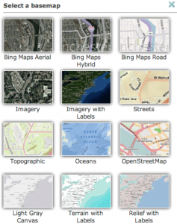
Basic Elements of a web map
Basemaps
Thematic layers
Interactive elements
The Basemaps
The Thematic Layers
The Interactive Elements
The background setting for a map that provide background detail necessary to orient the location of the map. Basemaps also add to the aesthetic appeal of a map
A GIS is a collection of geographic data presented as thematic layers on a map
Dynamic Visualize, Interact, Analyse, Extract and Export Map Info

Slide 7

Basic Requirement Before Learning WebMapping
Familiarity with HTML, CSS & Javascript
It is expected that you apply this familiarity to understanding the JavaScript syntax for
loops,
functions,
decision structures, and so forth.

Slide 8
Objectives of this Hands-On Tutorial
Identify commonly-used web mapping APIs (both proprietary and FOSS) and recognize programming patterns that are common to each.
Choose developer examples that relate to your web mapping task and adjust the code to meet the needs of your own application.
Use OpenLayers to create a mashup from a tiled basemap and a WMS thematic layer.
Create informational popups for your web map features using OpenLayers.

Slide 9
What is a web mapping API?
An API (Application Program Interface) is a framework that you can use to write a program.
It provides a set of classes and functions that help you avoid writing all the low-level code to perform specific actions.
For example, web mapping APIs typically include classes for maps and layers so that you don't have to write all the low-level code for displaying an interactive map image and drawing a new layer on it.
Instead, you can just create a new map object, create a new layer object, and call some method such as map.addLayer(layer).
APIs designed specifically for the purpose of making web maps include
OpenLayers,
Leaflet,
Google Maps API, and
ArcGIS API for JavaScript.

Slide 10
Examples of Open Source web mapping APIs
FOSS Based web mapping APIs for building browser-based apps with HTML and JavaScript.
OpenLayers :
Most Matured with extensive documentation and samples
Leaflet:
Light Weight and Mobile Friendliness
D3:
Web app with interactive maps and charts
Polymaps:
Mashing up map tiles with vector features drawn from GeoJSON and other sources.
ModestMaps
Lightweight FOSS API for displaying tiled maps

Slide 11
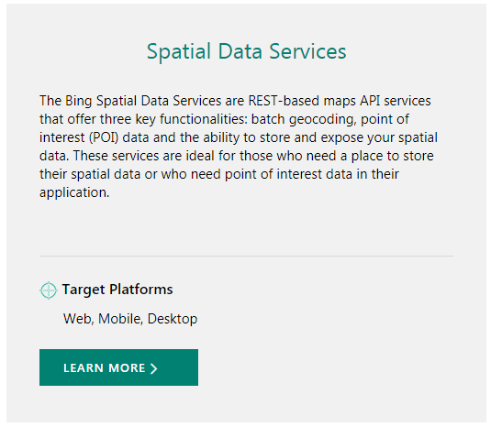
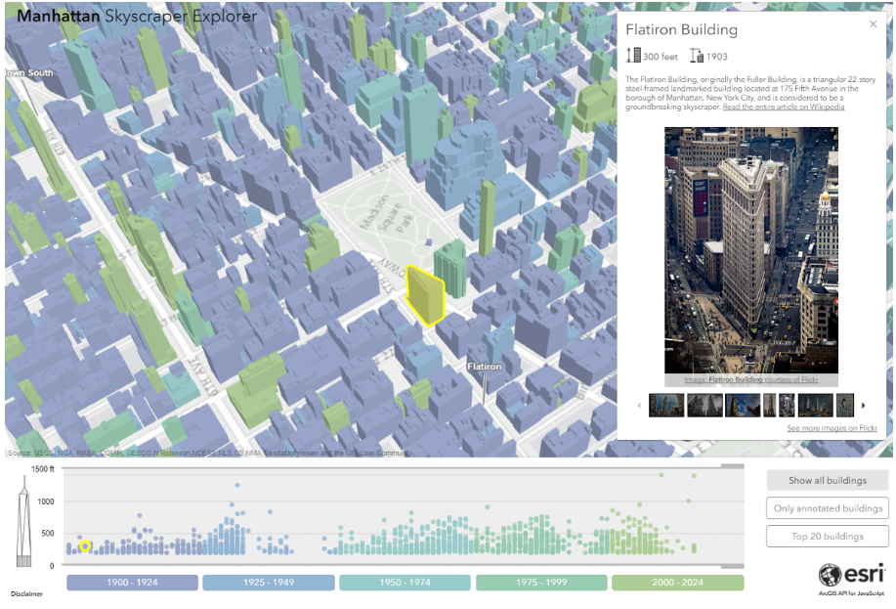
Examples of proprietary web mapping APIs
Google Maps and Bing Maps APIs
ArcGIS APIs
Yahoo Map API's

Slide 12
What is OpenLayers?
OpenLayers is a library for building mapping applications in a browser
An API for building web map applications
Pure client-side JavaScript
Web 2.0 and AJAX compliant – Interoperable & Fast/Responsive
Supports open standards.
BSD licensed
(implies minimum restriction on redistribution) (Berkeley Software Distribution)
OpenLayers History
OpenLayers appeared in the middle of 2006 as an open source alternative to Google Maps and other proprietary API providers, but it started gaining more attention in 2007, when the growing OpenStreetMap project adopted it for its website. Latest version : v5.3.0

Slide 13
Programming patterns with web mapping APIs
Nearly all pages that use web mapping APIs include the following:
1. References to JavaScript files and stylesheets
<script src="http://cdnjs.cloudflare.com/ajax/libs/openlayers/2.12/OpenLayers.js"></script>
<link rel="stylesheet“ href="http://cdnjs.cloudflare.com/ajax/libs/openlayers/2.12/theme/default/style.css" type="text/css">
2. The map div and object
<div id="map"></div>
Elsewhere in your page, in your JavaScript code, you can create an OpenLayers.Map object and relate it to the html div.
The OpenLayers.Map constructor takes the div name as an argument.
<script>
var myMap;
myMap = new OpenLayers.Map("map");
</script>

Slide 14
Components of OpenLayers

Slide 15
OpenLayers: Data Source Support
OGC WMS
OGC WFS
GeoRSS
CSV
ka-Map
WorldWind
Canvas
WebGL
Google Maps
MSN Virtual Earth
Yahoo! Maps
Multimap

Slide 16
Making our first map
The process for creating a map with OpenLayers requires, at a minimum, the following things: 
Including the OpenLayers library files
Creating an HTML element that the map will appear in 
Creating a map object from the Map class 
Creating a layer object from a Layer class 
Adding the layer to the map 
Defining the map's extent (setting the area the map will initially be displaying)

Slide 17
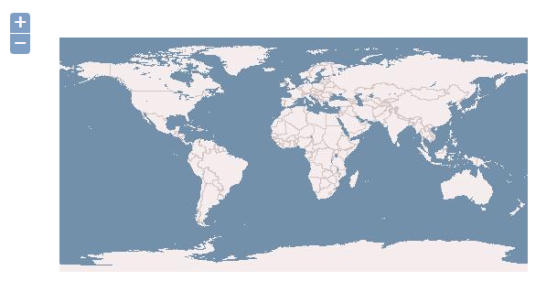
Making our first map
<!DOCTYPE html>
<html lang='en'>
<head>
<meta charset='utf-8' />
<title>My OpenLayers Map</title>
<script type='text/javascript' src='https://cdnjs.cloudflare.com/ajax/libs/openlayers/2.13.1/OpenLayers.js'></script>
<script type='text/javascript'>
var map;
function init() {
map = new OpenLayers.Map('map_element', {});
var wms = new OpenLayers.Layer.WMS(
'OpenLayers WMS',
'http://vmap0.tiles.osgeo.org/wms/vmap0',
{layers: 'basic'},
{}
);
map.addLayer(wms);
if(!map.getCenter()){
map.zoomToMaxExtent();
}
}
</script>
</head>
<body onload='init();'>
<div id='map_element' style='width: 1000px; height: 500px;'>
</div>
</body>
</html>
Output

Slide 18
Making our first map
1. Including the OpenLayers library files:
Line [6]
<script type='text/javascript' src='OpenLayers.js'></script>
2. Creating an HTML element for our map:
Lines [30] and [31]
<div id='map_element' style='width: 500px; height: 500px'>
</div>
3. Creating a map object from the Map class:
Line [12]
map = new OpenLayers.Map('map_element', { });
4. Creating a layer object from a Layer class:
Lines [13] to [18]
var wms_layer = new OpenLayers.Layer.WMS(
'WMS Layer Title',
'http://vmap0.tiles.osgeo.org/wms/vmap0',
{layers: 'basic'},
{}
);
5. Adding the layer to the map:
Line [20]
map.addLayer(wms_layer);
6. Defining the map's extent:
Lines [21] to [23]
if(!map.getCenter()){
map.zoomToMaxExtent();
}

Slide 19
OpenLayers Code : Adding our layers
<html>
<head>
<title>My Map</title>
<script src="https://cdnjs.cloudflare.com/ajax/libs/openlayers/2.13.1/OpenLayers.js"></script>
<link rel="stylesheet" href="https://cdnjs.cloudflare.com/ajax/libs/openlayers/2.13.1/theme/default/style.css" type="text/css">
</head>
<body>
<h1>My Map</h1>
<div id="map-id"></div>
<script>
var bounds = new OpenLayers.Bounds(89.701,24.135,96.021,27.977);
var map = new OpenLayers.Map("map-id");
var imagery = new OpenLayers.Layer.WMS("Wastelands","https://bhuvan-vec2.nrsc.gov.in/bhuvan/wms", {layers: "wasteland:AS_WL50K_0809", format: "image/png"});
map.addLayer(imagery);
map.zoomToExtent(bounds);
</script>
</body>
</html>
Task 1 : Create an html page (use Notepad/Notepad++). Insert these code and open it using a web browser

Slide 20
Ingredients of a map in OpenLayers
In OpenLayers, a map is a collection of layers and various controls for dealing with user interaction.
A map is generated with three basic ingredients:
markup
style declarations
initialization code
Map Markup
The markup for the map in the previous example generates a single document element:
<div id="map-id"></div>
This <div> element will serve as the container for our map viewport.
Here we use a <div> element, but the container for the viewport can be any block-level element. In this case, we give the container an id attribute so we can reference it easily elsewhere.

Slide 21
Ingredients of a map in OpenLayers
Map Style
OpenLayers comes with a default stylesheet that specifies how map-related elements should be styled.
We’ve explicitly included this stylesheet in the first.html page (<link rel="stylesheet“ href="openlayers/theme/default/style.css" type="text/css">).
OpenLayers doesn’t make any guesses about the size of your map. Because of this, following the default stylesheet, we need to include at least one custom style declaration to give the map some room on the page.
<link rel="stylesheet" href="OpenLayers-2.13.1/theme/default/style.css" type="text/css">
<style> #map-id { width: 512px; height: 256px; } </style>

Slide 22
Ingredients of a map in OpenLayers
Map Initialization
The next step in generating your map is to include some initialization code. In our case, we have included a <script> element at the bottom of our document <body> to do the work:
<script>
var bounds = new OpenLayers.Bounds(68.1061,6.7604,97.4152,37.0783);
var map = new OpenLayers.Map("map-id");
var imagery = new OpenLayers.Layer.WMS("Global Imagery","http://bhuvan3.nrsc.gov.in/cgi-bin/bhuvan_satdata.exe", {layers: "Bhuvan_satellite", format: "image/jpeg"}); map.addLayer(imagery);
map.zoomToExtent(bounds);
</script>
Note: The OpenLayers.Layer.WMS constructor requires 3 arguments and an optional fourth.

Slide 23
OSM in OpenLayers
<html>
<head>
<title>My NE Map</title>
<script src="https://cdnjs.cloudflare.com/ajax/libs/openlayers/2.13.1/OpenLayers.js"></script>
<link rel="stylesheet" href="https://cdnjs.cloudflare.com/ajax/libs/openlayers/2.13.1/theme/default/style.css" type="text/css">
</head>
<body>
<h1>My Map</h1>
<div id="map-id"></div>
<script>
var center = new OpenLayers.LonLat(94.0441, 25.3408).transform('EPSG:4326', 'EPSG:3857');
var map = new OpenLayers.Map("map-id", {projection: 'EPSG:3857'});
var osm = new OpenLayers.Layer.OSM();
map.addLayer(osm);
map.setCenter(center, 9);
</script> </body> </html>
Task 2 : Create second html page and repeat as before

Slide 24
Bing Map in OpenLayers
Proprietary Layers
<html>
<head>
<title>My Map</title>
<script src="https://cdnjs.cloudflare.com/ajax/libs/openlayers/2.13.1/OpenLayers.js"></script>
<link rel="stylesheet" href="https://cdnjs.cloudflare.com/ajax/libs/openlayers/2.13.1/theme/default/style.css" type="text/css">
</head>
<body>
<h1>My Map</h1>
<div id="map-id"></div>
<script>
var center = new OpenLayers.LonLat(94.0441, 25.3408).transform('EPSG:4326', 'EPSG:3857');
var map = new OpenLayers.Map("map-id", {projection: 'EPSG:3857'});
var osm = new OpenLayers.Layer.OSM(); map.addLayer(osm);
var bing = new OpenLayers.Layer.Bing({key: "cIOrzqir2awTVsM9SjjW~T8BBXo4E_enRaCFUdXvsGg~ArMNRFEJHx4LuNlhBbaGxzdY7zKQIJda7N4iyTrVWObFpYQk6saPPV-CDoF8PcLh",type: "Road",});
map.addLayer(bing);
map.addControl(new OpenLayers.Control.LayerSwitcher());
map.setCenter(center, 9)
</script>
</body>
</html>
Adding Control to Map
Task 3 : Using Bingmap on your application and adding controls

Slide 25
Working With Controls
Task 4: Creating an Overview Map
<html>
<head>
<title>My Map</title>
<script src="https://cdnjs.cloudflare.com/ajax/libs/openlayers/2.13.1/OpenLayers.js"></script>
<link rel="stylesheet" href="https://cdnjs.cloudflare.com/ajax/libs/openlayers/2.13.1/theme/default/style.css" type="text/css">
</head>
<body>
<h1>My Map</h1>
<div id="map-id"></div>
<script>
var bounds = new OpenLayers.Bounds(68.1061,6.7604,97.4152,37.0783).transform('EPSG:4326', 'EPSG:3857');
var center = new OpenLayers.LonLat(91.882754, 25.576002).transform('EPSG:4326', 'EPSG:3857');
var map = new OpenLayers.Map("map-id", {projection: new OpenLayers.Projection("EPSG:3857"), maxResolution: 0.0005, numZoomLevels: 5});
var osm = new OpenLayers.Layer.OSM();
var overview = new OpenLayers.Control.OverviewMap({mapOptions: { projection: new OpenLayers.Projection("EPSG:4326"), maxResolution: 0.0015, numZoomLevels: 5 } }); map.addControl(overview);
map.addLayer(osm);
map.zoomToExtent(bounds);
map.setCenter(center,17);
</script>
</body>
</html>

Slide 26
Working With Controls
Creating a ScaleLine Control
var scaleline = new OpenLayers.Control.ScaleLine(); map.addControl(scaleline);
Editing Toolbar
var map = new OpenLayers.Map("map-id", {projection: 'EPSG:3857'});
var osm = new OpenLayers.Layer.OSM();
map.addControl(new OpenLayers.Control.EditingToolbar(osm));
map.addLayer(osm);

Slide 27
Overlay Example
<html>
<head>
<title>Assam Map</title>
<link rel="stylesheet"href="http://dev.openlayers.org/theme/default/style.css">
<style>#map-id { width: 100%; height:100%; } </style>
<script src="http://dev.openlayers.org/OpenLayers.js"type="text/javascript"> </script>
</head>
<body>
<h1>Land Use Map</h1>
<div id="map-id"></div>
<script>
var bounds =new OpenLayers.Bounds(87.577066, 20.400794, 97.863033, 29.773545);
var map =new OpenLayers.Map("map-id");
var imagery =new OpenLayers.Layer.WMS("Bhuvan Base","https://bhuvan-ras2.nrsc.gov.in/tilecache/tilecache.py",{layers:"bhuvan_img",format:"image/png"},{isBaseLayer: true, transparent: true, singleTile: false, visibility: true},{projection:'EPSG:4326'});
var assam = new OpenLayers.Layer.WMS("Assam Land Use","https://bhuvan-vec2.nrsc.gov.in/bhuvan/wms",{layers:"lulc:AS_LULC50K_1112",format:"image/png"},{isBaseLayer: false, opacity: 0.5, singleTile: true, visibility: false},{projection:'EPSG:4326'});
var megh = new OpenLayers.Layer.WMS("Megh Land Use","https://bhuvan-vec2.nrsc.gov.in/bhuvan/wms",{layers:"lulc:ML_LULC50K_1112",format:"image/png"},{isBaseLayer: false, opacity: 0.5, singleTile: true, visibility: false},{projection:'EPSG:4326'});
map.addLayers([assam, megh,imagery]); //map.addLayer(imagery);
map.zoomToExtent(bounds);
map.addControl(new OpenLayers.Control.LayerSwitcher());
var scaleline=new OpenLayers.Control.ScaleLine();
map.addControl(scaleline);
map.addControl(new OpenLayers.Control.EditingToolbar(map));
</script>
</body>
</html>
Adding Bhuvan Satellite imagery as Base Map and overlayed with Thematic layers

Slide 28
OSM in OpenLayers
Exercise
Review the OSM layer API documentation to how to load other OSM layers
Modify your layer initialization according
Hint:
You can go to the official OSM site to view the layers available, change to any of them and use the browser tools to look for the url pattern of those tiles.

Slide 29
Leaflet Example
<html>
<head>
<link rel="stylesheet" href="https://unpkg.com/leaflet@1.4.0/dist/leaflet.css" integrity="sha512-puBpdR0798OZvTTbP4A8Ix/l+A4dHDD0DGqYW6RQ+9jxkRFclaxxQb/SJAWZfWAkuyeQUytO7+7N4QKrDh+drA==" crossorigin=""/>
<script src="https://unpkg.com/leaflet@1.4.0/dist/leaflet.js" integrity="sha512-QVftwZFqvtRNi0ZyCtsznlKSWOStnDORoefr1enyq5mVL4tmKB3S/EnC3rRJcxCPavG10IcrVGSmPh6Qw5lwrg==" crossorigin=""></script>
</head>
<style>#mapid
{
width: 100%;
height:100%;
}
</style>
<body>
<div id="mapid"></div>
<script>
var mymap = L.map('mapid',{zoom: 3});
var wmsLayer = L.tileLayer.wms('https://bhuvan-vec2.nrsc.gov.in/bhuvan/wms', {
layers: 'lulc:MN_LULC50K_1112',
transparent: true,
maxZoom: 14,
minZoom: 0,
format:'image/png',
version: '1.1.1',
attribution: “NESAC”
}).addTo(mymap);
var corner1 = L.latLng(25.768523, 92.778660),corner2 = L.latLng(23.491038, 94.468081), bounds = L.latLngBounds(corner1, corner2);
mymap.fitBounds(bounds);
</script>
</body>
</html>

Slide 30
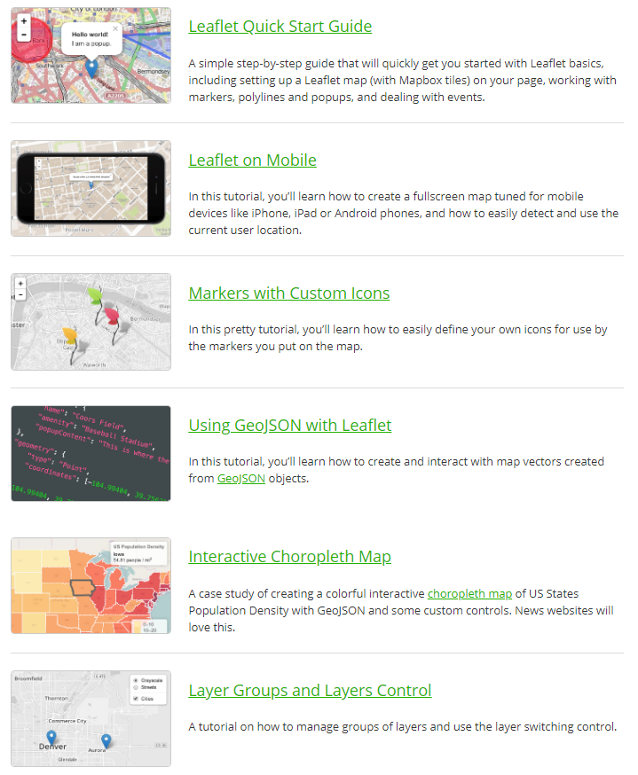
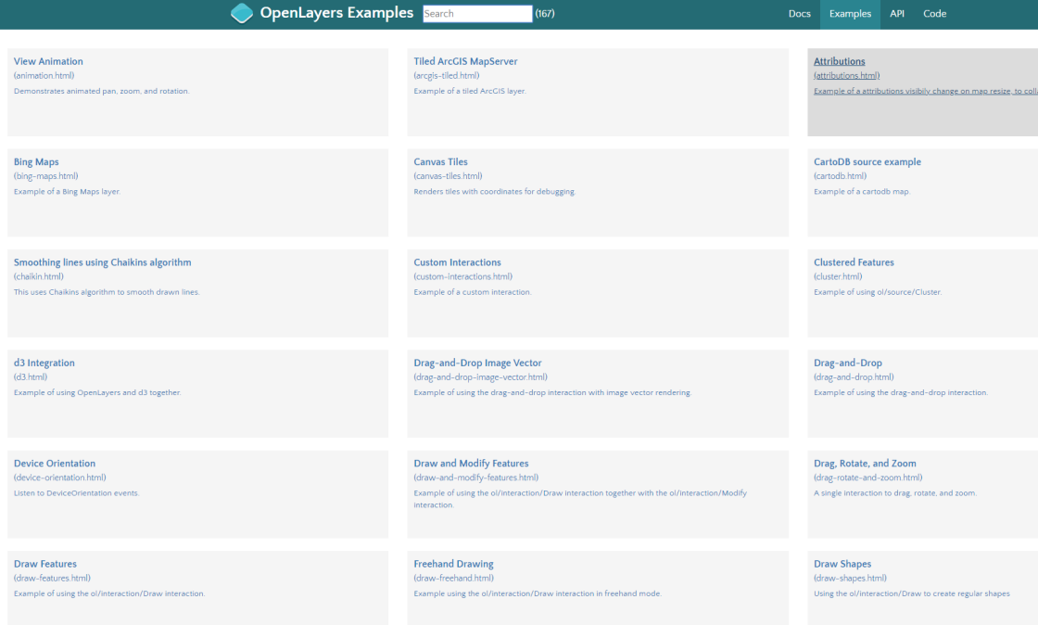
More OpenLayers / Leaflet Examples
https://leafletjs.com/examples.html
https://openlayers.org/en/latest/examples/

