Slide 1

Introduction to Open Source GIS Server
for Web Mapping – A Practical Approach
PS Singh
ss.puyam@nesac.gov.in

Slide 2
What you’ll be learning
Basic Understanding of OWS Servers
Installing and Setting Up GeoServer
Publishing of OGC service Using GeoServer
Understanding WMS service
Map Querying Using GeoServer CQL/ECQL
MapServer for Windows
Understanding Mapfile
Publishing of OGC service Using MapServer

Slide 3
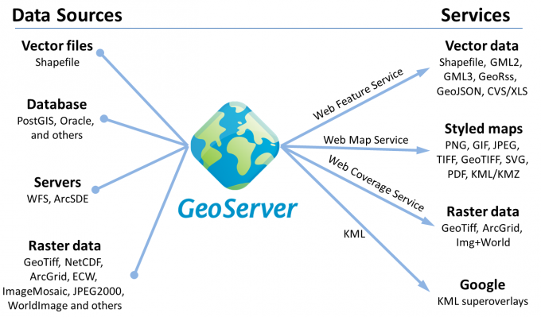
What is GeoServer? Why would You Use it?
GeoServer is an open source OWS server for sharing geospatial data
Server Side application publish and serves maps from any spatial data source using OGC open standards such as WMS, WFS, WPS, WCS, TMS, WMTS etc.
Excels at handling very large datasets, both raster and vector.
Produces high quality rendering of maps and can handle hundreds to thousands of map layers easily.

Slide 4
Walkthrough : Setting Up GeoServer

Slide 5
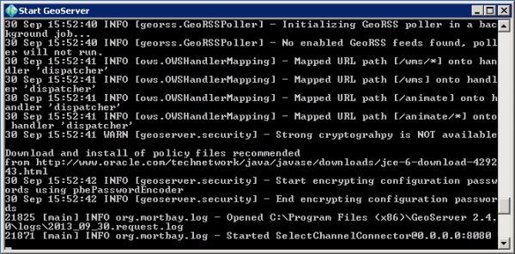
Setting Up GeoServer
Install the latest version of Java JRE
Download GeoServer and choose/download appropriate Version
Indicate the path of JRE subfolder. If you're using Windows, this is probably C:\Program Files (x86)\Java\jre8 or C:\Program Files (x86)\Java\jre1.8.x or something similar.
Once GeoServer is installed, start it by clicking Start > All Programs > GeoServer 2.x.x > Start GeoServer. You'll see a bunch of status messages appearing in a black and white console, like the following.
If you get a Windows Security Alert that Windows Firewall has blocked some features of the program, check the top box to allow it to run on private networks and click Allow access. Uncheck the bottom box, as public access will not be needed in this course.
Figure: Status messages during GeoServer startup.
Click Start > All Programs > GeoServer 2.14.0 > GeoServer Web Admin Page (or go to your browser and enter the address localhost:8080/geoserver/web).
This is a web page that you can use to administer GeoServer from this or any other computer in your network. GeoServer includes a servlet called Jetty, for serving web service and web page requests

Slide 6
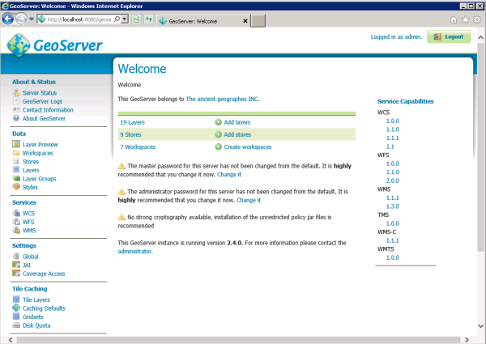
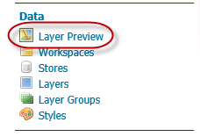
Setting Up GeoServer
Type a GeoServer username and password in the upper boxes and click Login. You may remember that the installation created an administrative user with the username admin and the password geoserver. You must use this the first time you log in. You will see a welcome page similar to the following
7. GeoServer works with the concept of layers and layer groups. You define a set of datasets that you want to have exposed on your server
8. In the left-hand menu, click Layer Preview.
Figure : Layer Preview
Figure: Geoserver startup webpage

Slide 7
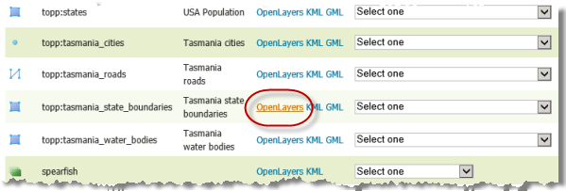
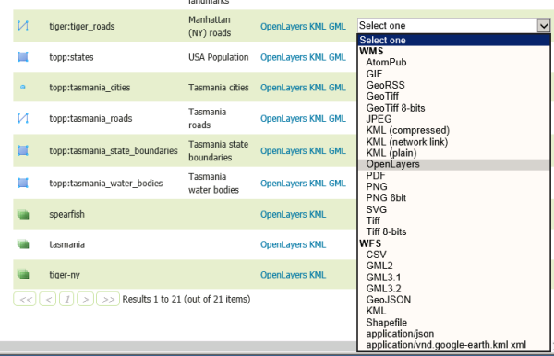
Setting Up GeoServer
9. Scroll down to the Tasmania state boundaries layer and click the OpenLayers link.
This displays your map as a web service that you can navigate. The web service was delivered through the Open Geospatial Consortium (OGC) Web Map Service (WMS) specification, an openly documented way of serving web maps. The map frame and navigation buttons were created through the OpenLayers JavaScript framework.
Figure : Find Tasmania in the list of layers
It's important to understand that you also could have done this by clicking the dropdown list and choosing WMS > OpenLayers. Looking at this list, you get a better idea of the many different output formats supported by GeoServer.
Figure : OpenLayers selection in GeoServer

Slide 8
Setting Up GeoServer
10. Close the map preview window and return to the GeoServer layer preview list. This time, click the KML link to get the layer as KML, and XML-based open specification for geographic data, often used by Google. If you have Google Earth installed, the layer should open there. If you don't have Google Earth, you can open the layer in Notepad and just examine the raw KML.
This confirms that, your GeoServer has been Set Up and Configured properly!

Slide 9
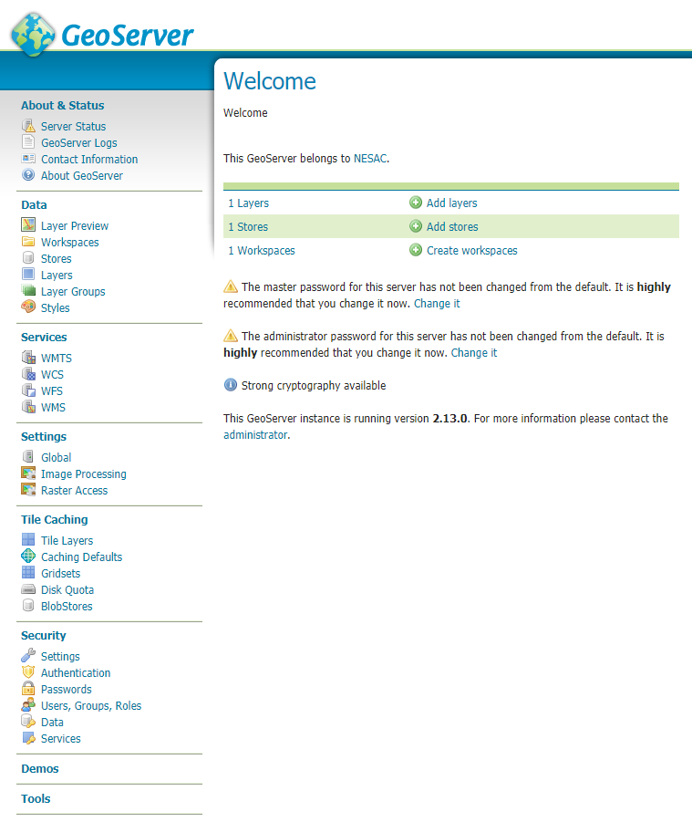
Understanding GeoServer : Web administration interface
The About & Status section provides access to GeoServer diagnostic and configuration tools, and can be particularly useful for debugging.
The Data management section contains configuration options for all the different data-related settings.
The Services section is for configuring the services published by GeoServer.
The Settings section contains configuration settings that apply to the entire server.
The Tile Caching section configures the embedded GeoWebCache.
The Security section configures the built-in security subsystem.
The Demos section contains links to example WMS, WCS, and WFS requests for GeoServer as well as a listing all SRS info known to GeoServer. In addition, there is a reprojection console for converting coordinates between spatial reference systems, and a request builder for WCS requests
The Tools section contains administrative tools. By default, the only tool is the Catalog Bulk Load Tool, which can bulk copy test data into the catalog.

Slide 10
Publishing Data in GeoServer

Slide 11
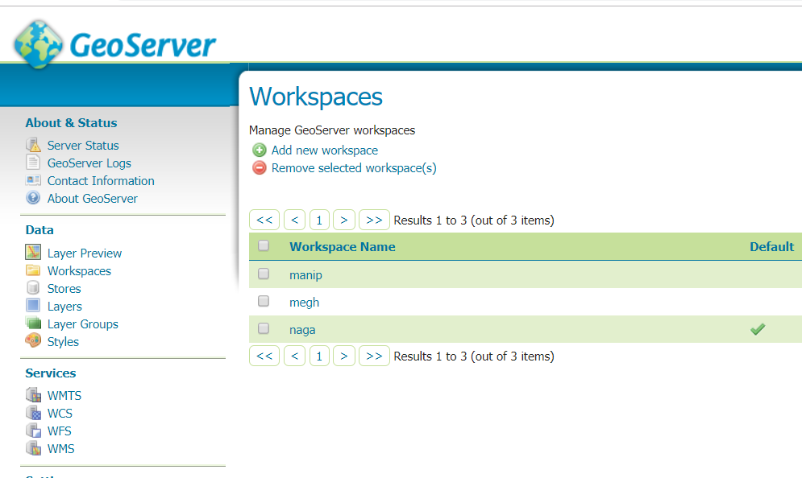
Publishing Data in GeoServer
Eg. Publishing a Shapefile
Move the shapefile directory, naga_data into <GEOSERVER_DATA_DIR>/data, where <GEOSERVER_DATA_DIR> is the root of the GeoServer data directory. If no changes have been made to the GeoServer file structure, the path is geoserver/data_dir/data/nagaland_data
Create a new workspace
In a web browser, navigate to http://localhost:8080/geoserver
Login and Navigate to Data ‣ Workspaces.
A workspace is often used to group similar layers together. Layers may be referred to by their workspace name, colon, layer name (for example naga:circle_boundary).

Slide 12
Publishing Data in GeoServer : Creating a Store
Create a Store under the workspace. The store tells GeoServer how to connect to the shapefile.
Navigate to Data‣Stores.
You should see a list of stores, including the type of store and the workspace that the store belongs to.
In order to add the shapefile, you need to create a new store. Click the Add new Store button. You will be redirected to a list of the data sources supported by GeoServer.
Click Shapefile. The New Vector Data Source page will display.
Begin by configuring the Basic Store Info.
Select the workspace naga from the drop down menu.
Enter the Data Source Name as Nag Boundary
Enter a brief Description (such as “Nagaland Circle Boundary”).
Under Connection Parameters, browse to the location URL of the shapefile, typically nagaland_data / Nag_Circle_UTM.shp.
Click Save. You will be redirected to the New Layer page in order to configure the Nag_Circle_UTM layer

Slide 13
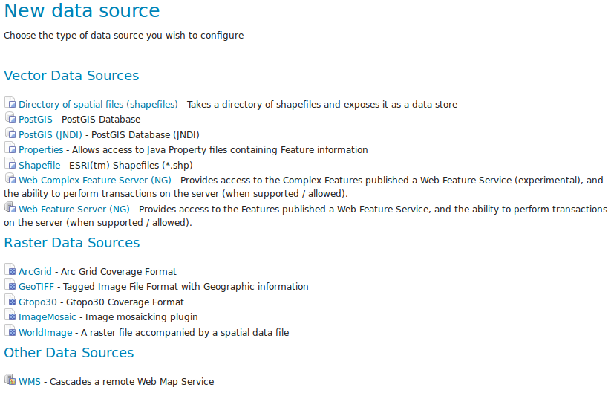
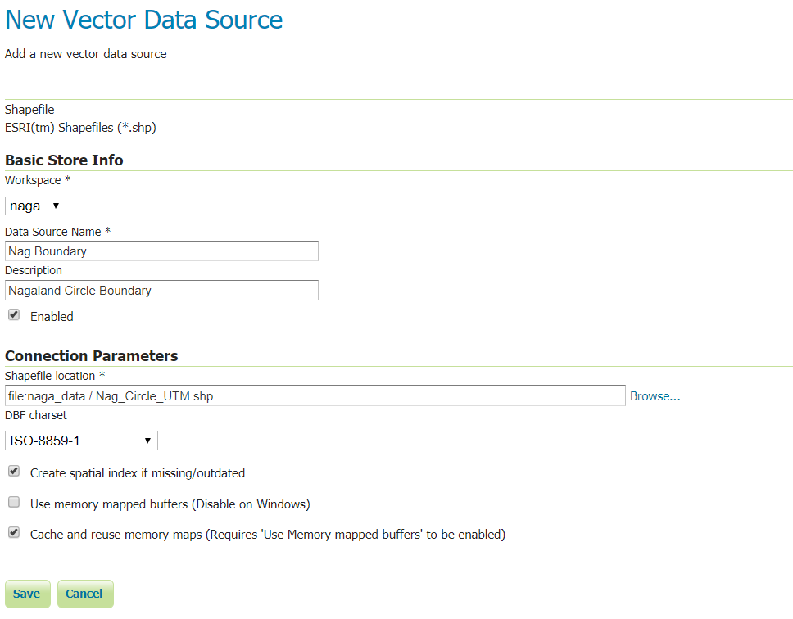
Publishing Data in GeoServer : Creating a Store
Data Stores
Basic Store Info and Connection Parameters

Slide 14
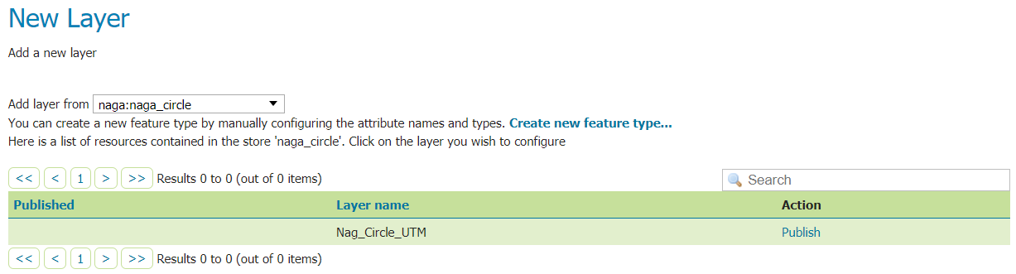
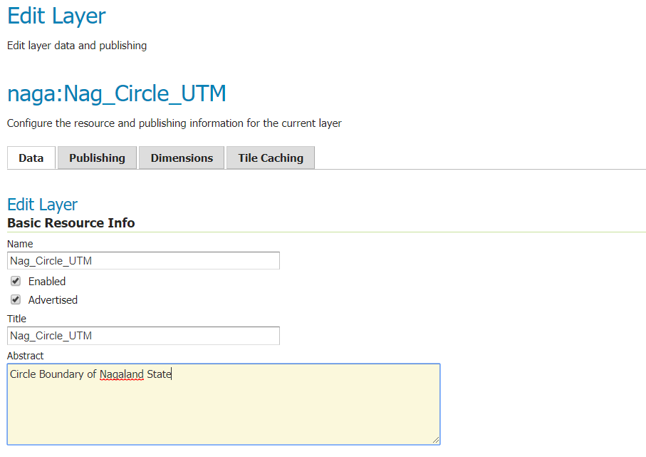
Publishing Data in GeoServer : Creating a Layer
1. On the New Layer page, click Publish beside the Nag_Circle_UTM layer name
New layer
2. The Edit Layer page defines the data and publishing parameters for a layer. Enter a short Title and an Abstract for the Nag_Circle_UTM layer.
Basic Resource Information

Slide 15
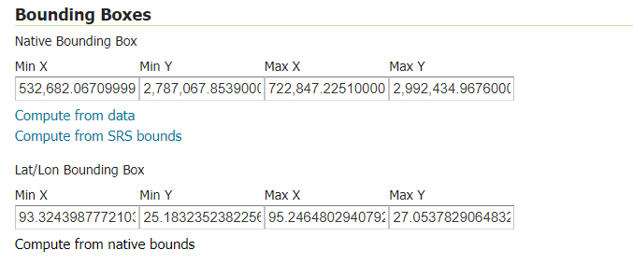
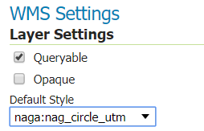
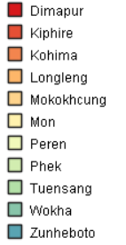
Publishing Data in GeoServer : Publishing a Layer
3. Generate the layer’s bounding boxes by clicking the Compute from data and then Compute from native bounds links
Generating bounding boxes
4. Click the Publishing tab at the top of the page.
5. We can set the layer’s style here. Under WMS Settings, ensure that the Default Style is set to line.
6. Finalize the layer configuration by scrolling to the bottom of the page and clicking Save.

Slide 16
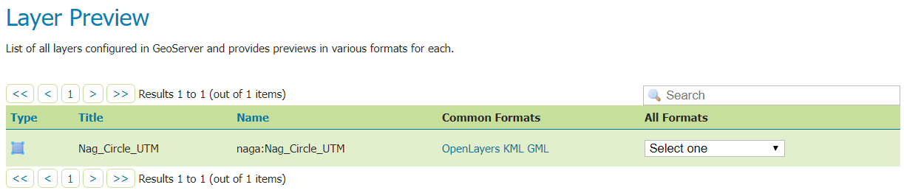
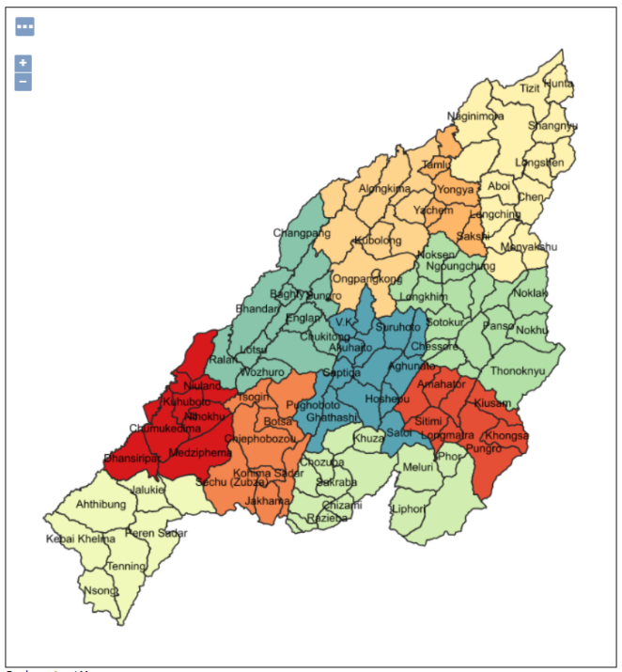
Publishing Data in GeoServer : Previewing a Layer
1. In order to verify that the Nag_Circle_UTM layer is published correctly, we can preview the layer.
Layer Preview
2. Click the OpenLayers link in the Common Formats column.
3. An OpenLayers map will load in a new tab and display the shapefile data with our custom style for the layer. You can use this preview map to zoom and pan around the dataset, as well as display the attributes of features.

Slide 17
Understanding a WMS Service

Slide 18
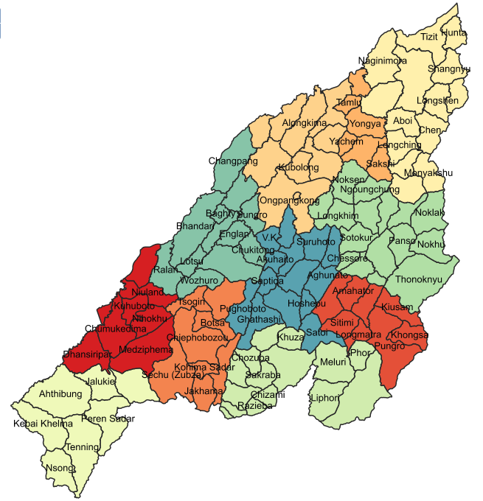
Understanding a WMS Service: ‘GetMap’ Request
The request
The following URL is a WMS 'GetMap' request:
http://localhost:8080/geoserver/naga/wms?service=WMS&version=1.1.0&request=GetMap&layers=naga:Nag_Circle_UTM&styles=&bbox=532682.0670999996,2787067.8539000005,722847.2251000003,2992434.9676000006&width=711&height=768&srs=EPSG:32646&format=image/png&TRANSPARENT=TRUE

Slide 19
Understanding a WMS Service: ‘GetMap’ Request
Breaking down the request
That big, long URL is actually made up of many small bits, separated by '&' characters. Here is the request, broken up so that each bit is on its own line, and with bits re-arranged so they flow better:
http://localhost:8080/geoserver/naga/wms?
service=WMS&
version=1.1.0&
request=GetMap&
layers=naga:Nag_Circle_UTM&
styles=&
bbox=532682.0670999996,2787067.8539000005,722847.2251000003,2992434.9676000006&
width=711&
height=768&
srs=EPSG:32646&
format=image/png
TRANSPARENT=TRUE

Slide 20
Understanding a WMS Service: ‘GetMap’ Request
http://localhost:8080/geoserver/naga/wms?
The protocol, host and path
service=WMS&
The *SERVICE* parameter tells the server which exact service you're sending your message to. In some cases, the service endpoint might work for multiple services, and this parameter could be used to specify whether you're sending your 'GetMap' request to the WMS or the WFS.
version=1.1.0&
The 'VERSION' parameter
request=GetMap&
The *REQUEST* parameter tells the server which operation you'd like to perform. The 'GetMap' request tells the server you want to fetch a map image. Other request types include 'GetLegendImage', 'GetFeatureInfo', 'GetCapabilities, ‘GetLegendGraphic‘

Slide 21
Understanding a WMS Service: ‘GetMap’ Request
layers=nesac:Nag_Circle_UTM&
The *LAYERS* parameter lists for the WMS, the exact layers you wish to have drawn, as a comma-separated list. The order in which you list the layers is the //order in which they're drawn//. So layers *listed first* are *drawn first*.
styles=&
The *STYLES* parameter tells the server //how// to draw the layers you've specified in the *LAYERS* parameter.
bbox=532682.0670999996,2787067.8539000005,722847.2251000003,2992434.9676000006&
The *BBOX* parameter tells the WMS what spatial extent to use for this map. It is specified as four ordered spatial points: //minx,miny,maxx,maxy//
width=711&height=768&
The *WIDTH* and *HEIGHT* parameters specify the width and height of the created image

Slide 22
Understanding a WMS Service: ‘GetMap’ Request
srs=EPSG:32646&
The *SRS* parameter tells the WMS which coordinate system the *BBOX* parameter is expressed in. The SRS parameter is written as an EPSG code.
format=image/png
The *FORMAT* parameter specifies the format of the returned image
TRANSPARENT=TRUE
The *TRANSPARENT* parameter specifies whether areas of the map which are not otherwise drawn should be marked as transparent in the response image
Other Parameters:
http://www.opengeospatial.org/standards/wms

Slide 23
GeoServer CQL/ECQL

Slide 24
GeoServer CQL/ECQL
CQL (Common Query Language) is a query language created by the OGC for the Catalogue Web Services specification. CQL is written using a text-based syntax. It is thus more readable and better-suited for manual authoring.
Common Query Language or CQL can be a shorter (as compared to other filters), more readable way to put a "filter" or SQL-like "where" statement into a URL.
ECQL is an extension of CQL and thus provides a more flexible language with stronger similarities with SQL.
GeoServer supports the use of both CQL and ECQL in WMS and WFS requests, as well as in GeoServer’s SLD dynamic symbolizers. Requests can contain attribute statements or spatial requests.
Use cql_filter to define filter parameters in your application (OL/Leaflet)

Slide 25
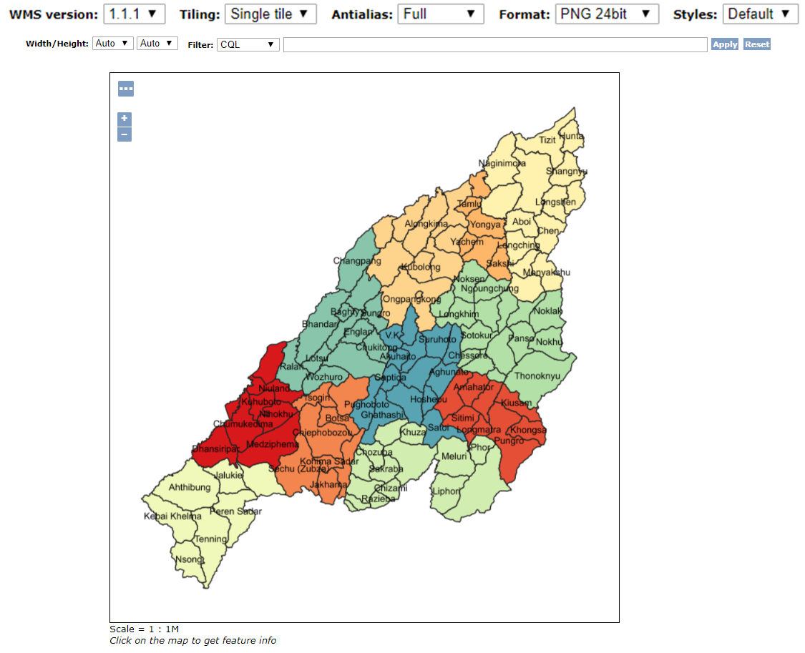
GeoServer CQL/ECQL :Opening and Using CQL Filter box
The following examples use the naga:Circle Boundary of Nagaland . It demonstrates how CQL filters work by using the WMS CQL_FILTER vendor parameter to alter the data displayed by WMS requests.
Open the GeoServer Map Preview for the naga:Circle Boundary of Nagaland layer.
Click on the Options button at the top of the map preview to open the advanced options toolbar.
The example filters can be entered in the Filter: CQL box
Attributes Names

Slide 26
GeoServer CQL/ECQL :Comparisons
Layer : Load Nagaland block boundary in Geoserver
Simple comparisons
The full list of comparison operators is: =, <>, >, >=, <, <=
CQL query:
District_N =‘Zunheboto’
Circle_N LIKE 'A%'
Shape_Area > 300
list comparisons
If instead we want to extract the states whose name is in a given list we can use the IN operator specifying an attribute name, as in
Circle_N IN ('Meluri','Liphori','Lotsu')

Slide 27
GeoServer CQL/ECQL :Filter
Filter functions
CQL/ECQL can use any of the filter functions available in GeoServer. This greatly increases the power of CQL expressions.
For example, suppose we want to find all circles whose name contains an “a”, regardless of letter case. We can use the strToLowerCase to turn all the circle names to lowercase and then use a like comparison: strToLowerCase(Circle_N) like '%a%‘
strToLowerCase(Circle_N) LIKE '%a%‘

Slide 28
GeoServer CQL/ECQL : Geometric Filter
Geometric filters
CQL provides a full set of geometric filter capabilities. Say, for example, you want to display only the district boundary that intersect the (x,x,x,x) bounding box
Check the current BBOX values from URL and change the bbox and supply it to BBOX query
BBOX(the_geom, 532682.0670999996,2787067.8539000005,722847.2251000003,2992434.9676000006)
The full list of geometric predicates is: EQUALS, DISJOINT, INTERSECTS, TOUCHES, CROSSES, WITHIN, CONTAINS, OVERLAPS, RELATE, DWITHIN, BEYOND
Eg Using CQL filter for WFS GetFeature as URL. http://host:port/geoserver/wfs?service=WFS&version=1.0&request=GetFeature&typeName=myLayer&CQL_FILTER=INTERSECTS(the_geom, POLYGON((...)))&propertyName=data1,data2,data3
More Ref : https://docs.geoserver.org/2.7.1/user/filter/ecql_reference.html#spatial-predicate

Slide 29
An Introduction to MapServer

Slide 30
MapServer : An Introduction
MapServer is an Open Source geographic data rendering engine written in C. MapServer was originally developed by the University of Minnesota (UMN) ForNet project in cooperation with NASA. MapServer is one of the founding projects of the OSGeo foundation and All source code is openly available via GitHub.
Advanced cartographic output
Scale dependent feature drawing, Feature labeling, Fully customizable, template driven output, TrueType fonts, Map element automation (scalebar, reference map, and legend), Thematic mapping using logical- or regular expression-based classes
Support for popular scripting and development environments
PHP, Python, Perl, Ruby, Java, and .NET
Cross-platform support
Linux, Windows, Mac OS X, Solaris, and more
Support of numerous (OGC) standards : WMS, WFS, WCS etc
A variety of raster and vector data formats
TIFF/GeoTIFF, NetCDF, MrSID, ECW, and many others via GDAL
ESRI shapfiles, PostGIS, SpatiaLite, ESRI ArcSDE, Oracle Spatial, MySQL and many others via OGR
Map projection support
On-the-fly map projection with 1000s of projections through the PROJ.4 library

Slide 31
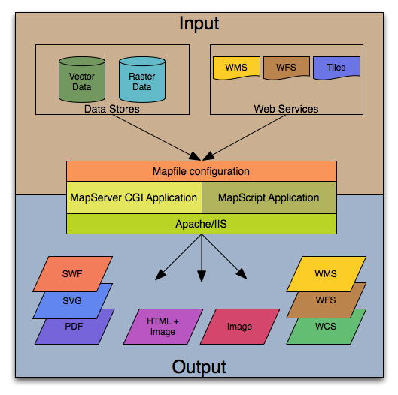
MapServer : An Introduction
MapServer is an open source development environment and well suited for building spatially enabled internet applications
Support for display and querying of hundreds of raster, vector, and database formats
On-the-fly projections
High quality rendering
Fully customizable application output
Many ready-to-use Open Source application environments

Slide 32
MapServer : The Software
MapServer 7.2
MS4W :
MapServer for Windows : For a beginner looking for a complete MapServer solution on the Windows platform, or an advanced user looking to avoid compiling your own
MS4W is a complete Web Server/MapServer/MapScript package
UbuntuGIS : UbuntuGIS provides up to date packages of MapServer and related OSGeo tools for Ubuntu.

Slide 33
MapServer : The Application
A simple MapServer application consists of: -
Map File : The Mapfile is the heart of MapServer. It defines the relationships between objects, points MapServer to where data are located and defines how things are to be drawn
Geographic Data - MapServer can utilize many geographic data source types. The default format is the ESRI Shape format
HTML Pages :
Initialization File - uses a form with hidden variables to send an initial query to the web server and MapServer. This form could be placed on another page or be replaced by passing the initialization information as variables in a URL
Template File - controls how the maps and legends output by MapServer will appear in the browser. The template also determines how the user can interact with the MapServer application (browse, zoom, pan, query).
MapServer CGI - The binary or executable file that receives requests and returns images, data, etc. It sits in the cgi-bin or scripts directory of the web server. The Web server user must have execute rights for the directory that it sits in, and for security reasons, it should not be in the web root. By default, this program is called mapserv
Web/HTTP Server - serves up the HTML pages when hit by the user’s browser. You need a working Web (HTTP) server, such as Apache or Microsoft Internet Information Server, on the machine on which you are installing MapServer.

Slide 34
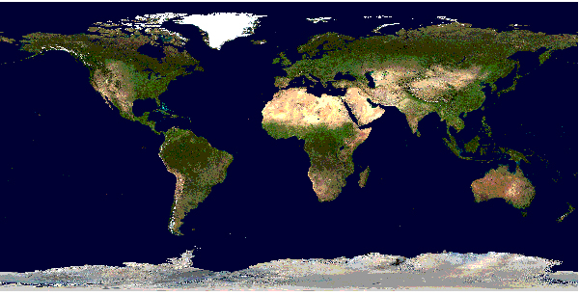
MapServer : Introduction to Mapfile
The .map file is the basic configuration file for data access and styling for MapServer. The file is an ASCII text file, and is made up of different objects. Each object has a variety of parameters available for it.
MAP
NAME "sample"
STATUS ON
SIZE 600 400
SYMBOLSET "../etc/symbols.txt"
EXTENT -180 -90 180 90
UNITS DD
SHAPEPATH "../data"
IMAGECOLOR 255 255 255
FONTSET "../etc/fonts.txt"
#
# Start of web interface definition
#
WEB
IMAGEPATH "/ms4w/tmp/ms_tmp/"
IMAGEURL "/ms_tmp/"
END # WEB
#
# Start of layer definitions
#
LAYER
NAME 'global-raster'
TYPE RASTER
STATUS DEFAULT
DATA bluemarble.gif
END # LAYER
END # MAP
Rendered Bluemarble Image

Slide 35
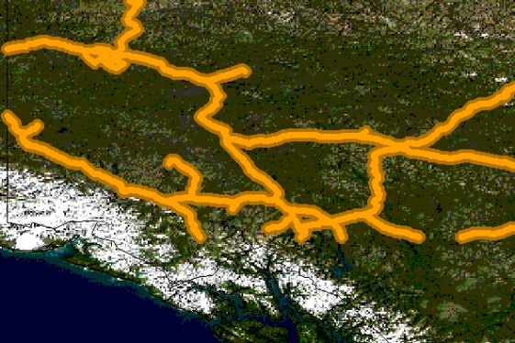
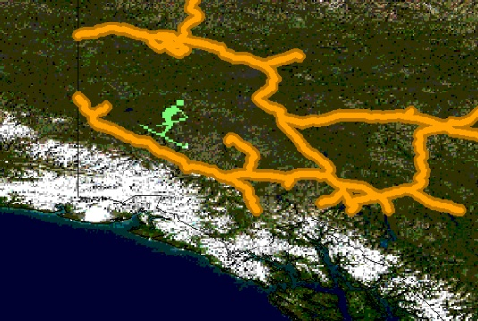
MAP # MAP object
NAME "sample"
STATUS ON
SIZE 600 400
SYMBOLSET "../etc/symbols.txt"
EXTENT -180 -90 180 90
UNITS DD
SHAPEPATH "../data"
IMAGECOLOR 255 255 255
FONTSET "../etc/fonts.txt"
#
# Start of web interface definition
#
WEB
IMAGEPATH "/ms4w/tmp/ms_tmp/"
IMAGEURL "/ms_tmp/"
END # WEB
#
# Start of layer definitions
# LAYER Object
LAYER # raster
NAME 'global-raster'
TYPE RASTER
STATUS DEFAULT
DATA bluemarble.gif
END # LAYER
LAYER #vector
NAME "world_poly"
DATA 'shapefile/countries_area.shp'
STATUS ON
TYPE POLYGON
CLASS
NAME 'The World'
STYLE
OUTLINECOLOR 0 0 0
END # STYLE
END # CLASS
END # LAYER
END # MAP
Introduction to Mapfile
CLASS & STYLE Object
CLASS
NAME "Primary Roads"
STYLE
SYMBOL "circle"
COLOR 178 114 1
SIZE 15
END # STYLE
STYLE
SYMBOL "circle"
COLOR 254 161 0
SIZE 7
END # STYLE
END # CLASS
SYMBOLs
SYMBOL
NAME "ski"
TYPE PIXMAP
IMAGE "ski.png"
END # SYMBOL
“symbols.txt”
MAP
NAME "sample"
EXTENT -180 -90 180 90 # Geographic
SIZE 800 400
IMAGECOLOR 128 128 255
SYMBOLSET "../etc/symbols.txt"
END # MAP

Slide 36
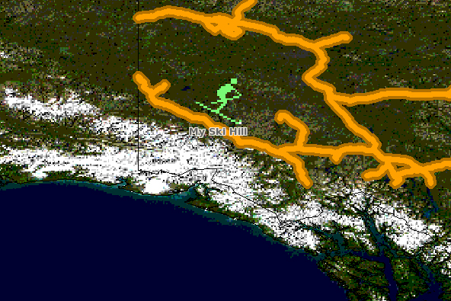
Introduction to Mapfile
LABEL
CLASS Expressions
MapServer supports 3 types of CLASS Expressions in a LAYER
String comparisons : EXPRESSION “africa”
Regular expressions : EXPRESSION /^9|^10/
Logical expressions : EXPRESSION ([POPULATION] > 50000 AND '[LANGUAGE]' eq ‘HINDI')
The following logical operators are supported: =, >, <, <=, >=, =, or, and, lt, gt, ge, le, eq, ne, in, ~, ~*
defined within a CLASS object
the LABELITEM parameters in the LAYER object can be used to specify an attribute in the data to be used for labeling.
Eg. LAYER
NAME "states"
CLASSITEM "district"
...
CLASS
NAME "district-ribhoi"
EXPRESSION "ribhoi"
...
END
END
# Get States layer containing district names and displays only ribhoi district
LABEL
FONT "sans-bold"
TYPE truetype
ENCODING "UTF-8"
SIZE 10
POSITION LC
PARTIALS FALSE
COLOR 100 100 100
OUTLINECOLOR 242 236 230
END # LABEL
LAYER
NAME 'regexp-example'
FILTERITEM 'placename'
FILTER /hotel/
...
END
# Match and retrieve/display records having “hotel” in the layer
# Match records that have a value from 2000 to 2010 in the attribute “year”
FILTERITEM "year"
FILTER /^20[0-9][0-9]/

Slide 37
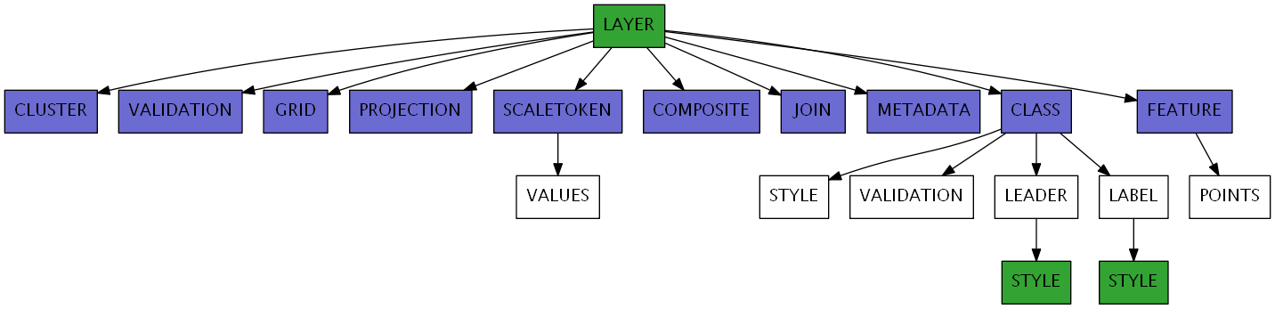
Introduction to Mapfile
More advance options on Layer
Securing Encrypted Connections Using msencrypt in Mapfile
Using CONNECTIONTYPE for OGR, Oracle Spatial, PostGIS, SDE
msencrypt -keygen [key_filename] # To create a new encryption key. Will generate a key, say, 3656026A23DBAFC04C402EDFAB7CE714
msencrypt -key [key_filename] [string_to_encrypt] # To encrypt a string
CONFIG MS_ENCRYPTION_KEY "/path/to/mykey.txt“ # in Mapfile
LAYER
NAME “land_use"
TYPE POLYGON
CONNECTIONTYPE POSTGIS
CONNECTION "host=127.0.0.1 dbname=apps1 user=postgres password=nesac123 port=5432"
DATA "the_geom FROM land_use using SRID=4326"
STATUS DEFAULT
CLASS
NAME “land_class"
COLOR 255 0 0
END
END
Unsecured Connection
Secured Connection
CONNECTION "host=127.0.0.1 dbname=apps1 user=postgres
password={3656026A23DBAFC04C402EDFAB7CE714} port=5432"

Slide 38
MapServer : Setting Up WMS Server
Check that your mapserv executable includes WMS support
Setup a Mapfile For our WMS
Each instance of WMS server represents a single mapfile comprising of one/many layers
C:\apache\cgi-bin> mapserv -v
MapServer version 6.3-dev OUTPUT=GIF OUTPUT=PNG OUTPUT=JPEG OUTPUT=KML
SUPPORTS=PROJ SUPPORTS=GD SUPPORTS=AGG SUPPORTS=FREETYPE SUPPORTS=CAIRO
SUPPORTS=ICONV SUPPORTS=FRIBIDI SUPPORTS=WMS_SERVER SUPPORTS=WMS_CLIENT
SUPPORTS=WFS_SERVER SUPPORTS=WFS_CLIENT SUPPORTS=WCS_SERVER
SUPPORTS=SOS_SERVER SUPPORTS=GEOS INPUT=JPEG INPUT=POSTGIS INPUT=OGR
INPUT=GDAL INPUT=SHAPEFILE
list of parameters and metadata items to be configured
At the MAP level:
Map NAME
Map PROJECTION
Map Metadata (in the WEB Object):
wms_title
wms_onlineresource
wms_srs
wms_enable_request
And for each LAYER:
Layer NAME
Layer PROJECTION
Layer METADATA
wms_title
wms_srs (optional)
Layer STATUS
Layers set to STATUS DEFAULT will always be sent to the client.
Layers set to STATUS ON or STATUS OFF can be requested by the client.
Layer TEMPLATE (required for GetFeatureInfo requests)

Slide 39
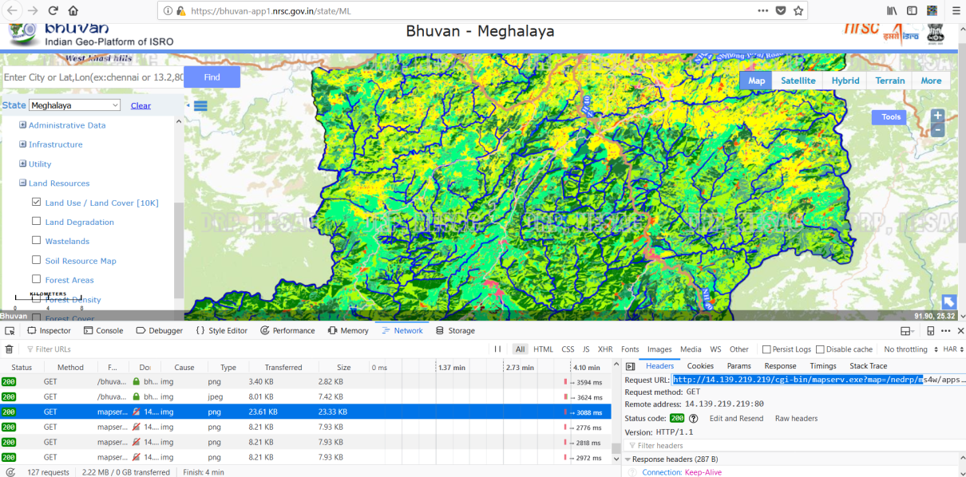
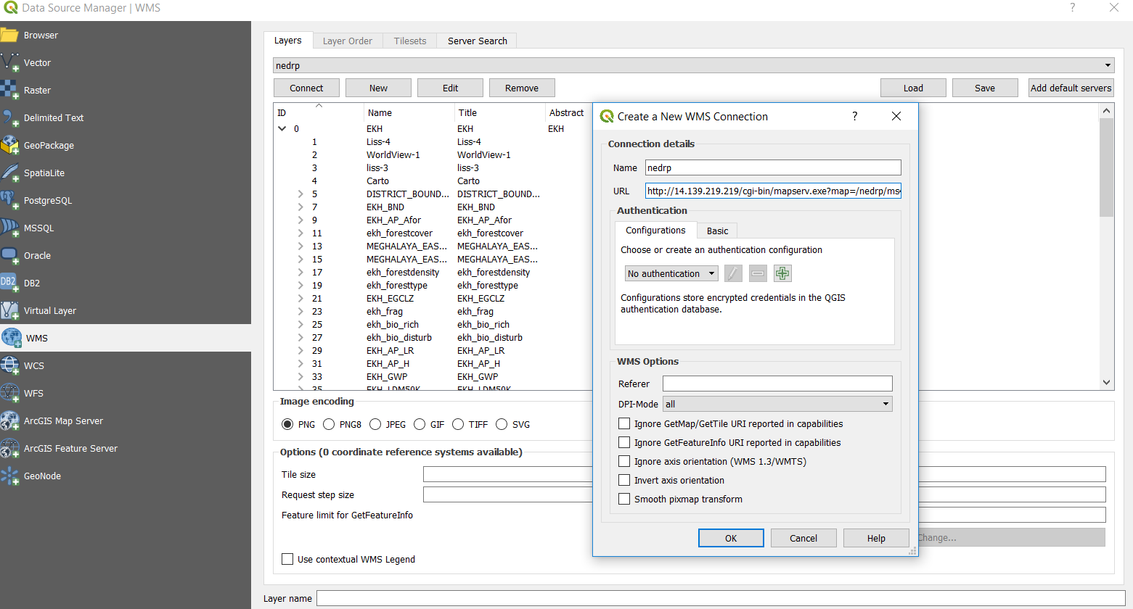
MapServer : Introduction to Mapfile
Setup a Mapfile For our WMS (contd)
Eg. NEDRP WMS MapServer
http://14.139.219.219/cgi-bin/mapserv.exe?map=/nedrp/ms4w/apps/nedrpekh/code/config/default/ekh.map&

Slide 40
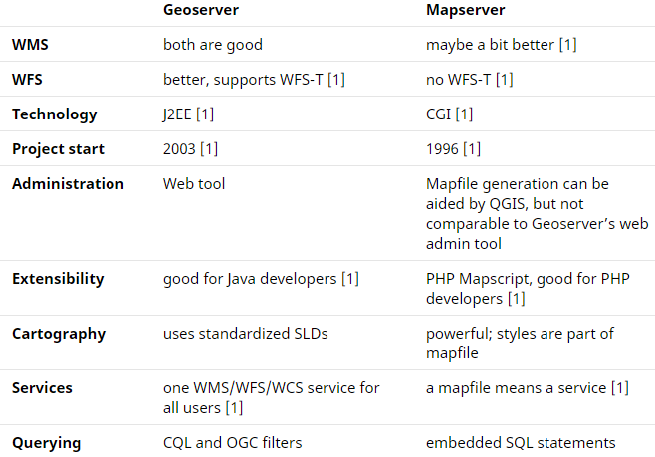
MapServer Vs GeoServer
http://osgeo-org.1803224.n2.nabble.com/Mapserver-vs-Geoserver-td4905798.html
http://wiki.osgeo.org/wiki/Benchmarking_2010
http://www.slideshare.net/gatewaygeomatics.com/wms-performance-shootout

