Slide 1
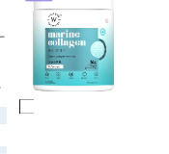
wellbeing
nutrition
CRO CASE STUDY
Conversion Rate
Optimisation Proposal
Pure Korean Marine Collagen Peptides
PURE KOREAN MARINE
COLLAGEN PEPTIDES
Turning product credibility into clearer purchase decisions.
8g / serving
<1000 Da
CORE THESIS
Sell the routine — not just the tub.
Rahul Singh
Heuristic CRO audit + competitive benchmark + clickable HTML prototype
23 Sep 2026

Slide 2
EXECUTIVE DIAGNOSIS
Strong proof. Opportunity in purchase architecture.
The current PDP is rich in trust, science and reviews. The biggest opportunity is making the buying decision easier — especially the pack choice.
571
customer reviews
12
weeks of consistent use
20+
ingredient studies
ALREADY STRONG
CURRENT FRICTION
CRO OPPORTUNITY
Clickable reviews + rating
Pack choice is quantity-led
Frame packs as routines
Sticky pack / price CTA
Flat value across bundles
Surface proof at purchase anxiety
Traceability + lab reports
12-week use is disconnected from pack choice
Make science scannable
Deep science library
Science is credible but dense
Keep real pricing; test incentives separately
The page does not need more persuasion — it needs the right persuasion at the right moment.
RAHUL SINGH · CRO CASE STUDY
Source: Wellbeing Nutrition PDP capture + page content reviewed 23 Sep 2026
02

Slide 3
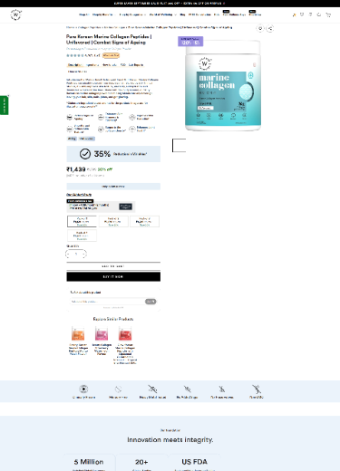
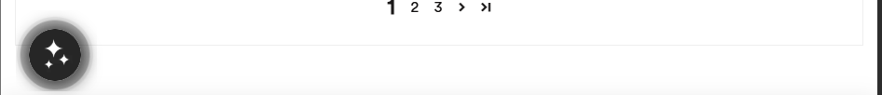
CURRENT-STATE AUDIT
Preserve what works. Fix the decision architecture.
A heuristic audit of the current PDP — not a redesign for redesign’s sake.
1
KEEP
Clickable reviews are already visible near the product title.
2
KEEP
Sticky pack / pricing CTA persists while users scroll.
3
IMPROVE
Pack selector communicates quantity — not the routine it enables.
4
IMPROVE
Each quantity is ~20% off, so larger packs lack incremental value.
5
IMPROVE
The 12-week use story appears away from the pack decision.
Audit snapshot shows “Only 32 left” — useful, credible scarcity worth preserving.
RAHUL SINGH · CRO CASE STUDY
Screenshots: current Wellbeing Nutrition PDP supplied for the case
03

Slide 4
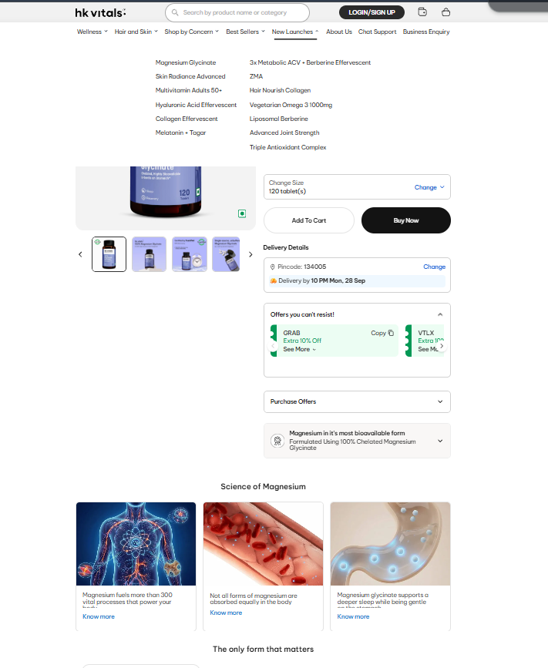
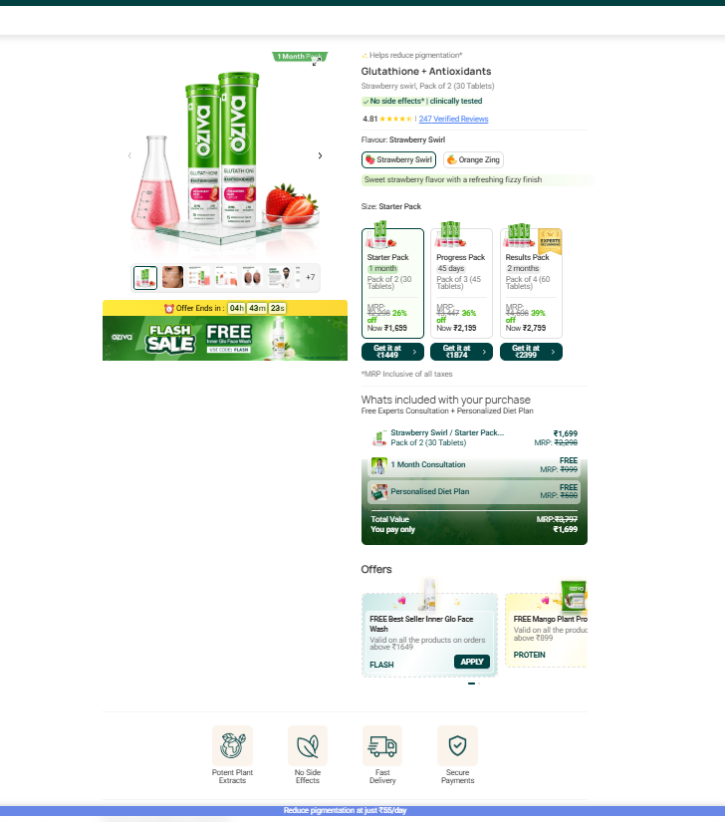
COMPETITIVE INSPIRATION
Borrow behaviour patterns — not visual design.
Two relevant PDPs show how regimen framing and conversion reassurance can be merchandised more clearly.
OZIVA
HK VITALS
Useful pattern
Useful pattern
Regimen-led packs
Reassurance near CTA
Starter → Progress → Results
Delivery expectation near purchase
Duration is visible at selection
Offers consolidated into one module
Savings escalate with commitment
Science broken into scannable cards
What we borrow
What we borrow
Help users choose a commitment window, not a tub count.
Answer transactional anxiety where it occurs.
RAHUL SINGH · CRO CASE STUDY
Reference screenshots: OZiva + HK Vitals PDPs supplied for benchmarking
04

Slide 5
HERO RECOMMENDATION
Sell the routine — not the tub.
Reframe quantity into a consistency decision using the product’s actual serving size and 12-week use window.
CURRENT
PROPOSED
“How many tubs do I want?”
“How long do I want to stay consistent?”
→
COVERS 12 WKS
Pack 1
Pack 2
STARTER
BUILD THE ROUTINE
CONSISTENCY
₹1,439
₹2,878
12-WEEK ROUTINE
200g ÷
8g/day
~25 days
~50 days
~75 days
~100 days
Pack 3
Pack 4
1 tub · ₹1,439
2 tubs · ₹2,878
3 tubs · ₹4,318
4 tubs · ₹5,757
₹4,318
₹5,757
Recommended for 12-week use
≈20% off across every quantity
Rational upsell: the 4-pack covers ~100 daily servings, enough to span an 84-day / 12-week routine.
RAHUL SINGH · CRO CASE STUDY
Pack math uses 200g tub ÷ 8g serving = 25 servings per tub
05

Slide 6
PROPOSED PURCHASE EXPERIENCE
Keep the brand. Reduce cognitive load.
A high-fidelity CRO concept for the above-the-fold purchase module — designed to feel native to Wellbeing Nutrition.
What changed
Pure Korean Marine Collagen Peptides
1
Outcome-led hierarchy
★★★★★ 571 reviews
Supports hydrated, firmer-looking skin from within.
2
Proof chips near decision
8g / serving
<1000 Da
Mercury-free
Heavy-metal tested
₹1,439
Only 32 left
3
Routine-led pack selector
₹1,799
20% OFF
Choose your routine
4
Inventory signal preserved
UNFLAVOURED
200g
25d
50d
75d
100d
1 tub
2 tub
3 tub
4 tub
₹1,439
₹2,878
₹4,318
₹5,757
5
Delivery reassurance added
Deep-sea sourced · lab tested
ADD TO CART
BUY IT NOW
No fake discounts. No invented benefits.
Check delivery · Enter pincode
RAHUL SINGH · CRO CASE STUDY
CRO concept mock-up; all commercial terms use the audited PDP snapshot
06

Slide 7
PROOF ARCHITECTURE
Make evidence easier to consume — not less rigorous.
Move from a long proof stack to a sequence that answers the next customer objection.
UNDERSTAND
→
CHOOSE
→
BELIEVE
→
DE-RISK
→
BUY
Outcome + formulation
Routine-led packs
Science + traceability
Reviews + lab reports
Clear CTA
Make science scannable
SKIN HYDRATION
WRINKLES + ELASTICITY
SKIN TEXTURE
JOINT SUPPORT
Randomised controlled study
Triple-blind study
Double-blind study
Systematic review
TRUST CHECK
Standardise absorption messaging: the current page uses 1.5×, 4× and 5× in different contexts. Keep one substantiated claim and make the comparator explicit.
RAHUL SINGH · CRO CASE STUDY
Principle: benefit first → mechanism second → evidence third
07

Slide 8
TEST & MEASURE
Treat every redesign choice as a hypothesis.
No claimed uplift without analytics. Prioritise high-impact experiments, then validate with controlled testing.
EXPERIMENT
HYPOTHESIS
PRIMARY MEASURE
Routine-led packs
Duration framing increases multi-pack selection.
Pack mix · AOV
Progressive savings
Incremental incentive increases commitment.
Revenue / visitor
Simplified hero
Faster comprehension improves purchase intent.
Add-to-cart rate
Proof near CTA
Earlier reassurance reduces purchase hesitation.
ATC → checkout
Delivery module
Delivery certainty reduces transactional friction.
Checkout starts
Scannable science
Easier evidence increases proof engagement.
Engagement + ATC
Winning idea
Use the existing credibility better: make the routine obvious, place proof at anxiety points, and test before scaling.
RAHUL SINGH · CRO CASE STUDY
Deliverables: CRO deck + interactive HTML PDP prototype
08

