Slide 1

SQL Project: RCB - IPL Strategy
Submitted By:
Rajiv Kumar

Slide 2

Problem Statement
You are hired as a Sports Data Analyst by RCB to identify top-performing and reliable players who can help the team win tournaments. The analysis focuses on player performance, match impact, all-round abilities, venue and toss trends, and value for money during the Mega Player Auction.
Your task is to provide data-driven strategies and suggestions for selecting the best players and optimizing RCB’s auction investments.
Objective
To use SQL-driven IPL data analysis to identify high-impact players, optimize RCB’s auction strategy, and develop data-backed strategies for improving match and tournament performance.

Slide 3
Data Description
Ball_by_Ball
Match_id: Unique identifier for a cricket match
Over_id: Unique identifier for an over in a cricket match
Ball_id: Unique identifier for a ball in an over
Innings_No: The innings number in a cricket match
Team_Batting: The team batting in a particular innings
Team_Bowling: The team bowling in a particular innings
Striker_Batting_Position: The batting position of the striker batsman
Striker: The batsman currently on strike
Non_Striker: The batsman currently at the non-striker's end
Bowler: The bowler bowling the current delivery
Batting_style
Batting_id: Unique identifier for a batsman's batting record
Batting_hand: The batting hand (right or left) of a batsman
Bowling_style
Bowling_id: Unique identifier for a bowler's bowling record
Bowling_skill: The bowling skill (e.g., right-arm fast, left-arm spin) of a bowler
City
City_id: Unique identifier for a city
City_Name: The name of a city
Country_id: Unique identifier for a country

Slide 4
Data Description
Matches
Match_Id: Unique identifier for each match.
Match_Date: The date when the match took place.
Match_Winner: The team that won the match.
Outcome_Type: Type of result (win, tie, etc.).
Toss_Winner: The team that won the toss.
Win_Type: The method by which the match was won (e.g., runs or wickets).
Win_Margin: The margin by which the match was won.
Venue_Id: Reference to the venue where the match was played.
Season_Id: The season in which the match occurred.
Venue
Venue_Id: Unique identifier for each venue.
Venue_Name: Name of the venue.
City_Id: Reference to the city where the venue is located.
Country
Country_Id: Unique identifier for each country.
Country_Name: Name of the country.
Player Match
Match_Id: Reference to the match in which the player participated.
Player_Id: Reference to the player.
Role_Id: Role of the player (e.g., batsman, bowler).
Team_Id: Team that the player represented in the match.
Wickets Taken
Ball_Id: Reference to the specific ball during which the wicket was taken.
Fielder: Reference to the player who fielded the ball.
Bowler: Reference to the bowler who took the wicket.
Player_Out: Reference to the player who was dismissed.

Slide 5
Data Description
Extra Type
Extra_Type_Id: Unique identifier for the type of extra runs scored in a cricket match.
Extra_Runs: The number of extra runs scored in a particular delivery.
Innings_No: The innings number in a cricket match.
Extra_Id: Unique identifier for an instance of extra runs scored.
Extra_Name: The name or description of the type of extra runs scored (e.g., byes, leg byes, wides, no-balls).
Season
Season_Id: Unique identifier for a particular season or tournament.
Venue_Id: Unique identifier for the venue or stadium where the match is played.
Win_By
Win_Type: The type of win (e.g., runs, wickets) achieved by the winning team.
Win_Margin: The margin of victory (e.g., runs or wickets) for the winning team.
Outcome
Outcome_type: The type of outcome or result of the match (e.g., win, loss, tie, no result).
Match_Winner: The team that won the match.
Man_of_the_Match: The player awarded the Man of the Match award.
Out_Type
Out_Id: Unique identifier for the type of dismissal or way a batsman got out.
Out_Name: The name or description of the type of dismissal (e.g., caught, bowled, lbw, run out).
Outcome_Id: Unique identifier for the outcome or result of a match.

Slide 6
Data Description
Role
Role_Id: Unique identifier for a player's role or skills (e.g., batsman, bowler, all-rounder).
Role_Desc: Description of a player's role or skills.
Man_of_the_Series: The player awarded the Man of the Series award for a particular tournament.
Orange_cap: The player awarded the Orange Cap (for most runs scored) in a particular tournament.
Purple_cap: The player awarded the Purple Cap (for most wickets taken) in a particular tournament.
Extra Runs
Ball_Id: Reference to the specific ball during which extra runs were conceded.
Extra_Type_Id: Type of extra run (e.g., wide,no-ball).
Innings_No: The innings number during which the extra run occurred.
Match_Id: Reference to the match in whichthe extra runs were conceded.
Umpire
Umpire_id: Unique identifier for an umpire officiating the match.
Umpire_name: The name of an umpire.
Umpire_country: The country or nationality of an umpire.
Toss Decision
Toss_Name: The name or description of the toss (e.g., heads or tails).
Player
Player_Id: Unique identifier for a player.
Player_Name: The name of a player.
Team
Team_Id: Unique identifier for a team.
Team_Name: The name of a team.

Slide 7

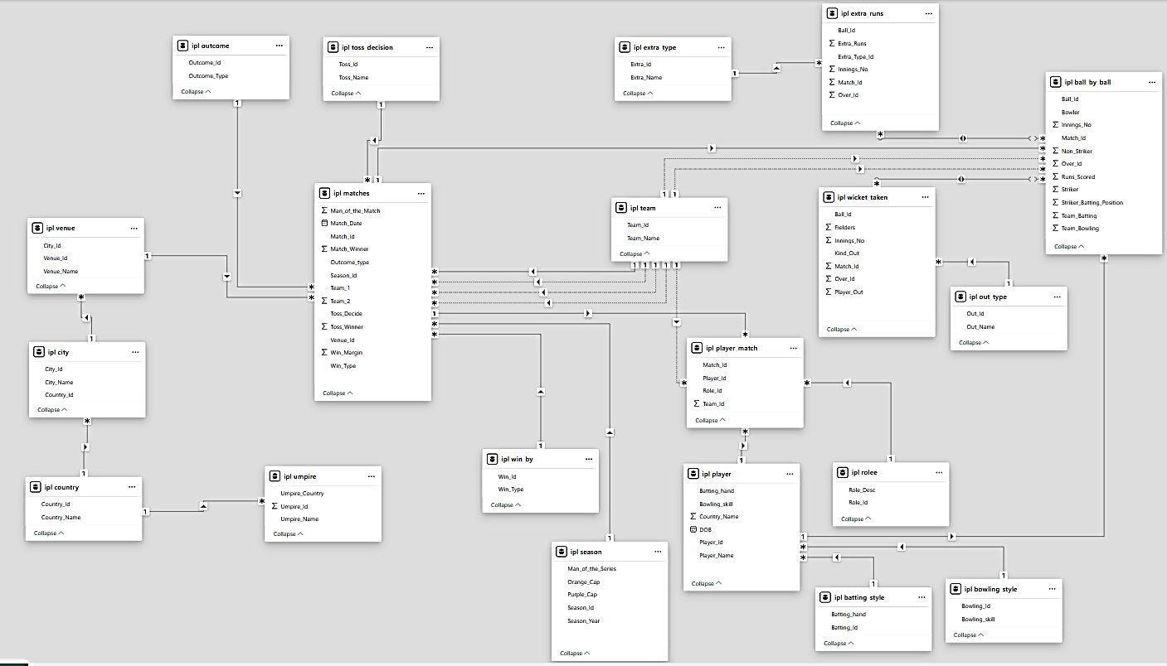
Database Schema

Slide 8
Data Overview & Methodology
Data Sources
Match Data
Season, venue, teams, toss details, match outcomes
Ball-by-Ball Data
Every delivery: bowler, batsman, runs, wickets, extras
Data Sources
Player Data
Demographics, bowling styles, batting positions
Venue Data
Stadium details, geographical factors, pitch characteristics
Analysis Methodology
SQL-Powered Analysis
SQL queries extracted patterns across seasons, teams, venues:
Player performance metrics and rankings Team win-loss patterns with venue correlations Match factor analysis (toss, batting order) Player consistency tracking across seasons

Slide 9
Strategic Takeaways
Batting Champions & Strike Rates
Bowling Stars & Economy Rates
Toss Decision Impact
Win-Loss Patterns & Venue Impact
Team Insights: RCB Performance Analysis
All-rounders & Consistent Performers
Strategic KPIs for Team Success
Data-driven Player Recommendations
Key Findings & Conclusion

Slide 10
Batting Champions & Strike Rates
Highlighting IPL's top performers by batting average and strike rate
Top Batting Averages
Batting Champions – Average Runs per Innings:
This analysis evaluates the top batting averages across all IPL seasons, led by GJ Maxwell (37.93) and MEK Hussey (35.87), with RCB's own V Kohli (30.59) also ranking among the top 10. It helps identify consistent performers who could be valuable assets in future auctions. Players with higher averages demonstrate reliability and the potential to anchor innings, making them strong contenders for retention or strategic bidding.

Slide 11
Batting Champions & Strike Rates
Highlighting IPL's top performers by batting average and strike rate
Top Strike Rates
Top Strike Rates :
This query identifies the Top players with the highest strike rates over the seasons, led by SK Raina at a blistering 139.05, measuring how quickly players score runs. High strike rate batsmen are valuable in T20 formats for accelerating innings. For RCB, such players could be prioritized for aggressive middle-order roles or targeted in the upcoming auction.

Slide 12
Bowling Stars
Showcasing IPL's wicket-takers and their bowling performance metrics
Top Wicket Takers
Top Wicket-Takers by Season:
This query identifies the highest wicket-takers across each IPL season by aggregating total dismissals per bowler. It highlights bowlers with consistent match-winning impact. For RCB, such insights are crucial in evaluating past performers and targeting top wicket-takers for strengthening the bowling unit in upcoming auctions.
Total Wickets = Sum of all wickets taken across seasons

Slide 13
Bowling Stars
Showcasing IPL's wicket-takers and their bowling performance metrics
Top Bowling Averages
Bowling Performance
This query tracks each bowler's bowling average (runs conceded per wicket) across IPL seasons, led by JD Unadkat (28.08) and YS Chahal (25.50). It helps evaluate a player's consistency and impact across different IPL years. For RCB, analyzing seasonal wicket trends supports decisions on retaining effective bowlers or scouting potential replacements for future auctions.
Bowling Average = Total Wickets / Innings Bowled

Slide 14
Toss Decision Impact
How winning the toss and choosing to bat or field affects match outcomes
Impact of Toss Decision on Match Decision
This analyzes how toss decisions (bat or field first) influence match outcomes across different venues. It calculates the percentage of matches won by teams that won the toss. These insights help RCB optimize match-day strategies based on venue-specific trends and inform decisions during high-pressure toss moments.

Slide 15
Win-Loss Pattern
How venues affect team performance
RCB Win Loss Pattern by Venue
RCB's Venue-Wise Performance
RCB have a mixed win-loss record by venue. They have played most matches at M Chinnaswamy Stadium, their home ground, with an almost equal number of wins (16) and losses (11), showing moderate home advantage. At several venues like Feroz Shah Kotla and Maharashtra Cricket Association Stadium, RCB have maintained an unbeaten record, reflecting strong adaptability. However, venues like Wankhede Stadium and Rajiv Gandhi International Stadium have seen more losses than wins, indicating challenging conditions. Improving performance at these tough venues could enhance RCB's overall success and consistency.

Slide 16
Team Insights: RCB Performance Analysis
Analyzing Royal Challengers Bangalore's journey, performance trends, and strategic challenges
RCB's Seasonal Performance Overview (2013–2016):
This analysis tracks RCB’s win percentage across IPL seasons from 2013 to 2016. The data reveals fluctuating form, with the highest win rate at 56.25% in both 2013 and 2016 (9 wins in 16 matches each) and the lowest at 35.71% in 2014 (5 wins in 14 matches), while 2015 saw a moderate 50% win rate (8 wins in 14). With an overall average of 49.55% across these four seasons, such fluctuations highlight the need for greater consistency in team selection and leadership—when preparing for future auctions and squad rebuilding.

Slide 17

Strategic KPIs for Team Success
Key Performance Indicators that drive strategic decisions and team performance
Performance Metrics
1. Win Percentage
Measures overall success rate across seasons
(Matches Won / Matches Played) × 100
4. Run Rate
Measures scoring speed across matches
Total Runs Scored / Total Overs Faced
Team Success
Scoring Speed
RCB home win rate: 59.26% at M Chinnaswamy
2. Average Runs per Match
Measures team's scoring consistency
Total Runs Scored / Total Matches Played
Batting
Top team: Kings XI Punjab (2014): 176.5 runs/match
5. Toss Impact KPI
Win % after toss decision (bat/field)
(Wins After Decision / Matches with That Decision) × 100
Strategy
3. Average Wickets per Match
Shows bowling strength of team
Total Wickets Taken / Total Matches Played
Bowling
MA Chidambaram: 72.73% wins when batting first
Barabati Stadium: 66.67% wins when fielding first
Chennai Super Kings (2015): 7.06 wickets/match
Translating KPIs into Winning Strategies:
RCB has demonstrated strong batting capabilities with a high run rate and powerful top-order performances. By strengthening bowling depth, reinforcing the middle order, and optimizing toss-time decisions, the team can convert its potential into consistent victories. These KPIs offer a clear roadmap to build a more balanced and competitive squad for future success.

Slide 18
Data-driven Player Recommendations
Player selection based on performance metrics, consistency, and venue expertise
High Impact Players (Highest Total in all Seasons)
Top 5 High Impact Players
Player-wise Seasonal Batting Trends:
The season-wise batting performance highlights Chris Gayle as the top run-scorer with 910 runs, showcasing his explosive impact at the top of the order. Close behind, DR Smith (872 runs) and SR Watson (781 runs) also delivered strong, reliable form. RA Jadeja (320 runs) and JP Faulkner (180 runs), while lower on the list, added valuable finishing depth. These trends not only spotlight key performers but also help identify stable batting pillars for future team planning and auction strategies.

Slide 19
Data-driven Player Recommendations
Player selection based on performance metrics, consistency, and venue expertise
High Impact Players (Highest Wickets in all Seasons)
Top 5 High Impact Players
Bowling Performance Insights Across Seasons:
The multi-season wicket trends reveal JP Faulkner as the most impactful bowler with 48 wickets, well ahead of the rest of this group. RA Jadeja (31) and SR Watson (23) follow, showcasing valuable all-round bowling contributions. DR Smith (6) and CH Gayle (3) chipped in with occasional breakthroughs alongside their primary role as batsmen. The visual progression highlights players like Faulkner and Jadeja as the most reliable bowling assets for any team's strategy.

Slide 20
Data-driven Player Recommendations
Player selection based on performance metrics, consistency, and venue expertise
RCB players with High Average Runs
Consistent Run-Scorers and Key Contributors:
Chris Gayle leads the batting performance with a remarkable average of 35.00, reinforcing his reputation as one of the most consistent run-scorers in this group. V Kohli (30.59) and AB de Villiers (28.65) follow closely, underlining their impact in the top order. Yuvraj Singh (27.42) and CA Pujara (23.00) also contribute meaningfully further down the list. This trend underscores a strong core of top-order performers, while several middle and lower-order players add moderate value. These averages provide clear guidance for identifying dependable batting options and evaluating player potential for future match strategies.

Slide 21
Key Findings & Conclusion
Key Data Insights
Top Batting Performers
LMP Simmons (42.82 avg runs/match), V Kohli (39.87), and DA Warner (38.49) emerged as the leading run contributors in the analysis.
• Strong Bowling Performers
DJ Bravo (81 wickets), MM Sharma (78 wickets), and B Kumar (77 wickets) stood out as the leading wicket-takers.
All-Rounder Impact Identified
KH Pandya (186.61 SR, 1.16 economy), AD Russell (163.16 SR, 1.29 economy) and GJ Maxwell (156.60 SR, 1.60 economy) showed strong dual-role impact with both batting and bowling contributions.
Venue-Specific Trends Matter
Brabourne Stadium (1.41 runs/ball) and M Chinnaswamy Stadium (1.38) emerge as high-scoring venues, highlighting the importance of venue-specific batting strategy.
Toss Decisions Drive OutcomesMA Chidambaram Stadium showed the strongest toss impact, with 72.73% of toss winners going on to win the match when choosing to bat.
Future-Ready Strategy Recommendations
• Prioritize All-Rounders in Auctions — Build squad flexibility with proven dual-role players.
• Strengthen Bowling Attack — Focus on wicket-taking ability and bowling consistency.
• Adopt Venue-Based Squad Rotation — Select combinations based on venue-specific trends.
• Enhance Tactical Decisions Using Data — Use toss, win % and historical outcomes.
• Integrate Advanced Analytics in Planning — Combine player, venue and season trends for smarter decisions.

Slide 22
Acknowledgements & References
References
IPL Dataset
SQL Database Schema
SQL Queries & Joins
Aggregation & Filtering Techniques
Player & Match Performance Data
RCB Strategic Analysis
Acknowledgements
Special thanks to the project creators and mentors for providing the dataset, project framework, and analytical guidance used in this SQL project.
Thank You

