Slide 1
IT Service Desk
Analytics Report
IT Ticket Dataset (2016–2020) · Prepared by: Rishabh Singh
97,498
50
16
4.1 / 5
Total Tickets
IT Agents
Attributes
Avg CSAT

Slide 2
OVERVIEW
Problem Statement & Data Overview
THE PROBLEM
97,498
As IT ticket volumes grow year-on-year, the service desk needs to understand where bottlenecks exist, which agents need support, and how to invest resources to improve resolution speed and satisfaction.
Total Tickets
2016–2020
Date Range
DATA CLEANING PERFORMED
Fixed 4,836 'Mayor' → 'Major' errors in Severity column
Filled missing Agent Names using XLOOKUP from IT Agents sheet
Verified all 16 attributes — no other column-level issues found
16
Attributes
50
IT Agents

Slide 3
ANALYSIS — VOLUME
Ticket Volume Growth: 2016–2020
KEY INSIGHTS
123% growth over 5 years
(13K → 29K tickets)
2020 saw biggest single-year jump — +35% vs 2019
Avg resolution time held stable at ~4.5 days despite volume doubling
CSAT improved 3.98 → 4.16 even as workload doubled
→ Team is coping but automation is urgently needed

Slide 4
ANALYSIS — CATEGORIES
Ticket Distribution by Category
KEY INSIGHTS
System dominates at 40%
(39,002 tickets)
Login Access is 2nd at 30%
(29,193) — resolves in just 0.3 days
Hardware is smallest (10%)
but takes longest to resolve
→ Automate Login Access to
free agents for harder cases

Slide 5
ANALYSIS — RESOLUTION
Resolution Time by Category
KEY INSIGHTS
Hardware = biggest bottleneck
at 7.62 days avg
System issues take 6.62 days
despite highest volume
Login Access resolves in 0.31 days — 24x faster than Hardware
→ Investing in Hardware tools
has highest ROI potential

Slide 6
ANALYSIS — AGENTS
Agent Performance Analysis
KEY INSIGHTS
Team avg CSAT: 4.1 / 5
Top performers: Jesus Contreras, Aurelio Tanori & Elena Velez — high speed + satisfaction
Agents needing support:
Alfonso Barraza, A. Trejo & Nurio Zepeda fall below 3.5 satisfaction-to-resolution ratio
→ 2-week targeted training
for bottom 5 agents recommended

Slide 7
ANALYSIS — ISSUE TYPE
IT Error vs IT Request Split
KEY INSIGHTS
75% are IT Requests (73,220)
— mostly routine in nature
25% are IT Errors (24,278)
— high priority, technical failures
Errors likely drive longer resolution times and lower CSAT
→ Self-service portal can deflect routine IT Requests

Slide 8
ANALYSIS — SATISFACTION
Customer Satisfaction Trend (CSAT)
KEY INSIGHTS
Steady year-on-year improvement
3.98 → 4.16 CSAT (+4.5%)
over 5 years
Team handled double the work with better quality — sign of improving processes
→ Target: 4.2+ CSAT via training
& automation investment

Slide 9
CONCLUSION
Recommendations & Conclusion
🔧 Invest in Hardware Tools
⚡ Automate Login Access
🎓 Train Low-Performing Agents
Hardware tickets take 7.62 days on avg — the longest of any category. Upgrading diagnostic software & spare parts inventory can cut this significantly.
29,193 Login Access tickets/year resolve in 0.31 days. An automated password reset portal can free up hundreds of agent hours annually.
Agents 6, 19 & 25 have the lowest satisfaction-to-resolution ratio. A 2-week targeted training + peer mentoring program can bring them to team standards.
97,498 tickets · 4.1/5 CSAT · 4.55 days avg resolution · 50 agents · 2016–2020

Slide 10
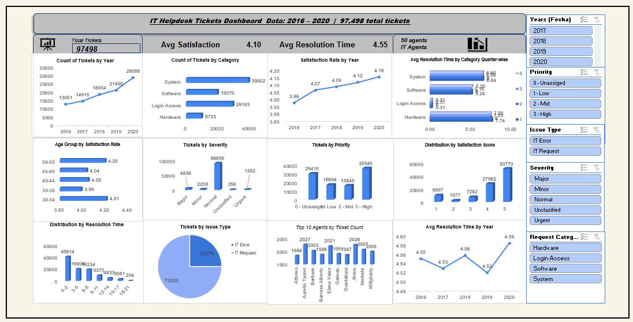
DASHBOARD
Interactive Dashboard
Slicers: Request Category · Severity · Priority · Issue Type · Year (Fecha) — Built in Microsoft Excel

Slide 11
Thank You
Questions & Discussion
Rishabh Singh
IT Ticket Service Desk Dataset (2016–2020)

