Slide 1
Social Media Analytics
Turning Instagram-Style User Data into Business Insight with SQL
Rishabh Singh | 24 August 2026
1 / 18

Slide 2
THE CHALLENGE
Problem Statement
The volume: Social platforms generate massive volumes of user interaction data every single day.
The gap: Raw activity logs alone don't reveal who matters, what content performs, or who's quietly disengaging.
The approach: Use SQL to transform raw platform data into clear, structured, query-driven insight.
The goal: Support strategic decisions on retention, marketing, and creator partnerships.
SOCIAL MEDIA ANALYTICS
2 / 18

Slide 3
DATA FOUNDATION
Dataset Overview — Core Entities
Users
Photos
Comments
• id — unique user identifier
• username — chosen handle
• created_at — account activity date
• id — unique photo identifier
• image_url — link to posted image
• user_id — owner of the photo
• created_at — date posted
• id — unique comment identifier
• photo_id — linked photo
• user_id — commenter
• created_at — date commented
SOCIAL MEDIA ANALYTICS
3 / 18

Slide 4
DATA FOUNDATION
Dataset Overview — Relationships
Likes
Follows
Tags & Photo Tags
• user_id — who liked
• photo_id — liked photo
• created_at — date liked
• follower_id — the follower
• followee_id — being followed
• created_at — date followed
• tag_id / tag_name — hashtag
• photo_id — tagged photo
• links tags to individual posts
SOCIAL MEDIA ANALYTICS
4 / 18

Slide 5
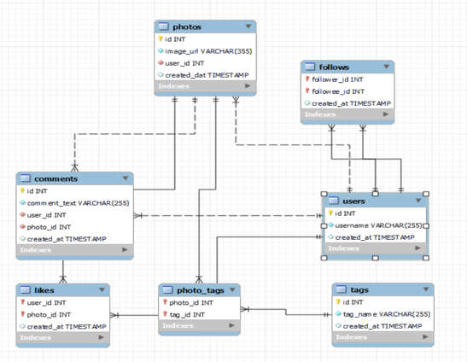
DATA FOUNDATION
Database Schema (ER Diagram)
SOCIAL MEDIA ANALYTICS
5 / 18

Slide 6
PREPARING THE DATA
Data Cleaning & Methodology
Integrity check: Every table scanned for duplicate records and missing (null) values before analysis began.
Built-in safeguards: Composite keys on Likes, Follows & Photo Tags plus NOT NULL constraints keep duplication low.
Why it matters: Clean inputs prevent misleading engagement numbers and bad business decisions.
SQL TECHNIQUES USED
Joins · Aggregate Functions · GROUP BY / HAVING · Subqueries · CTEs · Window Functions
SOCIAL MEDIA ANALYTICS
6 / 18

Slide 7
APPROACH
Analysis Framework
User Activity Lens
Engagement Lens
• Who is posting, and how often?
• Which users have gone quiet?
• How does activity map to loyalty?
• What content earns likes & comments?
• Which hashtags actually perform?
• Who deserves influencer status?
SOCIAL MEDIA ANALYTICS
7 / 18

Slide 8
OBJECTIVE ANALYSIS · 01
User Activity Analysis
Top creators: A small group of users (Eveline95, Clint27, Cesar93) post far more than the rest.
Loyalty signal: Posting frequency helps Instagram recognise consistently active, loyal users.
Action: Users far down the list become natural targets for re-engagement campaigns.
SOCIAL MEDIA ANALYTICS
8 / 18

Slide 9
OBJECTIVE ANALYSIS · 02
Engagement Breakdown
Likes & comments dominate: Photo tags are used far less than likes or comments.
Standouts: Eveline95 and Cesar93 lead across every engagement metric at once.
Use case: High-performing creators here become the shortlist for collaborations.
SOCIAL MEDIA ANALYTICS
9 / 18

Slide 10
OBJECTIVE ANALYSIS · 03
Hashtag Performance Analysis
Top hashtag: #smile leads usage by a wide margin, followed by #beach and #party.
Visibility boost: Popular hashtags improve content discovery and audience interaction.
Marketing use: Campaigns built around top-performing tags reach larger audiences.
SOCIAL MEDIA ANALYTICS
10 / 18

Slide 11
OBJECTIVE ANALYSIS · 04
Influencer & Brand Ambassador Analysis
Balanced picks: Candidates combine a solid follower base with consistently high engagement per post.
Brand ambassadors: Loyal, highly-engaged users build trust faster than reach alone.
Next step: Shortlist these creators for collaboration and ambassador programs.
SOCIAL MEDIA ANALYTICS
11 / 18

Slide 12
EXTENDED ANALYSIS · NEW
Follower & Following Analysis
One-way fame: The most-followed accounts follow almost no one back.
Reach vs. reciprocity: Follower count alone doesn't reflect how socially active a user is.
Business use: These high-reach accounts are prime candidates for paid promotion.
SOCIAL MEDIA ANALYTICS
12 / 18

Slide 13
EXTENDED ANALYSIS · NEW
Mutual Connections Analysis
Method: A self-join on the Follows table finds pairs where both users follow each other back.
SAMPLE MUTUAL PAIRS
Adelle96 ⇄ Alek_Watsica
Why it matters: Reciprocal follows signal stronger social bonds than one-directional follows.
Adelle96 ⇄ Bethany20
Business value: These pairs power "friend" recommendations and community-building features.
Adelle96 ⇄ Colten.Harris76
Adelle96 ⇄ Damon35
Adelle96 ⇄ Erick5
SOCIAL MEDIA ANALYTICS
13 / 18

Slide 14
OBJECTIVE ANALYSIS · 05
Personalized Marketing & Segmentation
Segmentation: Users are grouped by activity level — Content Creators, Active Engagers, and Inactive Users.
Majority group: Active Engagers make up the largest share, driving likes and comments platform-wide.
Campaign proxy: With no ad data available, hashtag engagement stands in as a campaign-effectiveness signal.
Outcome: Each segment gets a tailored recommendation strategy rather than one-size-fits-all.
SOCIAL MEDIA ANALYTICS
14 / 18

Slide 15
SO WHAT?
Business Insights
80/20 Effect
Reach ≠ Reciprocity
Hashtags Matter
A small share of users drives the majority of platform engagement.
The most-followed users rarely follow others back.
A handful of trending tags concentrate most interaction.
SOCIAL MEDIA ANALYTICS
15 / 18

Slide 16
WHAT'S NEXT
Recommendations
Marketing
Engagement
Recognise active creators through badges & promotional slots.
Re-engage inactive users with personalised notifications.
Build campaigns around trending, high-engagement hashtags.
Continuously monitor metrics to support long-term growth.
SOCIAL MEDIA ANALYTICS
16 / 18

Slide 17
CONCLUSION
From Raw Data to Business Strategy
This project analysed user behaviour, engagement, and content performance across an Instagram-style platform.
SQL transformed raw activity logs into measurable, decision-ready business insight.
Thank you for your time — happy to answer any questions on the analysis or techniques used.
17 / 18

Slide 18
Thank You
Questions on the analysis, the SQL, or the insights — happy to walk through any of it.
Rishabh Singh | Social Media Analytics
18 / 18

