Slide 1

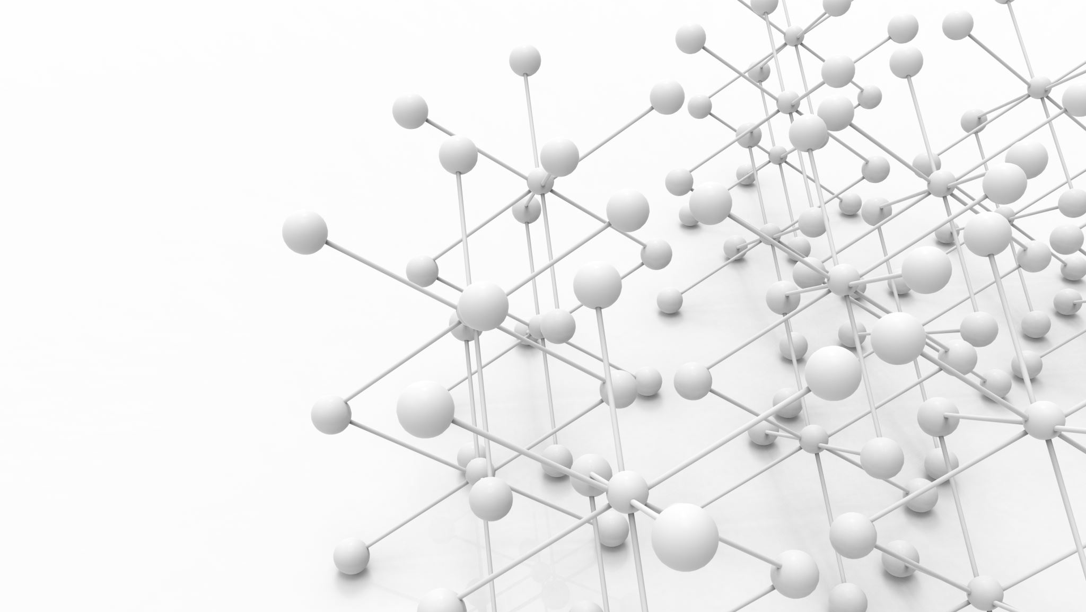
Computer networks Project 3
Group 16
( Eoin Redmond, Jyotirmay Panwar, Nawaldeep Singh, Prachi Singhroha )

Slide 2
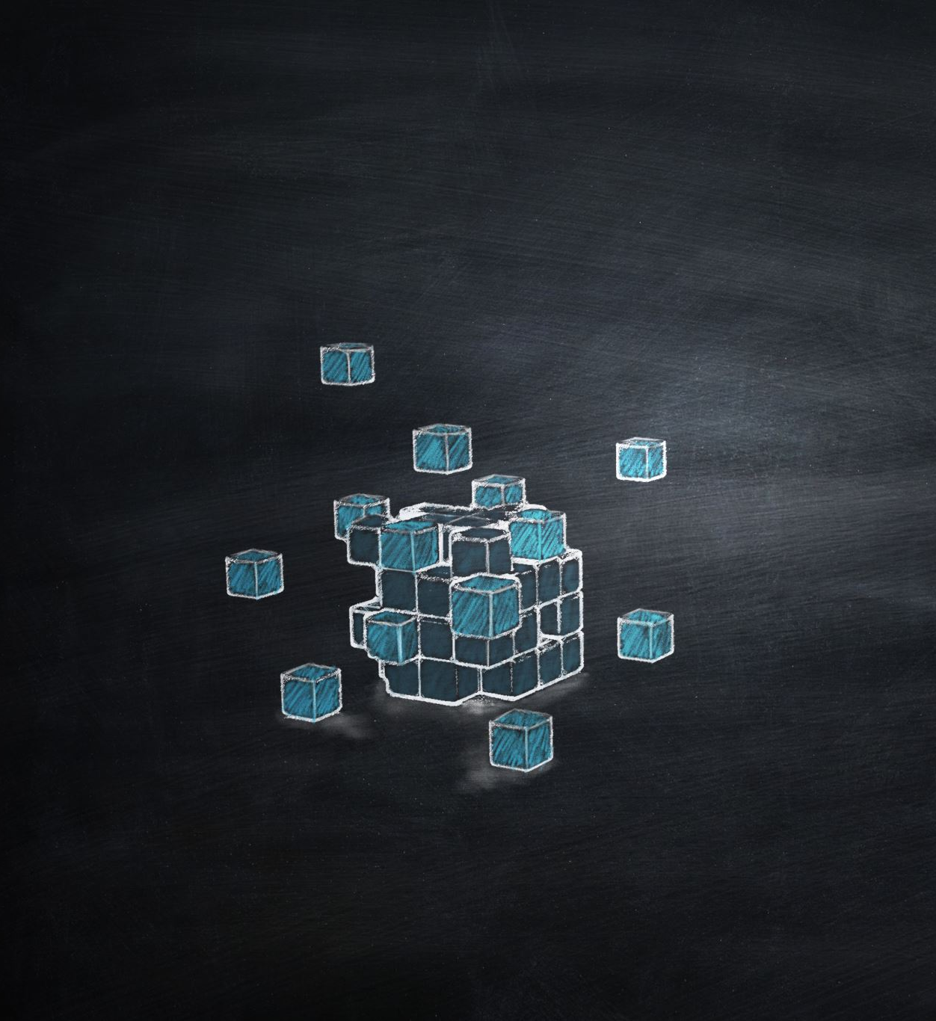

Blockchain Mining
A blockchain command-line interface without using any third-party library

Slide 3

Evolution from Individual projects
Discussion about what was initially set out to do, how, why, what achieved and how we evolved from individual projects

Slide 4

workload
Lessons learned and distribution of workload

Slide 5

Financial inclusion
What is it and why is it a global concern?

Slide 6

Our solution
How can this project make a meaningful difference in the field of financial inclusion?

Slide 7


our approach
Networking/communication aspects
Protocol followed
Security

Slide 8

live demonstration

