Slide 1
Safe On-Ramp Merging with Multi Agent Reinforcement Learning
Supervised by: Dr. Melanie Bouroche
Prachi Singhroha
Date: 23/03/2023

Slide 2
Overview
Introduction
Objective
Previous Works
Background
Ramp merging as MARL
Implementation
Evaluation
Remaining tasks
Enhancement Opportunities

Slide 3
Introduction
Notes:
On-ramp is the road taken by cars to access the highways. Improper handling of vehicle on-ramp merging may hinder traffic flow and contribute to lower fuel economy, while also increasing the risk of collisions. Not only it hinders traffic but also it is one of the main causes of traffic congestion since the driver trying to enter the road and the driver already on the road needs to make a decision if they should accelerate or decelerate the car to enter the road. To teach autonomous vehicles to make these decisions safe reinforcement learning is used.

Slide 4
Multi Agent Reinforcement Learning
Study of how multiple agents interact in a common environment
Notes:
That is, when these agents interact with the environment and one another, can we observe them collaborate, coordinate, compete, or collectively learn to accomplish a particular task. It can be further broken down into three broad categories:
· Cooperative: All agents working towards a common goal
· Competitive: Agents competing with one another to accomplish a goal
· Some mix of the two: Think a 5v5 basketball game, where individuals on the same team are coordinating with one another, but the two teams are competing against one another.

Slide 5
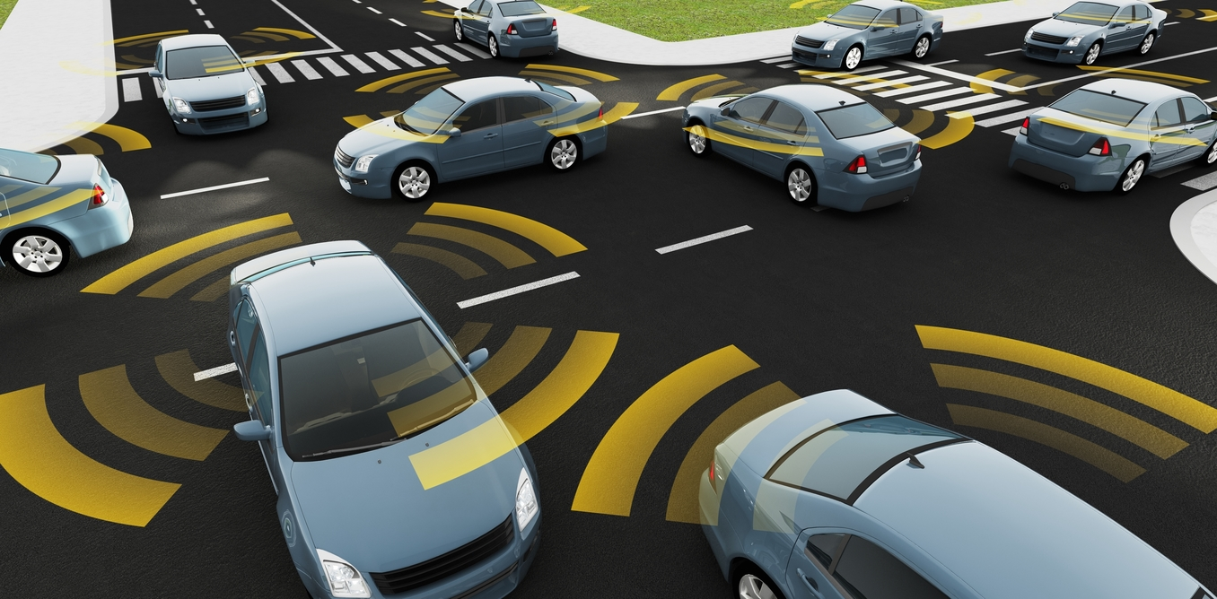
Connected and Autonomous Vehicles
Connected and autonomous vehicles (CAVs) combine connectivity and automated technologies to assist or replace humans in the task of driving.
Notes:
A connected vehicle is able to share information (or data) with other sources both inside and outside of the vehicle and the automated technologies are those which undertake parts of the driving task, or in the case of full autonomy, the whole driving task

Slide 6
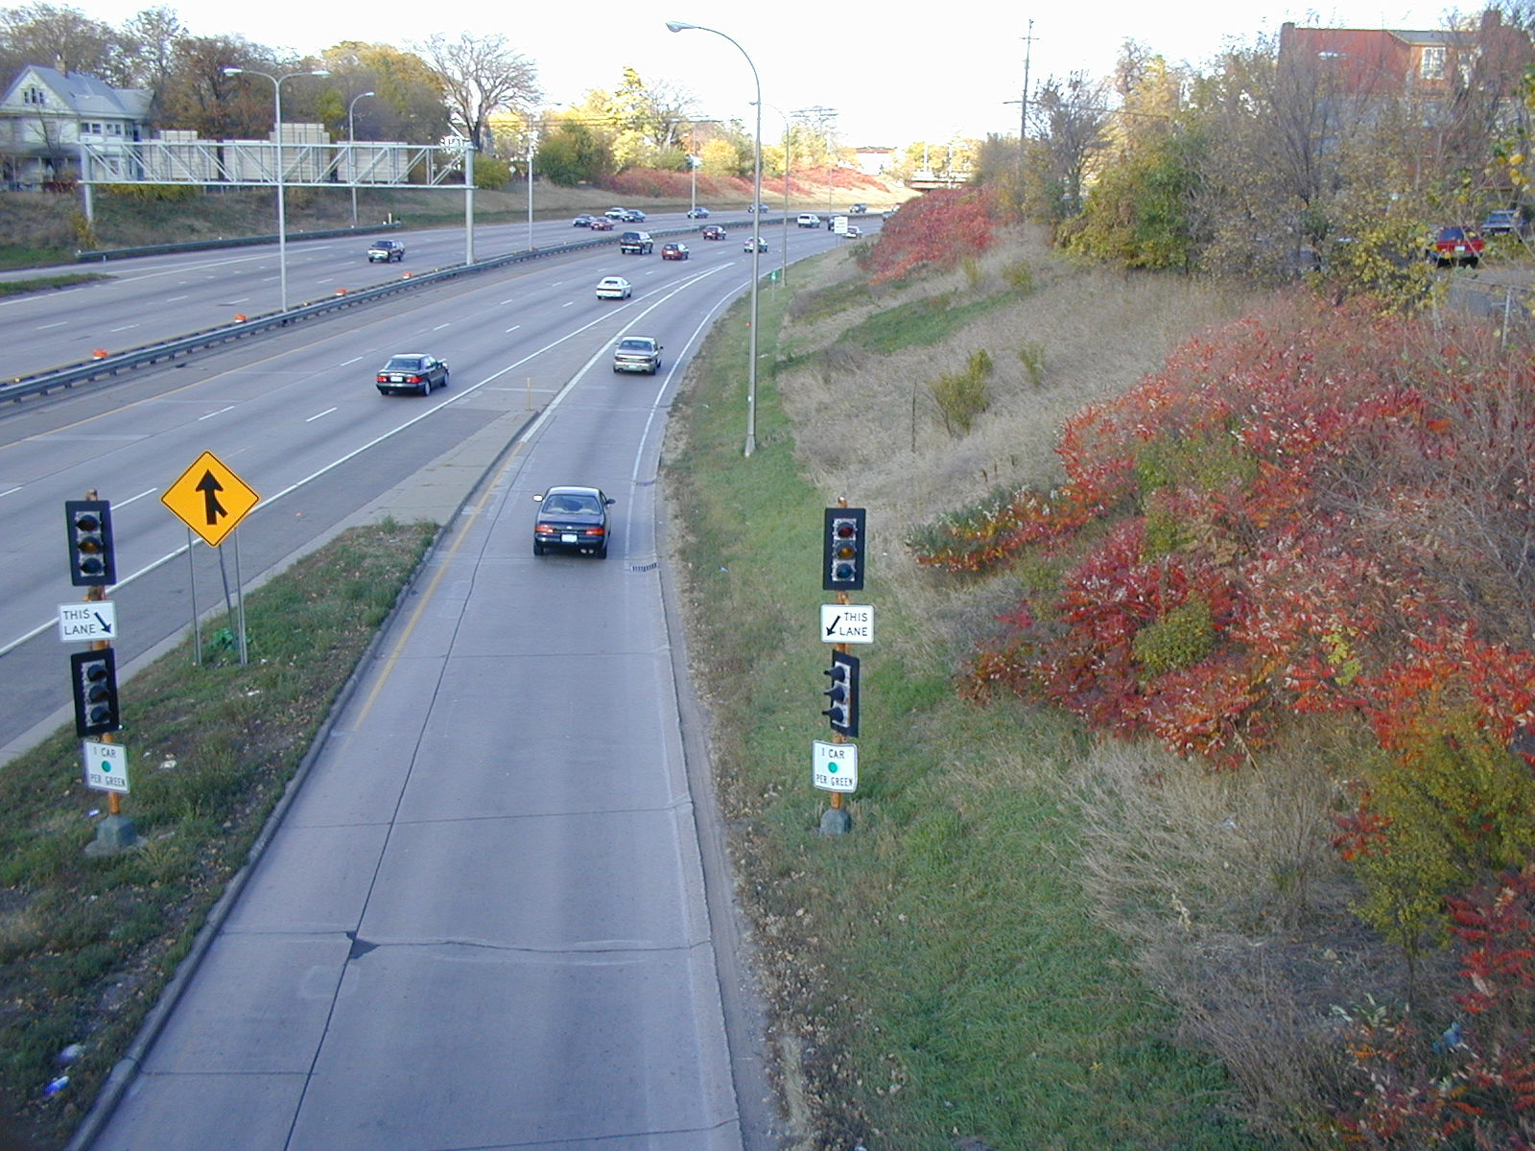
On Ramp Merging
What?
Why do we care about it?
Why use MARL to solve this?
Notes:
- On-ramp is the road taken by cars to access the highways.
- Improper handling of vehicle on-ramp merging may hinder traffic flow and contribute to lower fuel economy, while also increasing the risk of collisions.
It is also one of the main causes of traffic congestion since the driver trying to enter the road and the driver already on the road needs to make a decision if they should accelerate or decelerate the car to enter the road.
But the existing algorithms either compromise safety or competency. On-ramps can lead to bottlenecks, since merging vehicles may slow down initially or even stop on the ramp as they wait for an opportunity to merge. Improper handling of on-ramp merging can lead to major traffic congestion and teaching autonomous vehicles this makes it challenging. Additionally, the agent must behave safely to prevent accidents, making it an ideal scenario for studying SRL algorithms.
Additionally, the agent must behave safely to prevent accidents, making it an ideal scenario for studying Safe Reinforcement Learning algorithms.

Slide 7
Objectives

Slide 8
Objectives
Understand the existing Reinforcement Learning (RL) algorithms for on-ramp merging
Compare the algorithms and study the research and surveys done
Analyze how these algorithms ensure both safety and efficiency
Explore the safety supervisors proposed to recognize their working, issues and developments
Compare all the algorithms for on-ramp merging and implement one which considers both safety and efficiency of CAVs
Evaluate weather the implementation works for safe on ramp merging for different traffic densities and how effective the policy is

Slide 9
Previous works

Slide 10
Some previous works
"Cooperative Driving with Parallel Autonomous Vehicles using Reinforcement Learning" (2018) by Everett et al
"Traffic Management via Multi-Agent Reinforcement Learning" (2018) by Zhang et al.
"Multi-Agent Deep Reinforcement Learning for Autonomous Driving" (2019) by Li et al.
"Multi-Agent Reinforcement Learning for Cooperative Driving: A Survey" (2020) by Zhang et al.
“Deep Multi-agent Reinforcement Learning for Highway On-Ramp Merging in Mixed Traffic” by Cheng et al.
Notes:
presenting a RL-based approach for coordinating multiple Autonomous Vehicles in a cooperative driving scenario. The authors apply their approach to on-ramp merging, and show that their approach can lead to safe and efficient merging
proposing a multi-agent reinforcement learning approach to traffic management, where each vehicle learns its own policy through interactions with the environment. The approach presented in this paper can lead to improved traffic flow and reduced congestion.
presents a deep reinforcement learning-based framework for autonomous driving that takes into account multiple agents and their interactions.
provides a comprehensive survey of the recent developments in multi-agent reinforcement learning for cooperative driving. In this paper the authors discusses the different approaches and challenges in applying MARL to the problem of on-ramp merging.
The paper highlights the potential of MARL in cooperative driving and provides insights into the challenges and opportunities in this area of research.
\

Slide 11
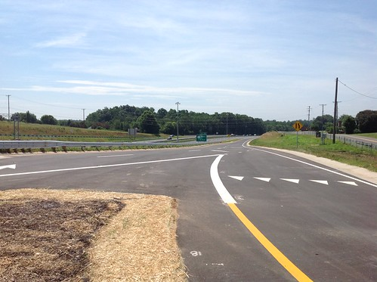
Limitations in prior research
Safety
Scalability
Real-world applicability
Notes:
Safety is a crucial consideration in traffic management, and the approach needs to ensure that the traffic flow optimization does not compromise safety. This is especially important when the traffic volume is high the AVs are operating near each other.
The approach may be limited in its scalability, as the complexity of the problem grows exponentially with the number of agents and the size of the road network. As the number of agents and the size of the network increase, the computational and communication overheads may become prohibitively expensive and may not be feasible to implement in practice.
The approach has only been tested in simulation, and its real-world applicability remains to be demonstrated. The approach needs to be tested in real-world scenarios to ensure that it can be safely and effectively deployed in practice.

Slide 12
Background

Slide 13
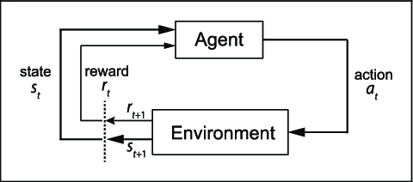
Reinforcement Learning
Notes:
In a RL setting, at each time step t, the agent observes thestatest ∈S⊆Rn,takesanactionat ∈A⊆Rm,and subsequently receives a reward signal rt ∈ R and an updated state st+1 at time t + 1 from the environment. The goal of the RL agent is to learn an optimal policy π∗ :S→A a mapping from state to action, that maximizes the accumulated reward.
The transition of agent from St to St+1 is generally called one iteration. The transition of agent through a sequence of states ending in terminal state is called an episode

Slide 14
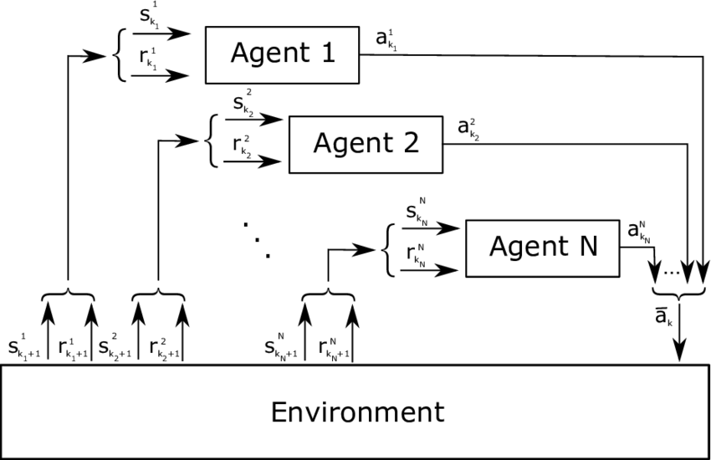
Multi Agent Reinforcement Learning (MARL)
Notes:
Multi-agent reinforcement learning studies how multiple agents interact in a common environment. That is, when these agents interact with the environment and one another, can we observe them collaborate, coordinate, compete, or collectively learn to accomplish a particular task. It can be further broken down into three broad categories:
· Cooperative: All agents working towards a common goal
· Competitive: Agents competing with one another to accomplish a goal
· Some mix of the two: Think a 5v5 basketball game, where individuals on the same team are coordinating with one another, but the two teams are competing against one another.

Slide 15
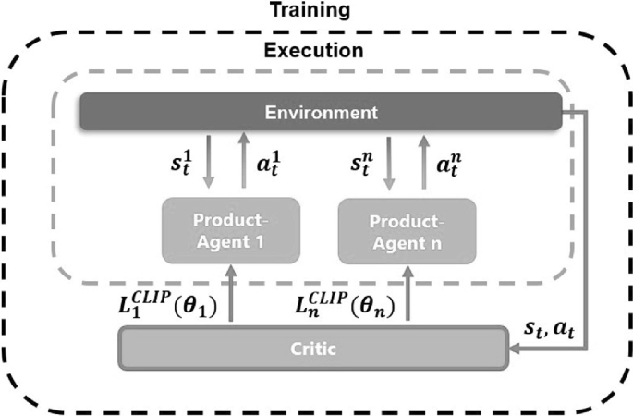
Multi Agent Proximal Policy Optimization
What is Proximal Policy Optimization?
Notes:
The “Proximal Policy Optimization” is a policy gradient method for a single agent approach. It is a family of policy optimization methods that use multiple epochs of stochastic gradient ascent to perform each policy update
PPO is a popular reinforcement learning algorithm that updates the policy of an agent in a way that maximizes the expected reward. It works by iteratively collecting experiences from the environment and updating the policy based on the advantage function, which measures the advantage of a certain action over the average action.
The MAPPO algorithm presented is based on the single agent PPO. The PPO, with its agent, describes a single product-agent. In contrast to the single agent PPO, in the MAPPO all product-agents share a centralized critic. The centralized critic evaluates the actions of each individual product-agent in the context of all product-agents. For this purpose, it receives the global state and all actions of time step t as input. The 𝐿𝐶𝑙𝑖𝑝 function of the PPO calculates the parameter ΘΘ, which indicates how strongly the parameters of the neural network of the product-agent must be adjusted, see Fig. 1. For the adjustment of the neural network of the critic, in addition to the global state, the assigned rewards are also needed. Thus, the product-agents maximize the overall reward with respect to their own reward. Comparable to the centralized critic of the MADDPG [6], the critic itself is only needed for training. During execution, each product-agent takes an action based on the available state, which implicitly considers the actions of the other product-agents.

Slide 16
Ramp merging as MARL

Slide 17
Problem formulation
Adapted from the paper Deep Multi-agent Reinforcement Learning for Highway On-Ramp Merging in Mixed Traffic
On ramp merging is considered as partially observable Markov decision process (POMDP) which is then solved by the MAPPO algorithm.
The POMDP can be denoted by the following tuple:
{A_{i} , S_{i} , Ri }_{i⊆ν} , T
where A_{i} is the action space, S_{i} is the state of the agent, R_{i} is the reward function and T is the transition possibilities
Notes:
Action Space: The action space Ai of agent i is de- fined as the set of high-level control decisions, including turn left, turn right, cruising, speed up, and slow down following the designs in [41], [42]. With a selected high- level decision, lower-level controllers will then produce the corresponding steering and throttle control signals to maneuver the AVs. The overall action space of the system is the joint actions from all AVs, i.e., A = A1 ×A2 ×···×AN.
State Space: The state of agent i, Si, is defined as a matrix of dimension NNi ×W, where NNi is the number of observed vehicles and W is the number of features used to represent the state of a vehicle, including: We assume that only the “neighboring vehicles” can be observed by the ego vehicle. The “neighboring vehicles” are defined as the nearest NNi vehicles that are within a 150 m longitudinal distance from the ego vehicle due to the local observability
Reward Function: The reward function Ri is crucial to train the RL agents so that it follows desired behaviors. As the objective is to train our agents to safely and efficiently pass the merging area, the reward for the ith agent at time step t is defined as follows:
ri,t = wcrc + wsrs + whrh + wmrm, (3)
where wc , ws , wh , and wm are positive weighting scalars corresponding to collision evaluation rc , stable-speed evaluation rs , headway time evaluation rh , and merging cost evaluation rm, respectively. As safety is the most important criteria, we make wc much bigger than other weights to prioritize safety.
Transition Probabilities: the transition probability T (s′ |s, a) characterizes the dynamics of the system. In the developed simulator, we exploit the intelligent driver model (IDM) [46] and MOBIL model [47] for longitu- dinal acceleration and lateral lane change decisions of HDVs, respectively.

Slide 18
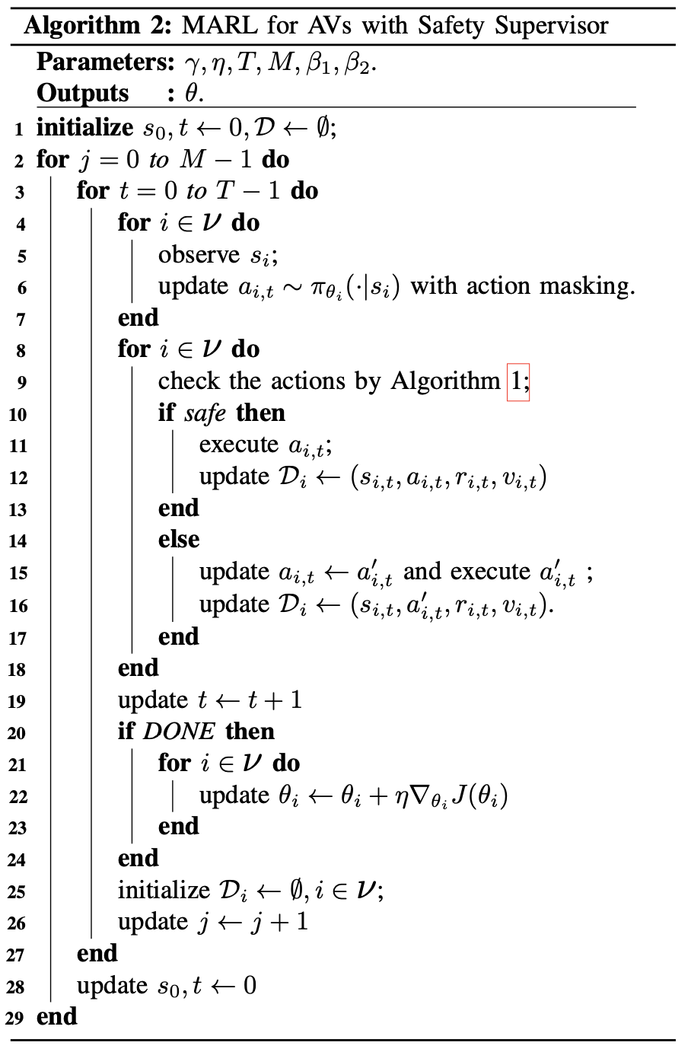
Algorithm
The hyperparameters are as follows.
γ: the (time)-discount factor
η: the learning rate
T: the epoch length
M: the total number pf training epochs
safety simulator
Notes:
The agent receives the observation s; from the environment and updates the action depending on its policy (Lines 6-9). The action will be taken by the agent and the corresponding experience will be collected and saved to the replay buffer (Lines 10-13). After each episode is completed, the network parameters are updated accordingly (Lines 9-11). The parameters of the policy network are updated using the collected experience sampled from the on-policy experience buffer after the completion of each episode (Lines 15-16). The DONE signal is flagged if either the episode is completed or a collision occurs. After receiving the DONE flag, all agents are reset to their initial states to start a new episode (Line 23).
Risky action rejected

Slide 19
Safety Supervisor
The safety supervisor takes the following actions into consideration
The action of changing lanes i.e. turning left or right, the safety margin is is defined as the minimum distance to the preceding and the following vehicles on the current and target lanes.
the action is speed up, idle, or slow down, the safety margin is set as the minimum distance headway.

Slide 20
Improvement in Safety Supervisor
MAPPO algorithm was updated to support the continuous action by updating the loss function to Gaussian policy
Notes:
A Gaussian policy is a continuous distribution that can model policies with more complex and flexible action spaces, such as the steering angle of a vehicle or the speed of a motor. The main advantage of using a Gaussian policy is that it can provide more flexibility and better performance for tasks that require fine-grained and continuous control over the actions of the agents.
The improvement made in the safety supervisor in the MAPPO algorithm was to support continuous action by updating the loss function to Gaussian policy. This update allowed for more precise control over the continuous action space and helped to improve the safety of the on-ramp merging process.

Slide 21
Implementation

Slide 22
Implementation
Why this environment?
Project is written in Python programming language.
Simulation is done using highway-env environment.
Simulation set up id as follows:
Number of training episodes: 20000
Evaluation Interval: 200
Max length of each episode: 20 seconds
Headway time: 1.2 seconds
γ = 0.99
β1 and β2 = 1 and 0.01 repectively
Notes:
The env assumes connection between all controlled vehicles. All vehicles receive data from surrounding vehicles as observation which makes the implementation of MAPPO easier.

Slide 23
Implementation Challenges
The simulation environment I chose is not tailor-made for CAVs.
Simulation does not support the multi agent environment.
Does not support continuous action.
Notes:
The main advantage of using a Gaussian policy is that it can provide more flexibility and better performance for tasks that require fine-grained and continuous control over the actions of the agents and then individual rewards were combined to receive the collective reward. Furthermore, the proximal policy optimization algorithm was updated to add support for multi-agent training and developed the multi-agent PPO (MA-PPO) algorithm.
The highway-env library does not support connected autonomous vehicles. To make the MARL-CAV implementation support collaboration among different agents, the MA-PPO algorithm was updated to support parameter sharing and add replay buffer functionality discussed in Section 2.4.3. This ensured that agents cooperatively take action.
The highway-env library out-of-box just supported discrete action for fast-highway-MA-vO environment. Therefore, MARL-CAV was developed to work with discrete action space. These actions were move left, move right, forward and idle
However, as discussed in 4.3.1 the safety technique, control barrier function (BF) was selected to be examined whether it adds safety to MARL-CAV. BFs only support continuous action space. Therefore, the code for fast-highway-MA-v0 environment and MA-PPO algorithm was updated, and support for continuous actions was added. The loss function of MA-PPO was updated to use a Gaussian policy rather than the initial categorical policy. The continuous actions were steering angle and throttle value for the vehicle
The continuous action PPO setup was tested on Open Al inverted pendulum environment
Brockman et al. (2016). The algorithm worked succêssfully and kept the pendulum in an upright position.
Furthermore, one more component was added to the reward function. This was added to ensure that the vehicle gets rewarded for staying in the centre of the lane while moving in the road.

Slide 24
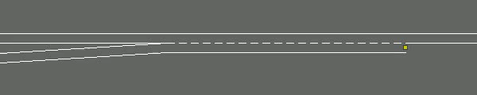
Traffic density: Low
Number of HDVs: 1-3
Number of CAVs: 1-3
Note: CAVs are green in color and HDVs are blue
Notes:
In each training episode, a different number of HDVs and AVs will randomly appear at the spawn points with a random position noise (uniformly distributed in [-1.5m, 1.5m]) added to each initial spawn position. The initial speed is randomly chosen between 25 to 27 m/s. The vehicle control sampling frequency is 5 Hz, i.e., AVs take an action every 0.2 seconds. A 5% random noise is added to the predicted acceleration and steering angle for HDVs. We train all MARL algorithms over 2 million steps with 3 different random seeds while the same random seeds are shared among the agents, which is around 20,000 episodes with episode horizon T = 100 steps. We evaluate the algorithm over 3 episodes every 200 training episodes.

Slide 25
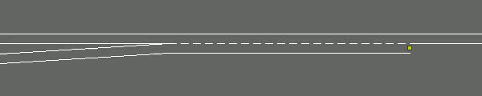
Traffic density: Medium
Number of HDVs: 2-4
Number of CAVs:2-4
Note: CAVs are green in color and HDVs are blue

Slide 26
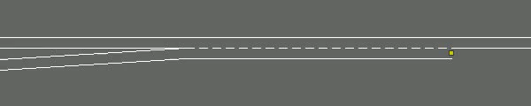
Traffic density: High
Number of HDVs: 4-6
Number of CAVs: 4-6
Note: CAVs are green in color and HDVs are blue

Slide 27
How is this implementation better than previous works?
The reward considers the safety factor.
Noise is added to the system which incorporates the uncertainty and risk-awareness in the decision-making process
Notes:
by incorporating safety constraints into the reward function and the update rule, MAPPO can be used to learn safe and efficient cooperative behavior in multi-agent systems. This can lead to significant improvements in the overall safety of the system and reduce the likelihood of accidents or other undesirable outcomes.

Slide 28
Evaluation

Slide 29
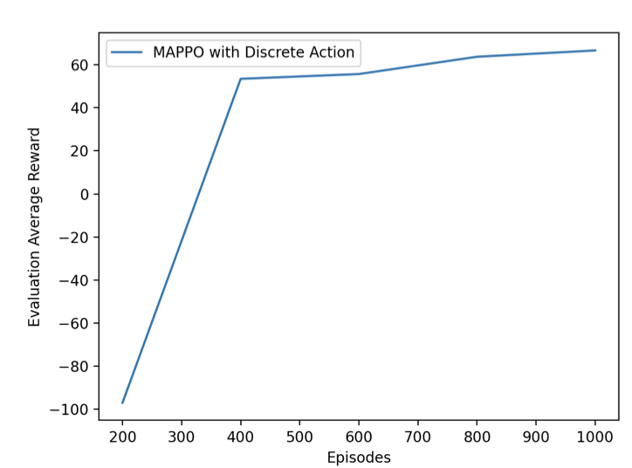
Evaluation
Record the affect of different number of episodes, traffic densities and how they affect the working of algorithm.
Comparison of MAPPO with other state of art techniques.
Record the rewards and plot average rewards per episodes which should look like as follows:
Notes:
we can observe that the average rewards of evaluation episodes have increased over the number of training episodes. In the beginning of training, the average reward was negative because there must be a lot of collisions resulting in higher penalties and negative rewards. The policy would not be good during the initial training episodes.
As the training reached 350 episodes, the policy improved, resulting in fewer or no collisions and higher rewards.
From Figure 6.1b we can observe

Slide 30
Remaining Tasks

Slide 31
Remaining tasks
Conduct a thorough evaluation to assess the performance of the algorithm and determine if it meets the expected results.
Collaborate with additional safety supervisors to investigate their impact on the algorithm's performance.
Finalize and submit the report, summarizing the research and findings related to the on-ramp merging problem using deep multi-agent reinforcement learning.

Slide 32
Enhancement Opportunities

Slide 33
Enhancement opportunities
Evaluate the proposed algorithm on more complex and realistic scenarios with more heterogeneous traffic conditions.
Incorporate more human-like driving behaviours into the learning process to make the CAVs more adaptive to different driving styles.
Incorporate real-world constraints and limitations, such as communication delays and network failures, into the learning process to improve the robustness and reliability of the proposed algorithm.
Investigate the potential of using a combination of different learning algorithms, such as deep reinforcement learning and imitation learning, to improve the overall performance of the proposed algorithm.

Slide 34
Questions ?
Notes:
Why mappo? MAPPO has several advantages. It combines the benefits of centralized training with decentralized execution, which allows for efficient learning and execution in large-scale systems. It also includes an adaptive KL penalty coefficient, which ensures stability and robustness during training. Additionally, MAPPO allows for communication and observation among agents, which can improve coordination and performance.
Efficient coordination: MAPPO allows for communication and observation among agents, which can improve coordination and performance. This enables agents to work together more effectively to achieve a common goal, even in complex systems with many agents.
Centralized training with decentralized execution: MAPPO uses a centralized critic network to estimate the value function of the joint actions of all agents during training, but during execution, each agent acts independently based on their own observations and policies. This approach allows for efficient learning and execution in large-scale systems.
Stability and robustness: MAPPO includes an adaptive KL penalty coefficient, which ensures stability and robustness during training. This means that the algorithm can handle changes in the environment or system without catastrophic failures or unstable learning.
Performance improvements: MAPPO has shown significant performance improvements compared to other state-of-the-art techniques in cooperative multi-agent systems. For example, in experiments on the multi-agent particle environment, MAPPO outperformed other techniques in terms of average return and convergence speed.
Recording the effect of different number of episodes and traffic densities on the algorithm is important because it helps to understand how the algorithm performs under different conditions. By varying the number of episodes and traffic densities, it is possible to see how the algorithm adapts to different situations and whether it is able to maintain its performance over time. This information can then be used to fine-tune the algorithm and improve its performance.
The rewards can be used to evaluate the algorithm's performance by measuring how well it achieves its objectives. In the case of the on-ramp merging problem, the objective is to merge onto the highway safely and efficiently. By recording the rewards for each episode and plotting the average rewards per episode, it is possible to see whether the algorithm is achieving its objectives and whether its performance is improving over time. If the rewards are consistently high and increasing over time, it indicates that the algorithm is performing well. If the rewards are low or inconsistent, it suggests that the algorithm may need to be adjusted or improved.
The length of the road is 520 m, where the entrance of the merge lane is at 320 m and the length of the merge lane is L = 100 m. There are 12 spawn points evenly distributed on the through lane and the ramp lane from 0 m to 220 m,
In each training episode, a different number of HDVs and AVs will randomly appear at the spawn points with a random position noise (uniformly distributed in [-1.5m, 1.5m]) added to each initial spawn position. The initial speed is randomly chosen between 25 to 27 m/s. The vehicle control sampling frequency is 5 Hz, i.e., AVs take an action every 0.2 seconds. A 5% random noise is added to the predicted acceleration and steering angle for HDVs. We train all MARL algorithms over 2 million steps with 3 different random seeds while the same random seeds are shared among the agents, which
is around 20,000 episodes with episode horizon T = 100 steps. We evaluate the algorithm over 3 episodes every 200 training episodes.

Slide 35
Thank You

