Slide 1
Data Science 2
Final Project
Ankush Vasishta
Rohit Singh
Sumer Singh

Slide 2
Problem Statement
Performing Classification on multiple unrelated datasets to find out which modelling technique is the most versatile.

Slide 3
Describe Dataset
1.Online Shoppers Purchasing Intention Dataset Data Set:- The dataset consists of feature vectors belonging to 12,330 sessions and 17 attributes. The dataset was formed so that each session would belong to a different user in a 1-year period to avoid any tendency to a specific campaign, special day, user profile, or period.
2.Heart Disease:-This database contains 304 samples and 13 attributes, The "goal" field refers to the presence of heart disease in the patient. It is integer valued from 0 (no presence) and 1 (presence).
3.Titanic:-Dataset containing the details of passengers of titanic. Consists of 889 samples and 11 attributes. We predict as to how many passengers based on different attributes will tend to survive.
Notes:
Links to datasets:
https://archive.ics.uci.edu/ml/datasets/Online+Shoppers+Purchasing+Intention+Dataset
https://www.kaggle.com/ronitf/heart-disease-uci
https://www.kaggle.com/c/titanic/data

Slide 4
Data Preprocessing
Impute missing values (use most frequent).
Scale features.
Convert categorical values to one hot vectors.

Slide 5
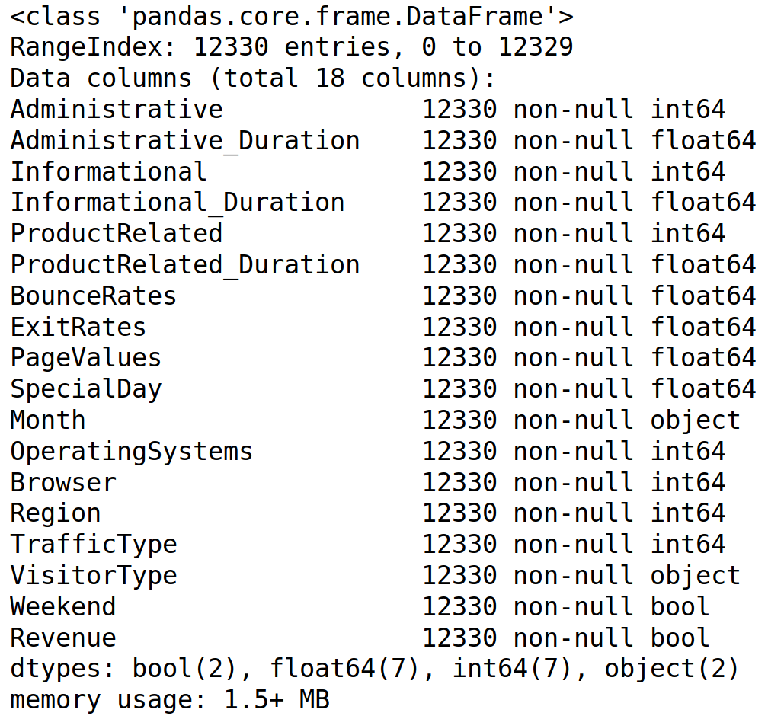
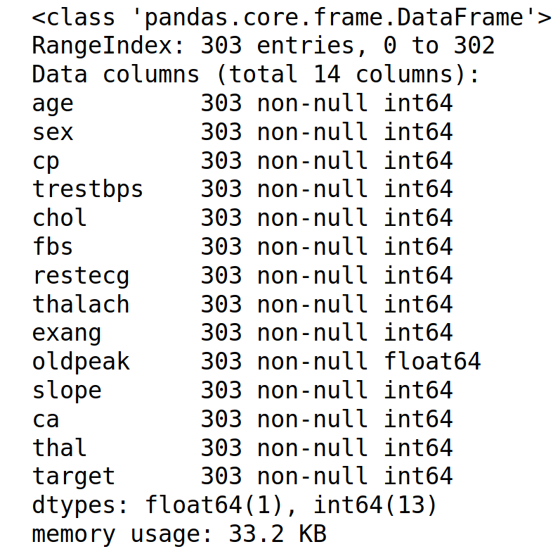
Examination of Data
Online Shopper Dataset Heart Disease Dataset

Slide 6
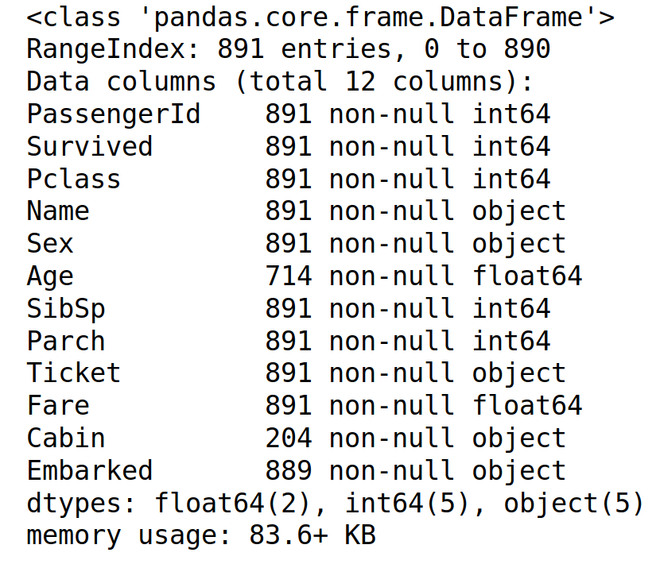
Examination of Data
Titanic Dataset

Slide 7
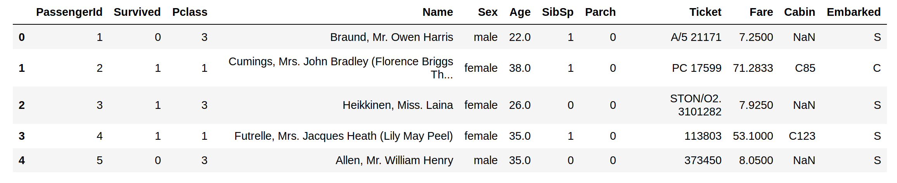
Additional Data Preprocessing for Titanic Dataset
Delete Cabin (lots of missing values), Names and Tickets (text based) and Passenger ID(ordered sequence).
Notes:
We delete Cabin because they’re more than 50% missing values.
Names and Tickets are string based data, so we delete them.
Passenger ID is a sequence of numbers, therefore we delete it.

Slide 8
Modelling Techniques
Logistic Regression
Random Forest
K Nearest Neighbours (k = 5)
Support Vector Machine
Notes:
Logistic Regression Parameters:
a) Regularization - L2 (lamba=1)
Random Forest Parameters: a) The number of trees - 100
KNN Parametres:
a) K = 5
4) SVM Parameters:
a)Kernel - RBF

Slide 9
Quality of Fit
Accuracy
F1
AUROC

Slide 10
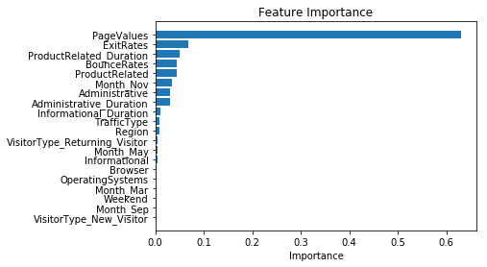
Feature selection - Online Shopper Intention

Slide 11
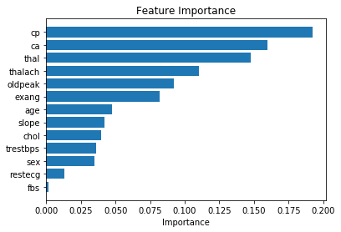
Heart
FBS - fasting blood sugar

Slide 12
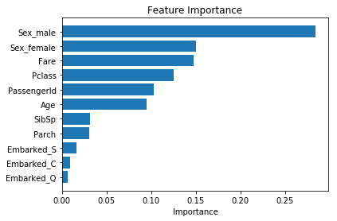
Titanic

Slide 13
Data Visualization
We create Pair Plots of the top 4 features.

Slide 14
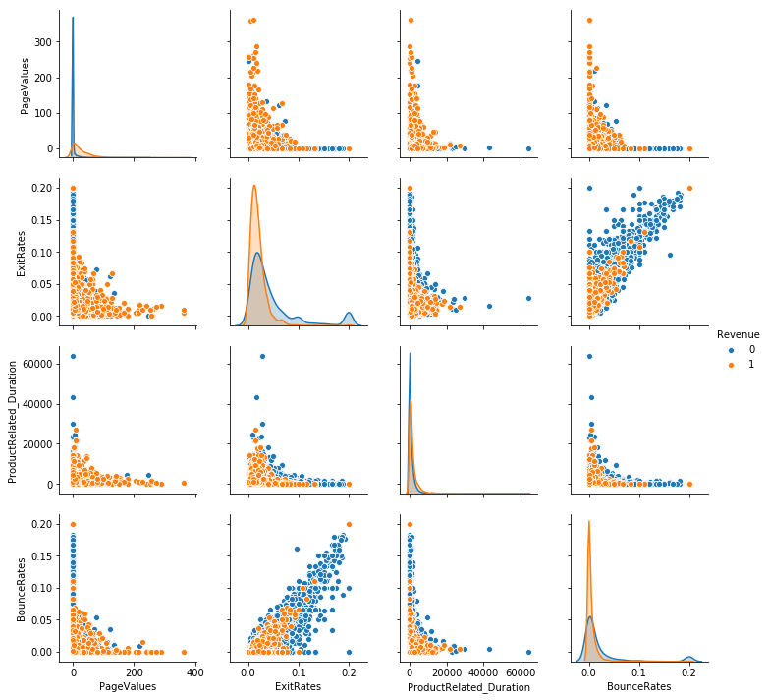
Notes:
Dataset - Online Shopper Intention
PageValues - We notice lower page values corresponds to negative class samples (no purchase made).
ExitRates - We can infer lower exit rates correspond to positive class samples (purchase made).
Product Related Duration - We notice lower exit rates corresponds to negative class samples (no purchase made).
Bounce Rates - We can infer lower exit rates correspond to positive class samples (purchase made).
Description of Parameters:
PageValues: feature represents the average value for a web page that a user visited before completing an e-commerce transaction
ExitRates: feature for a specific web page is calculated as for all pageviews to the page, the percentage that were the last in the session.
Product Related Duration: represent the number of different types of pages visited by the visitor in that session and total time spent in each of these page categories.
Bounce Rates: feature for a web page refers to the percentage of visitors who enter the site from that page and then leave ("bounce") without triggering any other requests to the analytics server during that session.

Slide 15
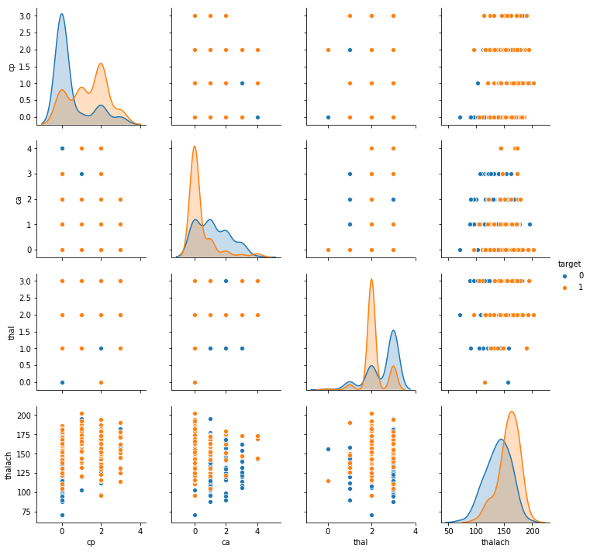
Notes:
Dataset - Heart Disease Dataset
cp - We notice lower cp corresponds to negative class samples (no heart disease).
ca - We can infer ca correspond to positive class samples (presence of heart disease).
thal - We notice high thal corresponds to negative class samples (no heart disease).
thalach - We can infer high thalch correspond to positive class samples (presence of heart disease).
Description of Parameters:
cp: chest pain type
ca: number of major vessels (0-3) colored by flourosopy
thalach: maximum heart rate achieved
Thal:not specified in data

Slide 16
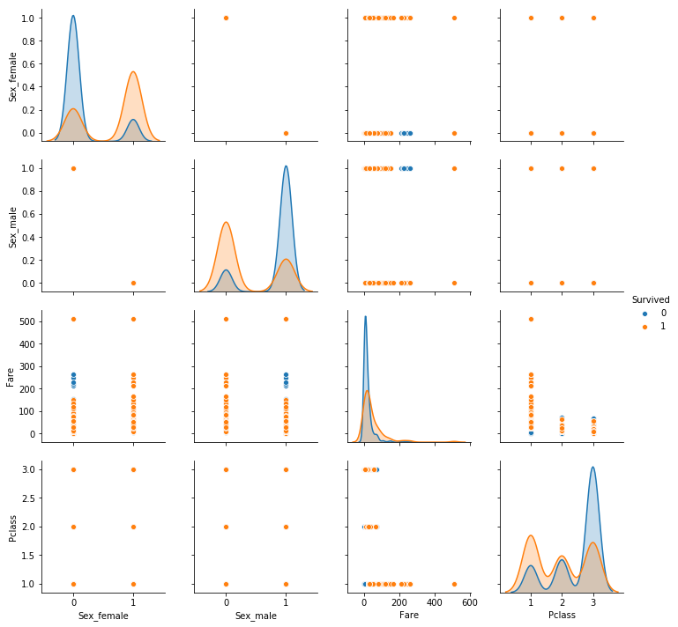
Notes:
Dataset - Titanic Dataset
sex_female - We notice that females survived at a higher rate.
sex_male - We notice that male survived at a lower rate.
fare - We notice people with higher fares survived at a higher rate.
Pclass - We can infer that first class passengers survived at a higher rate that second and third class.
Description of Parameters:
Sex_female : female passengers
Sex_male : male passengers
Fare : price of ticket
Pclass: Passenger’s class of travel

Slide 17
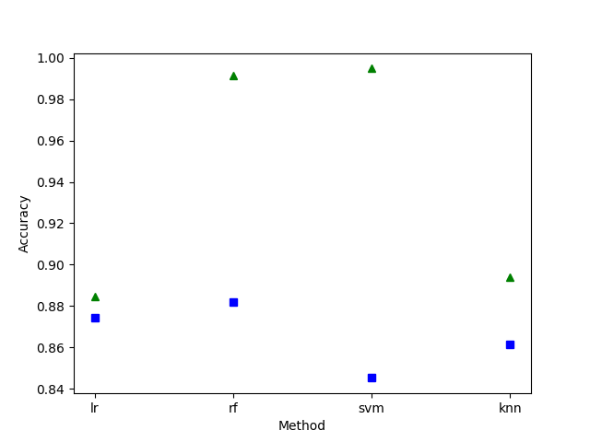
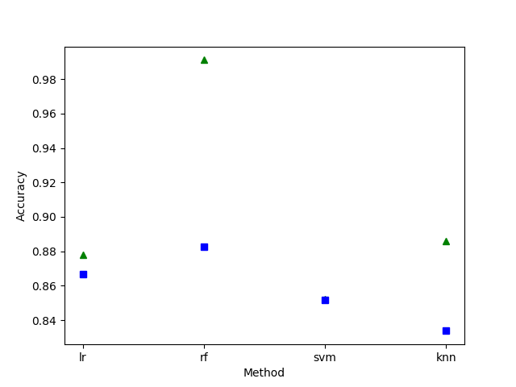
Online Shopper Accuracy
Notes:
Green triangle - Training metric
Blue Square - 10 fold cross validation metric
Left Graph - No scaling used
Right Graph - Values scaled between 0 and 1.
NOTE : WE HAVE REPLACED THE OLD GRAPHS(GENERATED USING NORMAL CROSS VALIDATION) WITH THE UPDATED ONES(USING 10 FOLD CROSS VALIDATION)

Slide 18
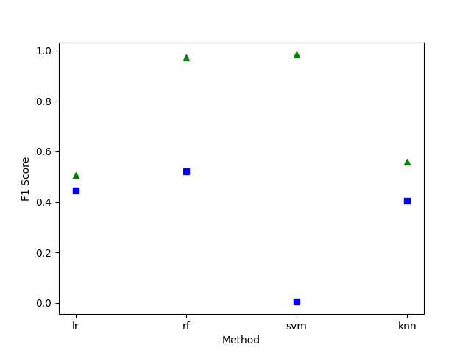
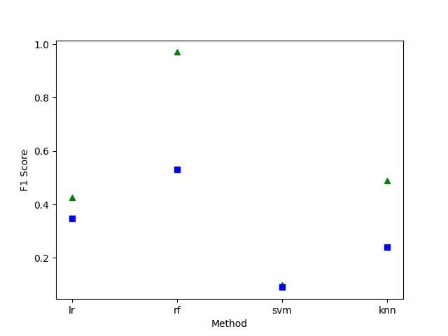
Online Shopper F1
Notes:
Green triangle - Training metric
Blue Square - 10 fold cross validation metric
Left Graph - No scaling used
Right Graph - Values scaled between 0 and 1.
NOTE : WE HAVE REPLACED THE OLD GRAPHS(GENERATED USING NORMAL CROSS VALIDATION) WITH THE UPDATED ONES(USING 10 FOLD CROSS VALIDATION)

Slide 19
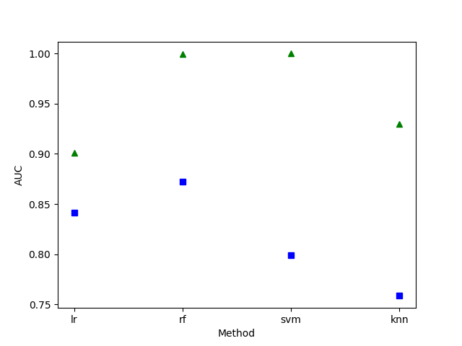
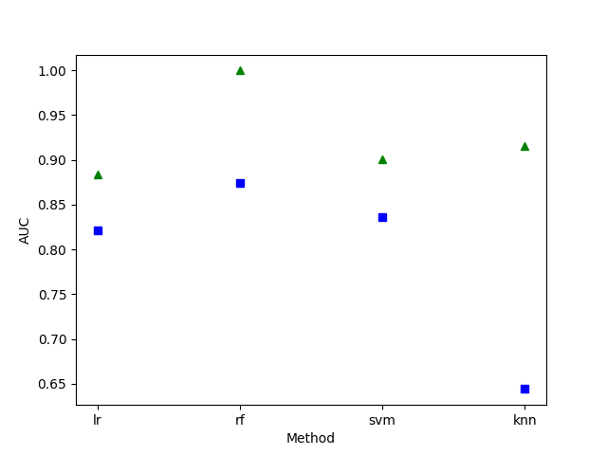
Online Shopper AUROC
Notes:
Green triangle - Training metric
Blue Square - 10 fold cross validation metric
Left Graph - No scaling used
Right Graph - Values scaled between 0 and 1.
NOTE : WE HAVE REPLACED THE OLD GRAPHS(GENERATED USING NORMAL CROSS VALIDATION) WITH THE UPDATED ONES(USING 10 FOLD CROSS VALIDATION)

Slide 20
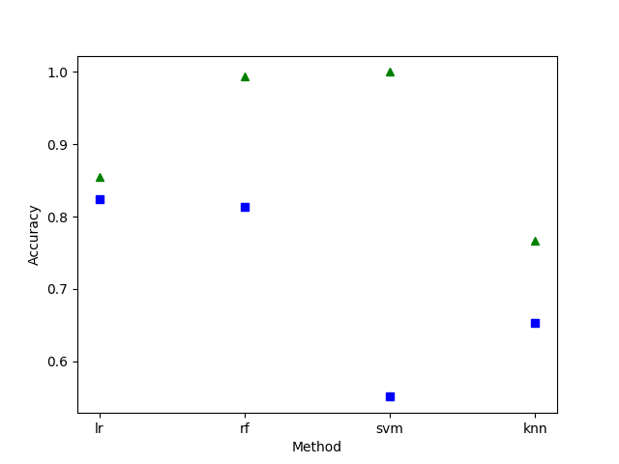
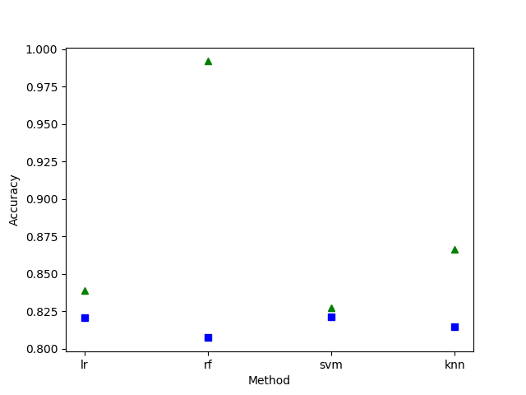
Heart Disease Accuracy
Notes:
Green triangle - Training metric
Blue Square - 10 fold cross validation metric
Left Graph - No scaling used
Right Graph - Values scaled between 0 and 1.
NOTE : WE HAVE REPLACED THE OLD GRAPHS(GENERATED USING NORMAL CROSS VALIDATION) WITH THE UPDATED ONES(USING 10 FOLD CROSS VALIDATION)

Slide 21
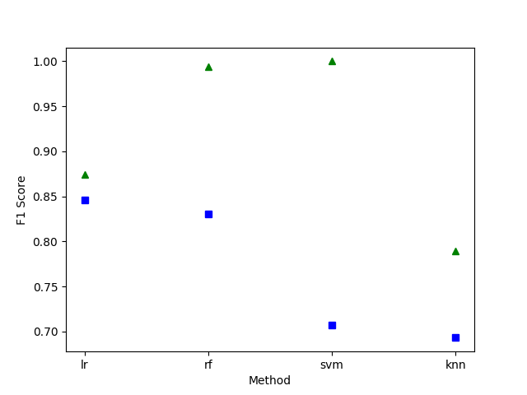
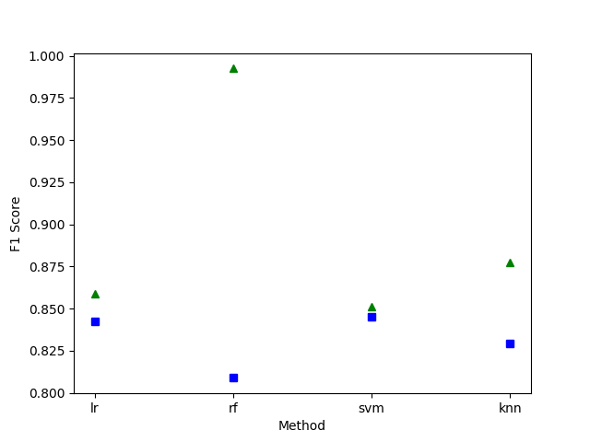
Heart Disease F1
Notes:
Green triangle - Training metric
Blue Square - 10 fold cross validation metric
Left Graph - No scaling used
Right Graph - Values scaled between 0 and 1.
NOTE : WE HAVE REPLACED THE OLD GRAPHS(GENERATED USING NORMAL CROSS VALIDATION) WITH THE UPDATED ONES(USING 10 FOLD CROSS VALIDATION)

Slide 22
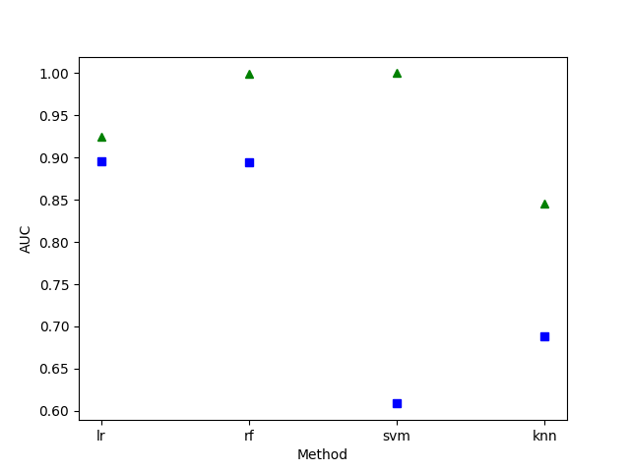
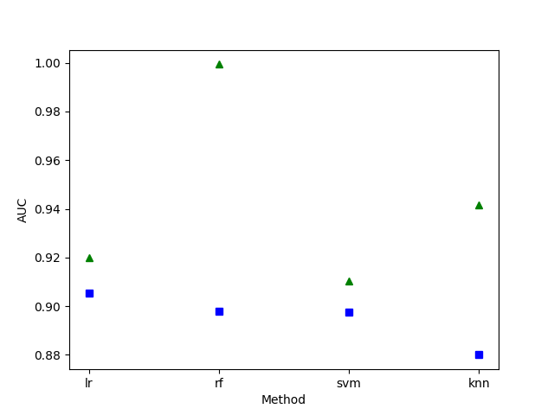
Heart Disease AUROC
Notes:
Green triangle - Training metric
Blue Square - 10 fold cross validation metric
Left Graph - No scaling used
Right Graph - Values scaled between 0 and 1.
NOTE : WE HAVE REPLACED THE OLD GRAPHS(GENERATED USING NORMAL CROSS VALIDATION) WITH THE UPDATED ONES(USING 10 FOLD CROSS VALIDATION)

Slide 23
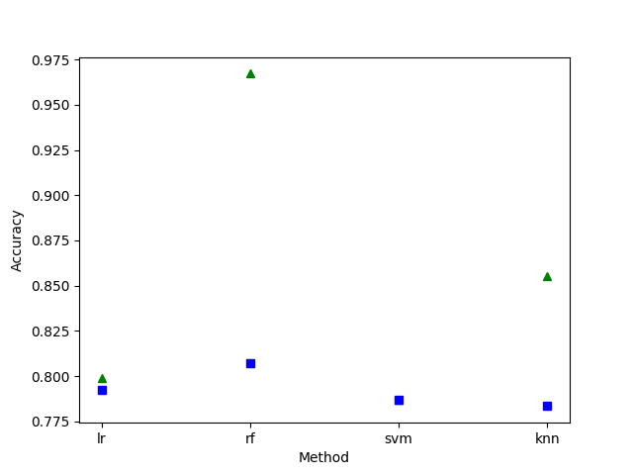
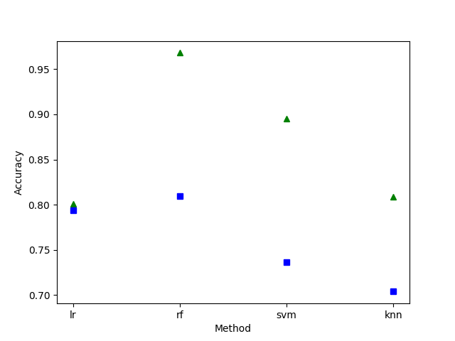
Titanic Accuracy
Notes:
Green triangle - Training metric
Blue Square - 10 fold cross validation metric
Left Graph - No scaling used
Right Graph - Values scaled between 0 and 1.
NOTE : WE HAVE REPLACED THE OLD GRAPHS(GENERATED USING NORMAL CROSS VALIDATION) WITH THE UPDATED ONES(USING 10 FOLD CROSS VALIDATION)

Slide 24

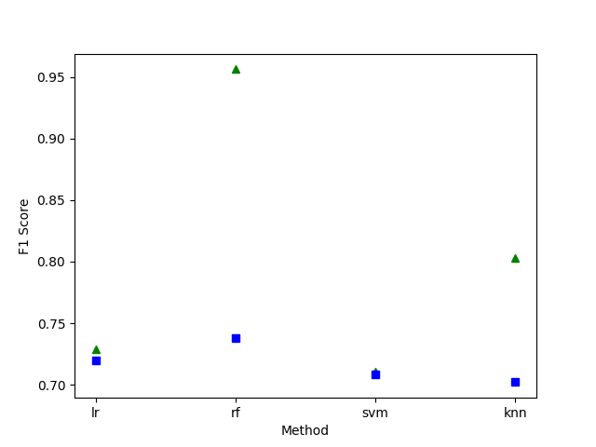
Titanic F1
Notes:
Green triangle - Training metric
Blue Square - 10 fold cross validation metric
Left Graph - No scaling used
Right Graph - Values scaled between 0 and 1.
NOTE : WE HAVE REPLACED THE OLD GRAPHS(GENERATED USING NORMAL CROSS VALIDATION) WITH THE UPDATED ONES(USING 10 FOLD CROSS VALIDATION)

Slide 25
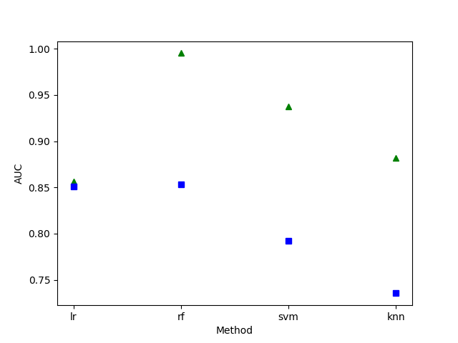
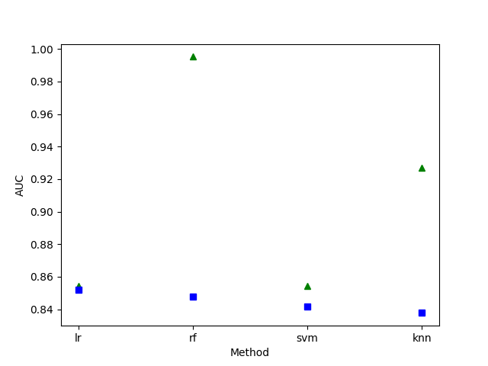
Titanic AUROC
Notes:
Green triangle - Training metric
Blue Square - 10 fold cross validation metric
Left Graph - No scaling used
Right Graph - Values scaled between 0 and 1.
NOTE : WE HAVE REPLACED THE OLD GRAPHS(GENERATED USING NORMAL CROSS VALIDATION) WITH THE UPDATED ONES(USING 10 FOLD CROSS VALIDATION)

Slide 26
Interpretation of Results
Scaling helps SVM and KNN in most cases.
Logistic Regression is usually invariant of scaling.
Scaling harms Random Forest in many cases.
Random Forest usually performs the best.
Svm usually performs the worst.

Slide 27
Recommendations of study
Try different models and datasets.
Tune current models by varying their parameters.

Slide 28
References
https://archive.ics.uci.edu/ml/datasets/Online+Shoppers+Purchasing+Intention+Dataset
https://www.kaggle.com/ronitf/heart-disease-uci
https://www.kaggle.com/c/titanic/data

