Slide 1



Problem Statement Title: Advanced Fake News Detection
Team Name: Runtime Terror
Team Leader Name: Saksham Singh
Mentor Name: Dr. Ankita Gupta

Slide 2

Runtime Terror brings you Verity.AI a one stop solution for all doubts that you have in mind
Whether the 2000 note really has a chip?
Whether the update on Russo-Ukraine war is really true or a war propaganda?
Whether there is really a religious remark made by someone or it is just for TRP purpose?
To realize the difference between the promises and work on ground done by elected ministers
And of course a lot about news article/stories related to sports , international and national affairs etc.
News forms a real basis of what happens tomorrow. So in order to refrain a news article to transform its action from a breaking news to a societal peace breaker Verity.AI steps in with a ML powered algorithm.

Slide 3
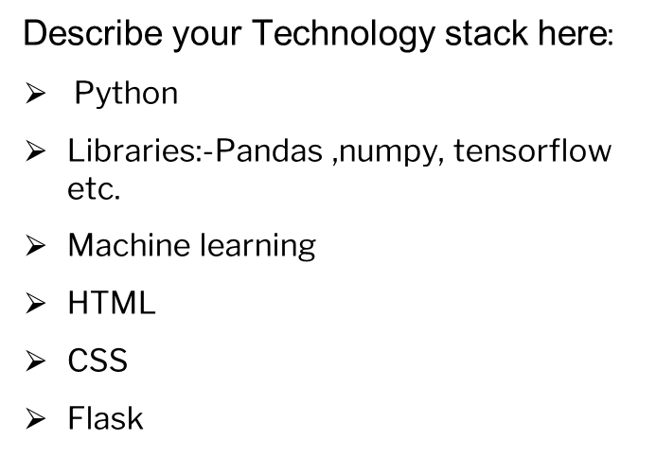
Idea or approach implementation
A ML LSTM algorithm is trained which keeps the platform text independent and makes all judgements by pure mathematical comparisons. This is done by training a deep learning model on a set of 40k+ news articles. Our model would be running on numerous data so it would be expanding day by day so its an ever learning model.
Article is decided to be fake or true depending on its own word constituents i.e. words are indexed and compared amongst each other. The preprocessed data when passed through the layered model gives a very good accuracy.
We eradicated linguistic barriers and keep it an open to all platform. Reputed news agencies could now use it to expand their business across globe thus we take many companies together under our umbrella , hence creating connections.
Top 5 links are crawled to realize the presence of news as fake or true on web.
An email is send to the publisher/user if news comes out to be false. This improves the trust factor , which will divert more traffic to our web.

Slide 4
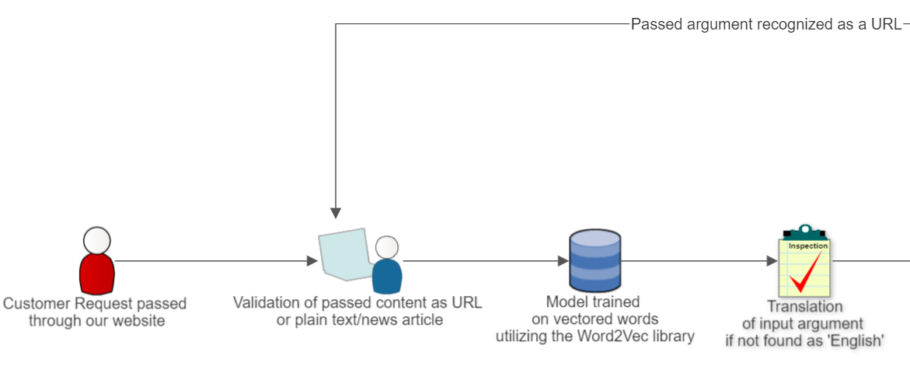
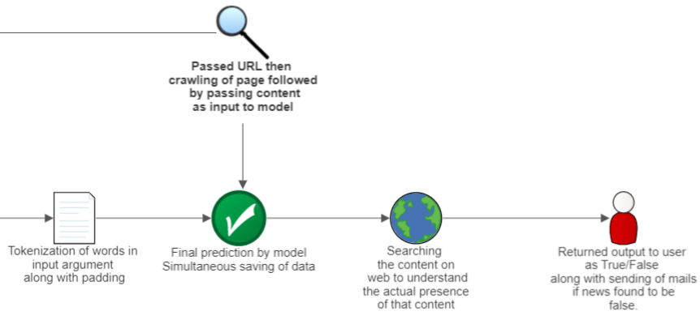
Lets look at flow of user interaction

Slide 5
Use Case | Show Stopper
Governments and other organizations can use fake news prediction technology to monitor the spread of fake news and disinformation on social media and other channels, helping to prevent the negative impacts of such content on society. Rational policies that are based on facts and real data thus providing open discussion platform. Online advertising agencies : Advertisers can use fake news predictors to avoid advertising on sites that have a history of publishing fake news. Also reputed org face financial loss too in case of false news. | Local news i.e. of importance to a comparative small group contains words that are weighed. Various news agencies , foul political play would like to influence this process to favour it unknowingly towards their side. Thus efforts are to keep whole process free from human. Also there needs to be a word limit to ensure that user pass a specified no. of words since , a fake news is decided by analysing crux of an article or story rather than by few words.
5

Slide 6
Use Case | Show Stopper
A powerful tech :- Identification and retracing fake news which could potentially disturb society political or religious order. Newsroom fact-checking: - Newsrooms can use fake news predictors to scan their own stories and verify the accuracy of their reporting. This helps during wartime , elections etc. Business Aspect:- The digital content is going to get disrupted as soon after its launch it would become a habit of readers compelling the writers to route their content via our site multiplying the traffic. Thus supporting startups. | Presence of word combinations in dataset on which the ML model is trained needs to be well furnished with diverse types of news along with tweets etc. Even after incorporating google translator still there are many regional languages which are still not compatible with this model restricting its use at roots. Small length texts will always give an uncertain result so news stories or articles are preferred over it. Also the biasness of the model towards pre written or published articles can not be ignored.
6

Slide 7
Team Member Details
Sr. No. | Name of Team Member | Course (B.Tech/MBA etc): | Stream (ECE, CSE etc): | Year | Position in team (Team Leader, Front end Developer, Back end Developer, Full Stack, Data base management etc.)
1 | Saksham Singh | B.Tech | CSE | 2021 | Team Leader(ML)
2 | Avval Narang | B.Tech | CSE | 2021 | Full Stack
3
4
5
Team Mentor Details
Sr. No. | Name of Mentor | Department
1 | Dr. Ankita Gupta | CSE
7

Slide 8

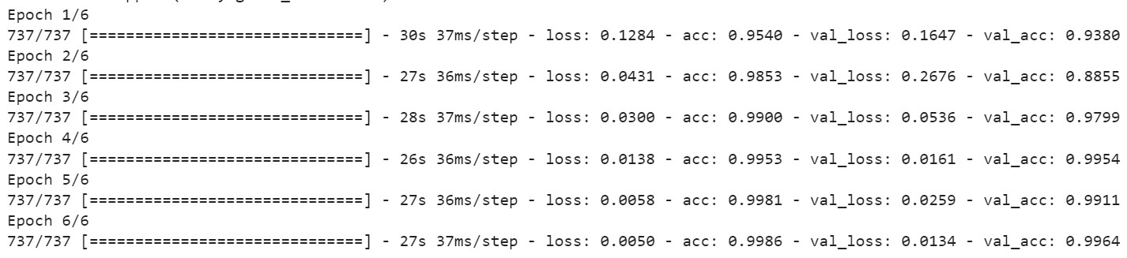
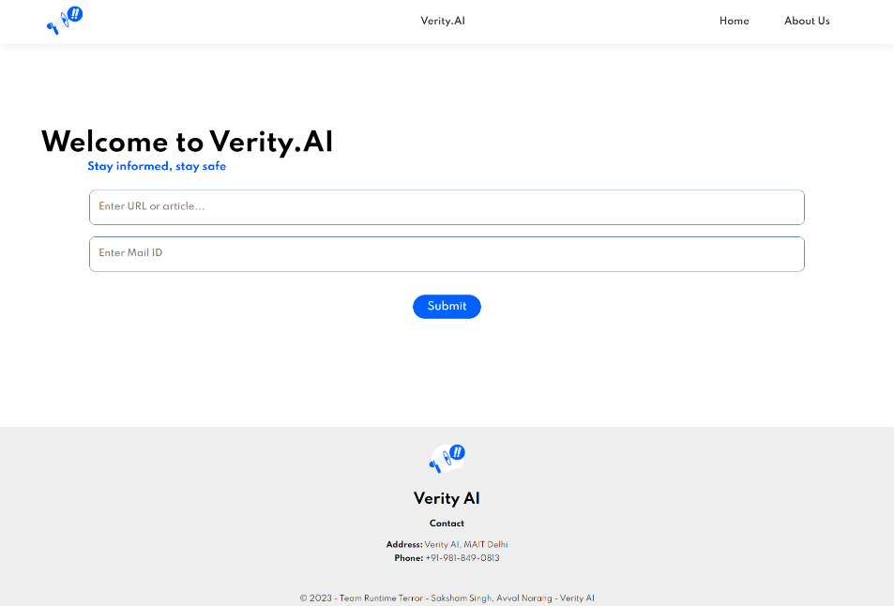
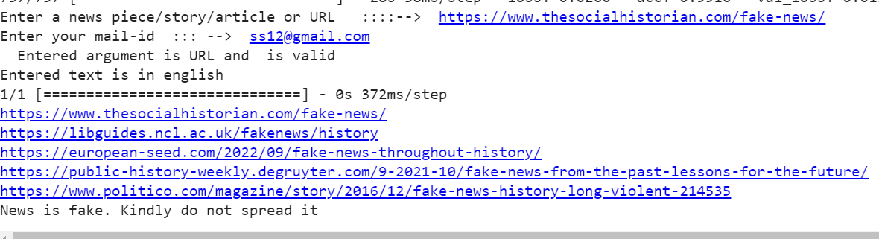
How the user interface looks like

