Slide 1

Basic Details of the Team and Problem Statement
Ministry/Organization Name/Student Innovation: Ministry of Home Affairs
PS Code: SIH1409
Problem Statement Title: AI based IT training system
Team Name: Runtime Terror-
Team Leader Name: Avval Narang
Institute Code (AISHE): C-32870
Institute Name: Maharaja Agrasen Institute of Technology
Theme Name: Smart Education

Slide 2
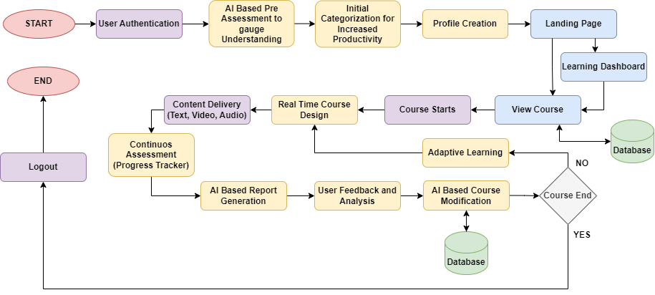








Idea/Approach Details
Describe your idea/Solution/Prototype here:
Evaluating level and pace of learning :
AI based user assessment measures the user's prior knowledge and learning preferences.
Personalization further groups and matches content to user's understanding.
Adaptive Learning and feedback loop continuously adapts course content to the user's progress and efficiency.
Real-time designing the course and AI based course modification :
Understanding requirements, dynamic recommendations, and adaptability ensures users are provided with up-to-date content, and AI designs it on the go.
Designing course comprising of videos , textual data and discussion forums
Continuous evolvement in duration and content of course depending on user performance in tests
Data analysis for skill gap , feedback/rating, platform engagement to enhance content integrity and course recommendation engine.
Reducing time and increasing productivity:
Through section-wise categorization and partnerships with institutes the solution minimizes time wastage and exponentially increase the department’s / institute productivity.
AI based automation for all administrative tasks like-enrollment , reports etc.
Continuous assessment and business expansion :
The AtmaSiksha portal employs AI , web scraping , NLP and database to deliver suitable and crisp content
Assessment and performance guides third party for introducing guided training/seminars.
Opening opportunity of live teaching collaboration and reducing time by grouping same minds on various evaluation parameters.
24x7 support and guidance by AI based chatbot on AtmaSiksha portal itself.
Describe your Technology stack here:
Frontend : HTML, CSS, JS, ChakraUI, ReactJs
Backend : Axios, React router, Bcrypt, ExpressJs, MongoDB, NodeJs
AI / Python : Web Scraping (BeautifulSoup, requests), Data Analysis (Pandas, Openpyxl, matplotlib), NLP / Word Processing (nltk, wordcloud), Machine Learning, ANI (Artificial Narrow Intelligence), random, isodate
APIs / Deployment : FastAPI, Google API (Youtube v3), StackOverflow API, Docker, Heroku , Google Translate Text-To-Speech

Slide 3

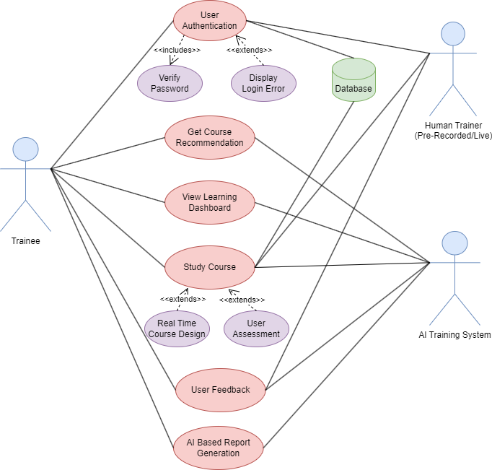
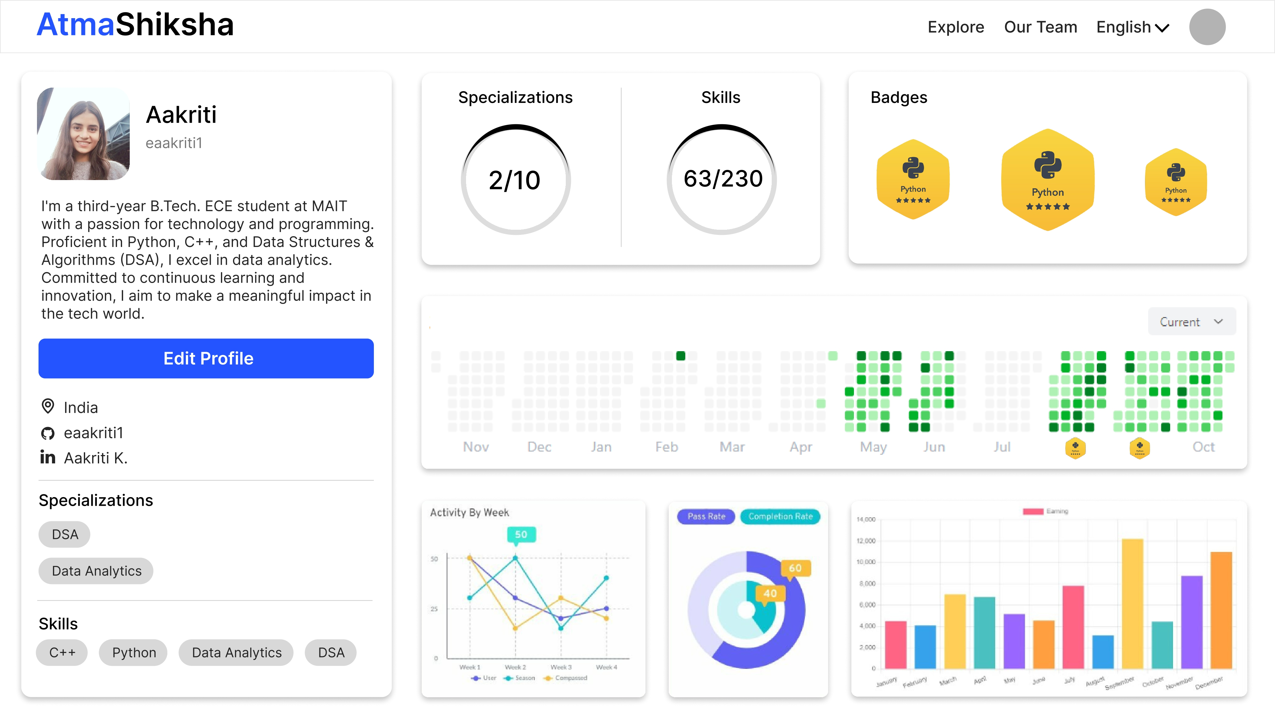
Idea/Approach Details
Describe your Dependencies / Show stopper here
Describe your Use Cases here
Show Stopper
Evaluating level of understanding
AI based content curation
Accessibility (Beginner to Advanced)
Systematic division of training topics and candidates
Multi-lingual platform
Future collaboration and easy interface
Gamified learning and quizzes
Feedback loop
Real time report generation
Audio lectures for differently abled
Dependencies
User Feedback and Assessment
Access to Good Quality Course Content
Rich and comprehensive database
API and External Services

Slide 4
Team Member Details
Team Leader Name: Avval Narang
Branch (Btech/Mtech/PhD etc): Btech Stream (ECE, CSE etc): CSE Year (I,II,III,IV): III
Team Member 1 Name: Aakriti Kumari
Branch (Btech/Mtech/PhD etc): Btech Stream (ECE, CSE etc): ECE Year (I,II,III,IV): III
Team Member 2 Name: Pritish Singhal
Branch (Btech/Mtech/PhD etc): Btech Stream (ECE, CSE etc): CSE Year (I,II,III,IV): III
Team Member 3 Name: Saksham Singh
Branch (Btech/Mtech/PhD etc): Btech Stream (ECE, CSE etc): CSE Year (I,II,III,IV): III
Team Member 4 Name: Sparsh Shandilya
Branch (Btech/Mtech/PhD etc): Btech Stream (ECE, CSE etc): CSE Year (I,II,III,IV): III
Team Member 5 Name: Sumedhav Krishna
Branch (Btech/Mtech/PhD etc): Btech Stream (ECE, CSE etc): CSE Year (I,II,III,IV): III
Team Mentor 1 Name: Ankita Gupta
Category (Academic/Industry): CSE Dept MAIT Expertise (AI/ML/Blockchain etc): Software Engineering, Machine Learning, Image Processing Domain Experience (in years): 11

