Slide 1
Image Captioning
Samrathpreet Singh Randhawa
1801CS43

Slide 2
MoMotivationvation
Basic Task
Would serve as a huge help for visually impaired people.
Social Media. Platforms like facebook can infer directly from the image to report violent or hate related images
medical image understanding that conveys the clinical physician that the algorithm had found something fishy in the patient
Google Photos - tells if a person is at birthday party , vacation , office setting
Generating descriptive sentences automatically for images

Slide 3
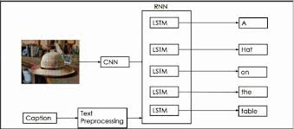
Implementation -
The model to caption images is built on recurrent and convolutional neural networks. A Convolutional Neural Network is used to extract the features from an image which is then along with the captions is fed into an Recurrent Neural Network.

Slide 4
Dataset Description -
Name - Flickr 8K dataset
Number of Images - 8092
Captions - Each image has around 5 captions
Type - Basic Day to day related like dogs running , skiing etcetera

Slide 5
Dividing the model into two parts
Encoder - Extract feature vector from images
Decoder - input image features along with current sentence and get next word

Slide 6
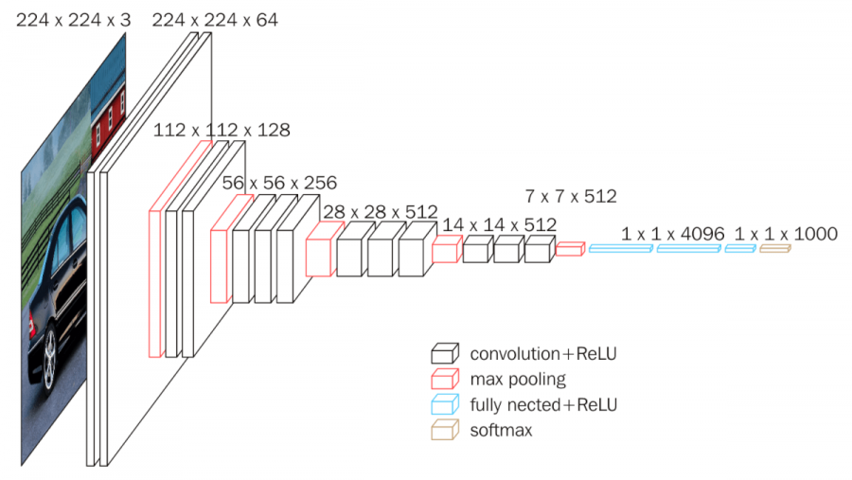
Encoder
VGG 16 model

Slide 7
Used Transfer Learning for encoding
1.Instead of training the VGG16 model on the dataset I used the already trained model available in keras .
2.As last layer is softmax layer which classifies the images in VGG16 . I have removed the last layer and just used the 1x4096 feature vectors for images

Slide 8
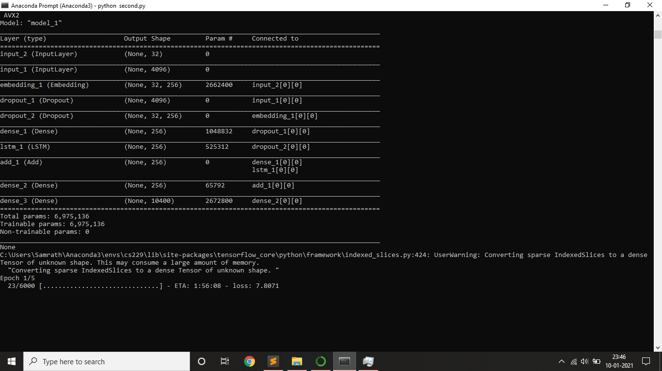
Decoder

Slide 9
Explaining the previous slide -
Input_1 -
Image feature vector
Input_2 -
Sentence formed so far
Dropout_1
Embedding Layer - 256
Dropout_2
Dense_1
add_1
LSTM
dense_2
dense_3

Slide 10
Data Generator
Eg- A man is running
Image
startseq
Image
startseq
A
Image
startseq
A
man
Image
startseq
A
man
is
Image
startseq
A
man
is
running
Image
startseq
A
man
is
running
endseq

Slide 11
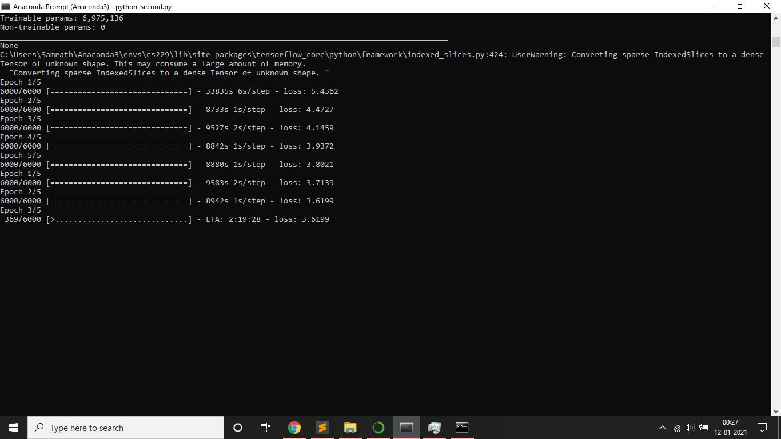
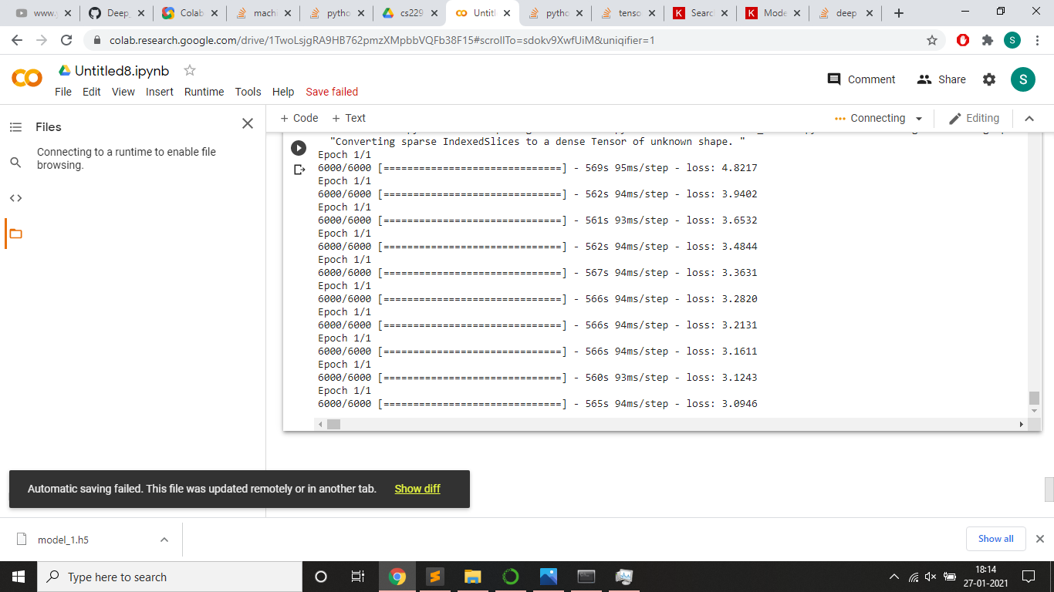
Results -
Loss - 3.8021
Epochs were increased with slight change in hyperparameters and Loss was further reduced considerably
Loss - 3.0946

Slide 12
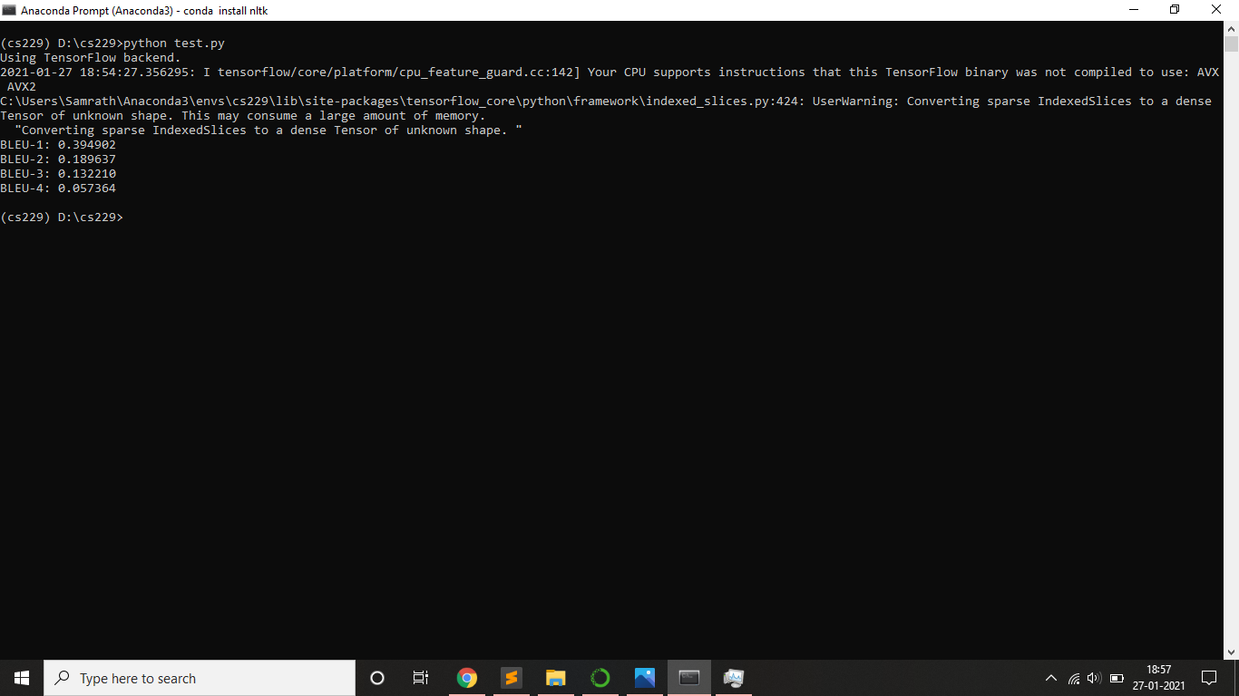
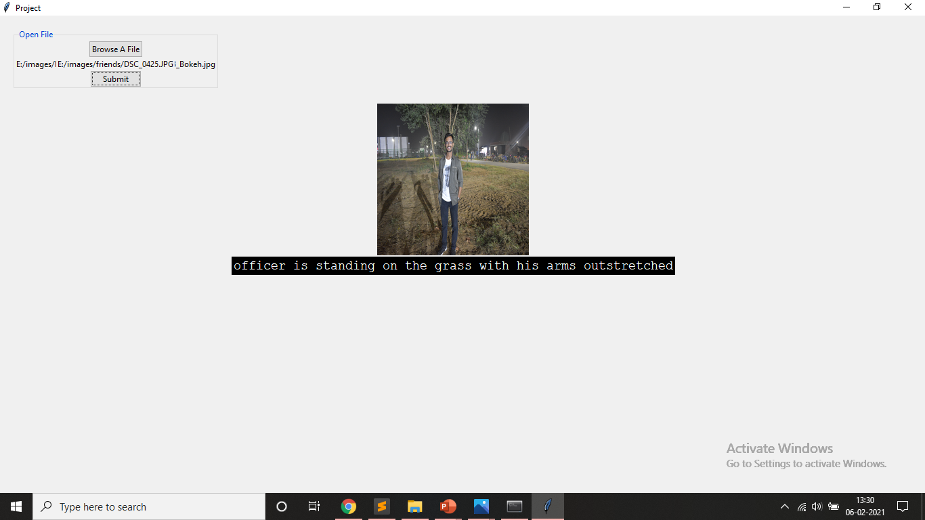
BLEU Scores
Frontend
1.Used Tkinter GUI in Python

Slide 13
Innovation
A step towards solving problem for blind and social media platforms .
Can be extended to make app like google photos
Increased accuracy by changing hyper parameters and choosing the optimal one .
Implementing it as ‘one of its kind’ service in form of PC App .

Slide 14
Demo

Slide 15
Thank You

