Slide 1
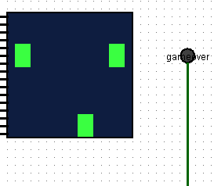
CS 225 - 226
Topic –A simple Game implemented in Logisim
Submitted by
Samrathpreet Singh Randhawa
1801CS43

Slide 2
Contents
What is my Game
How I implemented it / my approach towards building it
How to display // Display circuit
What to display // input select circuit
Main object controlling // object control circuit
Combining the circuits // Main circuit

Slide 3
What is the game
The gamer has two control buttons left right
He has to dodge the obstacles that are coming towards the main object using them .
The game has 4 lanes .
Obstacles
Main Object

Slide 4
My approach towards building the game……

Slide 5
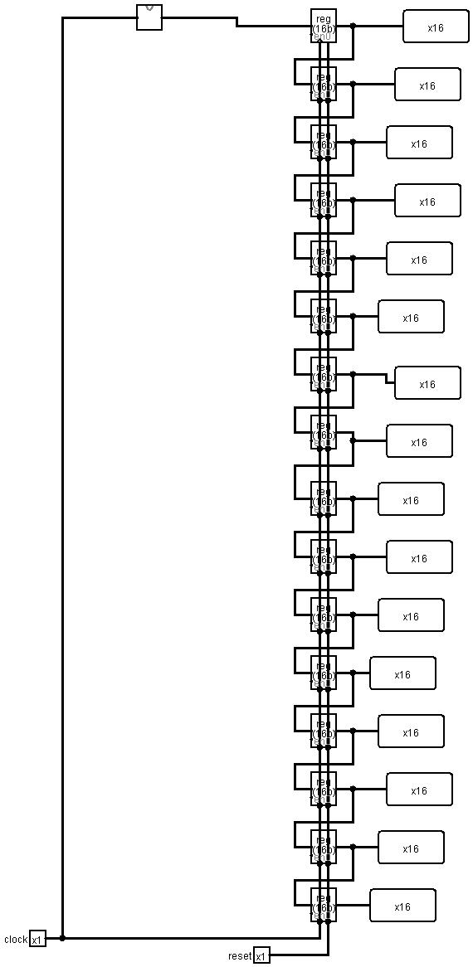
Display Circuit
Display approach
The Led Matrix takes input of each row and wherever there is 1 it shows in green color and where there is 0 it shows in black color .
1111 0000 0000 0000
So I have used 16 bit Register for 16 columns to store the output of each row .and therefore I have used 16 Registers in total .
For showing the movement of hurdles downwards I have taken the use of shift register technique .
So basically the value at previous register is given to next register Therefore it induces the effect of movement .
For the topmost register the input is fed into it using the input select circuit .
For resetting the game back I have used reset in registers

Slide 6
The transition of values of one register to the register below it .
If the transition is somewhat fast it will be giving the effect of movement of blue boxes downward

Slide 7
How to implement Lanes 1, 2,3,4
Using 4 columns for each lane
This is 16 bit input of respective lanes
0110 0000 0000 0000
0000 0110 0000 0000
0000 0000 0110 0000
0000 0000 0000 0110

Slide 8
Input Select
What hurdles to give next

Slide 9
So I wanted that for 4 clock cycles the output should be one of the predefined states and also once randomly it has been selected it should not change for 4 clock cycles .
For ex if at 0 state I choose hurdle should be present in lane 1 then it should remain this for 4 clock cycles
So that the hurdles have height of 4 rows .
After every 4 clock cycles the output should be 0000 that is no hurdles so that gamer can change the position of the object . And this should also be for 4 clock cycles
And after every 8 clock cycles the process should repeat .
Randomly select the hurdle and give it as output
Give the same selected hurdle as output until 3
0
1
2
3
Based on this FSM diagram
7
6
5
4
For 4 clock cycles give 0000 as output

Slide 10
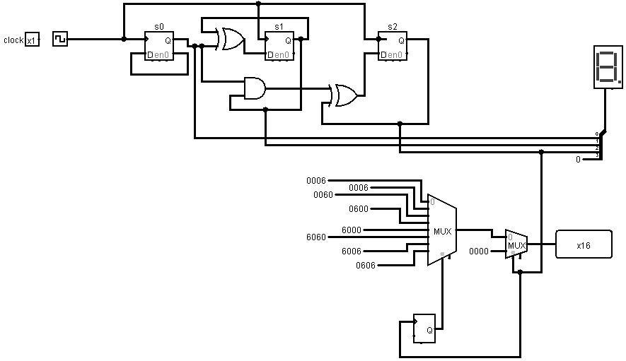
3 BIT Counter
Random Generator is used for giving one of predefined 8 inputs along with multiplexer
The predefined states are 0006 means there is hurdle in 4th lane
Similarly 0606 means hurdles in lane 2 and lane 4
Use of 6 represent 0110 as it is Binary coded decimal
After every 4 clock counts one of predefined states is given as output
After that for 4 clock cycles 0000 is given as output

Slide 11
Main object Control

Slide 12



Total 4 states
FSM
left
00
01
10
11
Right
No input

Slide 13
Encode the input
00 – no input // remain in this state
01 – move right
10 – move left
11 – Invalid / don’t care
S1 | S0 | L | R | N1 | N0
0 | 0 | 0 | 0 | 0 | 0
0 | 0 | 0 | 1 | 0 | 1
0 | 0 | 1 | 0 | 0 | 0
0 | 1 | 0 | 0 | 0 | 1
0 | 1 | 0 | 1 | 1 | 0
0 | 1 | 1 | 0 | 0 | 0
1 | 0 | 0 | 0 | 1 | 0
1 | 0 | 0 | 1 | 1 | 1
1 | 0 | 1 | 0 | 0 | 1
1 | 1 | 0 | 0 | 1 | 1
1 | 1 | 0 | 1 | 1 | 1
1 | 1 | 1 | 0 | 1 | 0
Truth Table based on FSM diagram

Slide 14


LR
S1S0
0 | 0 | X | 0
0 | 1 | X | 0
1 | 1 | X | 1
1 | 1 | X | 0
N0 = S0R + S1 L’ + S1 S0
0 | 1 | X | 0
1 | 0 | X | 0
1 | 1 | X | 0
0 | 1 | X | 1
N1 = S0’R + S1 R + S0’L’R’ +S1S0’L

Slide 15
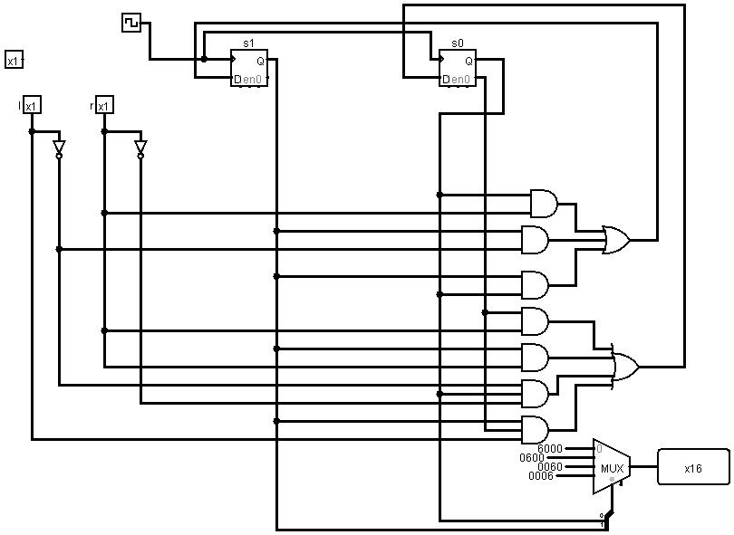

Slide 16
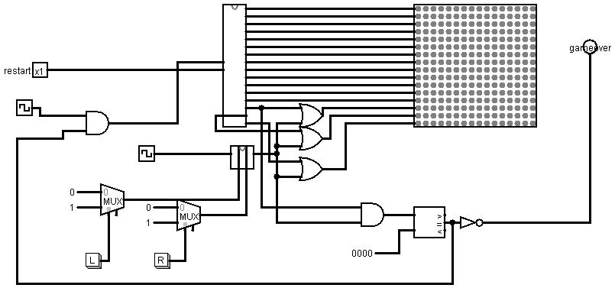
The Game
Implemented left right buttons
Game over Boolean using and gate
Giving high frequency clock to controls so that movement is smooth
Combined last three rows with that of main so that main object has height of 3 bottom rows // giving input using or gate to led matrix

Slide 17
Working

Slide 18
Thank You

