Slide 1
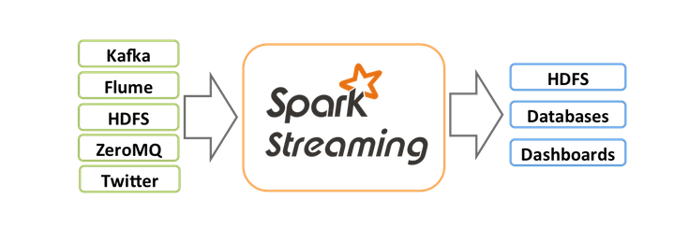
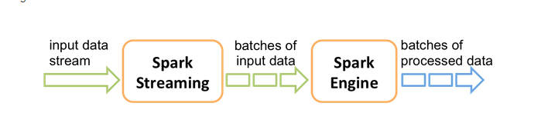
Spark Streaming is an extension of the core Spark API that allows enables high-throughput, fault-tolerant stream processing of live data streams.
Spark Streaming receives live input data streams and divides the data into batches, which are then processed by the Spark engine to generate the final stream of results in batches.
Ref: http://spark.apache.org/docs/0.9.1/streaming-programming-guide.html

Slide 2
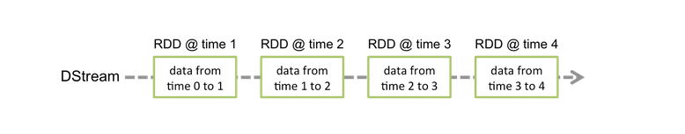
Discretized Stream or DStream is the basic abstraction provided by Spark Streaming. It represents a continuous stream of data, either the input data stream received from source, or the processed data stream generated by transforming the input stream. Internally, it is represented by a continuous sequence of RDDs, which is Spark’s abstraction of an immutable, distributed dataset. Each RDD in a DStream contains data from a certain interval, as shown in the following figure.
There are two kinds of DStream operations - transformations and output operations.

Slide 3
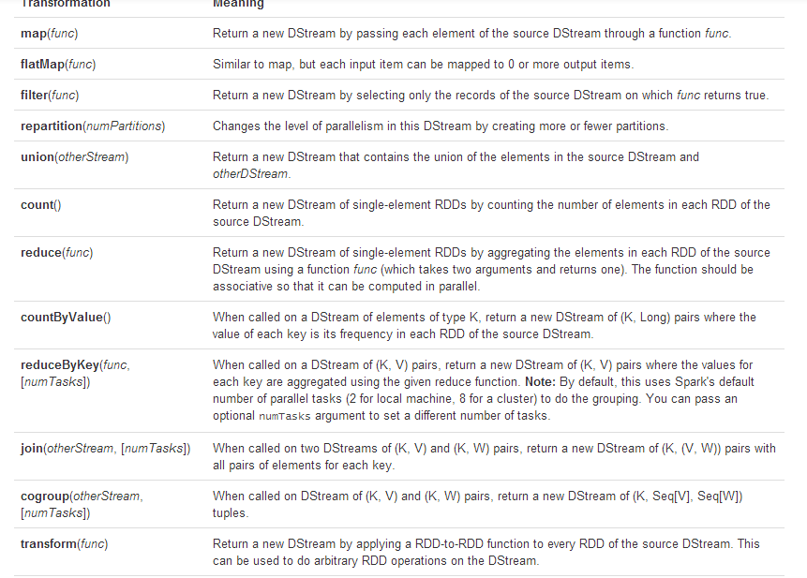
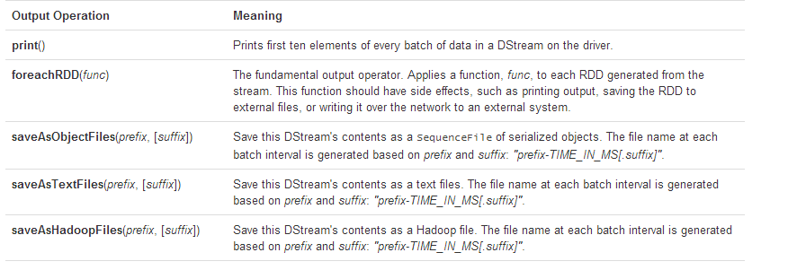

Slide 4
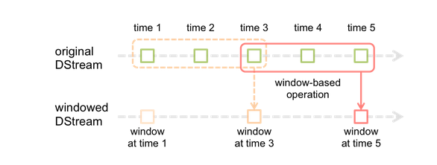
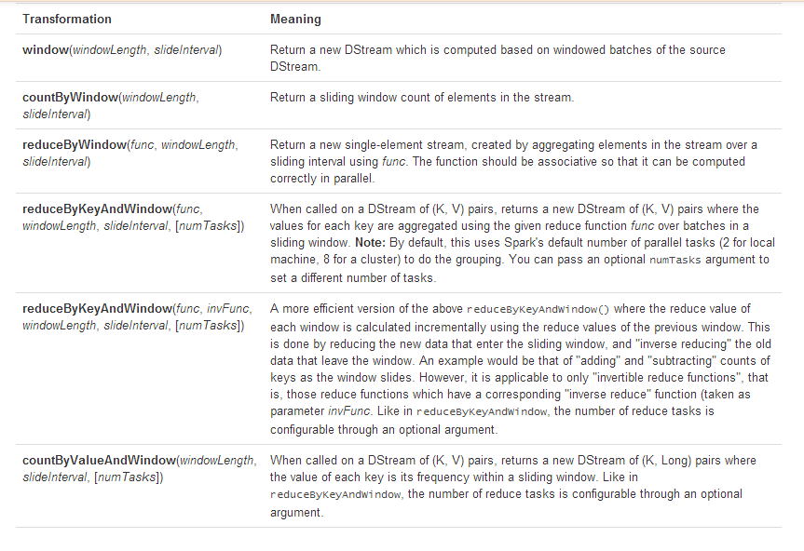

Slide 5
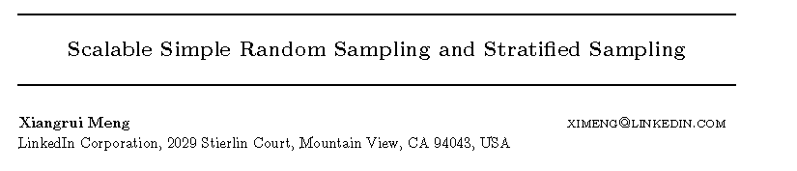

Slide 6
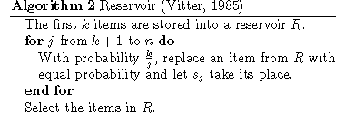
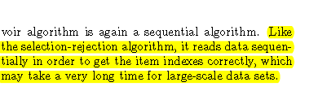

Slide 7
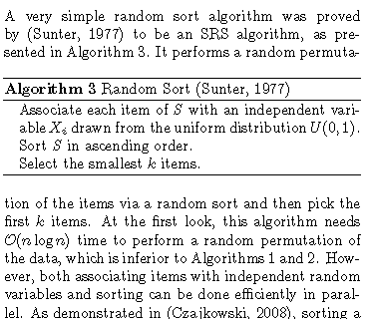

Slide 8
