Slide 1



Slide 2
NETWORK MODELS
BY
(Shreoshee)1MV18CS101
(Saurav)1MV18CS91
(Rohit Das)1MV18CS81
(Vishruth)1MV18CS71
(Praveen)1MV17CS121

Slide 3
Today's schedule
What is network model?
Types of network models.
OSI model
What is OSI model?
Architecture of OSI
Advantages and disadvantages
TCP/IC model
What is TCP?
Architecture of TCP/IP
Features provided
The Layers
OSI vs TCP/IP

Slide 4
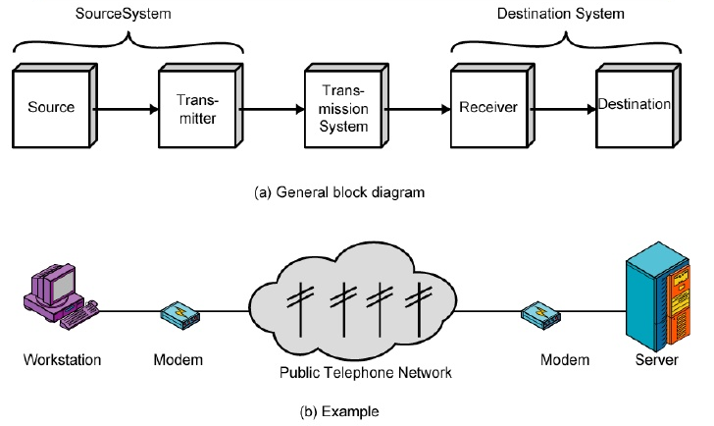
What are network models?
For data communication to take place and two or more users can transmit data from one to other, a systematic approach is required. This approach enables users to communicate and transmit data through efficient and ordered path. It is implemented using models in computer networks and are known as computer network models.
Computer network models are responsible for establishing a connection among the sender and receiver and transmitting the data in a smooth manner respectively.

Slide 5
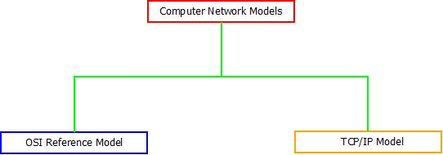
TYPES OF NETWORK MODELS

Slide 6
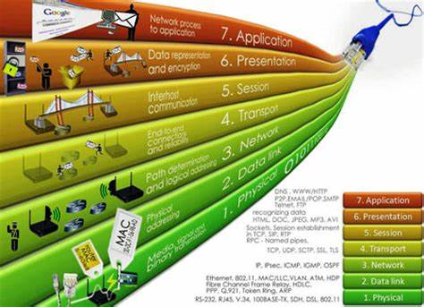
WHAT IS OSI MODEL?
The OSI Model is one of the general purpose networking or communication model among computer network models, which is responsible for establishing connection in an open manner between all the communicable devices present across the globe.
OSI stands for “Open System Interconnection” and the name of this reference model was given by an organization known as “International Organization for Standardization”.

Slide 7
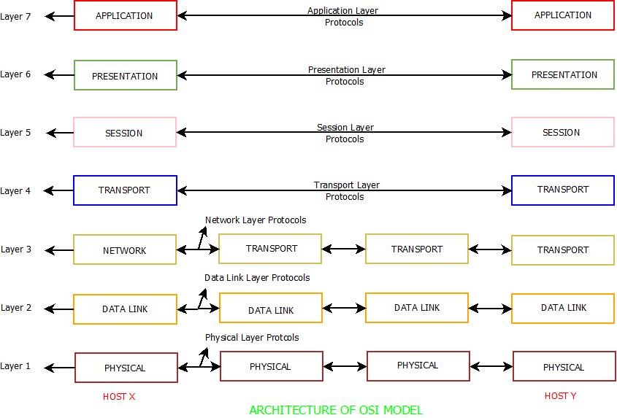
ARCHITECTURE OF OSI MODELS

Slide 8
ADVANTAGES OF OSI MODEL
Each layer has its definite structure and functionality which makes OSI model simple and easy to use.
It is a general purpose reference model that can be used for data communication.
Connection oriented and connection-less services are supported.
Connection between any type of devices or host or hardware or software is possible.

Slide 9
DISADVANTAGES OF OSI MODEL
Because of its inability to fit protocols, this model was replaced by TCP/IP Internet Model.
Session and Presentation layers does not provide high end functionalities and are not of much use as compared to other layers.
Connection oriented and connection-less services are supported.
Connection between any type of devices or host or hardware or software is possible.

Slide 10
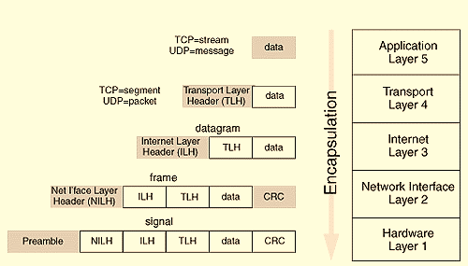
WHAT IS TCP/IP MODEL?
Image Courtesy : peasoncmg.com

Slide 11
TCP/IP Mode Architecture Description
The TCP/IP network model takes its name from two of its protocols, the Transmission Control Protocol (TCP) and the Internet Protocol (IP).
The lower four layers of the model represent functionality performed internally by the Linux kernel.
The Application layer includes commands and daemons.
Each layer wraps the data passed to it by the previous layer with information used to determine where the packet is supposed to go and which service needs to be invoked to handle the application data itself.
The information added by each layer is called a header when it is prefixed to the data from the previous layer, and a trailer when it is suffixed.

Slide 12
Features provided by TCP/IP Protocol
peer-to-peer communication
Encapsulation & de encapsulation
Security

Slide 13
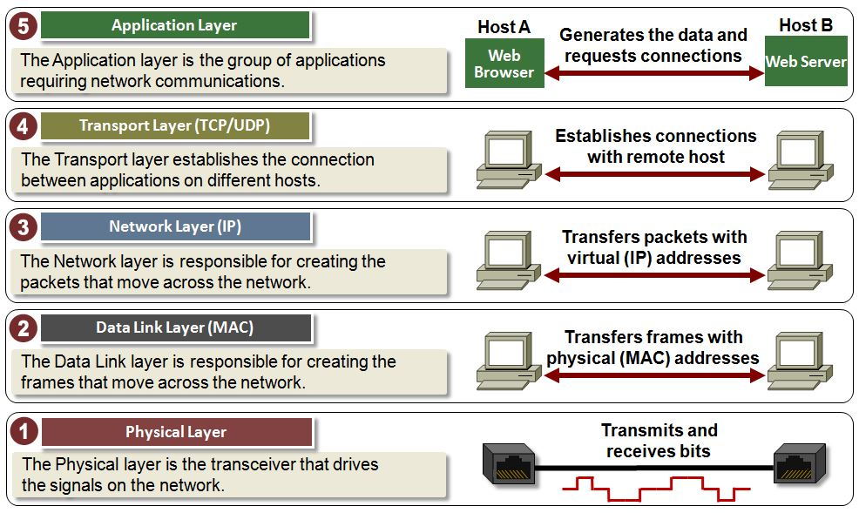

Slide 14
The Hardware Layer
hardware
Preamble
repeaters and amplifiers
maximum transfer unit (MTU)

Slide 15
The Network Interface Layer
device drivers
Destination and source physical address
Switches or hubs or bridges or layer 2 routers.
computing a Cyclic Redundancy Check
(CRC)

Slide 16
The Internet Layer
Two available versions of the protocols: 4 and 6.
Routers or layer 3 switches
Layer multicasting
IP , ICMP, IGMP

Slide 17
The Transport Layer
UDP(packet)
TCP(segment)
TCP and the UDP

Slide 18
The Applicaion Layer
gateway
understanding the data format , interpreting the data
NFS, Samba, e-mail, FTP and the telnet utility.
DNS
DHCP

Slide 19
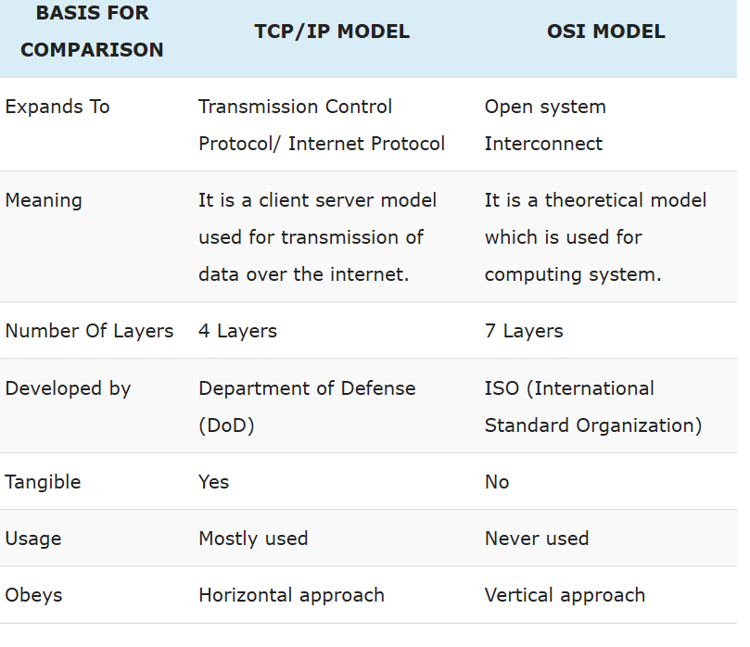
OSI vs TCP/IP

Slide 20

This Photo by Unknown Author is licensed under CC BY-SA-NC

