Slide 1
Website on college
A Report for the Evaluation of MTE PBL Web Tech
NEELESH SINGH Admission No.: 17SCSE105077
Under the Supervision of
V. Arul

Slide 2

School of Computing Science and Engineering
Greater Noida, Uttar Pradesh
Winter 2019-2020

Slide 3
Introduction
It is a website for college information and store data of student like queries and mails and mobile number.This web project is developed using HTML and CSS as the front-end.

Slide 4
Aim:
The main aim of this project is to create a website where a student or fresher come and have look for college information and put their queries regarding college and any information they want regarding college.

Slide 5
Features-
Online registration/login.
User registration.
Post queries.
Take information of college,fees, hostels,placemnts and know the history of college.
Admin area.

Slide 6
Advantages-
Student fill the form online regarding to come in college.
They can look our infrastructure and any other information they want.
They can easily contact the main staff of our university through our website.

Slide 7
Screenshots
Some glimpse of our website given below.

Slide 8
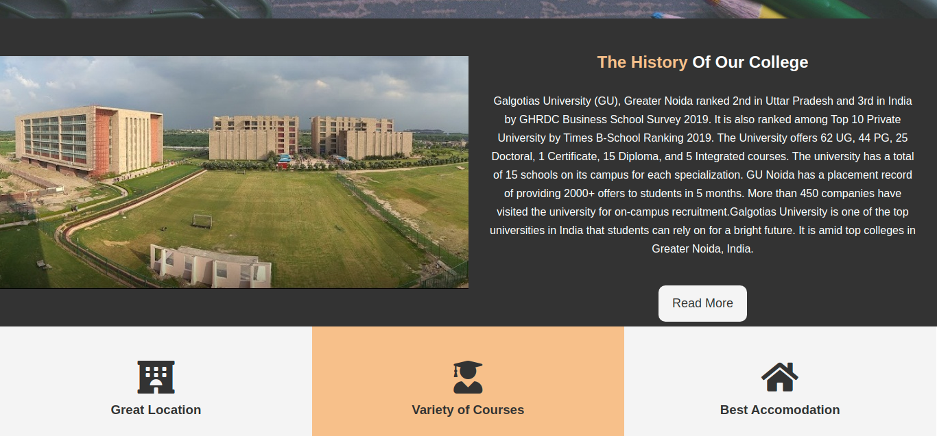
Home page

Slide 9
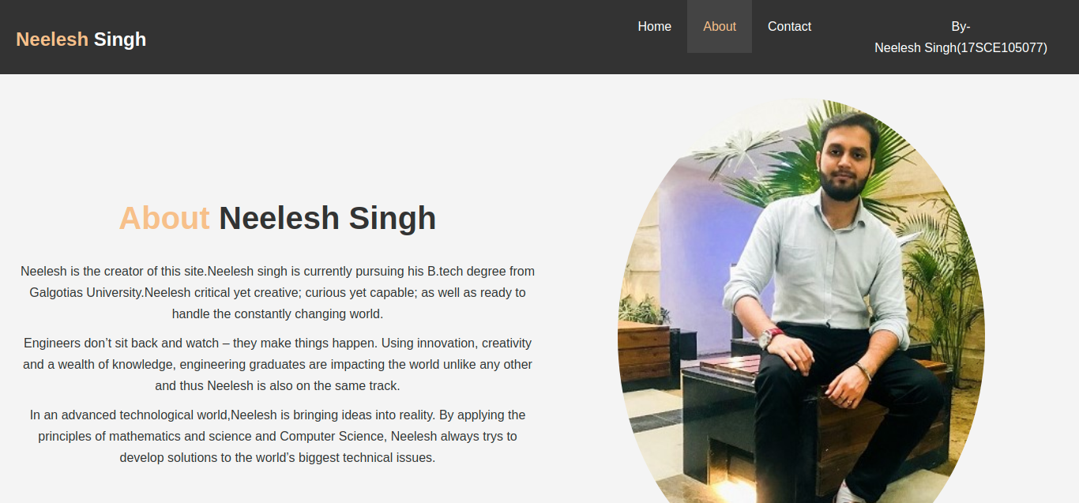
ABOUT:

Slide 10
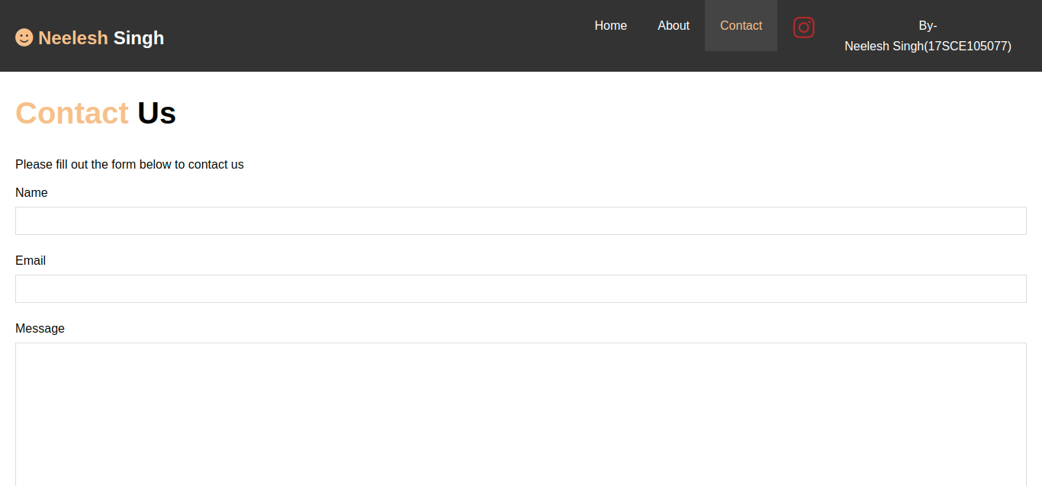
POST QUERIES AND CONTACT US

Slide 11
Thank you
STAY HOME AND STAY SAFE

