Slide 1
Rainfall Vs Agriculture Analysis Report
A Data-Driven Analysis of Monsoon Rainfall and Its Impact on Agricultural Output
ANKIT CHAUHAN | 24-OCT-2025 | Batch CPDA - B5

Slide 2
Assignment Overview & Dataset Summary
Objective:
To analyze rainfall variability and its impact on agricultural productivity across Indian states using Power BI.
To identify the relationship between rainfall distribution and crop area/yield efficiency.
To derive insights for sustainable crop planning and resource optimization.
Context:
Agriculture in India is heavily dependent on monsoon rainfall.
Understanding seasonal rainfall trends helps in predicting crop yield and planning resource allocation.

Slide 3
Data Description & Preparation
Dataset Details:
Time Period: 1966 – 2017
Coverage: Indian states & districts
Key Fields: State Name, District Code, Year, Crop Area (Rice, Wheat, Maize etc.),
Monthly Rainfall (Jun–Sep)
Tools Used:
Power BI Desktop (Power Query + DAX + Visualizations)
Data Preparation Steps:
Unpivoted crop columns → Crop Type & Crop Area
Calculated Total Rainfall = JUN + JUL + AUG + SEP
Created Month, Season, Monthly Rainfall fields
Cleaned & standardized missing values
DAX Measures Created [Total Rainfall, Avg Rainfall, Avg Crop Area, Max Crop Area, Rainfall per Year]

Slide 4
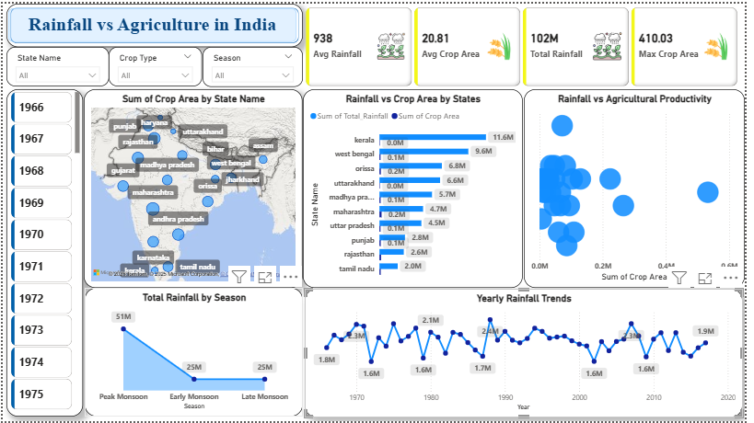
Dashboard Overview
Key Dashboard Elements:
Line Chart: Yearly Rainfall Trends
Bar Chart: Rainfall vs Crop Area by State
Scatter Plot: Rainfall vs Agricultural Productivity
Map Visual: Crop Area distribution by State
KPI Cards: Avg Rainfall, Avg Crop Area, Total Rainfall, Max Crop Area
Slicers: State, Year, Crop Type, Season

Slide 5
Analysis 1 – Rainfall Trends
Observation (from “Yearly Rainfall Trends”):
Rainfall fluctuated between 1.6M – 2.4M mm yearly.
Long-term average rainfall remained around 1.9M mm.
Periodic declines indicate years of drought impact.
Insight: Stable rainfall periods (e.g., 1975–1985, 2005–2015) correspond to improved crop productivity.

Slide 6
Analysis 2 – Seasonal Rainfall Pattern
Findings:
July–August: Peak monsoon months → Highest rainfall contribution.
June: Onset of monsoon with moderate rainfall.
September: Declining rainfall — supports post-harvest soil moisture.
Insight: Peak Monsoon (Jul–Aug) is the most critical window for agricultural output stability.

Slide 7
Analysis 3 – Regional & Crop Impact
From Bar & Map Charts:
States like Kerala, West Bengal, and Odisha receive high rainfall but show moderate crop efficiency.
Punjab & Haryana achieve high productivity with balanced rainfall → Efficient water usage.
Over-dependence on rainfall can reduce yield stability in drought-prone states.
Scatter Plot Insight:
Positive correlation between rainfall and crop area up to an optimal level — beyond which gains plateau.

Slide 8
Insights & Recommendations
Key Insights:
Peak monsoon rainfall (Jul–Aug) drives majority of crop yield.
Balanced rainfall (not extreme) supports higher yield efficiency.
Regional disparity: Southern & Eastern states get high rainfall but need irrigation efficiency improvement.
Late monsoon rainfall (Sep) aids residual soil moisture and secondary crop cycles.
Recommendations:
Promote water management systems in low-rainfall states.
Encourage crop diversification based on rainfall zones.
Implement early warning & rainfall prediction systems for crop planning.
Optimize irrigation scheduling around the Peak Monsoon Window (Jul–Aug).

Slide 9
Final Conclusions & Next Steps
Conclusion:
The Power BI analysis demonstrates a clear rainfall–productivity relationship.
Insights help policymakers and farmers plan adaptive strategies.
Next Steps:
Integrate soil and temperature data for multi-variable modeling.
Extend analysis for crop yield forecasting using ML.

Slide 10
Thank You
Content:
“Thank you for your time and attention.”
Prepared by: Ankit Chauhan Date: 24-Oct-2025 For: CPDA B5 Assignment Presentation
Feel free to ask any questions!

