Slide 1

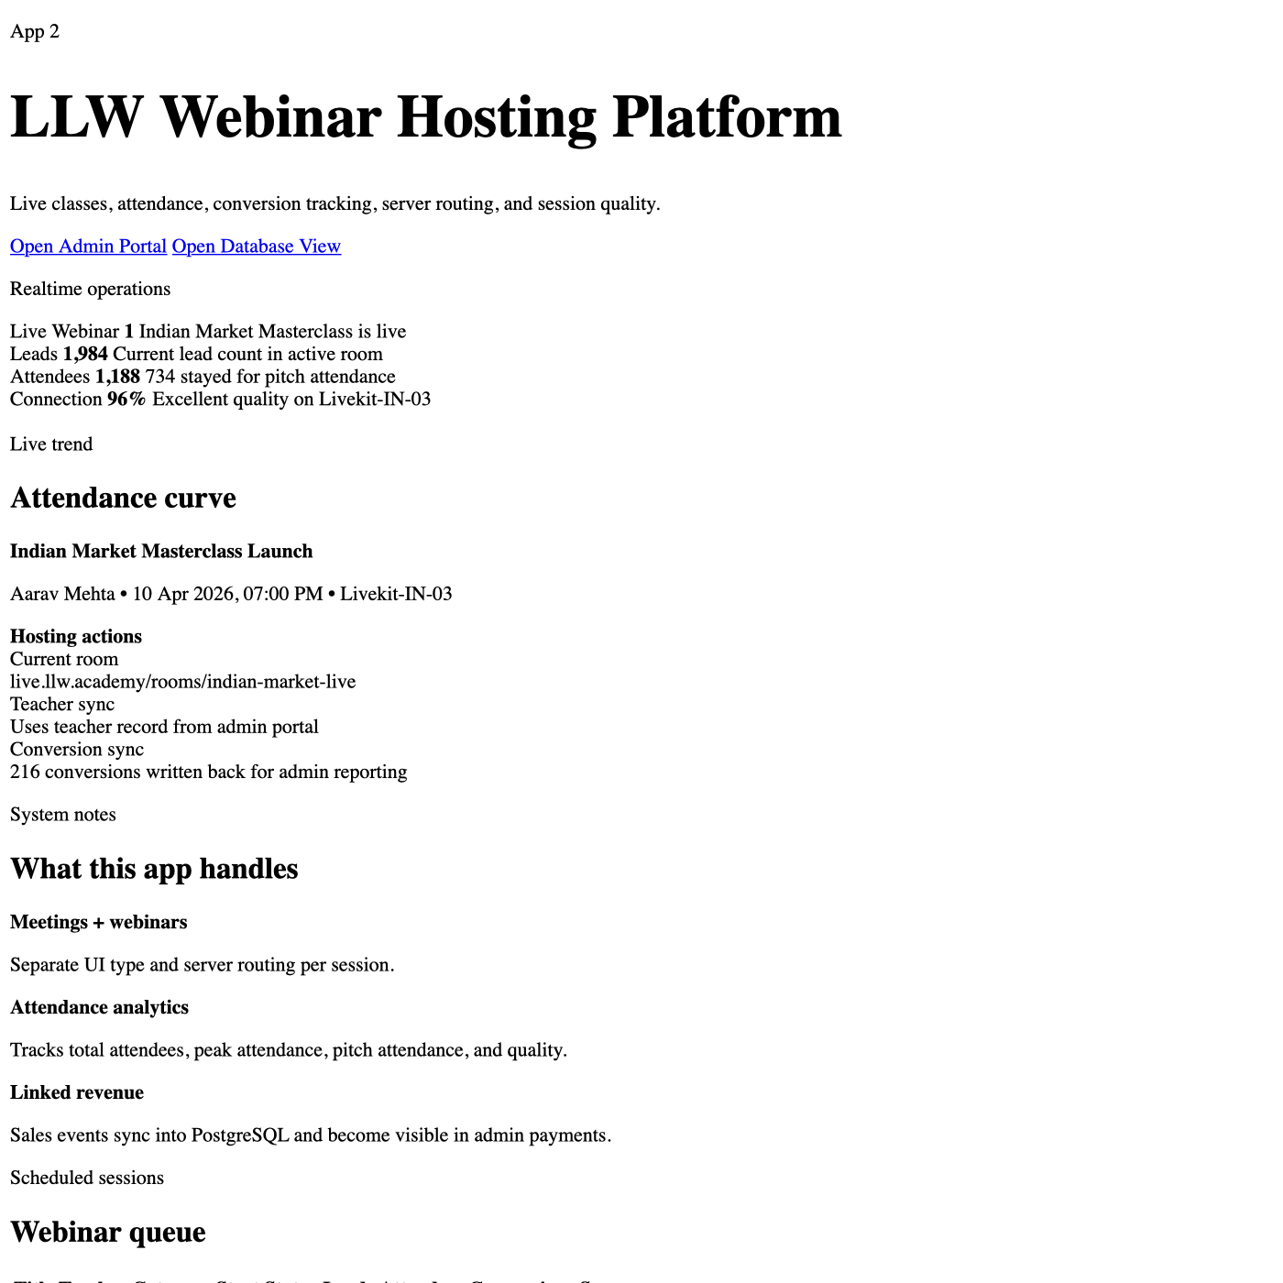
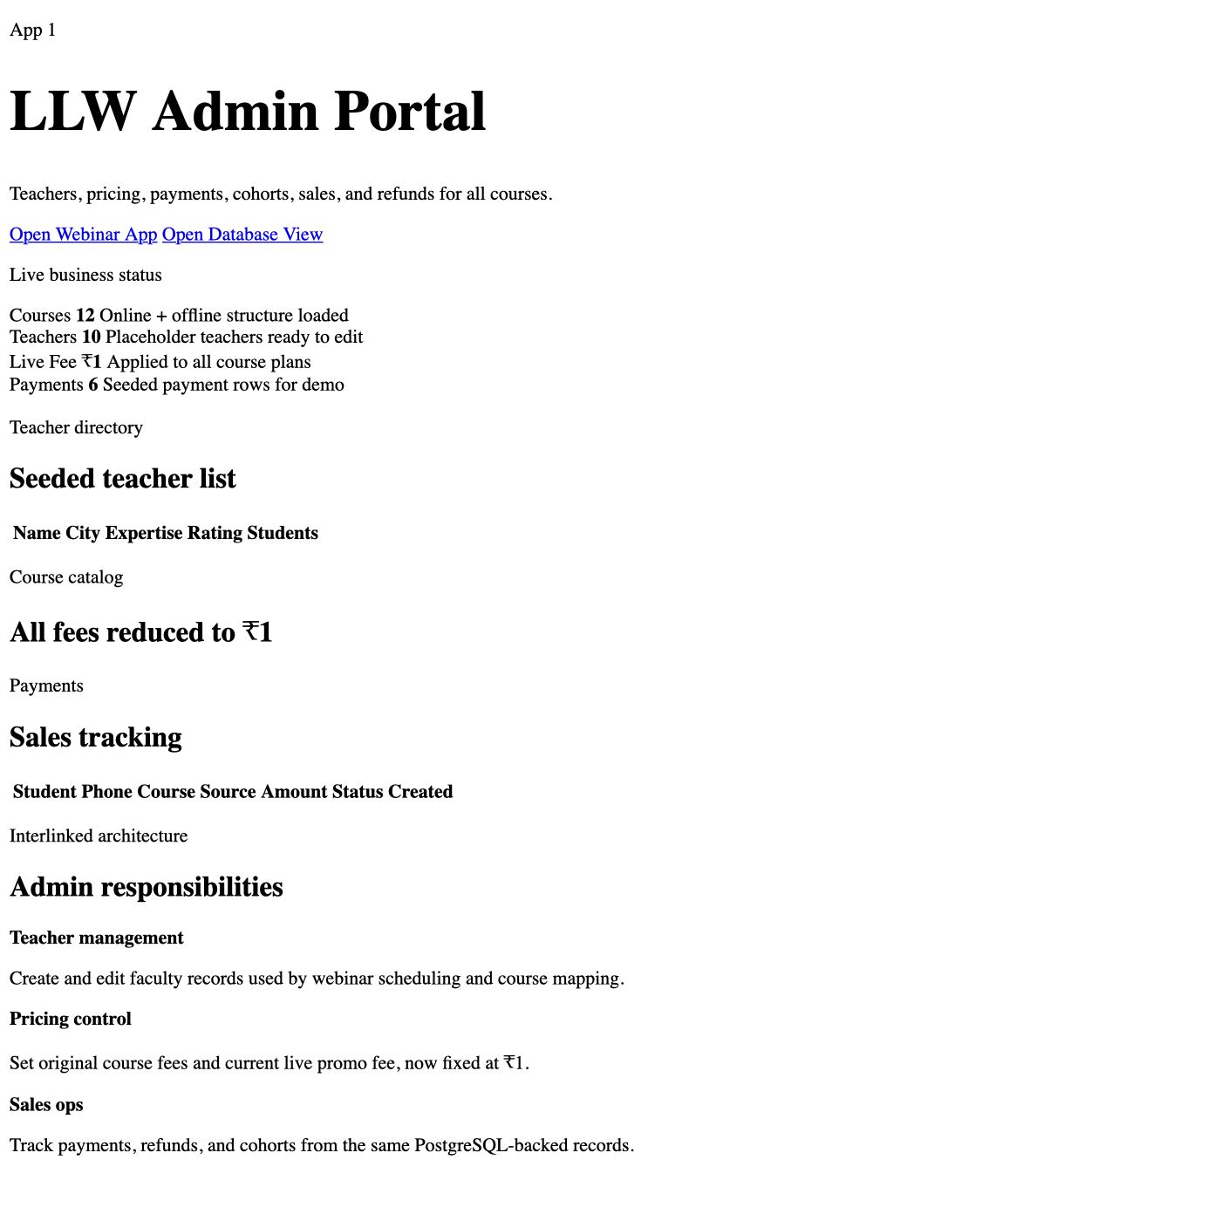
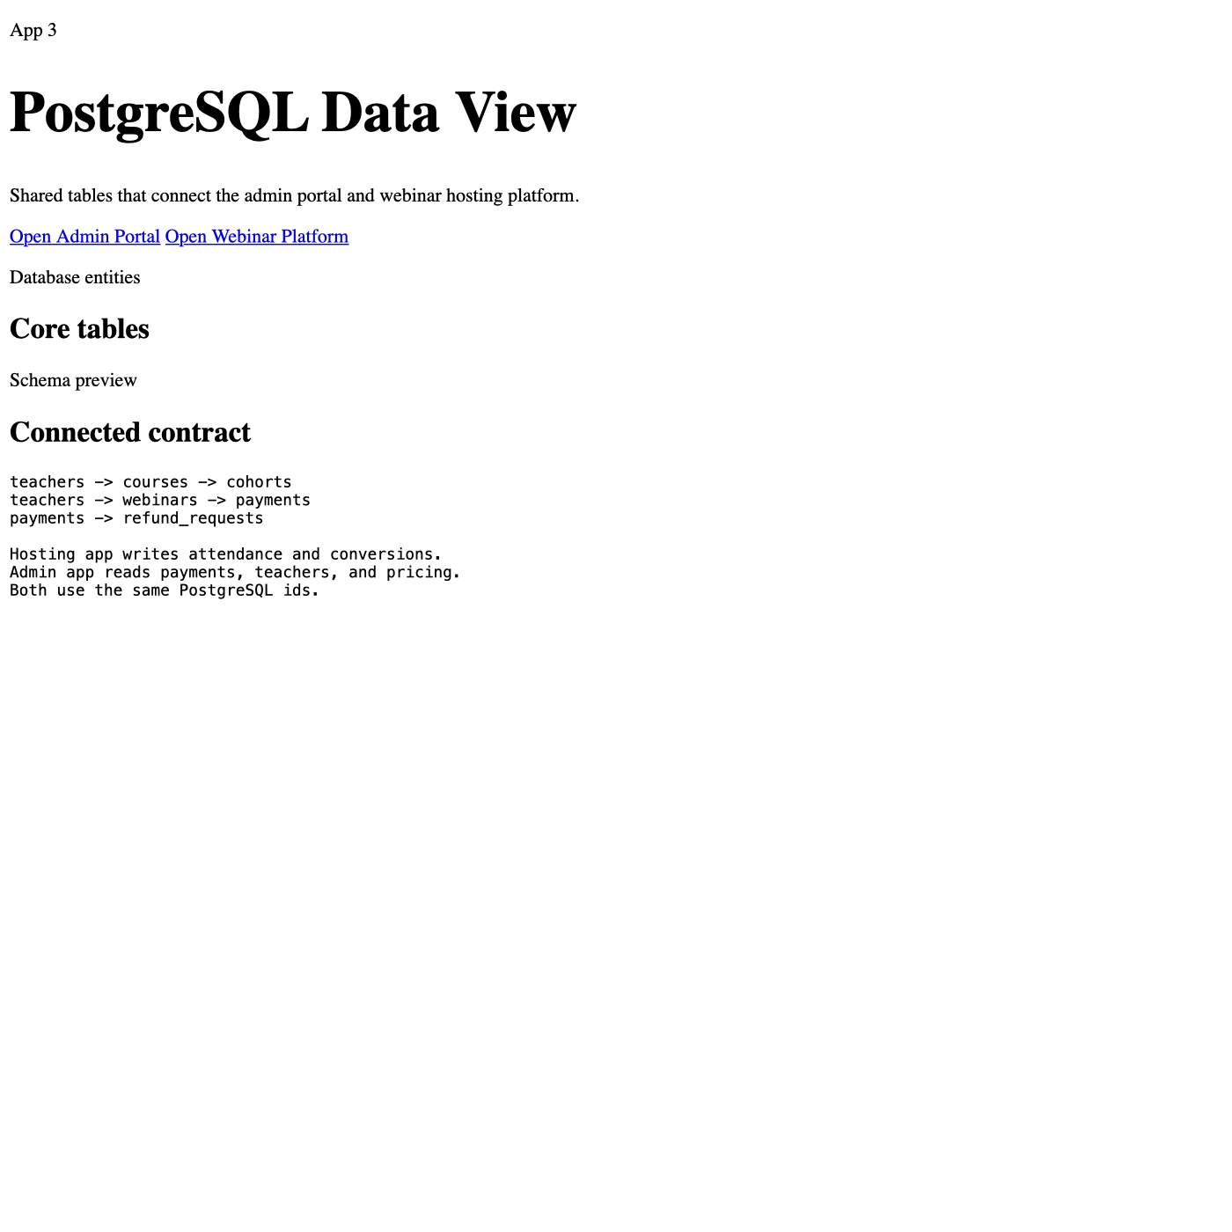
LLW APPLICATION TRAINING
Webinar side
BDA, BDM
& Admin
Lead capture, live sessions, and conversion visibility
Training deck for usability of the application, role-based work areas, and the full customer journey from lead to fulfilment.
Admin workspace
Payments, onboarding, tracker, team, and fulfilment
BDA
BDM
ADMIN
Focus for this session:
• how teams use the app today
• where each role should work
• what happens after payment right now
• what we may automate in future updates
Shared data layer
Orders, payments, refunds, students, and ops status stay connected
LLW internal training deck • April 2026
Notes:
Open with the shared objective: one connected workflow for revenue, operations, webinars, and fulfilment. Set the expectation that the deck is about current training usability first, then future-state messaging.
[Sources]
- Application routes and modules: src/App.tsx, src/components/Sidebar.tsx
- Static product overview pages used as support visuals: admin.html, webinar.html, database.html

Slide 2
PLATFORM OVERVIEW
02 / 09
One application, shared business workflow
The product combines acquisition, payment tracking, customer follow-up, operations, and webinar coordination in one workspace.
Acquisition & enrollment
Revenue & tracking
• Leads can come from webinar,
bootcamp, website, WhatsApp,
or manual campaigns. •
Enrollment can start from
Onboarding Form or Payment
Desk. • BDA ownership can be
assigned during onboarding.
• Dashboard, tracker, team, and
payments reflect sold value,
collected amount, due amount,
and refunds. • Orders keep BDA,
BDM, product, and transaction
mapping together.
Fulfilment & governance
• Only fully paid orders move to the Operations Queue. •
Operations then tracks portal access, broker setup, demat
setup, and welcome kit completion. • Refunds remain
auditable and are reviewed separately from day-to-day
payment handling.
Connected system view
Shared tables keep orders, students, payments, and refunds in sync
Dashboard
Tracker
Students
Orders
Payments
Onboarding
Operations
Refunds
Team & Exports
Current usability groups business activity into one connected admin operating system.
Notes:
Explain that this is not just a payment tool. It is a shared operations system where revenue, webinar activity, refunds, and fulfilment all touch the same customer/order records.
[Sources]
- Application routes and modules: src/App.tsx, src/components/Sidebar.tsx
- Order, student, and payment entities: db/schema.sql, server/data-store.mjs
- Static product overview pages used as support visuals: admin.html, webinar.html, database.html

Slide 3
ROLE ACCESS
03 / 09
BDA vs BDM vs Admin
Each role works in the same product, but the responsibilities and restricted areas are different.
BDA
BDM
Admin
• Use onboarding, tracker,
students, orders, and payments.
• Track due follow-ups and
customer ownership. • Can raise
refund requests from the payment
desk but cannot approve them.
• Monitor dashboard, manager
view, top-BDA performance, and
recoveries. • Can export
team-related data and access
settings. • Works more on
oversight than on basic
enrollment entry.
• Owns payment desk, refund
approvals, operations queue,
settings, links, marketing, and
governance. • Can review and
approve restricted workflows
across the system.
Module / area
BDA
BDM
Admin
Dashboard / Team view
View team dashboard
Team dashboard + manager view
Full visibility
Onboarding + Tracker
Core working area
View and review
Full visibility
Payments board
Use daily
Review with team lens
Full control
Exports
Restricted
Own-team export use
Full export access
Refund workflow
Raise request only
Restricted
Review + approve
Settings / Links / Ops
Restricted
Settings only
Full access
Training note: the user sees one product, but permissions decide which actions are open or restricted.
Notes:
Call out that route access is not only about page visibility. Some workflows, like refunds, are operationally split: BDA can initiate a request from payments, but admin users must approve it.
[Sources]
- Role permissions and restriction copy: src/lib/permissions.ts
- Payments board, recovery links, and checkout behavior: src/pages/Payments.tsx
- Refund workflow and admin approval behavior: src/pages/Refunds.tsx
- Exports filter behavior and access scope: src/pages/Exports.tsx

Slide 4
CUSTOMER JOURNEY
04 / 09
Lead to payment to fulfilment
The customer journey spans acquisition, enrollment, collection, recovery follow-up, and final fulfilment.
1
Lead captured
2
Enrollment created
3
Payment link or manual payment
Lead comes from webinar,
bootcamp, website,
WhatsApp, or a manual
campaign source.
Onboarding Form captures
customer info, product,
BDA assignment, payment
type, and source.
The team creates a
Razorpay link or records
cash / bank transfer
details.
Lead entry point
Webinar and conversion activity supports the top of the funnel
4
Payment completed
5
Token / due follow-up
6
Operations fulfilment
Successful payment
updates the order and
moves the customer
closer to fulfilment.
If the customer paid only a
token, the tracker and
payments board handle the
next follow-up and
remaining amount link.
Fully paid orders appear in the Operations
Queue for portal access, broker setup, demat
setup, and welcome kit completion.
Today’s working model: collection and fulfilment are linked, but post-payment customer messaging is not yet a finished automated journey.
Notes:
Present this as the simplest end-to-end story. After payment, there are two important branches: token follow-up for remaining dues, and operations fulfilment for fully paid customers.
[Sources]
- BDA onboarding and AiSensy payment-link flow: src/pages/Onboarding.tsx
- Payments board, recovery links, and checkout behavior: src/pages/Payments.tsx
- Tracker and recovery follow-up flow: src/pages/Tracker.tsx
- Operations queue and fulfilment checklist: src/pages/Operations.tsx
- Order, student, and payment entities: db/schema.sql, server/data-store.mjs

Slide 5
BDA WORKFLOW
05 / 09
How a BDA uses the application today
BDAs spend most of their time on enrollment capture, payment initiation, due follow-up, and customer ownership visibility.
1. Start from Onboarding Form
2. Share or record payment
• Enter customer name, phone,
email, source, product, and
assigned BDA. • Choose full
payment or token payment. •
Select Razorpay, bank
transfer, or cash.
• Create the enrollment and
generate the payment link. • For
manual payments, store reference
details in the workflow. • The
due amount is calculated
automatically when token is
used.
3. Use AiSensy manually when needed
4. Track recovery and ownership
• After the link is generated,
the BDA can use the manual
'Send via AiSensy' action from
onboarding. • This is a
payment-link send flow, not a
post-payment welcome
automation.
• Use Tracker and Payments Board
to follow up on token dues and
pending amounts. • Students and
orders help the BDA see history,
ownership, and status context.
Primary BDA working surface
Onboarding, tracker, students, orders, and payments stay closely connected
Restriction: no export + no refund approval
BDA training focus: clean onboarding entry, accurate payment mode selection, and disciplined follow-up.
Notes:
Emphasize accuracy at data entry time. Good onboarding setup controls the rest of the customer journey, including tracker visibility and recovery follow-up.
[Sources]
- BDA onboarding and AiSensy payment-link flow: src/pages/Onboarding.tsx
- Payments board, recovery links, and checkout behavior: src/pages/Payments.tsx
- Tracker and recovery follow-up flow: src/pages/Tracker.tsx
- Role permissions and restriction copy: src/lib/permissions.ts

Slide 6
BDM WORKFLOW
06 / 09
How a BDM uses the application today
BDMs work more as performance owners: they watch team collections, recoveries, manager summaries, and exports.
Collections
Recovery
Leaderboard
Exports
A BDM typically uses Dashboard, Team, Tracker, and Export views to understand how the team is performing, where recovery pipeline sits, and which BDA needs support.
Dashboard
Team view
Tracker oversight
• See sold value vs cash in
hand. • Monitor new revenue
and recovery revenue. • Check
manager snapshot and recent
orders.
• Review manager track. •
Compare top-BDA performance. •
See customer count and
pipeline.
• Watch promises due today and
overdue. • Track follow-up
pressure by BDA and product.
BDM visibility view
Dashboard and team-oriented summaries provide manager-level control
Access note: BDM can export team data and access settings, but refund approval remains restricted.
BDM training focus: read the system as a team-performance dashboard, not just a transaction list.
Notes:
Position the BDM workflow as supervisory. They still live in the same platform, but their core value is visibility, review, and escalation rather than basic data entry.
[Sources]
- Dashboard and team visibility copy: src/pages/Dashboard.tsx, src/pages/Team.tsx
- team
- Tracker and recovery follow-up flow: src/pages/Tracker.tsx
- Exports filter behavior and access scope: src/pages/Exports.tsx
- Role permissions and restriction copy: src/lib/permissions.ts

Slide 7
ADMIN WORKFLOW
07 / 09
How Admin uses the application today
Admin users connect collection, approvals, fulfilment, and settings so the whole customer journey stays governed.
Payments desk
Refund governance
• Filter by source, state,
mode, method, and date. • Mark
paid or failed, create due
links, request refunds, and
monitor transaction history.
• Admin reviews incoming
refund requests and keeps the
approval trail separate from
routine payment work. • This
is the approval layer that BDA
and BDM do not own.
Operations queue
Fulfilment checklist
• Only fully paid orders show
here. • The queue is meant for
fulfilment, not collection
follow-up. • This keeps
operations clean and
action-oriented.
Portal access
Broker setup
Admin working surface
Demat setup
Welcome kit
Payments, refunds, operations, settings, links, marketing, and exports
Admin and operations users close the loop after collection so the order can move from paid status into actual learner fulfilment.
Admin training focus: keep the revenue layer accurate and the fulfilment layer disciplined.
Notes:
Explain why the operations queue only shows fully paid orders: it protects the ops team from collection clutter and keeps fulfilment steps cleanly separated.
[Sources]
- Payments board, recovery links, and checkout behavior: src/pages/Payments.tsx
- Refund workflow and admin approval behavior: src/pages/Refunds.tsx
- Operations queue and fulfilment checklist: src/pages/Operations.tsx
- Role permissions and restriction copy: src/lib/permissions.ts

Slide 8
CURRENT USABILITY
08 / 09
How payment and messaging work right now
This is the current usability today. The payment workflow is operational, but the post-payment messaging journey is still incomplete.
What happens now
What is not automatic yet
• BDA or admin creates enrollment or payment link.
• Razorpay or manual payment details are captured.
• From Onboarding Form, the team can manually use 'Send via AiSensy' after generating the payment link.
• Tracker and Payments Board handle due follow-up for token or partial collections.
• After full payment, the order moves to the Operations Queue for fulfilment steps.
• A confirmed automatic post-payment AiSensy confirmation flow is not yet the main usable process for training.
• A confirmed automatic AiSensy welcome message after payment completion is also not yet the standard working flow.
• Because of that, teams should treat the current journey as: payment link send first, payment completion second, fulfilment actions after that.
Today: manual payment-link send exists
Current usability is like this
Today: post-payment welcome automation is pending
Training instruction: teach the current workflow first, then mention the future automation plan.
Notes:
Be explicit that the app already supports manual AiSensy payment-link sends from onboarding, but the automated post-payment confirmation and welcome sequence should still be presented as future-facing training context.
[Sources]
- BDA onboarding and AiSensy payment-link flow: src/pages/Onboarding.tsx
- Payments board, recovery links, and checkout behavior: src/pages/Payments.tsx
- Payment verification and AiSensy endpoints: server/webinar-server.mjs

Slide 9
FUTURE UPDATE
09 / 09
What we will try after payment completion
Future updates may improve the messaging handoff after successful payment, while the current operational flow remains unchanged for now.
Use now
Future updates we will try
• Create enrollment or payment link.
• Share payment link or record manual payment.
• Use tracker and payments board for pending amounts.
• Move fully paid orders into operations fulfilment.
1
Payment completed
2
AiSensy confirmation
3
AiSensy welcome
Successful payment
becomes the event that
can trigger the next
communication step.
We will try sending a
confirmation message
once payment is
completed successfully.
We will also try sending
a welcome message after
payment completion in
future updates.
Current standard process
Goal: reduce manual follow-up and improve onboarding consistency
Close the training by reinforcing the current working flow, then position automation as the next improvement.
Notes:
This closing slide should sound practical, not speculative. The future-state message is: after payment completion, the team will try to send AiSensy confirmation and welcome messages. Until that is complete, the current usability stays as already trained.
[Sources]
- Payment verification and AiSensy endpoints: server/webinar-server.mjs
- BDA onboarding and AiSensy payment-link flow: src/pages/Onboarding.tsx
- Operations queue and fulfilment checklist: src/pages/Operations.tsx

