Slide 1
Architect Thinking

Slide 2
Requirement
New Application
Architect
Existing Application
Re platform
Lift - Shift ( re hosting)
Requirement Provider
Re Factoring Or Re Language with Enhancement
Financer
Requirement Implementer
( Developer)
Re Engineering
( new design )
Retire

Slide 3
NFR
Time to Market
Reliability/ Trustability
Government Compliance
PCI
HIPA
Owner Preferences
Budget
Upfront + Operational cost
Easy Use ( End user)
Performance
High Availability
Scaling
Implementer
Preferences
Manageability
Extensionalbility
Reusability
Interoperability
Security

Slide 4
Architect Responsibilities
Life Cycle
Phase 0: Requirement capturing
Phase 1: Planning.
Phase 2: Requirements Analysis.
Phase 3: Design.
Phase 4: Coding.
Phase 5: Testing.
Phase 6: Deployment.
Phase 7: Maintenance
Phase 8: Enhancement
Phase 1: Requirement capturing
Requirement
Present to Customer Visualized about requirement capturing
& Minimize Gap
Capture Requirement & Minimize gap
[ Requirement Gathering]
Requirement Provider
Phase 2: Development
Requirement Implementation
Requirement
Design
Present to Developer Visualized about Design & Minimize Gap
NFR
Requirement Implementer
( Developer)
Budget
Architect
Technology
Data
Logic
Developer
Phase 3 : Deployment & Support ( Operation)
Store Design & Requirement Artifactory to Easy understand to Support guy
Architect
Support Developer

Slide 5
Different type Architecture
HLD
Design & Functional traceability
LLD
Catalog
OLTP
Application Architecture
Off Line
Matrix
Security Architecture
Deployment Architecture
Diagram
Reference Architecture
Industry Specific Architecture

Slide 6
How NFR Influence Design

Slide 7
How NFR influence in design : Manageability
Manageability
Extensionalbility
Reusability
Interoperability
Traceability Design To Code to Deployment
Separation of concern
Layers for UI,Logic,DB Logic
Clean Code
Break many sub functions
Avoid High learning path Lib or Syntax or pattern
Less boilerplate code but should not increase learning curve
What is new become old in future
Minimize CI/CD time
Batch Job result should easily verify by end user

Slide 8
How NFR influence in design : Reliability
Reliability
Test cases & testing
Resilience ,Integration ,Unit , Regress etc
Traceability
Within service or across the sevice
Transaction Consistency
Exception & Log should enough to identify & locate problem

Slide 9
Reference Architecture
Project A
Architecture
Project B
Architecture
Project C
Architecture
Development Reference Architecture
Deployment Reference Architecture
Dev/Ops Reference Architecture
Security Reference Architecture
Testing Reference Architecture

Slide 10
Application Reference Architecture
OLTP
Config Server /Security Vault
Log Aggregator
Service registry
k8S ConfigMap/ Secert
Proxy
Apigee /Datpower
App Logic
Pub /Sub
Kafka,Rabit MQ,..
Fault tolrance
CLB
UI
DB Logic
User
File System
Cache
JVM
Integration / Composition
Distributed
Proxy
Apigee /Datpower
3rd party
Service
System
Offline (Batch)
Single Instance
Multiple Instances
Batch Monitoring
Batch Notification

Slide 11
Security Reference Architecture

Slide 12
Deployment Reference Architecture
Hosting Type
Load Type
Dedicated
Rented /Cloud
Hybrid
Predictable
Un predictable
Sessional
Containerized
Non Containerized
Deployment Strategies
Blue Green
Canary
Private Subnet
Public Subnet
DMZ
NAT
Applications
ID&P
Applications
Proxy

Slide 13
Dev/Ops Reference Architecture

Slide 14
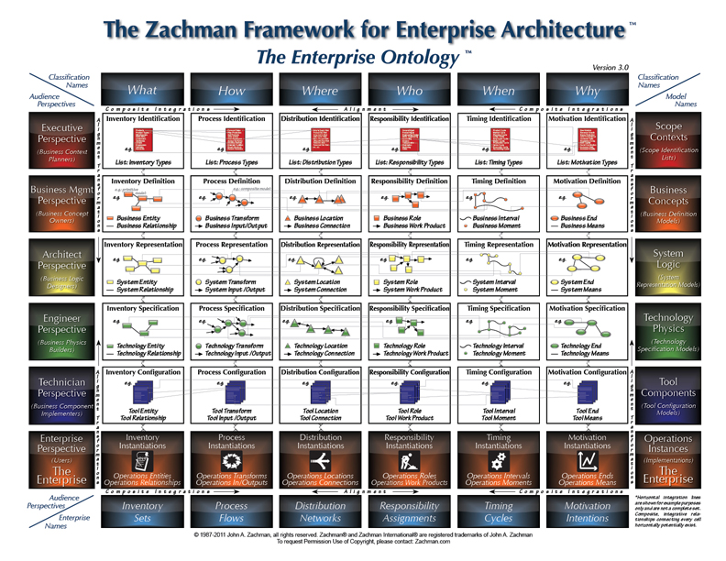
Zachman
Zach man only set context but not more Architect thinking
Architect is responsible at each level
2 major stake holder
Provider & Implementer
2 thing more important
Data (What) How (Logic) rest is optional

Slide 15
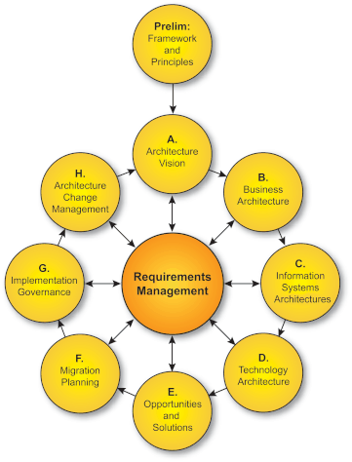
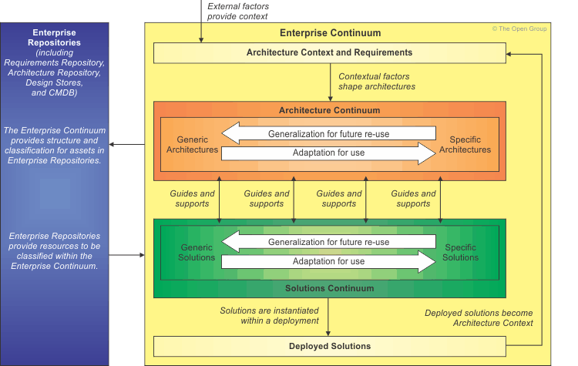
TOGAF Pillars
TOGAF
Enterprise architecture domains
Architecture Development Method
Enterprise Continuum
Business architecture
Data architecture
Applications architecture
Technical architecture

Slide 16
NFR

Slide 17
Architecture Deliverables
• Business Footprint diagram
• Business Service/Information
diagram
• Functional Decomposition
diagram
• Product Lifecycle diagram
• Goal/Objective/Service diagram
• Use-Case diagram
• Organization Decomposition
diagram
• Process Flow diagram
• Event diagram
Application Communication diagram
• Class diagram
• Data Dissemination diagram
• Data Security diagram
• Class Hierarchy diagram
• Data Migration diagram
• Data Lifecycle diagram
Process/Application Realization diagram
Application Migration diagram • Software Distribution diagram
Environments and Locations diagram • Platform Decomposition diagram
• Processing diagram • Networked Computing/Hardware diagram • Communications Engineering diagram
Catalogs
Matrices
Diagrams
• Organization/Actor catalog
• Driver/Goal/Objective catalog
• Role catalog
• Business Service/Function
catalog
• Location catalog
• Process/Event/Control/Product
catalog
• Contract/Measure catalog
Matrices
• Business Interaction matrix
• Actor/Role matrix

Slide 18
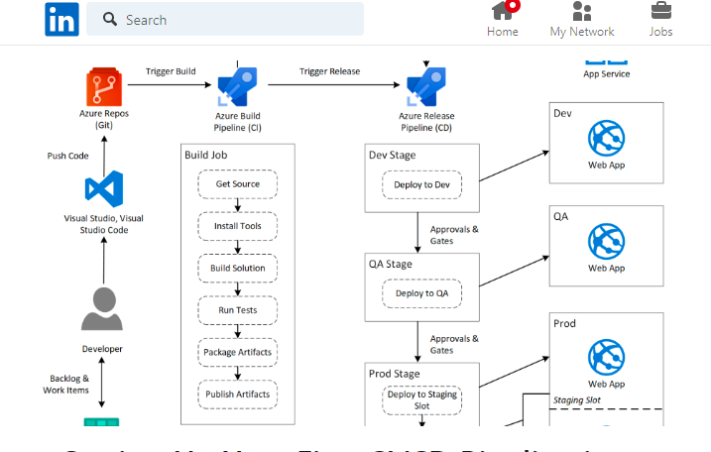
Maven Build SonarQ Checkmark t, build container image based on docker file, publish jar in repo and deploy on respective env

