Slide 1
New Application
Architect
Existing Application
Re platform
Lift - Shift ( re hosting)
Requirement Provider
Re Factoring Or Re Language with Enhancement
Financer
Requirement Implementer
( Developer)
Re Engineering
( new design )
Retire

Slide 2
NFR
Time to Market
Reliability/ Trustability
Owner Preferences
Budget
Easy Use ( End user)
Security
Performance
High Availability
Scaling
Implementer
Preferences
Manageability
Extensionalbility
Reusability
Interoperability

Slide 3
Architect Responsibilities
Life Cycle
Phase 0: Requirement capturing
Phase 1: Planning.
Phase 2: Requirements Analysis.
Phase 3: Design.
Phase 4: Coding.
Phase 5: Testing.
Phase 6: Deployment.
Phase 7: Maintenance
Phase 8: Enhancement
Phase 1: Requirement capturing
Requirement
Present to Customer Visualized about requirement capturing
& Minimize Gap
Capture Requirement & Minimize gap
[ Requirement Gathering]
Requirement Provider
Phase 2: Development
Requirement Implementation
Requirement
Design
Present to Developer Visualized about Design & Minimize Gap
NFR
Requirement Implementer
( Developer)
Budget
Architect
Technology
Data
Logic
Developer
Phase 3 : Deployment & Support ( Operation)
Store Design & Requirement Artifactory to Easy understand to Support guy
Architect
Support Developer

Slide 4
Different type Architecture
HLD
Design & Functional traceability
LLD
Catalog
OLTP
Application Architecture
Off Line
Matrix
Security Architecture
Deployment Architecture
Diagram
Reference Architecture
Specific Architecture

Slide 5
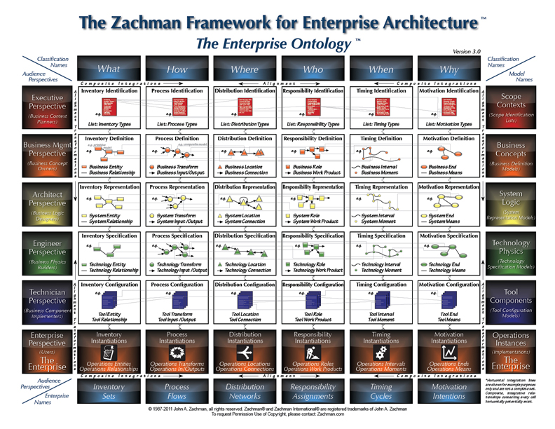
Zachman
Zach man only set context but not more Architect thinking
Architect is responsible at each level
2 major stake holder
Provider & Implementer
2 thing more important
Data (What) How (Logic) rest is optional

Slide 6
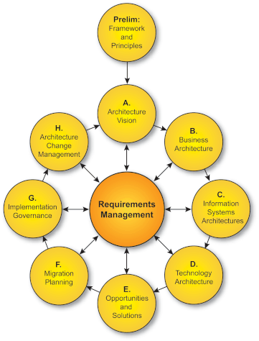
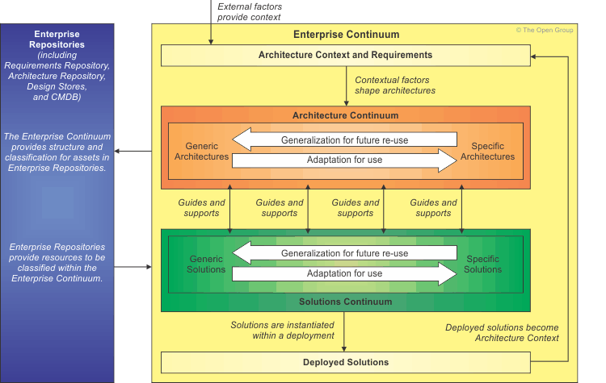
TOGAF Pillars
TOGAF
Enterprise architecture domains
Architecture Development Method
Enterprise Continuum
Business architecture
Data architecture
Applications architecture
Technical architecture

Slide 7
NFR

Slide 8
Architecture Deliverables
• Business Footprint diagram
• Business Service/Information
diagram
• Functional Decomposition
diagram
• Product Lifecycle diagram
• Goal/Objective/Service diagram
• Use-Case diagram
• Organization Decomposition
diagram
• Process Flow diagram
• Event diagram
Application Communication diagram
• Class diagram
• Data Dissemination diagram
• Data Security diagram
• Class Hierarchy diagram
• Data Migration diagram
• Data Lifecycle diagram
Process/Application Realization diagram
Application Migration diagram • Software Distribution diagram
Environments and Locations diagram • Platform Decomposition diagram
• Processing diagram • Networked Computing/Hardware diagram • Communications Engineering diagram
Catalogs
Matrices
Diagrams
• Organization/Actor catalog
• Driver/Goal/Objective catalog
• Role catalog
• Business Service/Function
catalog
• Location catalog
• Process/Event/Control/Product
catalog
• Contract/Measure catalog
Matrices
• Business Interaction matrix
• Actor/Role matrix

Slide 9
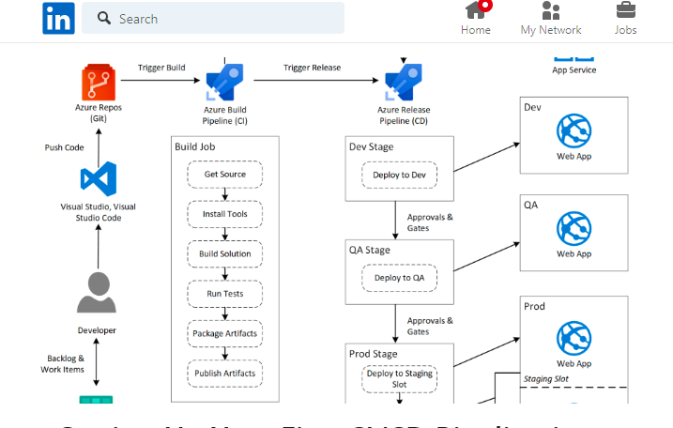
Maven Build SonarQ Checkmark t, build container image based on docker file, publish jar in repo and deploy on respective env

