Slide 1


Exploratory Data Analysis
Data@ANZ

Slide 2
Quick glance at the data
The Given Dataset contains 12043 transactions from 100 unique customers / account.
There are 23 categories as follows: 'status', 'card_present_flag', 'bpay_biller_code', 'account', 'currency', 'long_lat', 'txn_description', 'merchant_id', 'merchant_code', 'first_name', 'balance', 'date', 'gender', 'age','merchant_suburb', 'merchant_state', 'extraction', 'amount','transaction_id', 'country', 'customer_id', 'merchant_long_lat', 'movement’.
The dataset has 3 month of transaction data , the transaction period is from 1/8/2018 to 31/10/2018

Slide 3
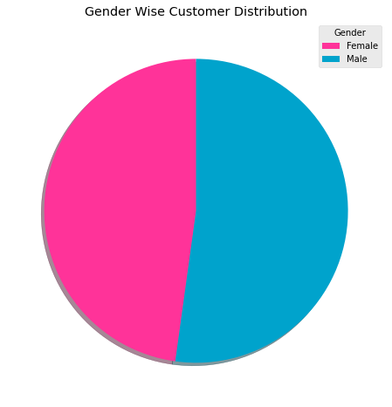
Exploratory data analysis insights.
The average number of customer transaction per is 133.
The Average amount of transaction per day is - 190.61 AUD. Although the mean transaction range from 100-400 AUD.
The count of male customers is slightly greater than female customers.

Slide 4
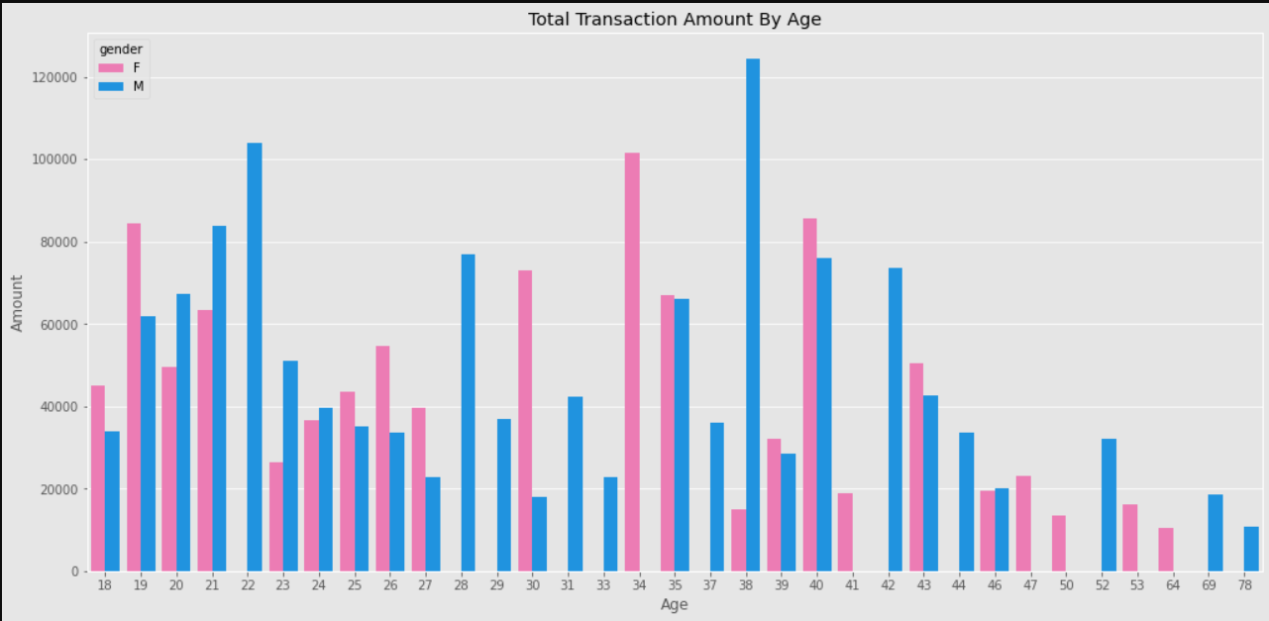
Exploratory data analysis insights.
Majority of the customers belong to the age group 18-53.

Slide 5
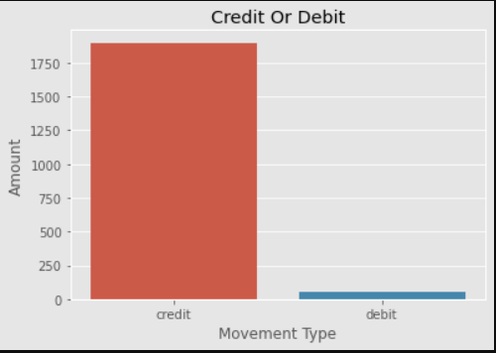
Exploratory data analysis insights.
The preferred payment mode for majority of the customers was credit.
The total payment made through credit transaction was 1899 AUD

Slide 6
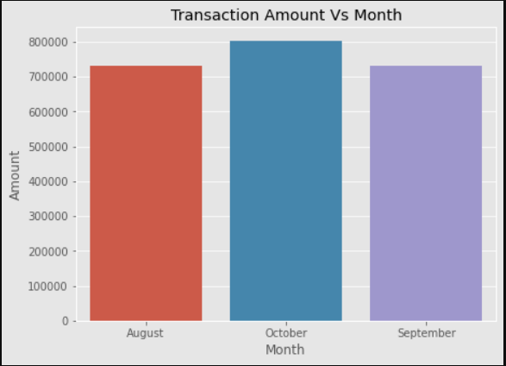
Exploratory data analysis insights.
Amount transacted in the month of October was more as compared to August and September.
The average payment made for the month of August, September and October are - 185, 182 & 196 AUD

