Slide 1

Note: The data and information in this document is reflective of a hypothetical situation and client. This document is to be used for KPMG Virtual Internship purposes only.
Sprocket Central Pty Ltd
Data analytics approach
[Division Name] - [Engagement Manager], [Senior Consultant], [Junior Consultant]

Slide 2
Note: The data and information in this document is reflective of a hypothetical situation and client. This document is to be used for KPMG Virtual Internship purposes only.
Agenda
Introduction
Data Exploration
Model Development
Interpretation

Slide 3
Note: The data and information in this document is reflective of a hypothetical situation and client. This document is to be used for KPMG Virtual Internship purposes only.
Introduction
Age Distribution
Bike purchases made in last 3 years & Gender wise distribution
Customer Distribution for each Job-Industry
Customer Distribution for each wealth segments
Widely preferred brands and product line
Car owner-ship in each state

Slide 4
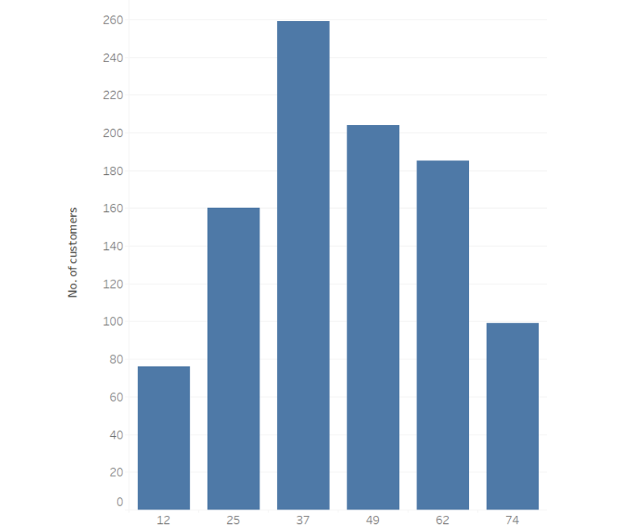
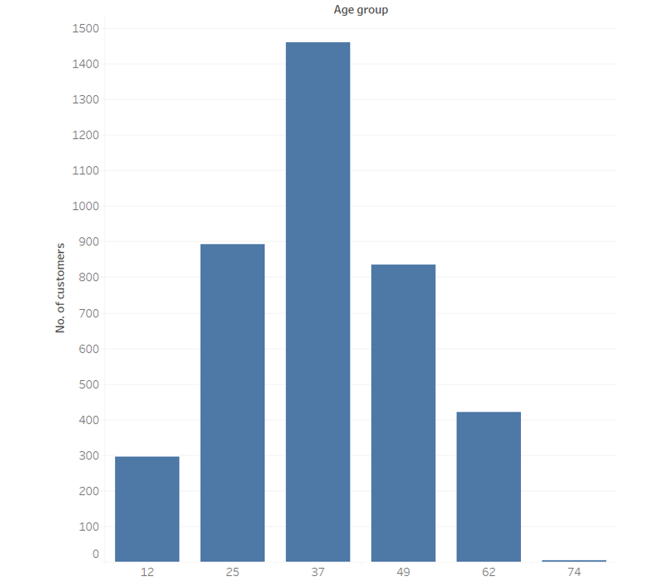
Note: The data and information in this document is reflective of a hypothetical situation and client. This document is to be used for KPMG Virtual Internship purposes only.
Data Exploration - Age-wise customer distribution
Majority of our new customers are between age group 25-49
There is a slight increase in number of customers between age group 62-74
No significant change in number of customers under 25
New
Old

Slide 5
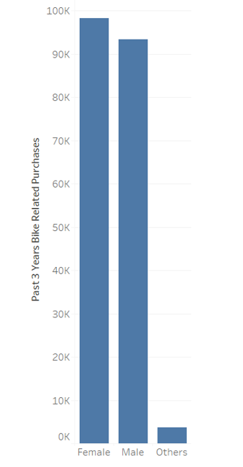
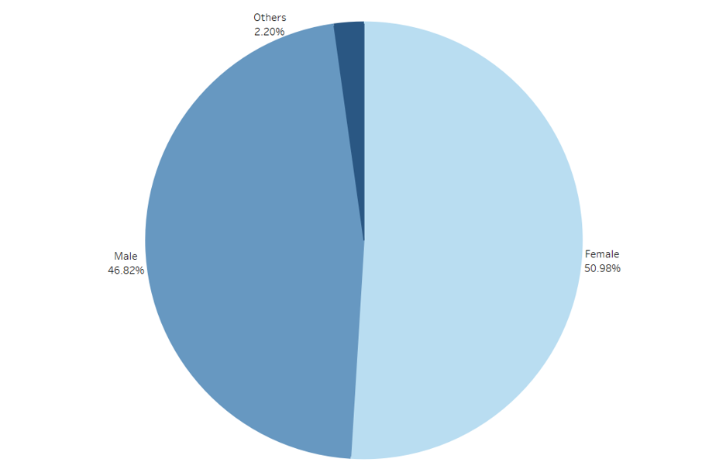
Note: The data and information in this document is reflective of a hypothetical situation and client. This document is to be used for KPMG Virtual Internship purposes only.
Data Exploration- Bike purchases made in last 3 years
As we can see, our new customers are mostly Female with 50.6% purchases with total of 25,212 bikes
Males contributed to 46.8% of the total purchases

Slide 6
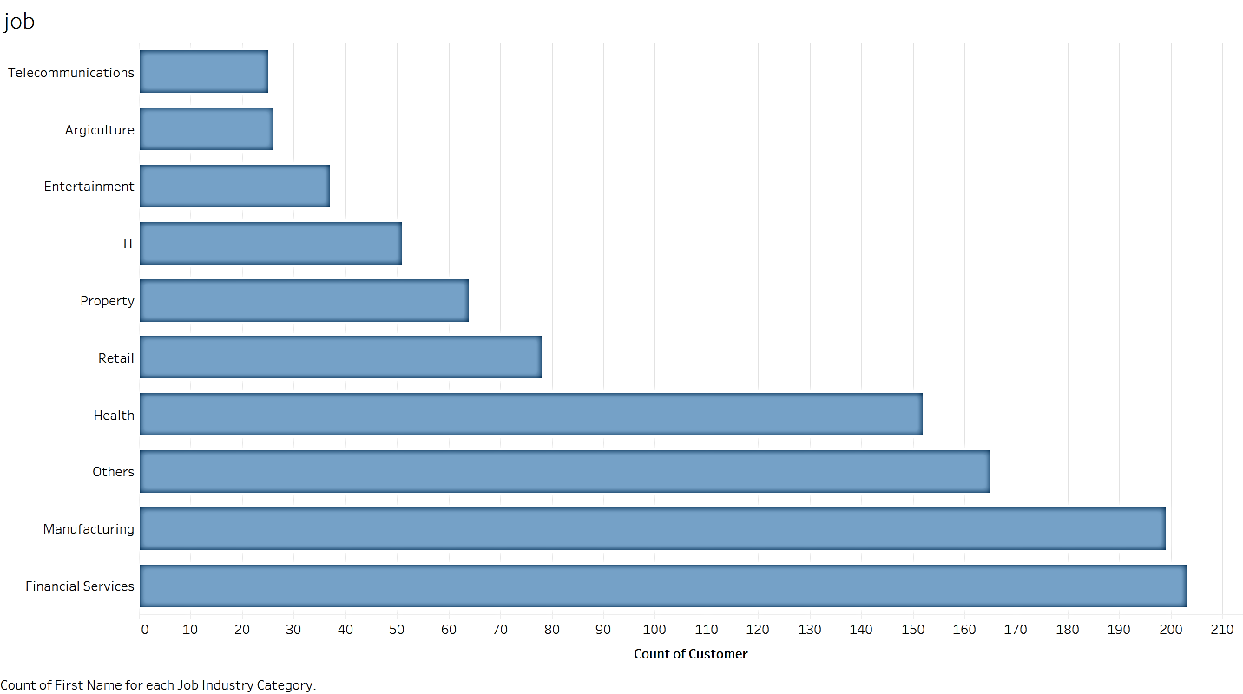
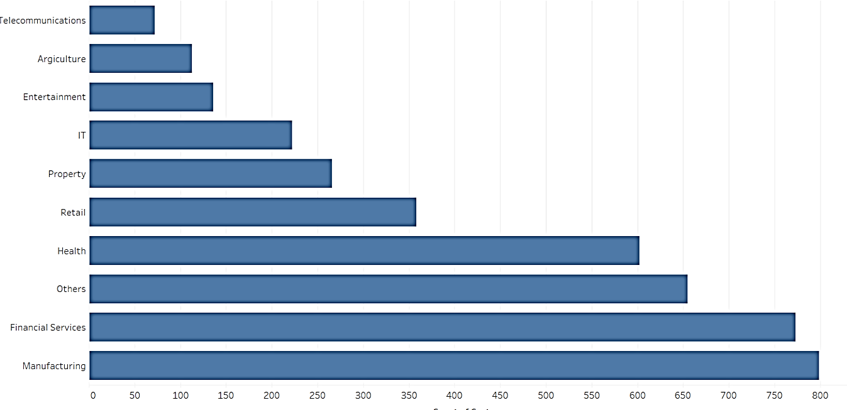

Note: The data and information in this document is reflective of a hypothetical situation and client. This document is to be used for KPMG Virtual Internship purposes only.
Model Development - Customer Distribution for each Job-Industry
High percentage of our new customers belong to the Manufacturing and Financial services.
No major changes in the customer percentage for rest of the industries.
.
Old

Slide 7
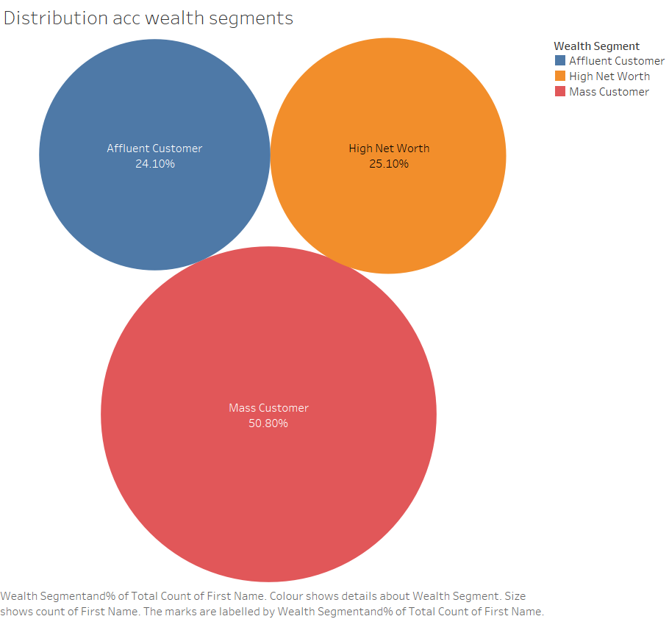
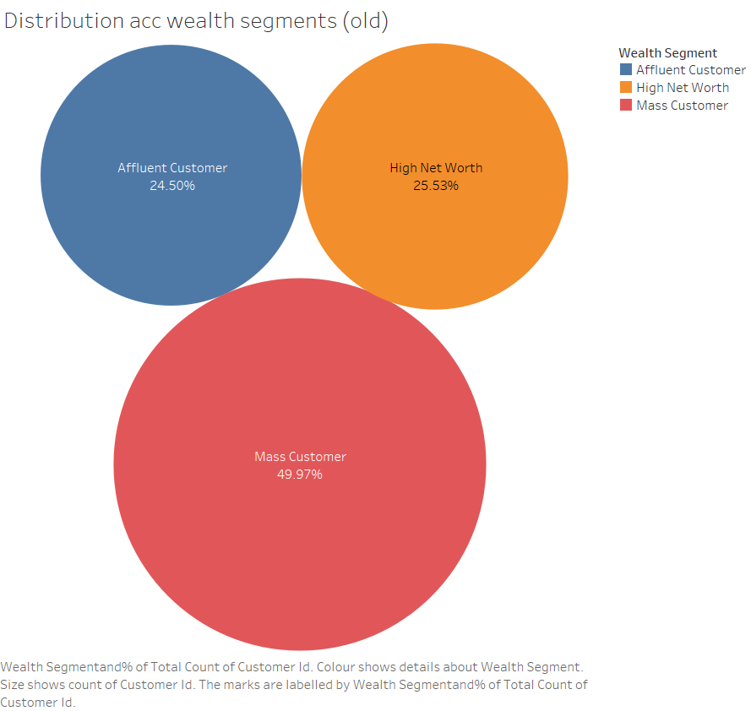
Note: The data and information in this document is reflective of a hypothetical situation and client. This document is to be used for KPMG Virtual Internship purposes only.
Model Development - Customer Distribution for each wealth segments
Almost 50% of our customers fall under the Mass Customer category and should our main focus
Affluent and High Net Customers contribute to around 25% each of the total customers
.
Old

Slide 8
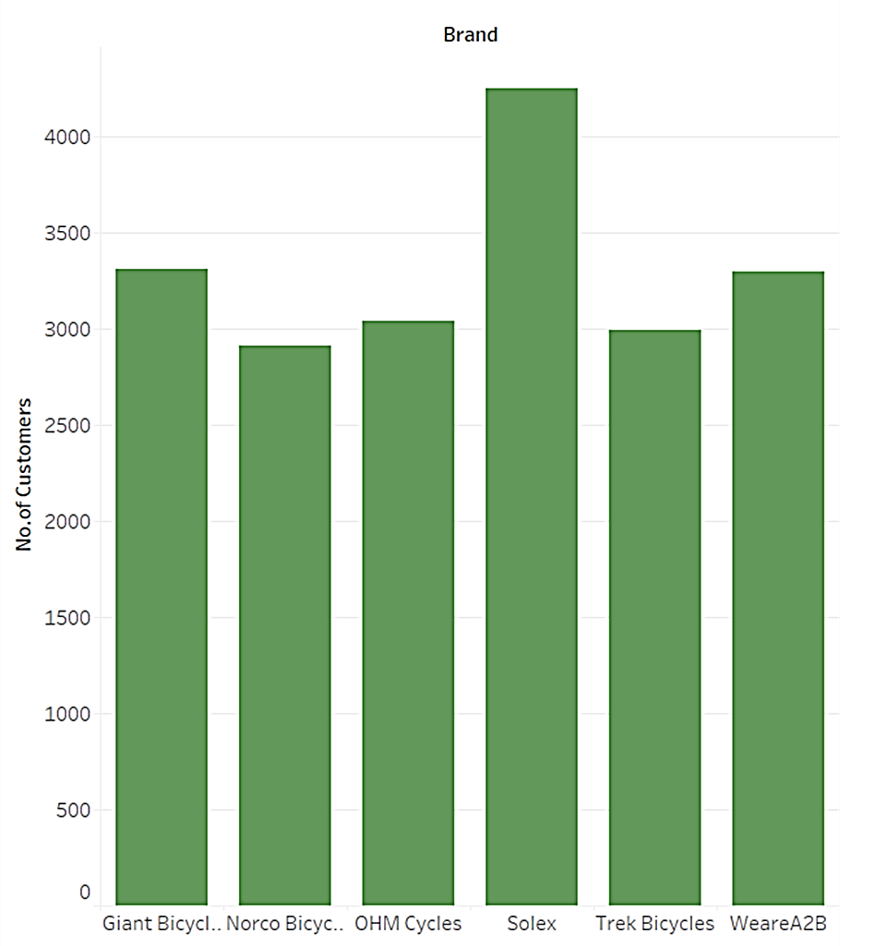
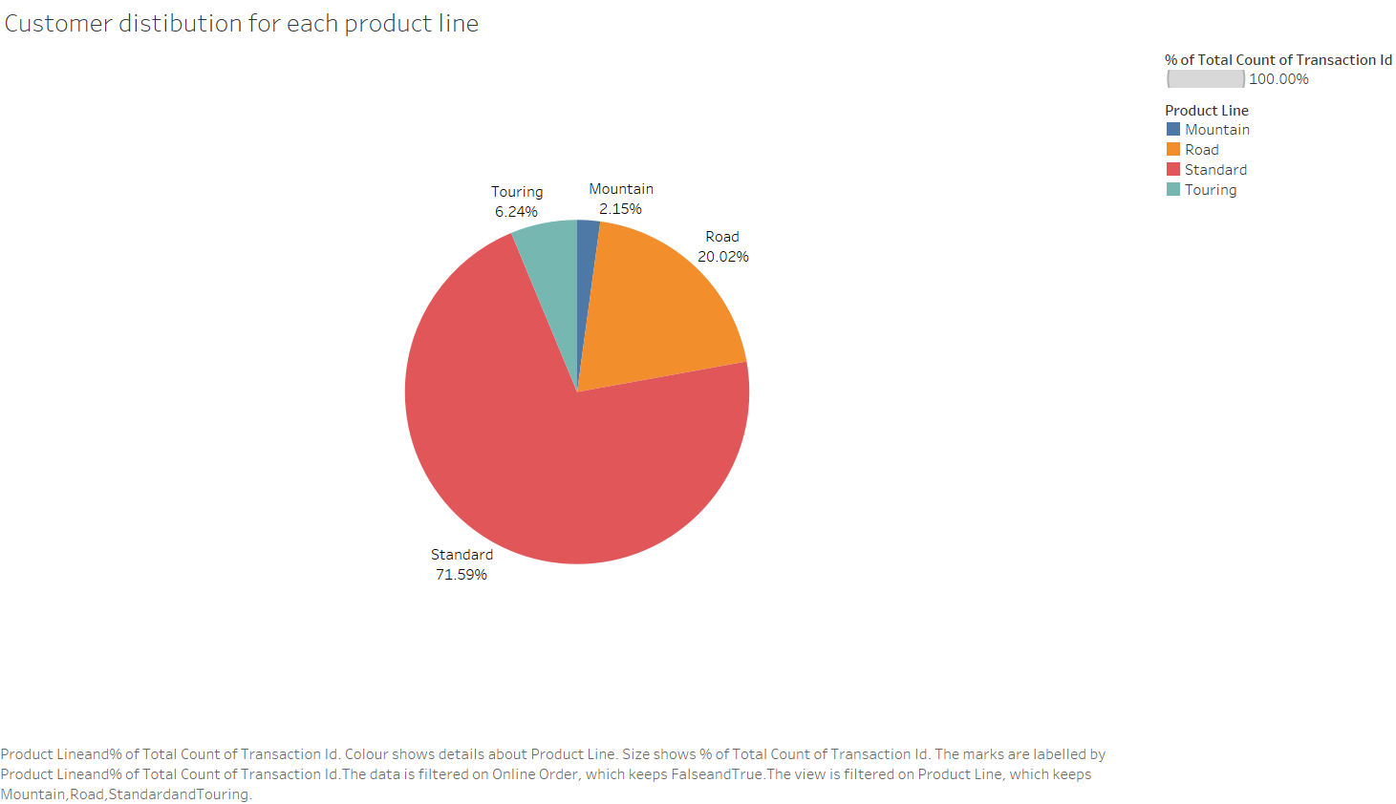
Note: The data and information in this document is reflective of a hypothetical situation and client. This document is to be used for KPMG Virtual Internship purposes only.
Interpretation - Widely preferred brands and product line
Customers prefer standard bikes over other product line
Solex is the most popular brand among the customers

Slide 9
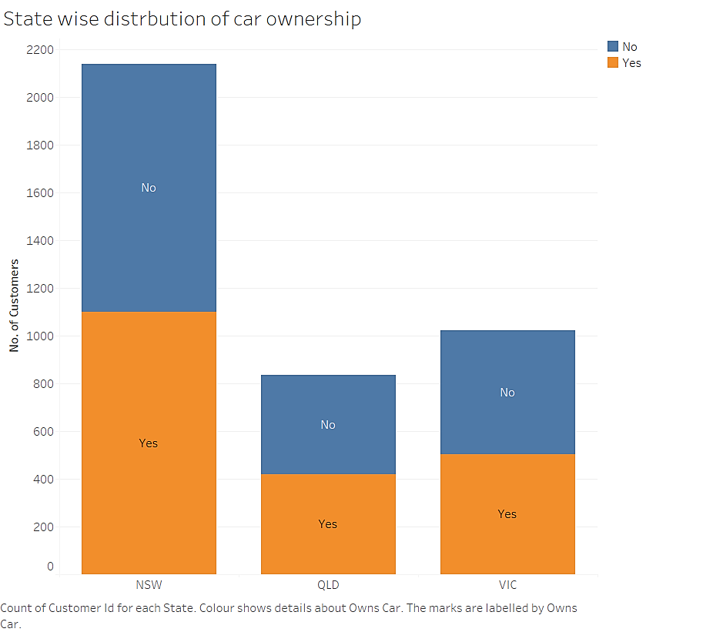
Note: The data and information in this document is reflective of a hypothetical situation and client. This document is to be used for KPMG Virtual Internship purposes only.
Interpretation – State wise car ownership
Company should target customers who don’t own cars
New South Wales has majority of customers who don’t own cars over those who own cars

Slide 10
Note: The data and information in this document is reflective of a hypothetical situation and client. This document is to be used for KPMG Virtual Internship purposes only.
Appendix

Slide 11
Note: The data and information in this document is reflective of a hypothetical situation and client. This document is to be used for KPMG Virtual Internship purposes only.
Appendix
This is an optional slide where you may place any supporting items.

