Slide 1
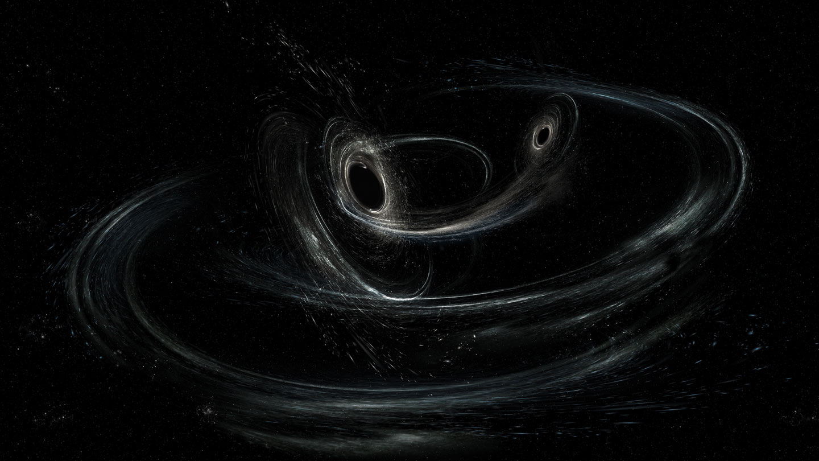


gravitational wave signals from Precessing and Nutating binary black holes
Tamanjyot Singh
Dr. Michael Kesden, Dr. Lindsay King
The University of Texas at Dallas
APS Global Physics Summit 2025
03/18/2025
Image credit: LIGO/Caltech/MIT/Sonoma State (Aurore Simonnet)

Slide 2
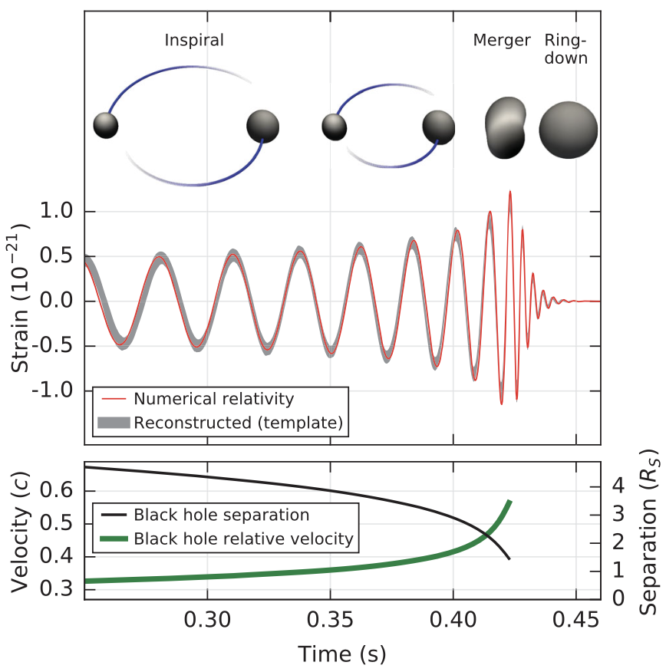
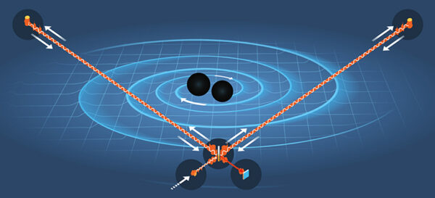
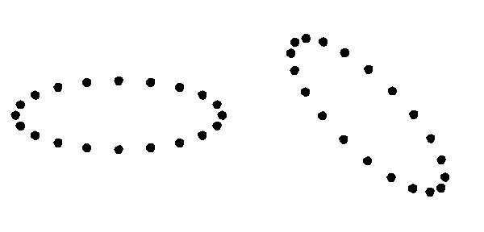
GW Emission
Illustration: Johan Jarnestad
Abbott+ (2016)
GWs emitted by merging (stellar-mass) compact objects are observed by LIGO-Virgo-KAGRA (LVK).
As GWs pass through interferometers, they stretch and squeeze spacetime.
LVK network has observed ~90 GW signals in 3 runs (+199 in O4).
Wikipedia
03/18/2025

Slide 3
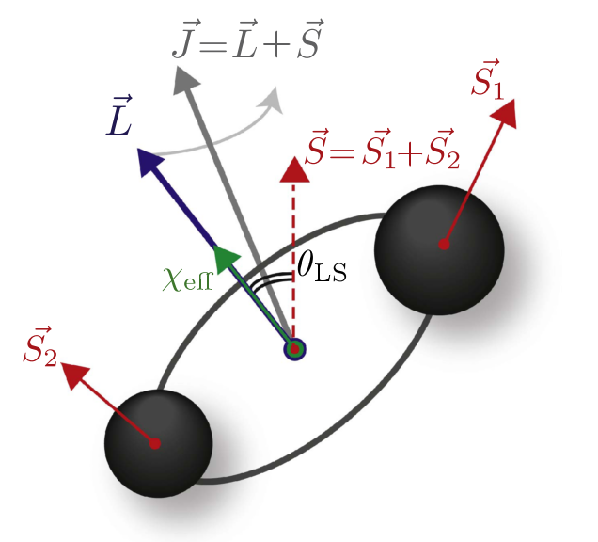
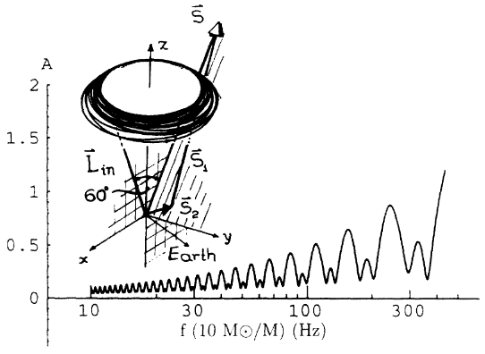
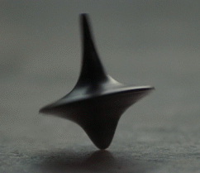
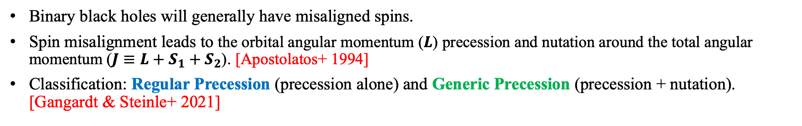

Precession and nutation
$$h\left(f\right)=B(f)e^{iΦ(f)}$$
Rodriguez group @ UNC
Apostolatos+ (1994)
Binary black holes will generally have misaligned spins.
Spin misalignment leads to the orbital angular momentum ($L$) precession and nutation around the total angular momentum ($J≡L+S_{1}+S_{2}$). [Apostolatos+ 1994]
Classification: Regular Precession (precession alone) and Generic Precession (precession + nutation). [Gangardt & Steinle+ 2021]
03/18/2025

Slide 4
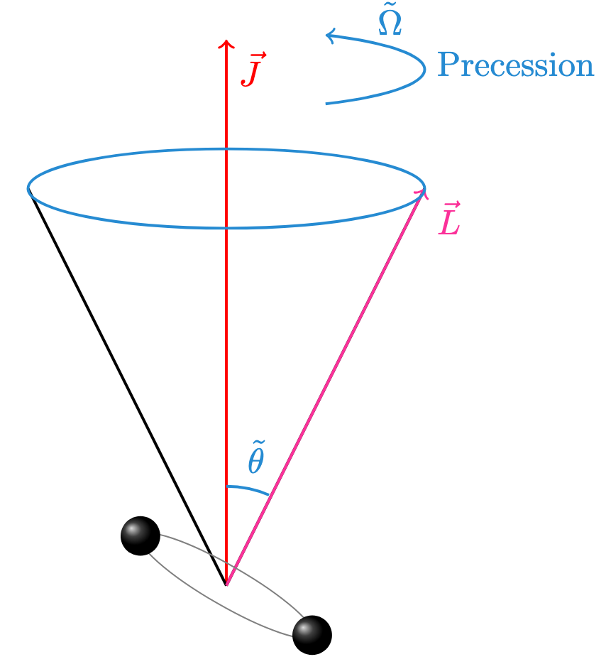
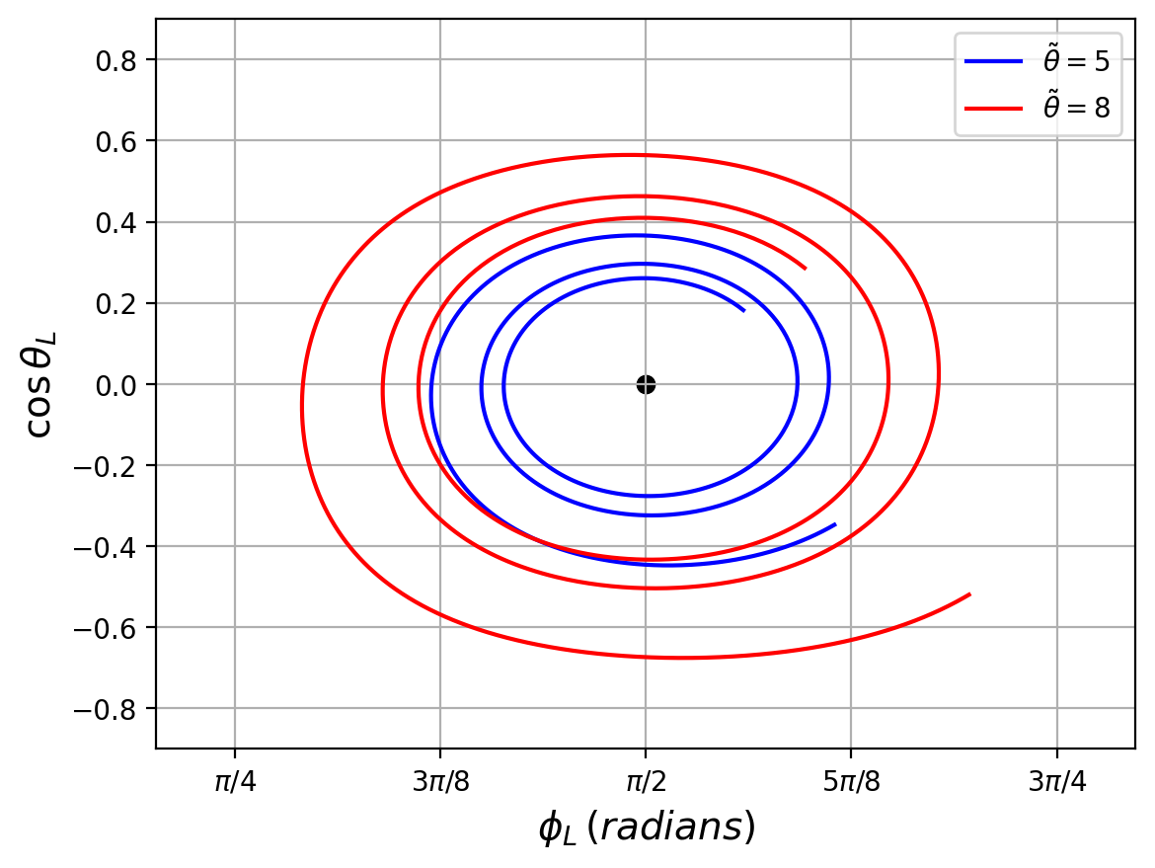
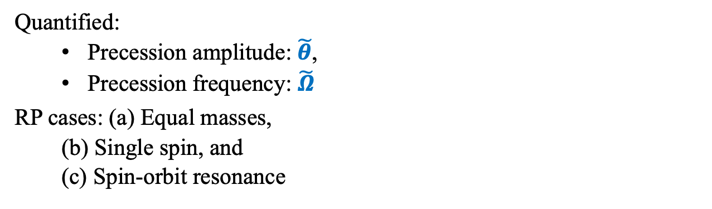

Regular Precession
$\tilde{Ω}$ = 2
TS+ (in prep)
Quantified:
  Precession amplitude: $\tilde{θ}$,
  Precession frequency: $\tilde{Ω}$
RP cases: (a) Equal masses,
  (b) Single spin, and
  (c) Spin-orbit resonance
Edge-on
03/18/2025

Slide 5
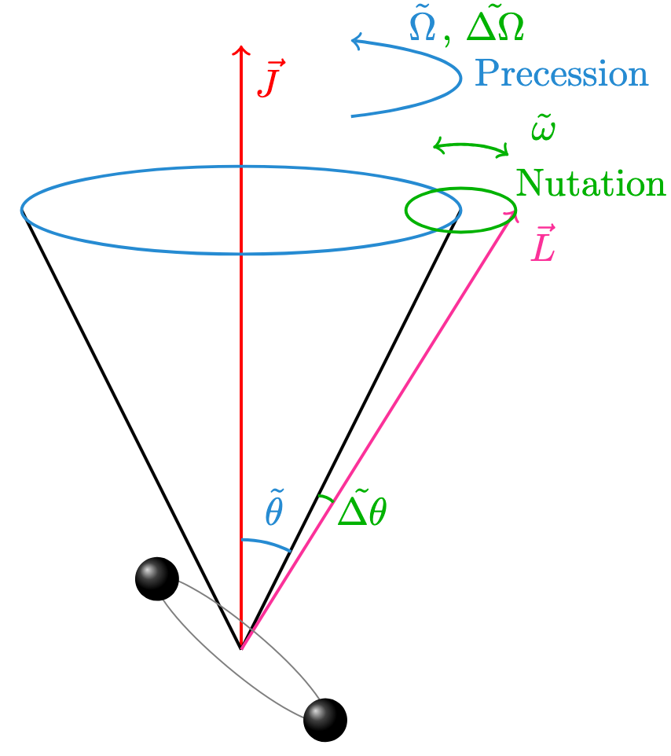
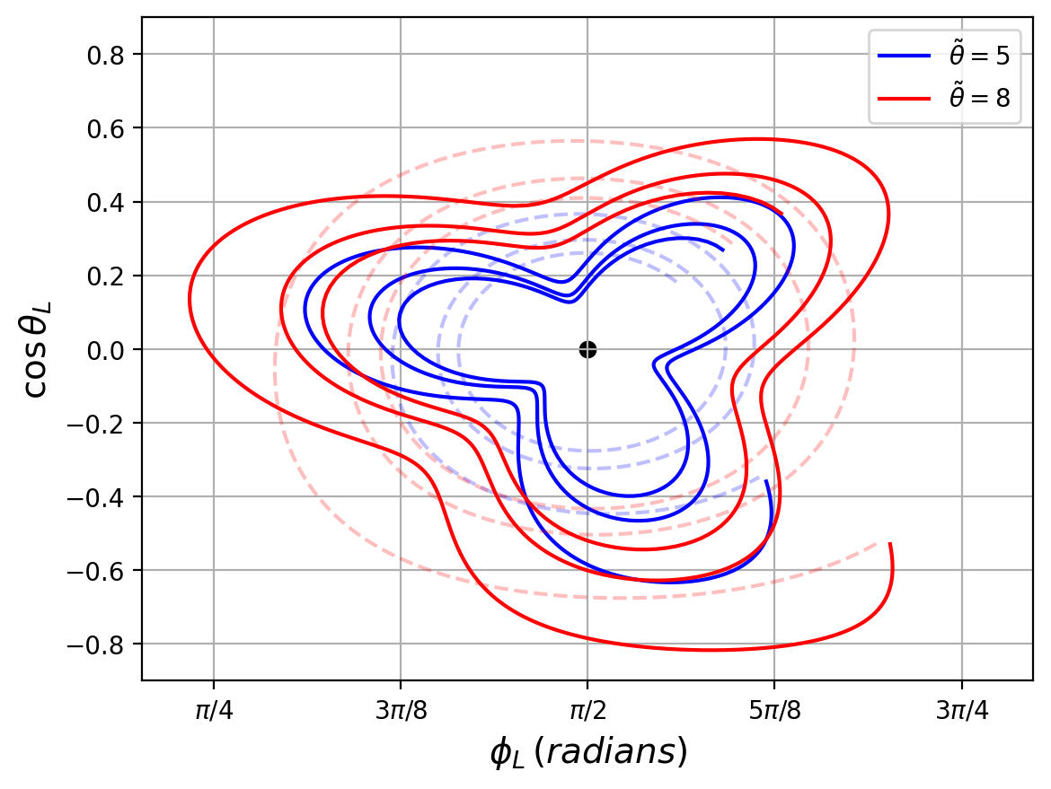
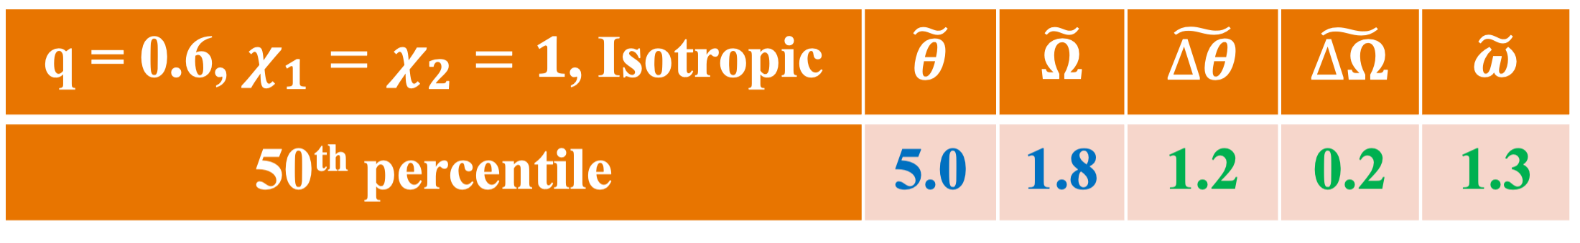
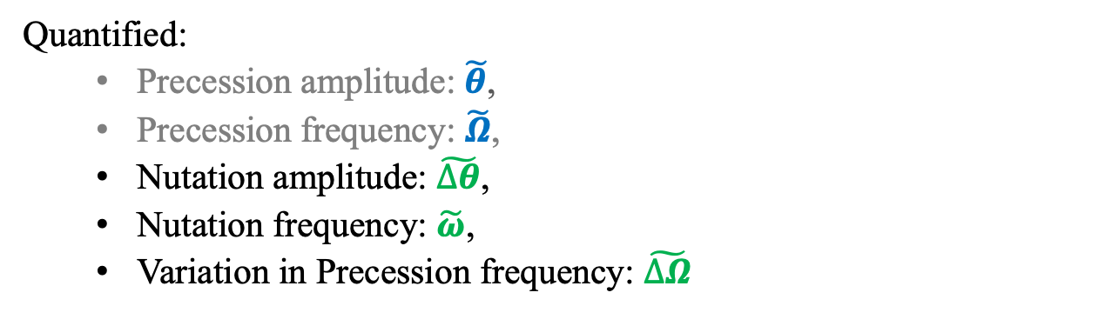
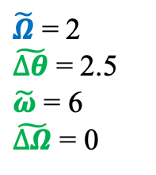
Generic Precession: with Nutation
$\tilde{Ω}$ = 2
$\tilde{∆θ}$ = 2.5
$\tilde{ω}$ = 6
$\tilde{∆Ω}$ = 0
TS+ (in prep)
Quantified:
  Precession amplitude: $\tilde{θ}$,
  Precession frequency: $\tilde{Ω}$,
  Nutation amplitude: $\tilde{∆θ}$,
  Nutation frequency: $\tilde{ω}$,
  Variation in Precession frequency: $\tilde{∆Ω}$
Edge-on
03/18/2025

Slide 6
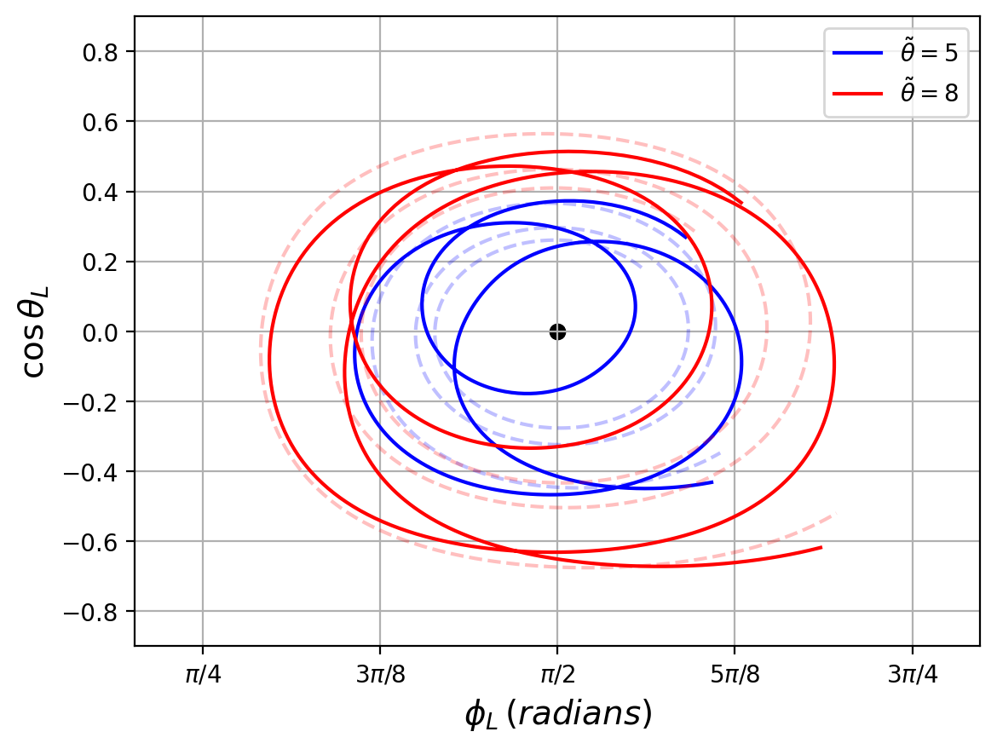
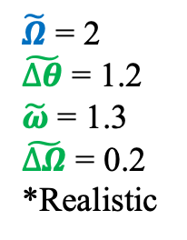
Generic Precession: with Nutation
$\tilde{Ω}$ = 2
$\tilde{∆θ}$ = 1.2
$\tilde{ω}$ = 1.3
$\tilde{∆Ω}$ = 0.2
*Realistic
TS+ (in prep)
Quantified:
  Precession amplitude: $\tilde{θ}$,
  Precession frequency: $\tilde{Ω}$,
  Nutation amplitude: $\tilde{∆θ}$,
  Nutation frequency: $\tilde{ω}$,
  Variation in Precession frequency: $\tilde{∆Ω}$
Edge-on
03/18/2025

Slide 7
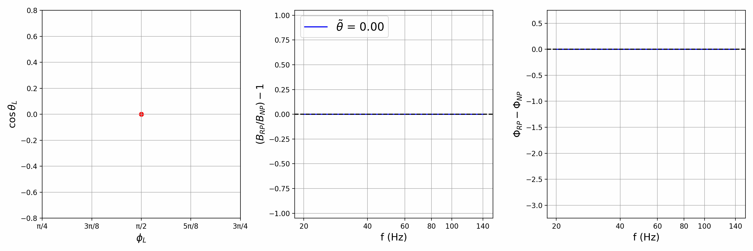

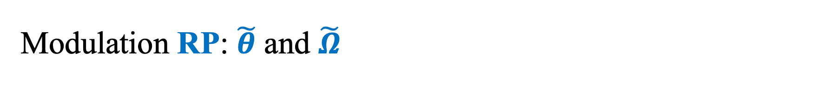
Modulation RP: $\tilde{θ}$ and $\tilde{Ω}$
Edge-on
$\tilde{Ω}$ = 2
TS+ (in prep)
Motion of L Fractional change in amplitude Phase difference
Precession: $\tilde{θ}$: Amplitude of modulations $\tilde{Ω}$: Frequency of modulations
03/18/2025

Slide 8
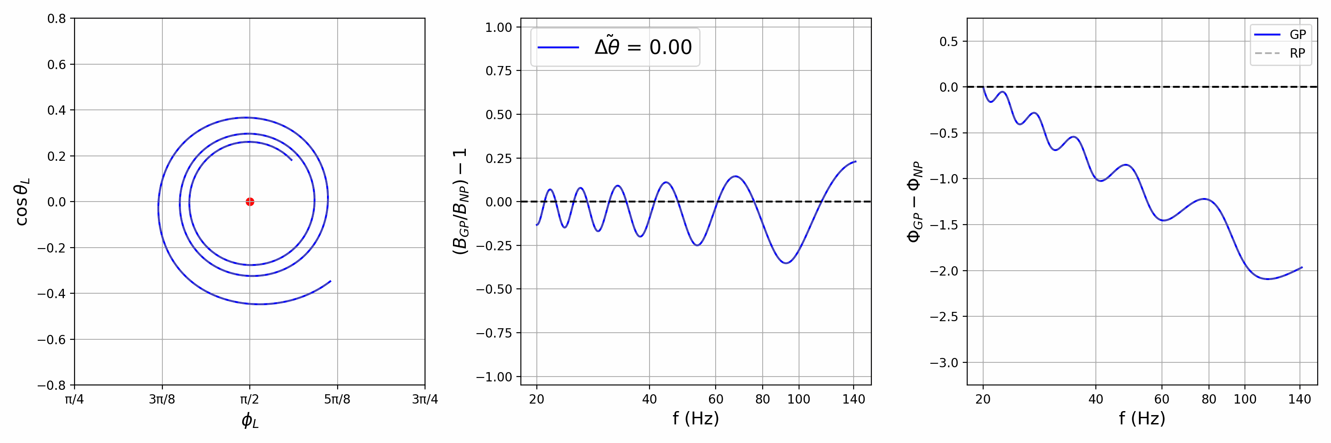
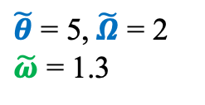
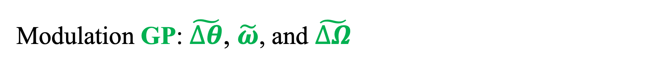
Modulation GP: $\tilde{∆θ}$, $\tilde{ω}$, and $\tilde{∆Ω}$
Edge-on
$\tilde{θ}$ = 5, $\tilde{Ω}$ = 2
$\tilde{ω}$ = 1.3
TS+ (in prep)
Motion of L Fractional change in amplitude Phase difference
Nutation: $\tilde{∆θ}$: Amplitude of the perturbation. $\tilde{ω}$: Frequency of the perturbation.
03/18/2025

Slide 9
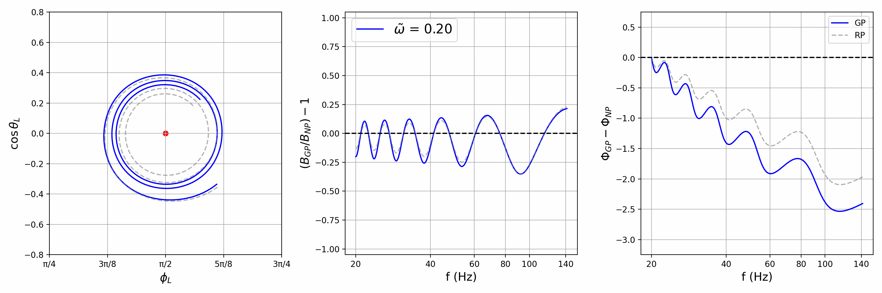
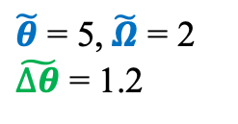
Modulation GP: $\tilde{∆θ}$, $\tilde{ω}$, and $\tilde{∆Ω}$
Edge-on
$\tilde{θ}$ = 5, $\tilde{Ω}$ = 2
$\tilde{∆θ}$ = 1.2
TS+ (in prep)
Motion of L Fractional change in amplitude Phase difference
Nutation: $\tilde{∆θ}$: Amplitude of the perturbation. $\tilde{ω}$: Frequency of the perturbation.
Not shown: $\tilde{∆Ω}$: Precession frequency change due to nutation
03/18/2025

Slide 10
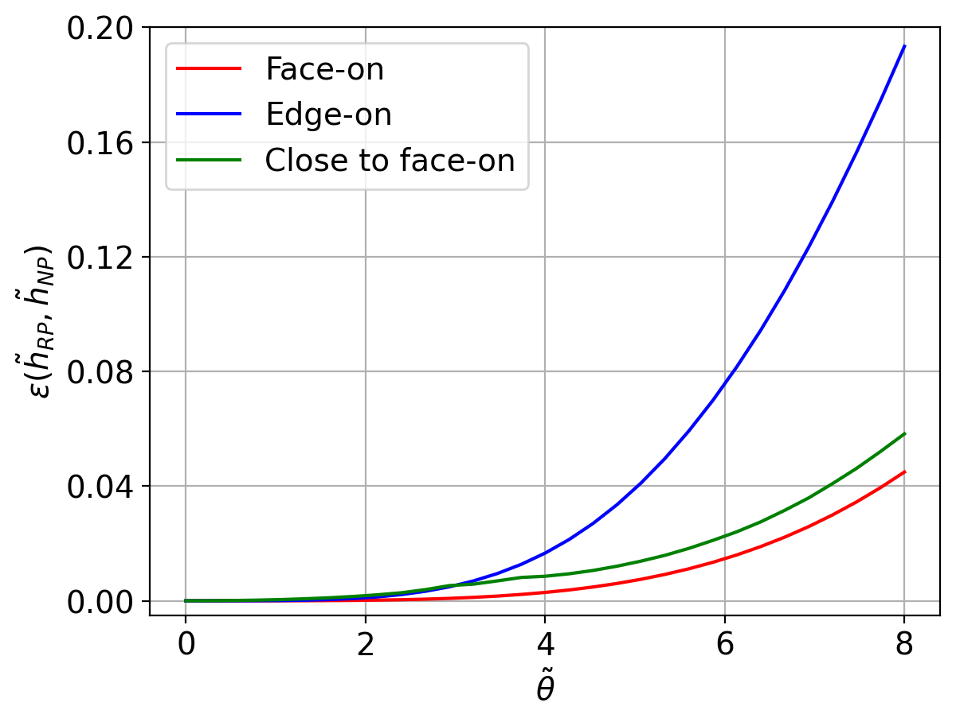
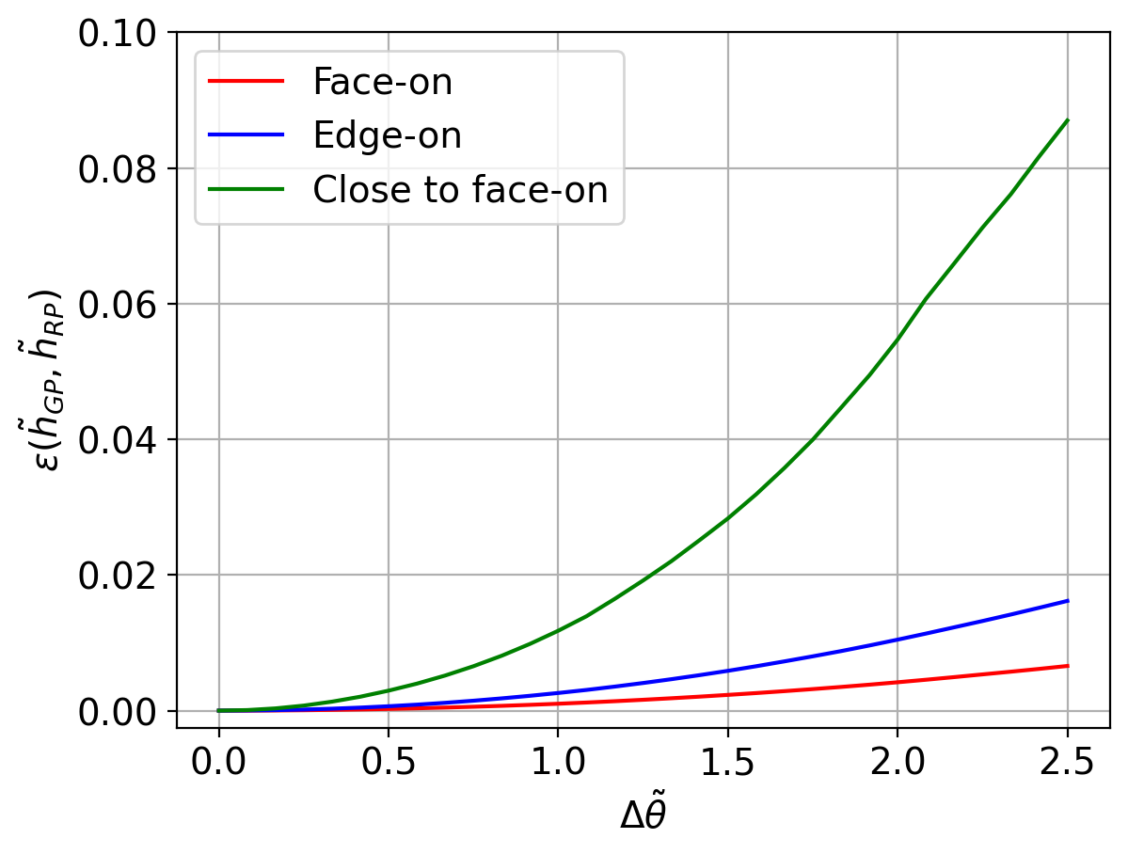
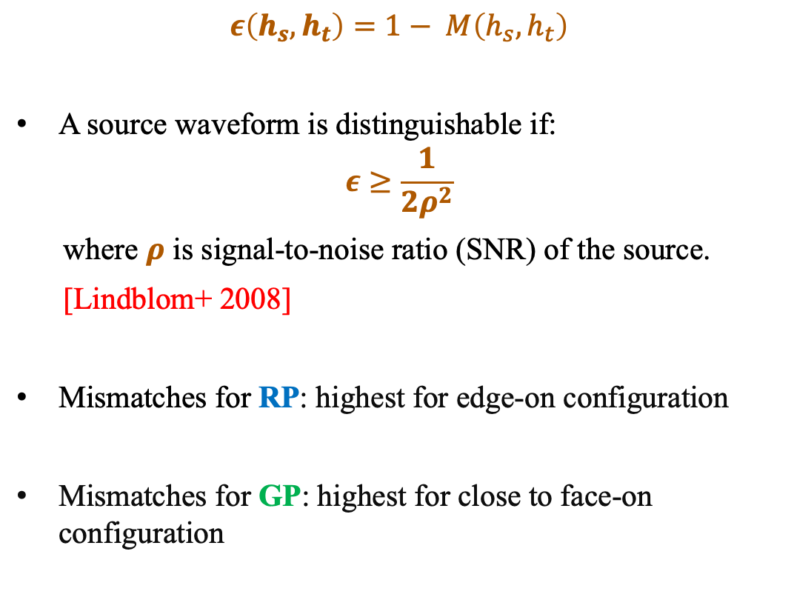

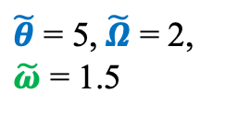
Mismatch:
RP vs non-precessing
(Precession)
$\tilde{Ω}$ = 2
$$ε\left(h_{s}, h_{t}\right)=1− M\left(h_{s}, h_{t}\right)$$
A source waveform is distinguishable if:
$$ε≥\frac{1}{2ρ^{2}}$$
where $ρ$ is signal-to-noise ratio (SNR) of the source.
[Lindblom+ 2008]
Mismatches for RP: highest for edge-on configuration
Mismatches for GP: highest for close to face-on configuration
TS+ (in prep)
$\tilde{θ}$ = 5, $\tilde{Ω}$ = 2,
$\tilde{ω}$ = 1.5
GP vs RP
(Nutation)
03/18/2025

Slide 11
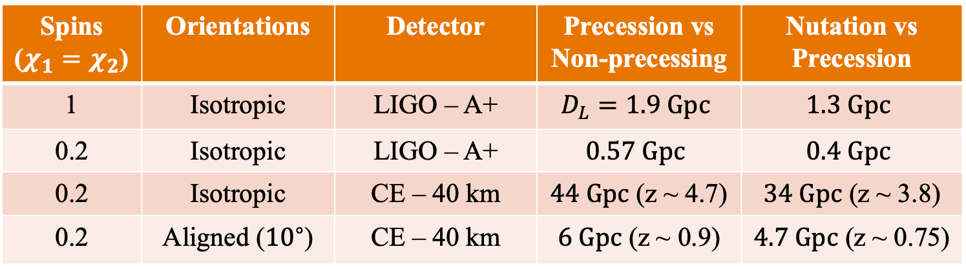
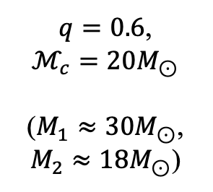
Distinguishability & next steps
Spins ($χ_{1}=χ_{2}$) | Orientations | Detector | Precession vs Non-precessing | Nutation vs Precession
1 | Isotropic | LIGO – A+ | $$D_{L}=1.9 Gpc$$ | $$1.3 Gpc$$
0.2 | Isotropic | LIGO – A+ | $$0.57 Gpc$$ | $$0.4 Gpc$$
0.2 | Isotropic | CE – 40 km | $44 Gpc$ (z ~ 4.7) | $34 Gpc$ (z ~ 3.8)
0.2 | Aligned (${10}^{∘}$) | CE – 40 km | $6 Gpc$ (z ~ 0.9) | $4.7 Gpc$ (z ~ 0.75)
$q=0.6$,
$$ℳ_{c}=20M_{⊙}$$
($M_{1}≈30M_{⊙}$,
$M_{2}≈18M_{⊙}$)
Luminosity distances (or redshifts) for different scenarios and noise curves at which we can distinguish precession/nutation in a particular source with 50% probability.
Precession distinguishability was explored in our previous work (in prep), now we are exploring distinguishability of nutation.
Future work: how a network of detectors (current and / or 3rd generation) can improve observational constraints on precession and nutation.
03/18/2025
Notes:
z = 0.1 ~ 0.4 Gpc, CE Prec02ISO comoving 7.78 Gpc – Nut02ISO comoving 7.1 Gpc
CE Prec02align comoving – 3 Gpc, Nut02align comoving 2.6 Gpc
FOR MORE DISTANT OBJECT: Apparent magnitude is affected (luminosity dist – relation between apparent and absolute magnitudes)

Slide 12



Thank you
Acknowledgements
GP toy model:
singhtaman-gp.onrender.com
Collaborators: Dr. Michael Kesden (Ph.D. Advisor), Dr. Lindsay King
This research is supported by National Science Foundation (NSF) grants PHY-2011977, AST-2219128, and PHY-2309320
High-performance computing: Texas Advanced Computing Center (TACC)
Research webpage:
singhtaman.github.io
Contact: tamanjyot@utdallas.edu
12
Image credit: LIGO/Caltech/MIT/Sonoma State (Aurore Simonnet)
Notes:
grants PHY-2011977 and PHY-2309320

Slide 13
Bonus Slides:
GP toy model:
singhtaman-gp.onrender.com
Research webpage:
singhtaman.github.io
Contact: tamanjyot@utdallas.edu
13
Image credit: LIGO/Caltech/MIT/Sonoma State (Aurore Simonnet)
Notes:
grants PHY-2011977 and PHY-2309320

Slide 14
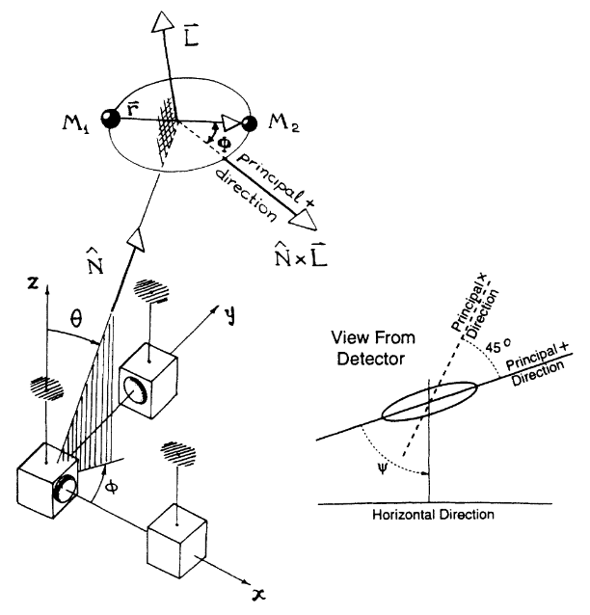



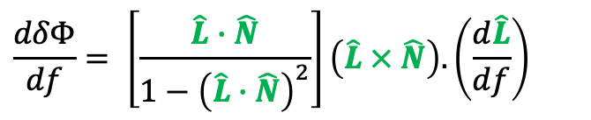

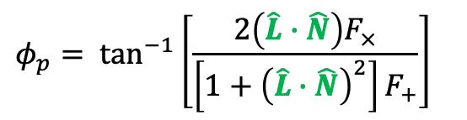
GW signal
$${\tilde{h}}_{+}\left(f\right)=Af^{−7/6}[1+{(\hat{L}∙\hat{N})}^{2}]e^{iΨ}$$
$${\tilde{h}}_{×}\left(f\right)=−2iAf^{−7/6}(\hat{L}∙\hat{N})e^{iΨ}$$
$$h\left(f\right)=F_{+}h_{+}\left(f\right)+F_{×}h_{×}\left(f\right)$$
$$h\left(f\right)=B(f)e^{iΦ(f)}$$
$$B\left(f\right)=Af^{−7/6}{\left\{4{\left(\hat{L}∙\hat{N}\right)}^{2}{F_{×}}^{2}+{\left[1+{\left(\hat{L}∙\hat{N}\right)}^{2}\right]}^{2}{F_{+}}^{2}\right\}}^{1/2}$$
$$Φ\left(f\right)=Ψ\left(f\right)− φ_{p} −2δΦ$$
$$φ_{p}= \tan^{−1}\left[\frac{2\left(\hat{L}∙\hat{N}\right)F_{×}}{\left[1+{\left(\hat{L}∙\hat{N}\right)}^{2}\right]F_{+}}\right]$$
$$\frac{dδΦ}{df}= \left[\frac{\hat{L}∙\hat{N}}{1−{\left(\hat{L}∙\hat{N}\right)}^{2}}\right]\left(\hat{L} × \hat{N}\right).\left(\frac{d\hat{L}}{df}\right)$$
Apostolatos+ (1994)
03/18/2025

Slide 15
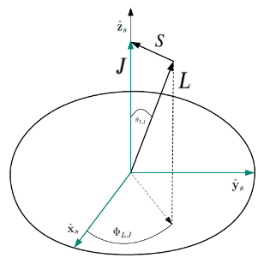
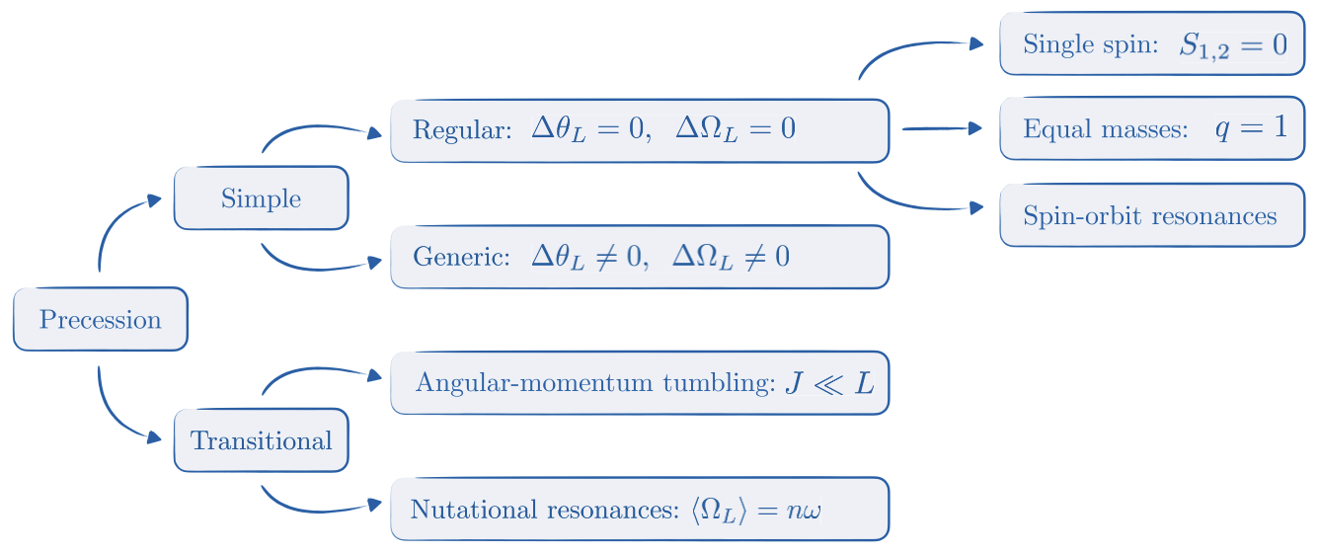
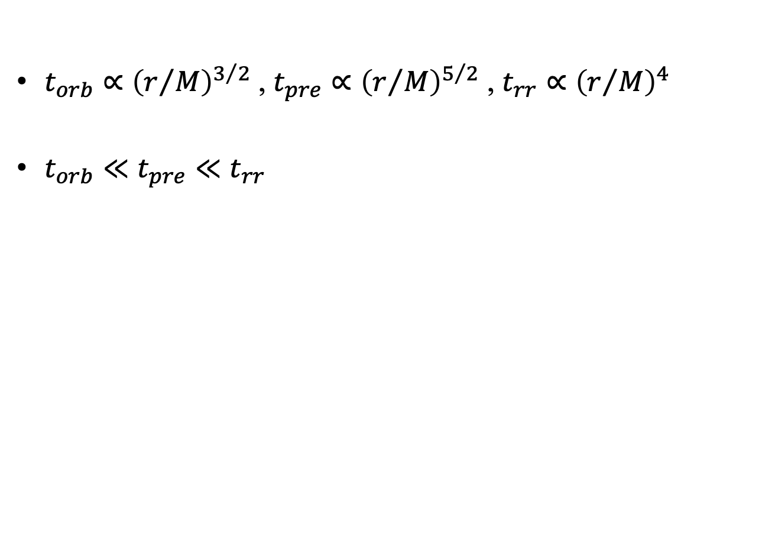
Multi-timescale + Taxonomy
*PN, quasi-circular, inspiral-only waveforms
$t_{orb}∝{\left(r/M\right)}^{3/2}$ , $t_{pre}∝{\left(r/M\right)}^{5/2}$ , $t_{rr}∝{\left(r/M\right)}^{4}$
$t_{orb}≪t_{pre}≪t_{rr}$
Orbital
Precession
Radiation–reaction
Gangardt and Steinle + (2021)
03/18/2025

Slide 16
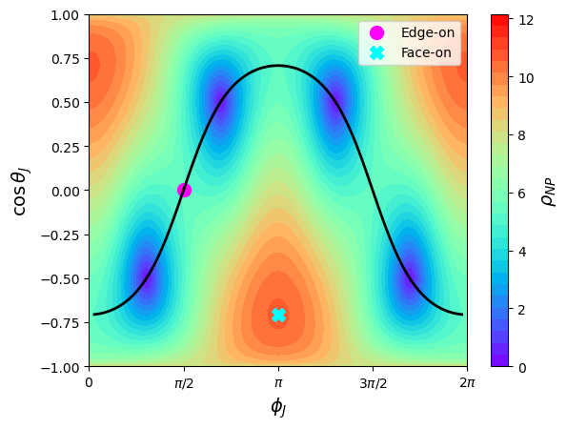
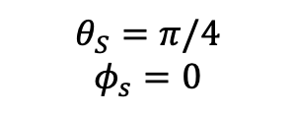
SNR (NP) for LIGO at z = 0.3
$$θ_{S}=π/4$$
$$φ_{s}=0$$
03/18/2025

Slide 17
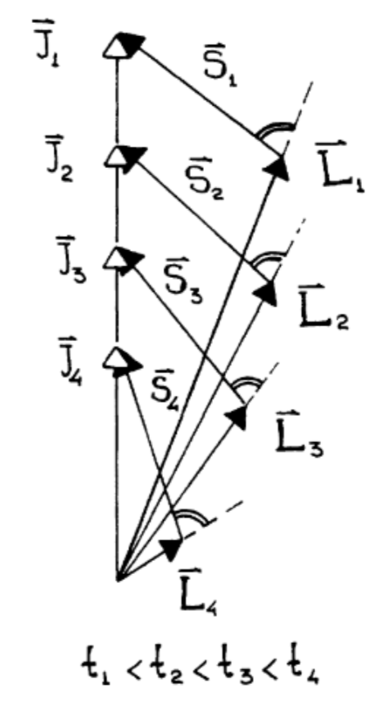
L spiraling out as binary merges
Apostolatos+ (1994)
TS+ (in prep)
03/18/2025

Slide 18
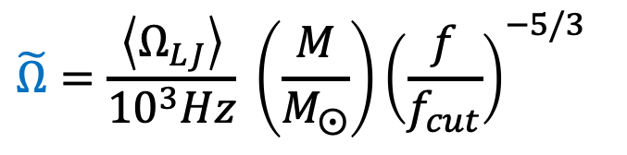
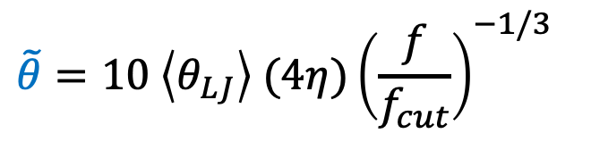
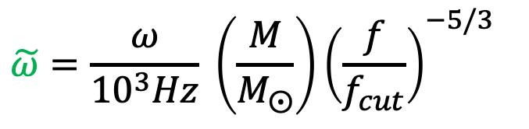
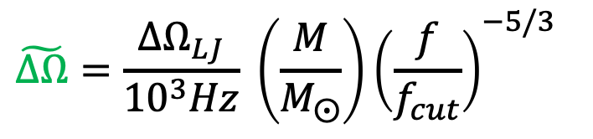
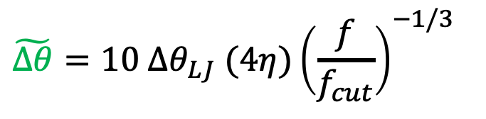
Dimensionless precession parameters – with nutation
$$\tilde{θ}=10 \left\langle θ_{LJ}\right\rangle (4η){\left(\frac{f}{f_{cut}}\right)}^{−1/3}$$
$$\tilde{Ω}=\frac{\left\langle Ω_{LJ}\right\rangle }{{10}^{3}Hz} \left(\frac{M}{M_{⨀}}\right){\left(\frac{f}{f_{cut}}\right)}^{−5/3}$$
$$\tilde{∆θ}=10 ∆θ_{LJ} (4η){\left(\frac{f}{f_{cut}}\right)}^{−1/3}$$
$$\tilde{ω}=\frac{ω}{{10}^{3}Hz} \left(\frac{M}{M_{⨀}}\right){\left(\frac{f}{f_{cut}}\right)}^{−5/3}$$
$$\tilde{∆Ω}=\frac{{∆Ω}_{LJ}}{{10}^{3}Hz} \left(\frac{M}{M_{⨀}}\right){\left(\frac{f}{f_{cut}}\right)}^{−5/3}$$
03/18/2025

Slide 19
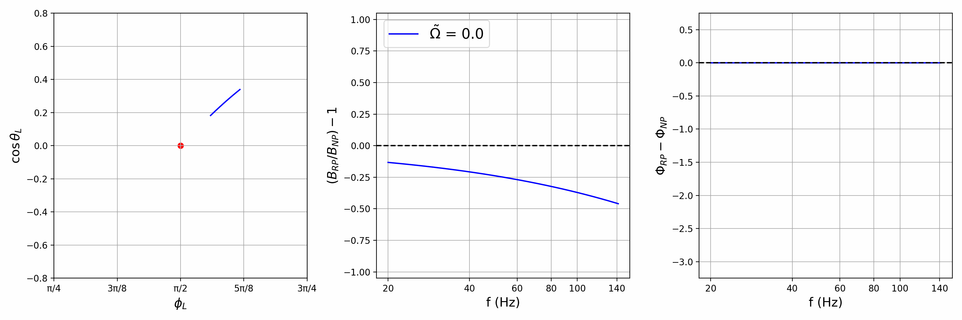

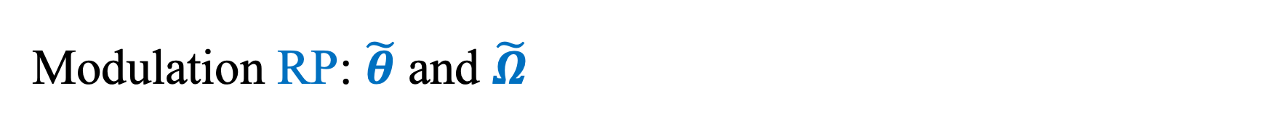
Modulation RP: $\tilde{θ}$ and $\tilde{Ω}$
Edge-on
$\tilde{θ}$ = 5
TS+ (in prep)
Motion of L Fractional change in amplitude Phase difference
Precession: $\tilde{θ}$: Amplitude of modulations $\tilde{Ω}$: Frequency of modulations
03/18/2025

Slide 20
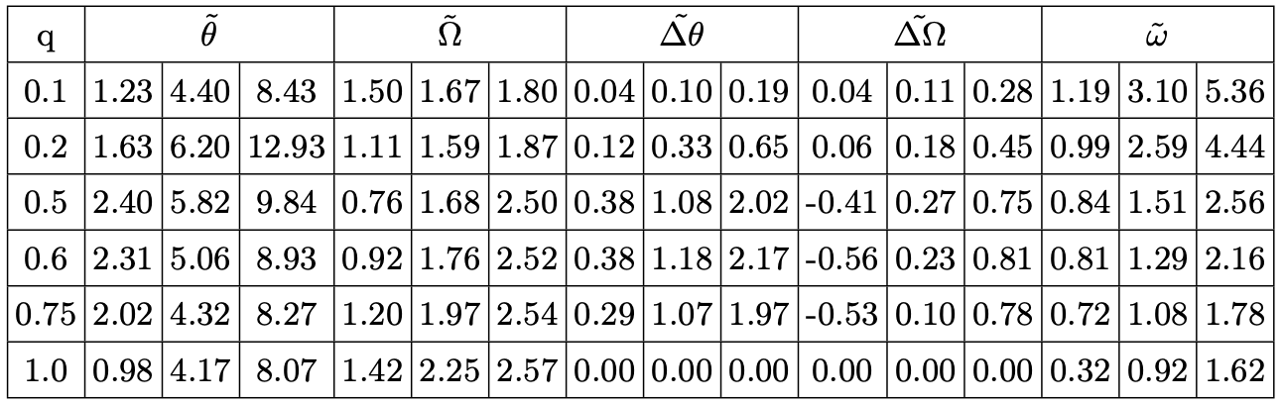
Distribution of parameters - maximal spins (q)
03/18/2025

Slide 21
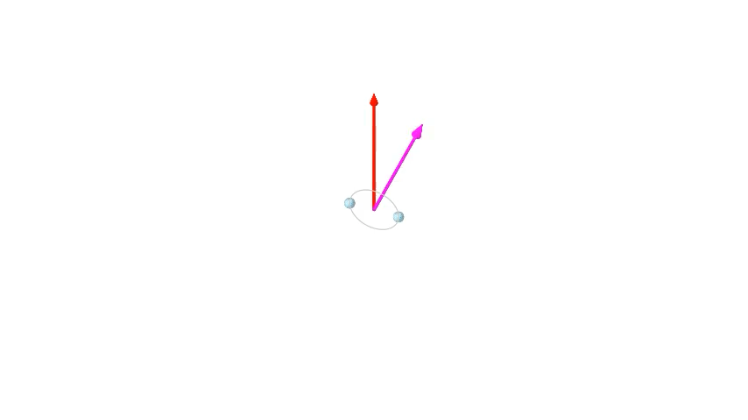

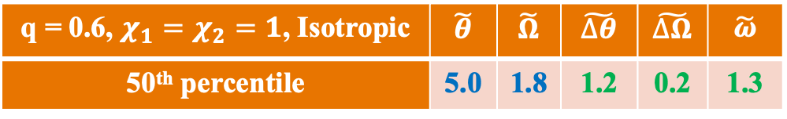
q = 0.6, $χ_{1}=χ_{2}=1$, Isotropic | $$\tilde{θ}$$ | $$\tilde{Ω}$$ | $$\tilde{∆θ}$$ | $$\tilde{∆Ω}$$ | $$\tilde{ω}$$
50th percentile | 5.0 | 1.8 | 1.2 | 0.2 | 1.3
03/18/2025

