Slide 1
PROJECT ON KAUN BANEGA CROREPATI PRESENTED BY:TEEKAM SINGH

Slide 2
LANGUAGE USED
PYTHON
IDE USED
JUPYTER NOTEBOOK
PYTHON IDLE

Slide 3
About Python
Developed by Guido Van Rossum in 1990.
High level,interpreted language.
Dynamically typed.
Interpreted Language.
Easy syntax.

Slide 4
Instructions
₹7,00,00,000 | 16
₹1,00,00,000 | 15
₹50,00,000 | 14
₹25,00,000 | 13
₹12,50,000 | 12
₹6,40,000 | 11
₹3,20,000 | 10
₹1,60,000 | 9
₹80,000 | 8
₹40,000 | 7
₹20,000 | 6
₹10,000 | 5
₹5000 | 4
₹3000 | 3
₹2000 | 2
₹1000 | 1
STAGE 2
STAGE 1

Slide 5

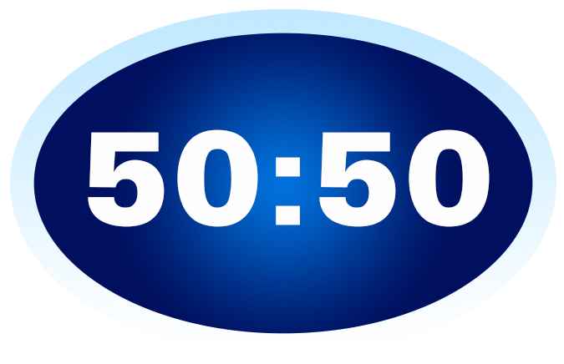
LIFELINES
Audience Poll
You will get Audience
help to choose answer
50:50
You will get 2 options
instead of 4
to choose answer

Slide 6


Double Dip
You will get 2 attempt to choose right answer
Flip the Question
If you don’t know answer you can skip the question

Slide 7
Rules
There are four lifelines in this game
named as Audience Poll,50:50,Double
dip and Flip the question.
2 Stages at ₹10,000 and ₹3,20,000.
User cannot use another lifeline after
taking Double Dip.
Lifelines can be used only once.
Quit option is not available after taking
Double Dip.
After taking Audience Poll,user can also
take another lifeline except Double Dip.
Same is for 50:50 and Flip the question.

Slide 8
User can quit from game anytime.
Total winning price will be displayed after
every question.
If user has selected incorrect option,amount
will be given according to stage cleared.

Slide 9
FLOWCHART

Slide 10
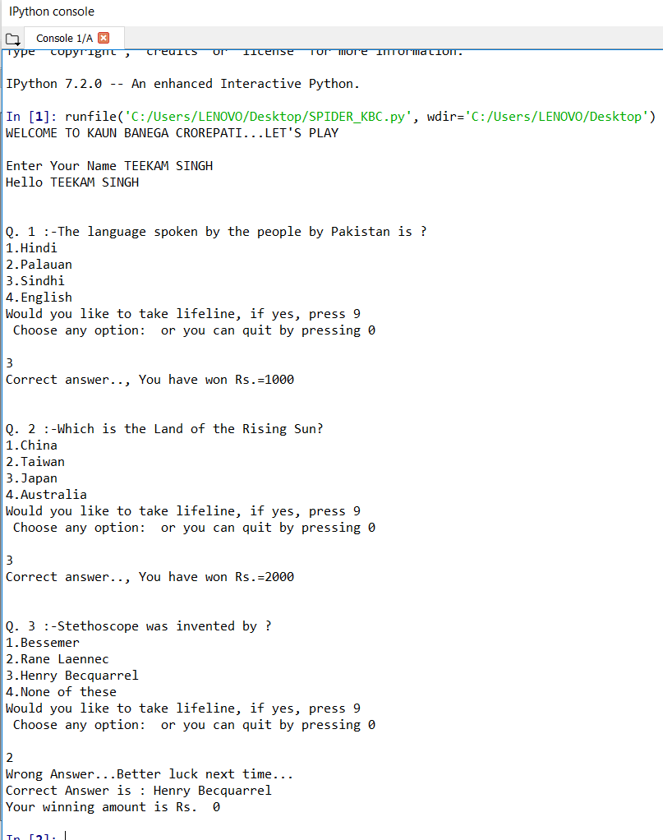
SNAPSHOTS

Slide 11
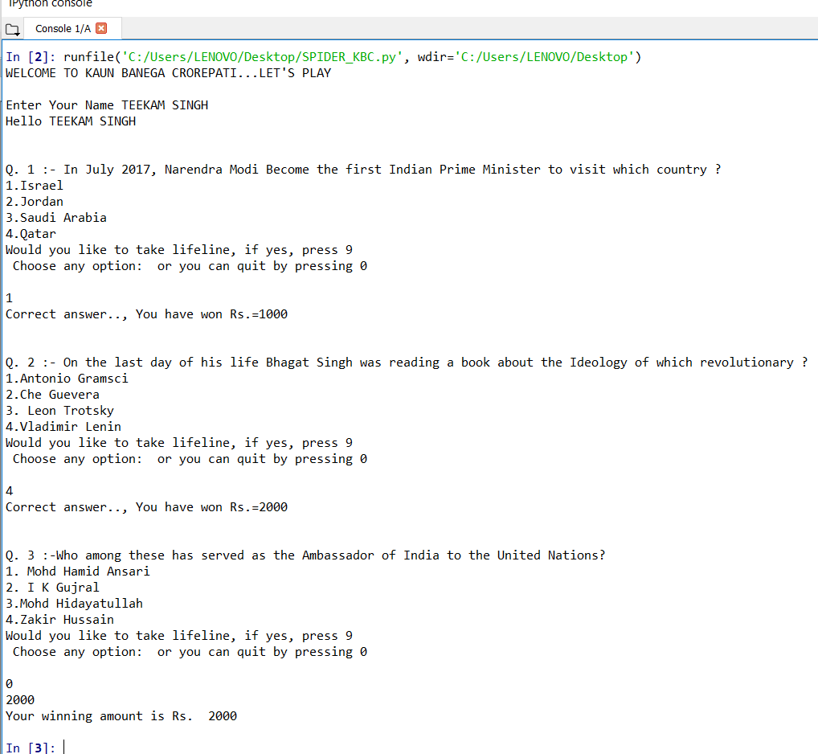

Slide 12
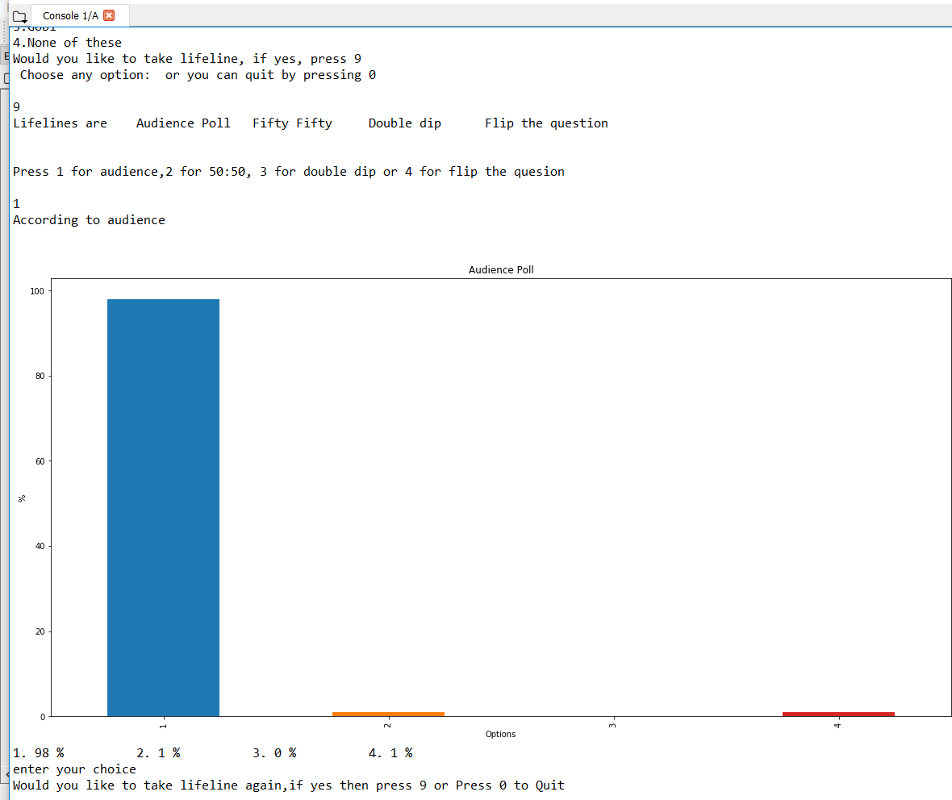

Slide 13
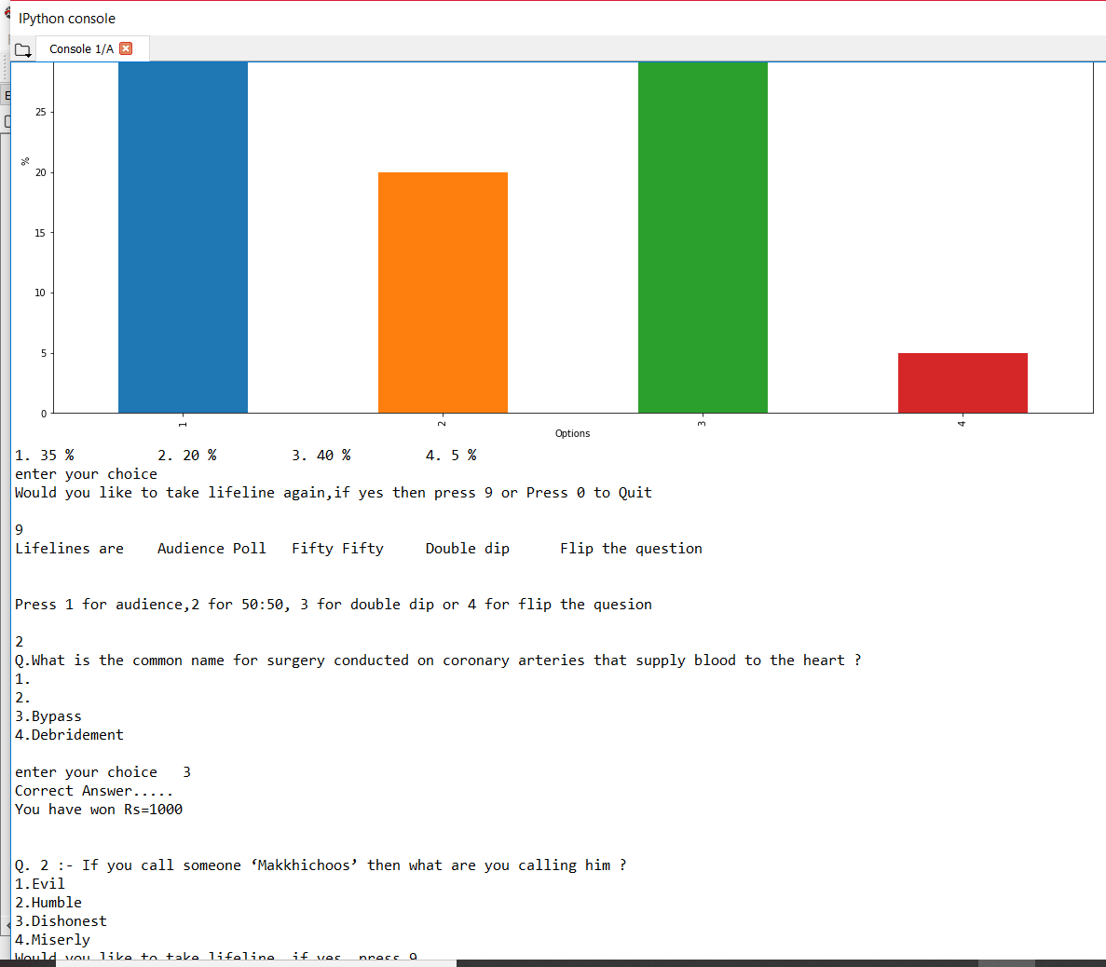

Slide 14
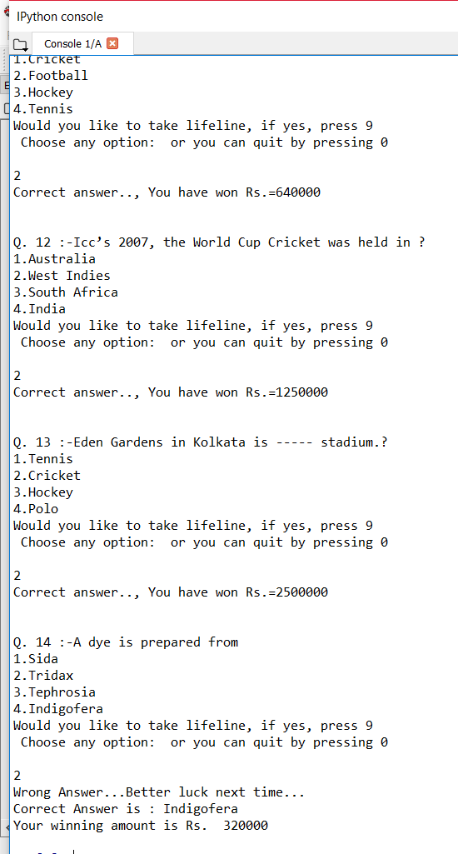

Slide 15
THANK YOU

