Slide 1

March 2026 A1c Screening Data Analysis

Slide 2
Aim and Hypothesis of the Analysis
Aim
To identify demographic, clinical, and geographic disparities in HbA1c and diabetes burden among U.S. blood donors.
Hypothesis
HbA1c and diabetes burden vary across donor subgroups and counties, with higher levels concentrated in specific demographic and medical-risk groups and in geographic clusters.

Slide 3
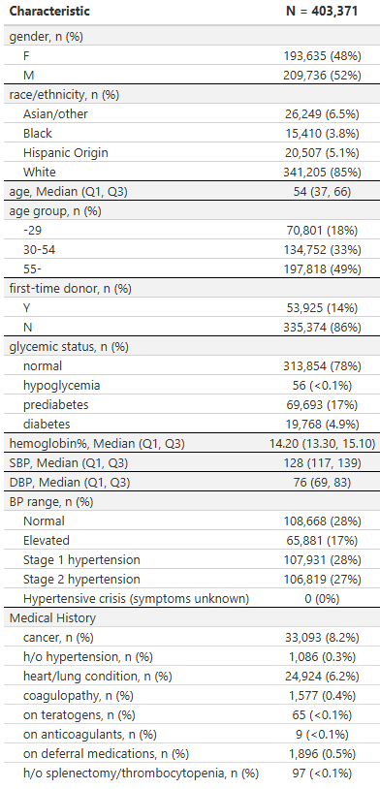
Donor Characteristics
Baseline descriptive profile of the March 2026 analytic donor cohort
Analytic cohort: 403,371 unique donors.
Median age was 54 years; 48.0% were female and 14% were first-time donors.
Overall glycemic distribution was 77.8% normal, 17.3% prediabetes, and 4.9% diabetes.
This descriptive table establishes the cohort context for subsequent subgroup and spatial comparisons.

Slide 4
Donor Medical History Summary
Selected donor medical history variables carried forward for HbA1c comparisons
Characteristic | Summary
Medical History
cancer | 33,093 (8.2%)
h/o hypertension | 1,086 (0.3%)
heart/lung condition | 24,924 (6.2%)
coagulopathy | 1,577 (0.4%)
on teratogens | 65 (<0.1%)
on anticoagulants | 9 (<0.1%)
on deferral medications | 1,896 (0.5%)
h/o splenectomy/thrombocytopenia | 97 (<0.1%)
These variables were combined later into a binary indicator of any medical history versus none.
That grouping was used to test whether HbA1c is systematically shifted upward among donors with a flagged medical history profile.

Slide 5
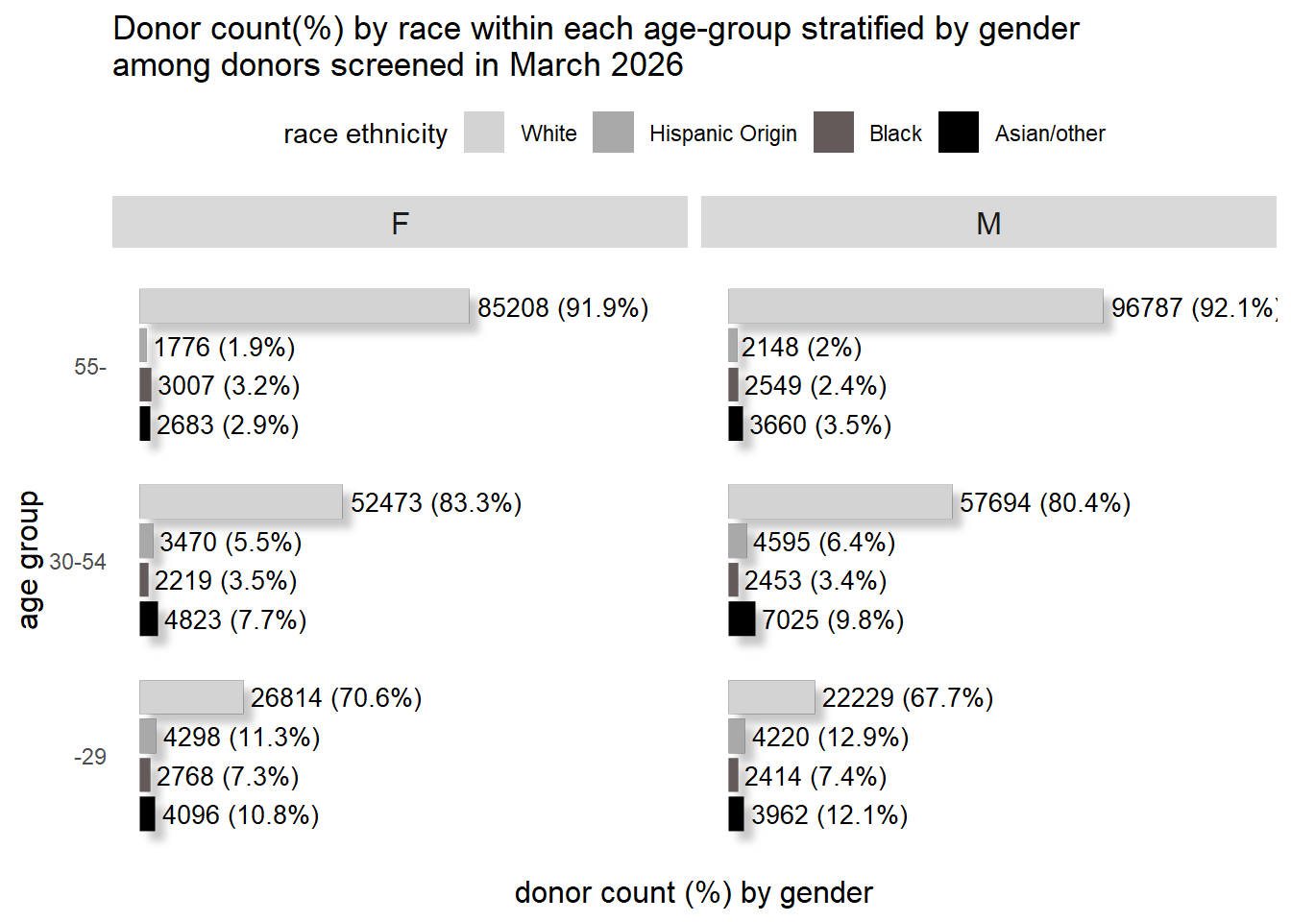
Donor Counts by Gender and Race/Ethnicity
Race/ethnicity composition differed significantly across age-by-sex strata
(Pearson chi-squared X^2 = 24,454, p < 0.001).
Among men, the proportion of White donors increased from 67.7% in donors younger than 29 years to 92.1% in donors aged 55 years or older.
These denominator differences indicate that apparent HbA1c disparities may partly reflect how heavily each demographic stratum is represented in the screened donor pool.

Slide 6
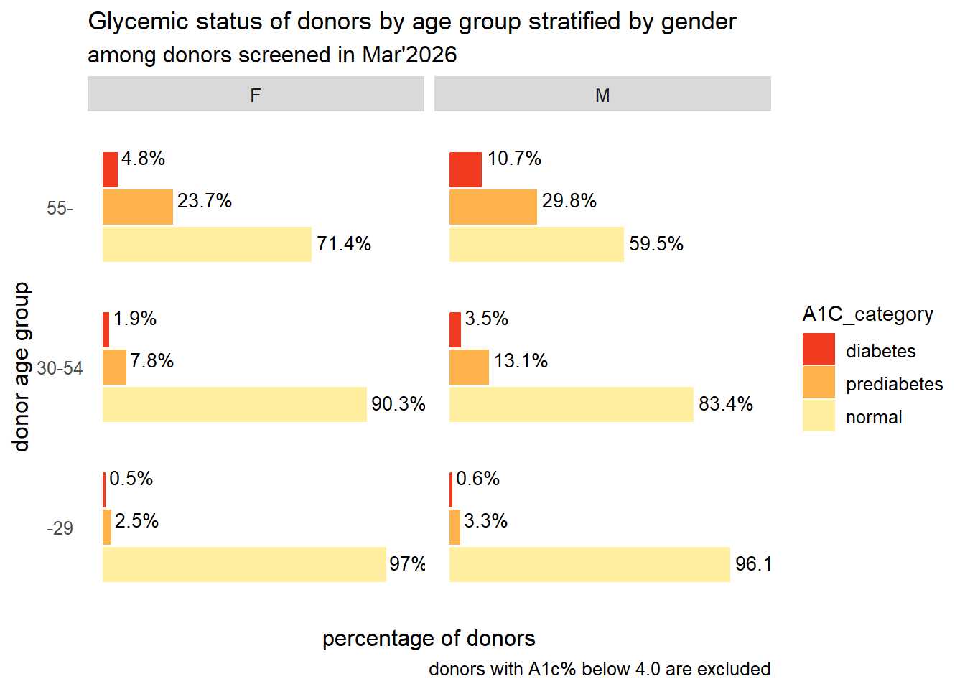
Glycemic Status by Age Group and Gender
Glycemic status differed significantly across age-by-sex strata (Pearson chi-squared X^2 = 45,552, p < 0.001).
Diabetes prevalence increased from 0.5% in women younger than 29 years and 0.6% in men younger than 29 years to 4.8% and 10.7%, respectively, among donors aged 55 years or older.
Older men carried the highest burden of dysglycemia, with both prediabetes and diabetes proportions notably elevated relative to younger donor groups.

Slide 7
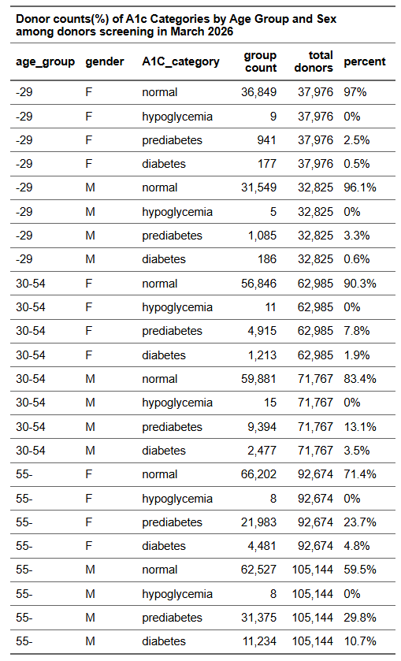
Exact Counts and Percentages for Glycemic Status
The highest combined prediabetes plus diabetes burden was observed in men aged 55 years or older: 40.5%.
For comparison, women younger than 29 years had a combined dysglycemia burden of only 2.9%.

Slide 8
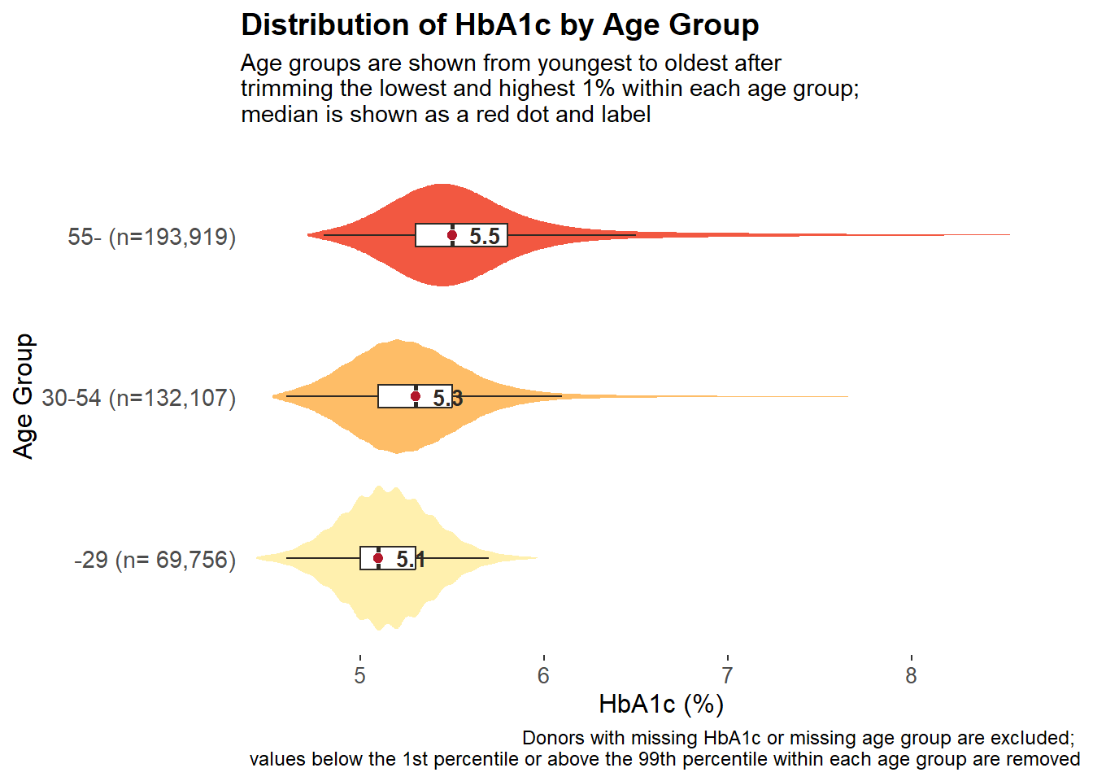
HbA1c Distribution by Age Group
HbA1c distributions differed significantly across age groups (Kruskal-Wallis chi-squared = 75,592, p < 0.001).
Median HbA1c increased from 5.1% in donors younger than 29 years to 5.3% in donors aged 30-54 years and 5.5% in donors aged 55 years or older.
The rightward shift of the full distribution suggests that the age effect is broad-based and not driven only by a small number of highly elevated observations.

Slide 9
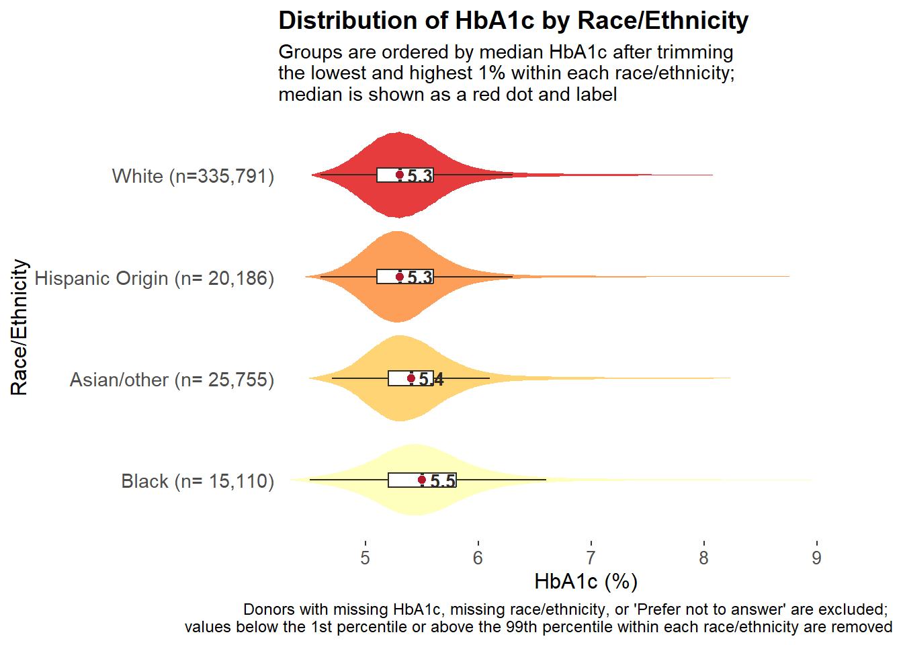
HbA1c Distribution by Race/Ethnicity
HbA1c distributions differed significantly across race/ethnicity groups (Kruskal-Wallis chi-squared = 1,626.3, p < 0.001).
Median HbA1c was highest among Black donors (5.5%), followed by Asian/other donors (5.4%), and lower in Hispanic Origin and White donors (both 5.3%).
These differences are modest in absolute magnitude but statistically robust because they reflect systematic distributional shifts across a large donor sample.

Slide 10
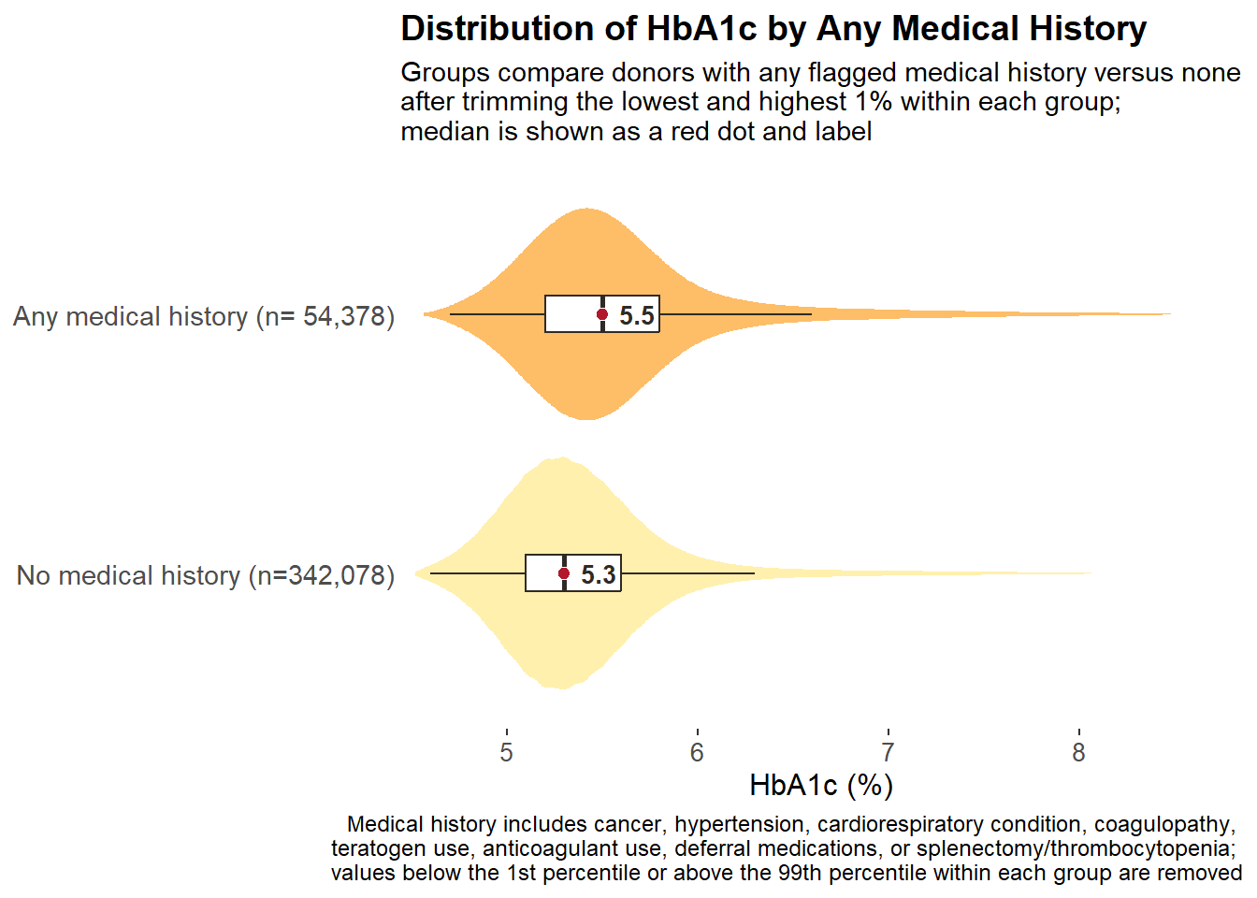
HbA1c Distribution by Any Medical History
Donors with any flagged medical history had significantly higher HbA1c values than those without (Wilcoxon rank-sum, p < 0.001).
Median HbA1c was 5.5% among donors with any medical history versus 5.3% among donors without.
The distribution is shifted to the right rather than differing only in the extreme upper tail, supporting a generalized association between medical-history burden and higher glycemic levels.

Slide 11
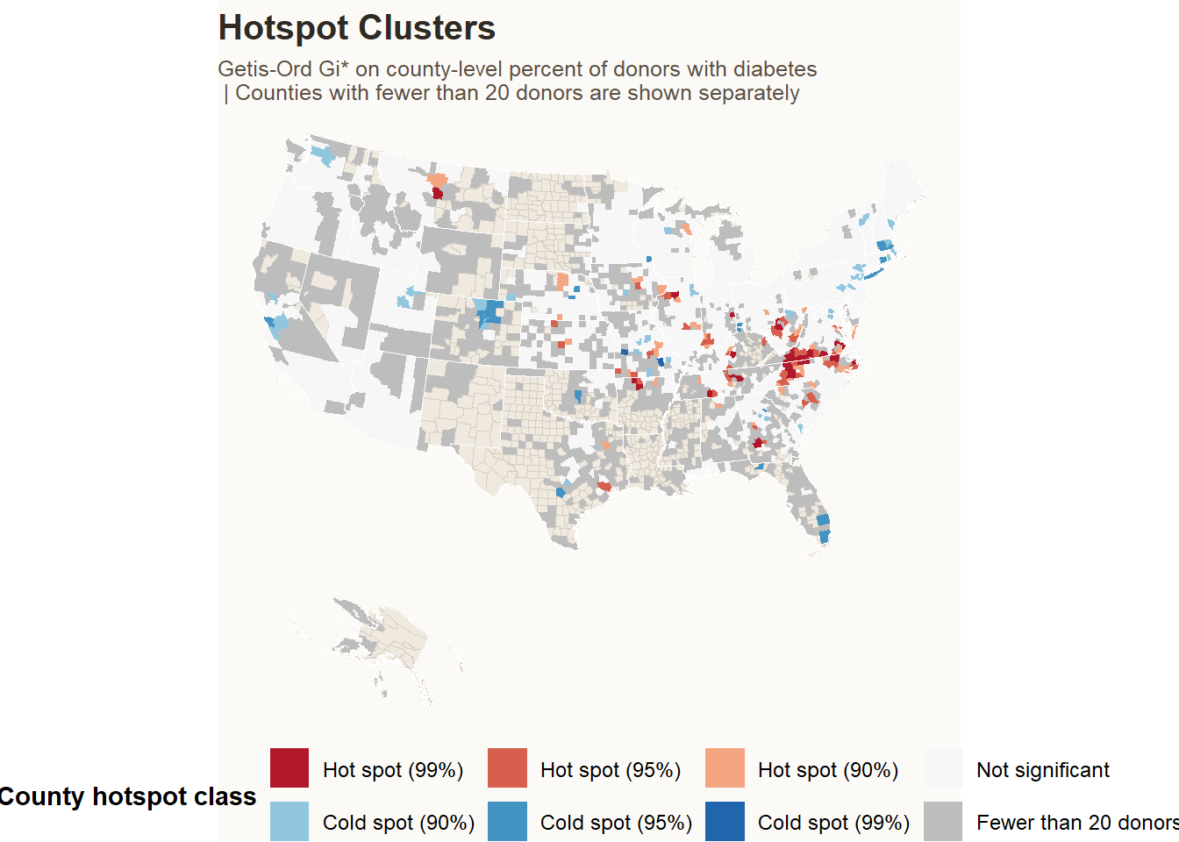
County-Level Hotspot Analysis of Diabetes Prevalence
Among 1,593 counties with at least 20 donors, 223 met Gi* significance criteria for a hotspot or coldspot.
This included 139 hotspot counties and 84 coldspot counties; 41 hotspots and 3 coldspots met the 99% significance threshold.
Hotspot status reflects local spatial clustering rather than a county's raw percentage alone, which is why isolated high-value counties may not be classified as hotspots.
The interactive county map is available at this link. https://singhuh.github.io/a1c_march2026/A1c_march_2026
The hotspot percentages are the statistical confidence level for the hotspot test.
Hot spot (99%) means the county is part of a cluster of unusually high diabetes percentages, with very strong statistical evidence against random chance.
Hot spot (90%): weaker but still statistically significant evidence of a high-value cluster
Hot spot (95%): moderate evidence
Hot spot (99%): strongest evidence
Cold spot (90%/95%/99%): the same idea, but for clusters of unusually low diabetes percentages
Not significant: no statistically detectable local clustering
For a county is labeled Hot spot (99%), it means:
the county and its neighboring counties form a high-value cluster that clustering is very unlikely to be due to random variation alone.
Important distinction (in the interactive map):
Diabetes% = the county’s observed percentage diabetic
Hot spot (99%) = how strongly the county belongs to a statistically significant high cluster relative to neighbors
So, a county with a higher raw diabetes % can still be Not significant, while another county with a lower % can be Hot spot (99%) if it sits inside a stronger regional cluster.

