Slide 1
Welcome to T(Technology) Learning

Slide 2
Topics
IOC
Types of Injection
Scope
Autowire
Circular Dependency
Collection
Lifecycle Callbacs
Injection Using Annotation
JdbcTemplate
Hbernate Template
MVC
AOP(Advice,Joinpoints,Pointcuts,Proxy,Advisor)
Declarative Transaction Management

Slide 3
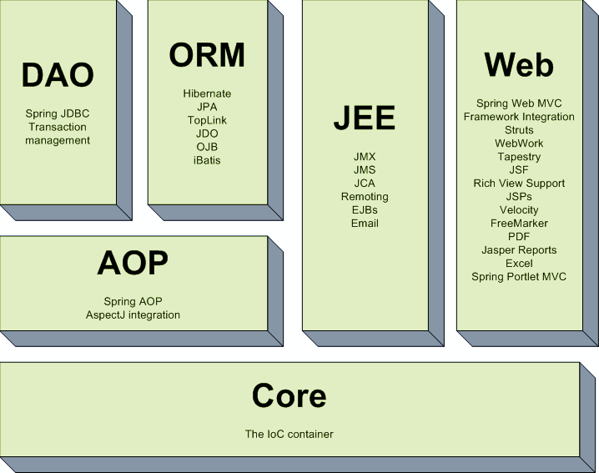
Spring Framework - Architecture

Slide 4
Why Spring Framework?
Advantages
1) Loose Coupling
2) Predefined Templates
3) Easy to test
4) Lightweight
5) Fast Development…

Slide 5
Topics of Spring Framework
Basics of Spring
Dependency Injection in Spring
Spring Jdbc Tutorial
Spring with ORM Frameworks
Spring MVC Tutorial

Slide 6
Basics of Spring
Learn the simple steps to create the spring application.
create the java project
add spring jar files
create the class
create the xml file to provide the values
create the test class
Run the test class

Slide 7
IoC Container
There are two types of IoC containers. They are:
BeanFactory
ApplicationContext
The main tasks performed by IoC container are:
to instantiate the application class
to configure the object
to assemble the dependencies between the objects

Slide 8
Difference between beanfactory and applicationcontext
BeanFactory provides basic IOC and DI features while ApplicationContext provides some advanced features like Jdbc template Hibernate etc.
Beanfactory instantiate Singleton bean when you call getBean() method while ApplicationContext instantiates Singleton bean when the container is started, It doesn't wait for getBean to be called.
If you are using auto wiring and using BeanFactory than you need to register AutoWiredBeanPostProcessor using API while you can configure in XML if you are using ApplicationContext.

Slide 9
Dependency Injection in Spring
DI exists in two major variants.
setter based DI
setter based dependencies injection is created by calling setter methods on main object or bean after invoking no argument constructor.
2. constructor based DI
constructor based dependency injection is created by invoking a constructor with arguments on main object or bean.
When to use constructor and setter based DI
setter injection doesn’t ensure DI which means we may have an object with incomplete dependency.
it’s better to use constructor injection for mandatory dependencies and setter injection for optional dependencies.

Slide 10
CIRCULAR DEPENDENCY
class A requires an instance of class B through constructor injection and class B require an instance of class A through constructor injection again.
if we configure beans for class A and class B to be injected into each other. springIoC container detects this circular reference at runtime and throws a BeanCurrentlyInCreation Exception.
SOLUTION TO CIRCULAR DEPENDENCY
We can configure circular dependencies with setter injection.

Slide 11
Spring SCOPE
we can also provide scope for the object created from bean definition file.
spring framework supports five scopes.
Singleton
Creates exactly one instance of the bean.
Prototype
Creates multiple instance everytime on request.
Request
Creates a new instance of the bean for each & every Http request. when request completes then these beans are garbage collected.
Session
Creates new instance of a bean for every new Http session.when session ends then this beans are garbage collected.
GlobalSession
Creates new instance of a bean for entire application and lives as long as application alive.

Slide 12
Spring AUTOWIRING
spring container is able to autowire relationship between beans.
This is an process in which bean references don’t need to be coded explicitly in the xml file but rather the spring container takes care of injecting dependencies.
There are five autowire nodes in springs.
autowire “no”
autowire “byName”
autowire “byType”
autowire “constructor”
autowire “autodetect”

Slide 13
Spring JdbcTemplate
Spring JdbcTemplate is a powerful mechanism to connect to the database and execute SQL queries.
It internally uses JDBC api, but eliminates a lot of problems of JDBC API.
The problems of JDBC API are as follows:
We need to write a lot of code before and after executing the query, such as creating connection, statement, closing resultset, connection etc.
We need to perform exception handling code on the database logic.
We need to handle transaction.
Repetition of all these codes from one to another database logic is a time consuming task.
Advantage of Spring JdbcTemplate
Spring JdbcTemplate eliminates all the above mentioned problems of JDBC API. It provides you methods to write the queries directly, so it saves a lot of work and time.

Slide 14
Let's see the methods of spring JdbcTemplate class.
Method | Description
public int update(String query) | is used to insert, update and delete records.
public int update(String query,Object... args) | is used to insert, update and delete records using PreparedStatement using given arguments.
public void execute(String query) | is used to execute DDL query.
public T execute(String sql, PreparedStatementCallback action) | executes the query by using PreparedStatement callback.
public T query(String sql, ResultSetExtractor rse) | is used to fetch records using ResultSetExtractor.
public List query(String sql, RowMapper rse) | is used to fetch records using RowMapper.

Slide 15
Spring with hibernate
The Spring framework provides HibernateTemplate class, so you don't need to follow so many steps like create Configuration, BuildSessionFactory, Session, beginning and committing transaction etc.
So it saves a lot of code.

Slide 16
Methods of HibernateTemplate class
Method | Description
void persist(Object entity) | persists the given object.
Serializable save(Object entity) | persists the given object and returns id.
void saveOrUpdate(Object entity) | persists or updates the given object. If id is found, it updates the record otherwise saves the record.
void update(Object entity) | updates the given object.
void delete(Object entity) | deletes the given object on the basis of id.
Object get(Class entityClass, Serializable id) | returns the persistent object on the basis of given id.
Object load(Class entityClass, Serializable id) | returns the persistent object on the basis of given id.
List loadAll(Class entityClass) | returns the all the persistent objects.

Slide 18
That’s all from my side..
Now do whatever you want to do man but
Don’t trouble your manager man.
Thank you

