Slide 1

What attributes make a song popular?
Visualizing the Spotify dataset
By: Shreya Paul, Siddhartha Rao, Vishal Singh
Notes:
Sid

Slide 2
Research Questions
What features determine the popularity of a song in a genre?
How duration of songs affect their popularity based on other attributes?
Notes:
Sid

Slide 3
Executive Summary
On analyzing this dataset, we find that -
Pop music in general is more popular than other genres of music.
Popularity decreases with increase in duration when loudness, tempo, and speechiness are high.
Interaction of duration with loudness, tempo, liveness and danceability gives us a better model than no interaction.
Notes:
Sid

Slide 4
Data
The dataset consisted of 232,000 entries.
For this project, we filtered for six genres – Pop, Electronic, Rock, Hip-Hop, Country, Jazz.
Our final dataset consisted 4385 entries after removing outliers.
Data source : Kaggle
Notes:
Sid

Slide 5
Definitions
Popularity (y) – Measure of how popular is the song(1 – 100)
Loudness – Overall loudness of the song in dB
Duration – The duration of song in milliseconds
Speechiness – Measure of presence of spoken words
Danceability – How suitable a song is for dancing
Tempo – Overall estimated tempo of a track in BPM
Liveness – Measure of presence of an audience
Valence – Measure describing musical positiveness of a track
Notes:
Vishal

Slide 6
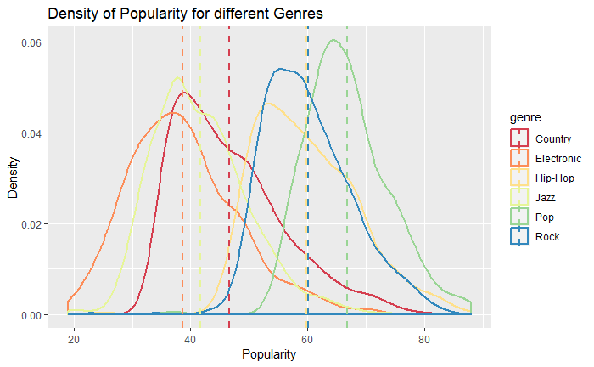
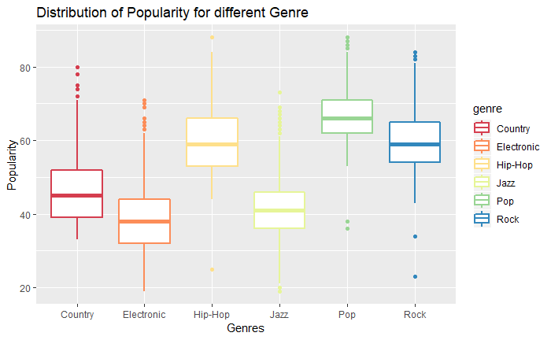
Amount of Data for different Genres
Notes:
Vishal

Slide 7
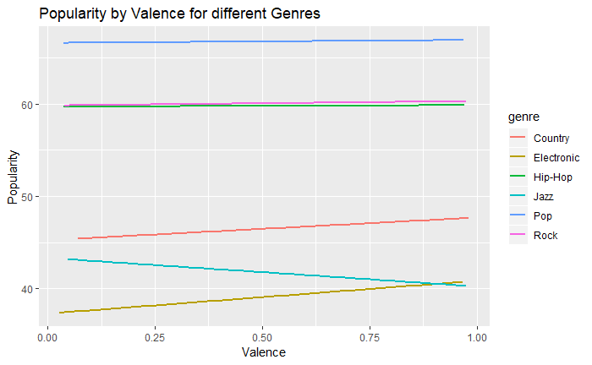
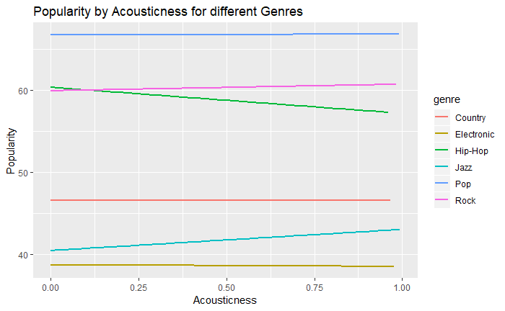
Change in popularity w.r.t. different features
Valence
Acousticness
Notes:
Vishal

Slide 8
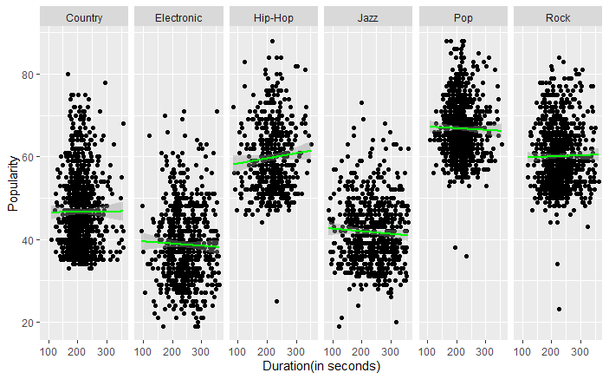
Effect of duration on popularity of songs of different genres
Notes:
Vishal

Slide 9
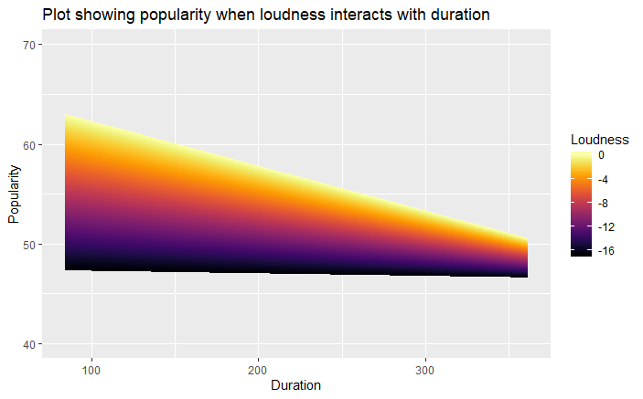
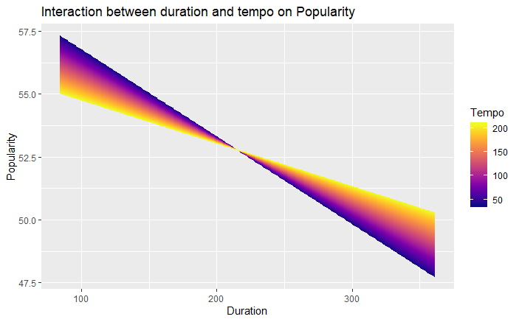
Interaction of Duration with different features
Loudness
Tempo
Notes:
Shreya
As we can see in the first plot, as loudness increases, with increase in duration, popularity decreases. I.e. a soft song or a song that is not much loud, the popularity doesn’t decrease much with increase in duration.
The second plot shows the interaction between tempo and duration. Here notice the cut point point in duration at around 220 seconds. Below this cut point, the popularity of songs with tempo seems to decrease more rapidly than songs with high tempo. Above the cut point, the popularity of songs with lower tempo decreases at a more rapid rate than songs with a higher tempo.

Slide 10
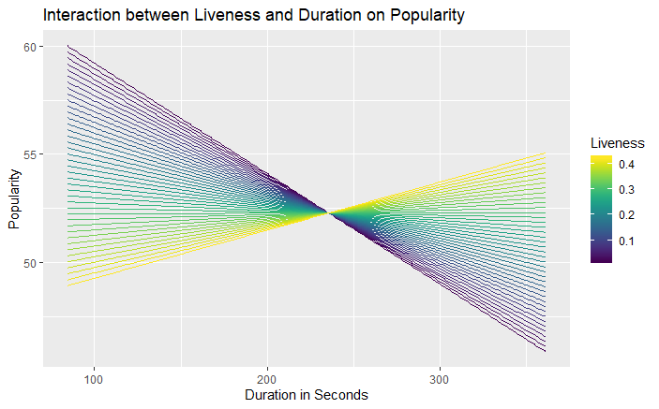
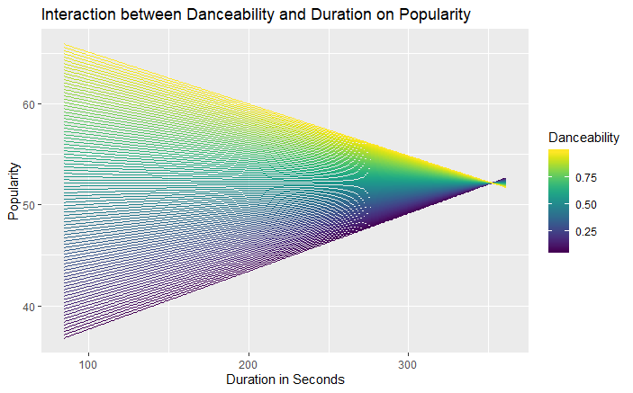
Interaction of Duration with different features
Liveness
Danceability
Notes:
First plot shows the interaction between duration and liveness.
We see in the plot that the popularity for a song with low liveness decreases with increase in duration whereas the popularity for a song high liveness increases with increase in duration.
Plot 2 – There is an interaction between danceabaility and duration. We notice that the popularity for songs with high danceability decreases with increase in duration whereas for songs with low danceability, the popularity increases with increase in duration.

Slide 11
Linear Model – Predicting Popularity
Popularity = lm(duration * (loudness + liveness + tempo + danceability +valence) + genre + acousticness +
danceability + tempo + speechiness + mode)
Track Name | Actual Popularity | Predicted Popularity
Havana (Pop) | 88 | 66.60
D'yer Mak'er (Rock) | 57 | 60.95
We Got Us (Country) | 43 | 47.16

Slide 12
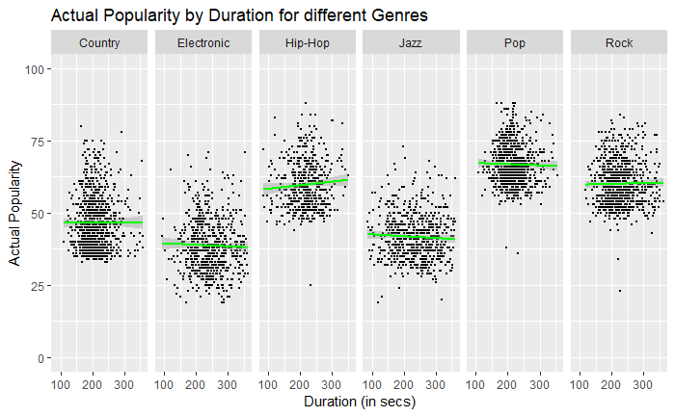
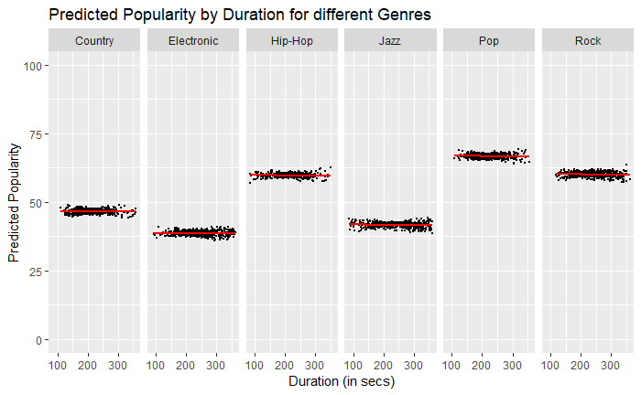
Actual vs Predicted Probability of linear model
Notes:
Adjusted R squared – 0.6121 ~ 61%
On plotting the graphs of actual value of popularity and predicted values of popularity we notice that the trend in both the plots remain the same. Therefore, our model is pretty good.

Slide 13
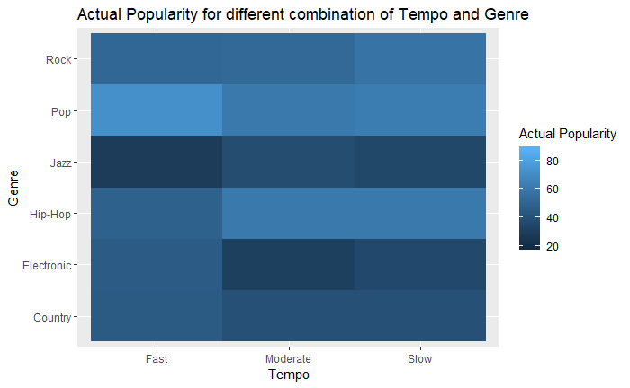
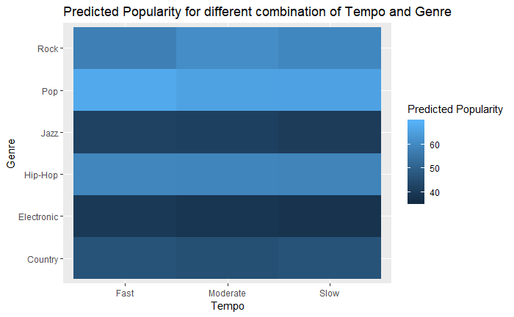
Actual vs Predicted Probability of linear model
Actual
Predicted
Notes:
Shreya

Slide 14
Conclusion
Different features have different effect on popularity for different genres
We could see significant interaction between features and ‘duration’ which were included in the model
Fitting a linear model on the features and interaction gave decent results
Notes:
Shreya

