Slide 1
Data Science for Impact and Decision Enablement (DSIDE) Phase 1: Data Exploration <Rugby Analysis> By <Kyle Tiyisela Manganyi and Bongani Nondyiwane>
Contents
13 July 2018

Slide 2
Contents
The DSIDE Data Analytics process
Project Question(s)/Problem Statement/Research Question/ Project Objectives
Description of Dataset
Gather and Prepare
Explore and Assert
Validate
Communicate
Final Project Outcome
Recommendations for Phase 2

Slide 3
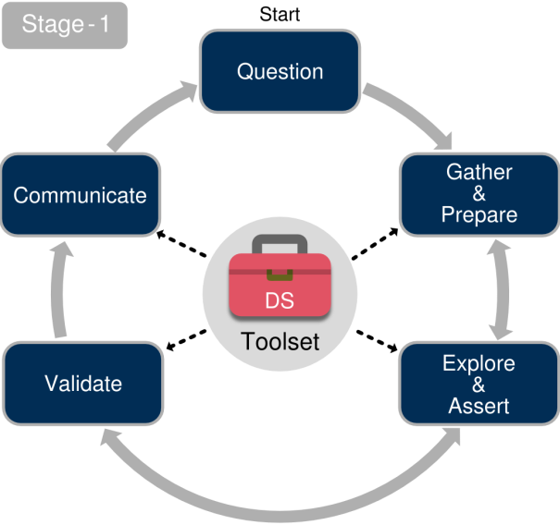
The DSIDE Data Analytics Process
Notes:
MAX 2 slide
1

Slide 4

Project Question(s)/Problem Statement
Using rugby data to develop a analysis model which can help predict outcomes of matches and provide visual analysis of events in a match
Notes:
MAX 1 slide
1

Slide 5
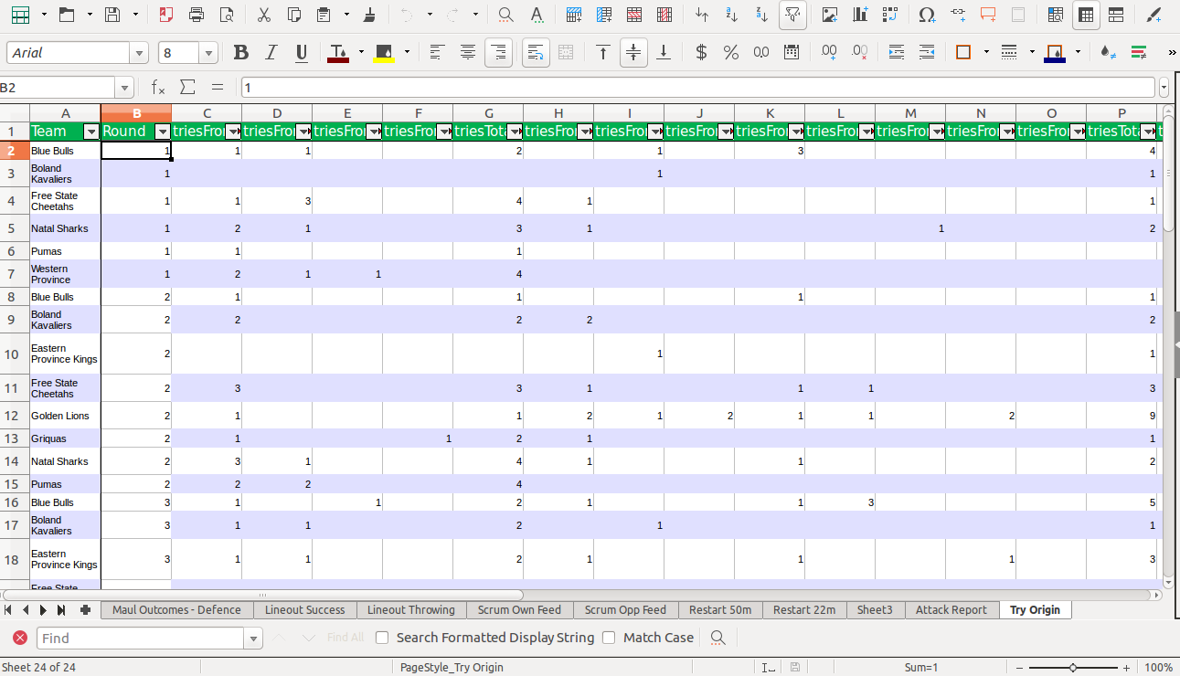
Description of Dataset
Notes:
MAX 2 slides
1

Slide 6
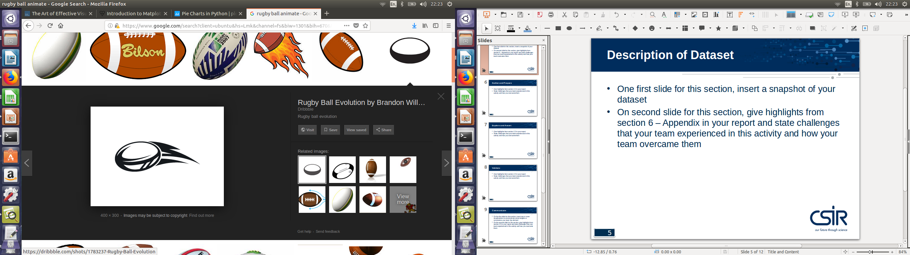
Description of Dataset
Data was provided in complex spreadsheets which were converted and merged together in dataframes
Data was redundant and poorly labelled with lot of ambiguous column names
Data cleaning and reshapping skills were emplyed to get data cleaned and usable for analysis
Notes:
MAX 2 slides
1

Slide 7

Gather and Prepare
Data Cleaning and handling
Handle for missing data and store clean data in resuable formats
Notes:
MAX 1 slide
1

Slide 8
Gather and Prepare
Some missing data couldnt be solved using data cleaning methods
Removed the data that was unreliable and reshapped dataframe to suite our analysis model
Notes:
MAX 1 slide
1

Slide 9
Explore and Assert
Normalize the data for accurate analysis and to make sure results are correct and constant
Normalization leads to over simplified results which might lead to simplied visuals
To solve this we made sure original data is considered along with normalized results
Notes:
MAX 1 slide
1

Slide 10
Validate
Mentor discussions and Domain experts
Confirm findings with domain experts to verify validity of our results
Discusions how to better improve our results
Notes:
MAX 1 slide
1

Slide 11
Validate
Challenge
Experts and mentors were not always readily available to validate findings
Solution
Made sure numbers made sense and research accuracy of findings
Notes:
MAX 1 slide
1

Slide 12
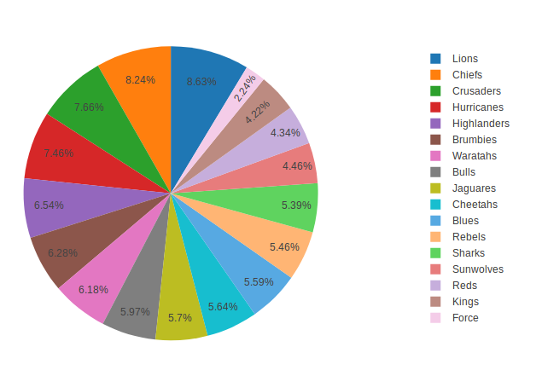
Communicate
Analysis
Notes:
MAX 2 slides
1

Slide 13
Communicate
Challenge
Plotly visualization limits
Choice of type of representation to use
Solution
Use plotly offline
Use visualization that best and easily get the points across
Notes:
MAX 2 slides
1

Slide 14
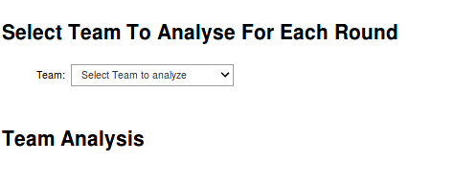
Final Project Outcome
A analysis tool which could be used to analyze a particular team based on chosen events
Notes:
MAX 1 slide
1

Slide 15
Final Project Outcome
Challenge
Limited time to work on project made creating effective final outcome difficult
Solution
Provide a tool which will make analysis easy for anyone using the tool
Notes:
MAX 1 slide
1

Slide 16
Recommendations for Phase 2
Increase dataset to generate more accurate outcomes
Work with video data for real time event analysis
Data should be readily available and clear problem statement should be defined given data available to use
Notes:
MAX 1 slide
1

Slide 17
Thank you
Notes:
<number>

