Slide 1
Relationship and interdependence between oil and gold prices

Slide 2
Overview
History
Data Used
Approach
Results

Slide 3
History
One of the most traded commodities
Gold follows Oil
Weak correlation in small term
Strong correlation in long term

Slide 4
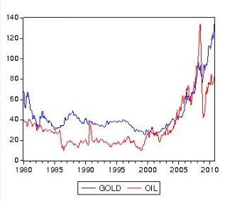
Data

Slide 5
Approach
Use Augmented Dickey Fuller and Correlogram to confirm the following:
non-stationarity of original series
stationarity of first order differenced series.
Test for cointegration between the two series.
What causes what using Granger Causality test.
Prediction of gold prices using oil prices.

Slide 6
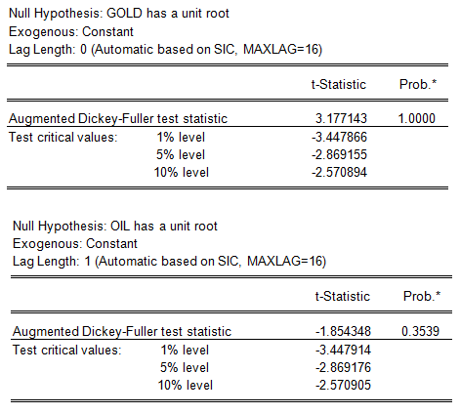
Non Stationarity

Slide 7
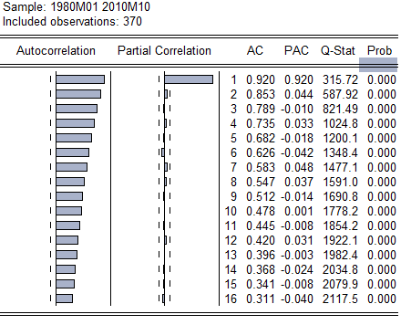
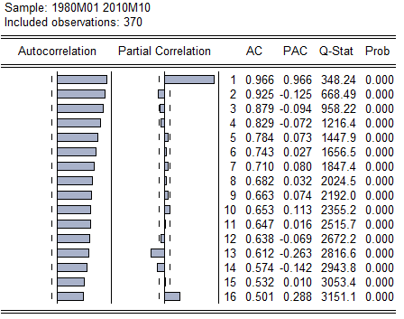
Non Stationarity

Slide 8
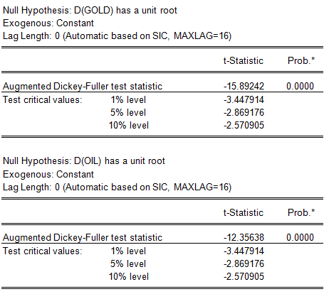
Stationarity

Slide 9
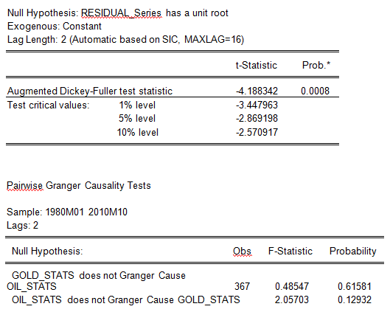
Cointegration and what causes what

Slide 10
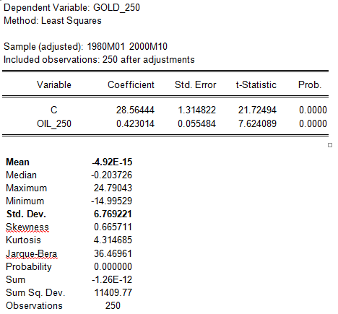
Forecasting

Slide 11
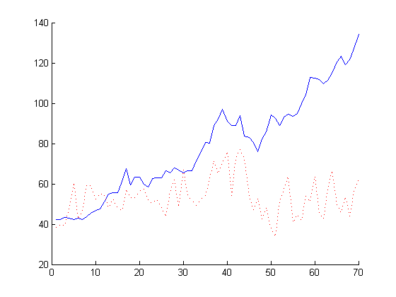
forecasting

Slide 12
Thanks.

