Slide 1
Price Discrimination
Monopoly Firms

Slide 2
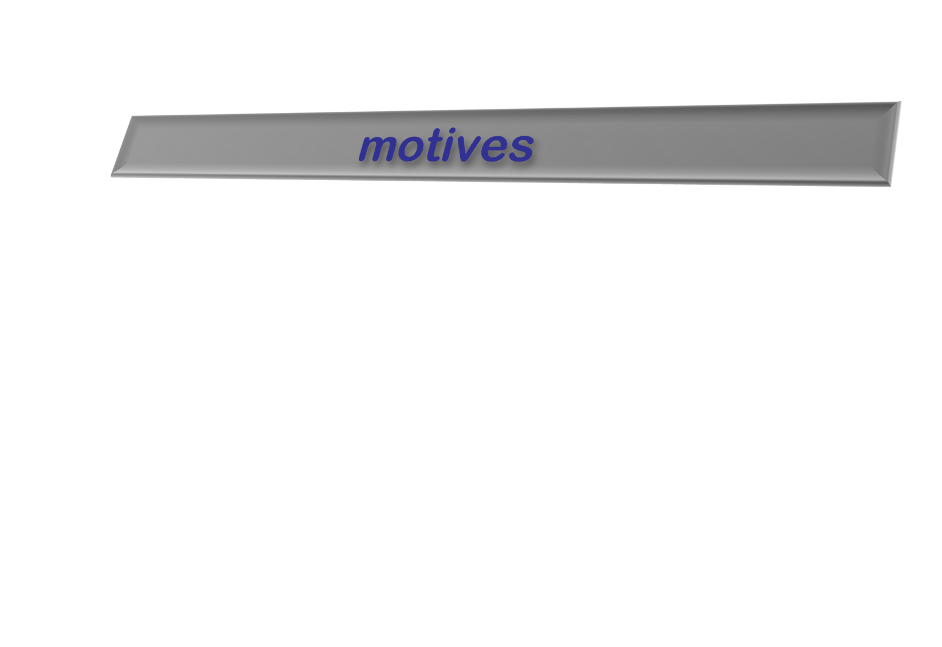
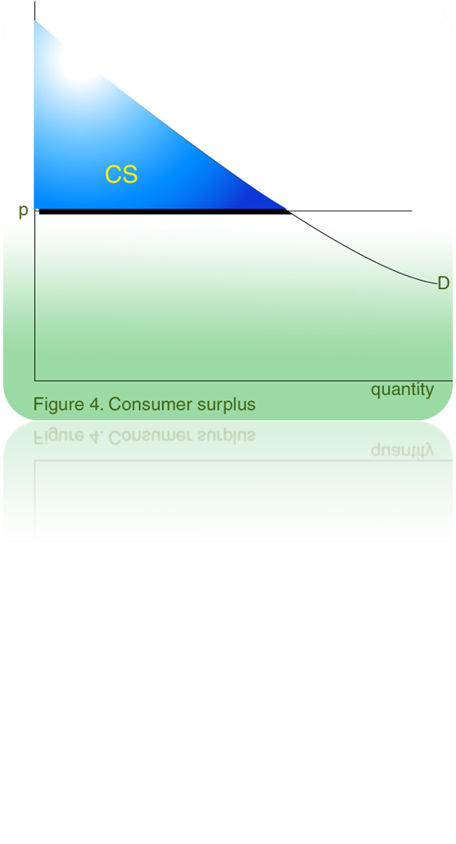

To acquire maximum
consumer surplus
To gain market power

Slide 3
Definition
A practice whereby similar products are priced differently to different customers or in different markets

Slide 4
Is any difference in price a sign of price discrimination?
No, only difference in prices that cannot be explained by the difference in costs
Examples:
Hardcover vs. paperback books
Business class travel. The difference in prices can be larger than the difference in costs
Volume discounts that do not reflect economies of scale

Slide 5
Effort to Discriminate
In 1990, IBM introduced the Laser Printer E.
The difference is that it printed 5 ppm rather than 10 ppm.
They did so by adding 5 chips in the E model. The purpose of the chips was to make the printer WAIT.
The price of the new laser printer E was 60% of the old one.
It costs 450 to make the faster printer and 475 to make the slower printer.

Slide 6
Effort to Discriminate
Sony Minidisc 60 minute vs. 74 minute versions minidiscs are the same except for a code on the 60 minute version written to stop it from writing the longer time.

Slide 7
Types
First Degree
Second Degree
Third Degree

Slide 8
Some more types
Intertemporal
Peak Load Pricing
Two Part Tariff
Bundling
Tying

Slide 9
First Degree Price Discrimination
The practice of charging each customer his or her reservation price.
  Perfect First Degree …
  Imperfect First Degree …

Slide 10
Perfect First Degree …
An ideal case of First Degree Price Discrimination.
  Captures whole consumer surplus.

Slide 11
Perfect First Degree …
P_{max}
Consumer surplus when a
single price P* is charged.
$/Q
Variable profit when a
single price P* is charged.
P*
MC
Additional profit from
perfect price discrimination
P_{C}
D = AR
MR
Q*
Q**
Quantity
Notes:
24

Slide 12
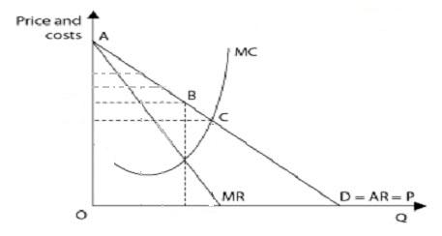
Imperfect First Degree …
Charging a few different prices based on the estimates of customer’s reservation prices.

Slide 13
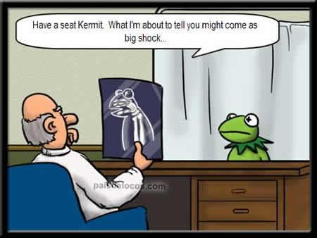
Doctors

Slide 14

Lawyers

Slide 15

Accountants

Slide 16

Architects

Slide 17
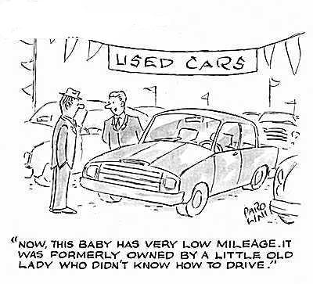
Car salesperson

Slide 18

Scholarships

Slide 19
Second Degree …
Practice of charging different prices per unit for different quantities of the same good or service.
  extract some, but not all of consumer surplus

Slide 20
Second Degree …
$/Q
Second-degree price
discrimination is pricing
according to quantity
consumed--or in blocks.
P₁
P₀
P₂
MC
P₃
D
MR
Q₁
Q₀
Q₂
Q₃
Quantity
1st Block
2nd Block
3rd Block
Notes:
33

Slide 21
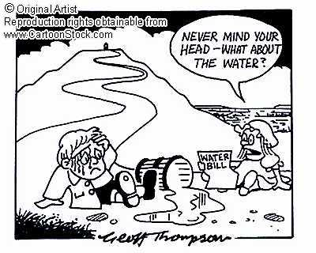
Example: Water Bills

Slide 22
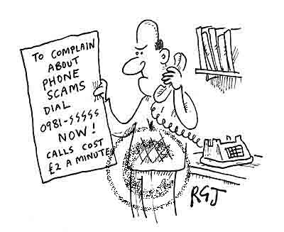
Example: Telephone or mobile Bills

Slide 23

Example: electricity bills

Slide 24
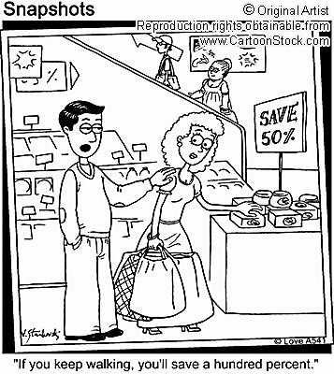
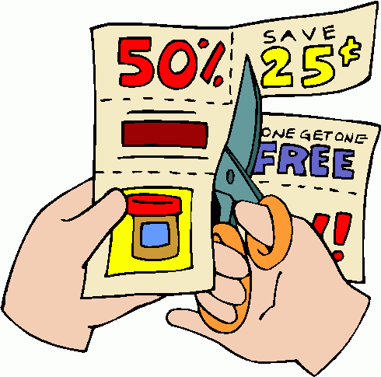
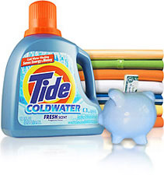

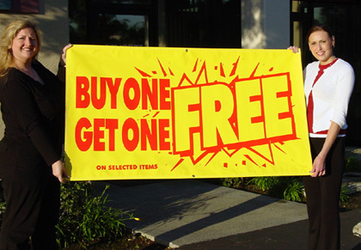
Some other examples

Slide 25
Third Degree …
This form of price discrimination divides consumers (with different demand curves) into two or more groups. It is the most prevalent form of price discrimination.
  Consumer groups can be made based on some observable characteristics.

Slide 26
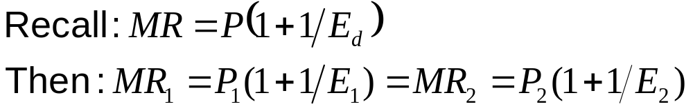
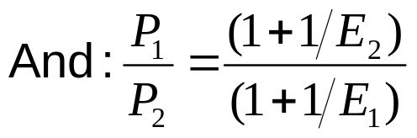
How to decide price for each group
Objective
    MR₁ = MR₂
    MR₁ = MR₂ = MC
Determining relative price
Higher price will be charged to group with low demand elasticity.

Slide 27
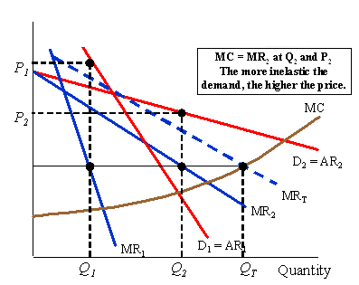
Third Degree …
$/Q

Slide 28
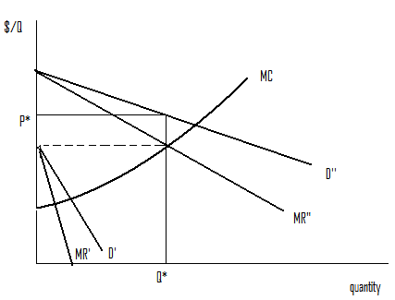
note
Even if third degree price discrimination is feasible it does not always pay to sell to both groups of consumers if marginal cost is rising very readily.

Slide 29
Examples
Discounts to students and senior citizens
Publishers charging a higher rate to libraries than to individuals
Different airline and train fairs
Different labels like premium/non-premium, supermarket label etc.

Slide 30
Firm should be able to prevent resales
Services: it is very difficult to resale a haircut
Students are required to show a student ID to enter a football game with a student ticket
It is very difficult to buy a car in Canada and bring it into the US

Slide 31
Intertemporal …
Separating the Market With Time
  Initial release of a product, the demand is inelastic
    Hard cover books
    New release of a movie
    Latest fashions
    Latest Technology
Notes:
57

Slide 32
Intertemporal …
Separating the Market With Time
  Once this market has yielded a maximum profit, firms lower the price to appeal to a general market with a more elastic demand
    Paper back books
    Movie Tickets
    Discount rack
Notes:
58

Slide 33

Examples
Plasma screens: Currently at
high prices but for how long?
Title: Thin-shaped television. Copyright: Getty Images,
available from Education Image Gallery

Slide 34
Peak-Load Pricing
Demand for some products may peak at particular times.
  Rush hour traffic
  Electricity - late summer afternoons
  Roses around valentine
  Hotels are more expensive in summer
Notes:
64

Slide 35
Peak-Load Pricing
Capacity restraints will also increase MC
Increased MR and MC would indicate a higher price
MR is not equal for each market because one market does not impact the other market

Slide 36
Peak-Load Pricing
$/Q
Off- load
price = P₂ .
MC
P₁
D₁ = AR₂
P₂
MR₁
D₂ = AR₂
MR₂
Q₂
Q₁
Quantity
Notes:
69

Slide 37
Two-Part Tariffs
A two-part tariff is a lump-sum fee, p₁, plus a price p₂ for each unit of product purchased
Thus the cost of buying x units of product is
p₁ + p₂x.
how should the monopolist design its two-part tariff?
What is the largest that p₁ can be?
p₁ is the “entrance fee” so the largest it can be is the surplus the buyer gains from entering the market.
What should be p₂?

Slide 38
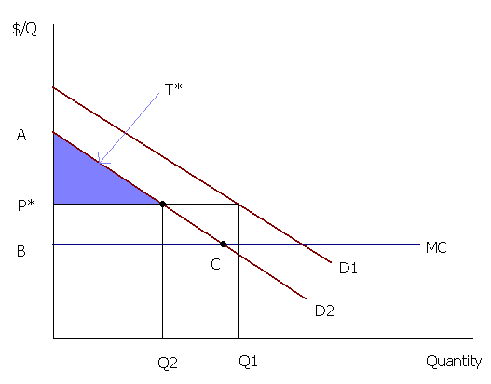
Two-Part Tariffs

Slide 39
Examples
The sports center charges a fee to join and then a per usage fee.
At Disneyland in California and Walt Disney World in Florida, the strategy is to charge a high entry fee and charge nothing for the rides.
In 1971, Polaroid introduced its new SX-70 camera. This camera and its film was sold separately. Polaroid could apply a two-part tariff to the pricing of SX-70.

Slide 40
Examples: Innovative pricing
Twist: the entry fee T entitles the customer to a certain number of free units.
Examples:
several blades are usually included in a pack of Gillette razor.
Monthly lease fee for a mainframe computer usually includes some free usage before usage is charged.
most telephone service plans

Slide 41
Bundling
Practice of selling two or more products as a package.
Demands are negatively correlated.
Two types of people:
  A values $100 for a Word, $120 for Excel
  B values $120 for Word, $100 for Excel

Slide 42
Examples
In 1939, company MGM, a division of Loews bundled i.e (sold as a package) a classic movie “Gone with the Wind” with a flop of that time “Getting Gertie’s Garter” to gain the maximum profit.

Slide 43
Mixed Bundling
Practice of selling two or more goods both as a package and individually.
Ideal strategy when demands are only somewhat negatively correlated and/or when marginal costs are significant.

Slide 44
Tying
Practice of requiring a consumer to purchase one good in order to purchase another.
Bundling is a common form of tying

Slide 45
Tying as two-part tariff
During 1950s, Xerox had a monopoly on copying machines but not on paper
Xerox required its customers to use only Xerox paper
Thereby allowing for two-part tariff to its machines

Slide 46
Tying: Higher profits
During 1950s, IBM required customers who leased its mainframe computers to use paper computer cards made only by IBM.
Pricing cards well above marginal cost, IBM was effectively charging the higher prices for computer usage.

Slide 47
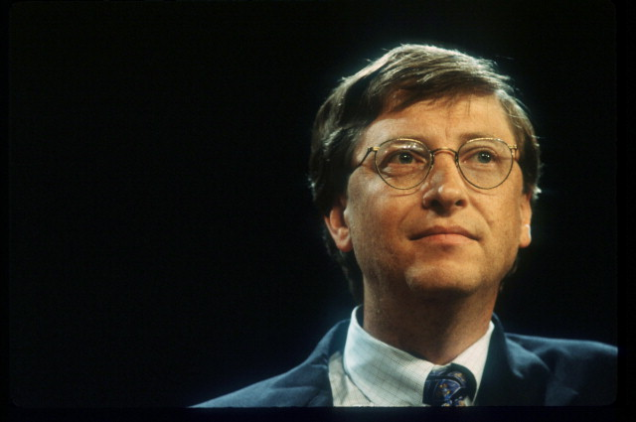
Tying: Extending firm’s market power
Microsoft – have been accused of predatory pricing strategies in offering ‘free’ software as part of their operating system – Internet Explorer and Windows Media Player - forcing competitors like Netscape and Real Player out of the market.
Title: Bill Gates speaks at UNIX convention. Copyright: Getty Images, available from Education Image Gallery

Slide 48
Tying: Protecting Cutomer Goodwill
Franchises are often required to purchase inputs from the franchiser.
Examples:
Mobil Oil requires its service stations to sell only Mobil motor oil, Mobil batteries etc.
Untill recently McDonald’s franchise had to purchase all supplies from McDonald’s.

Slide 49
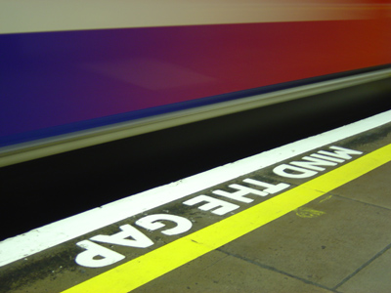
MIND THE GAP

Slide 50
So. Why is popcorn more expensive in the movie theaters?

