Slide 1
Traffic & Time analysis for an individual using Uber!!!
How does traffic in city affects the people’s daily schedule?

Slide 2
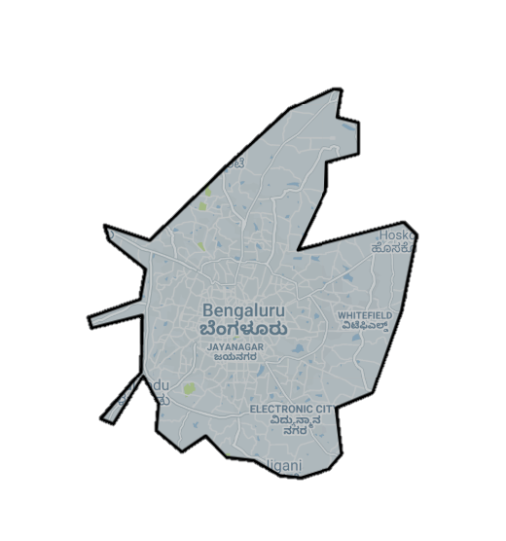
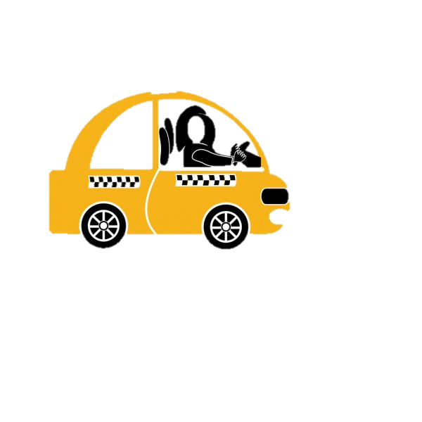
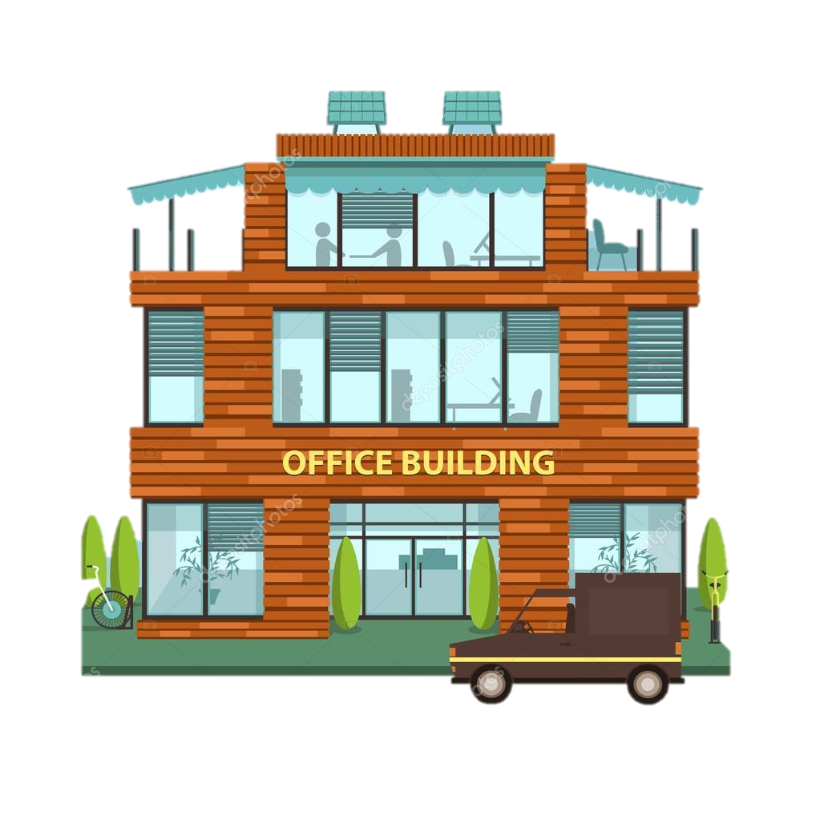
Majority of people use Uber as their daily commute to office, spending more time in travelling.

Slide 3

What is the cab price, by how much it has increased?
Wish I had record of how much time I spend in travelling, I have to plan my day accordingly!!!
Are cab available in my areas I travel?
Do Mondays have more demand than Sunday at 9 am?
Should I avoid cabs when traffic density is high? What is traffic rate during my office timings?

Slide 4
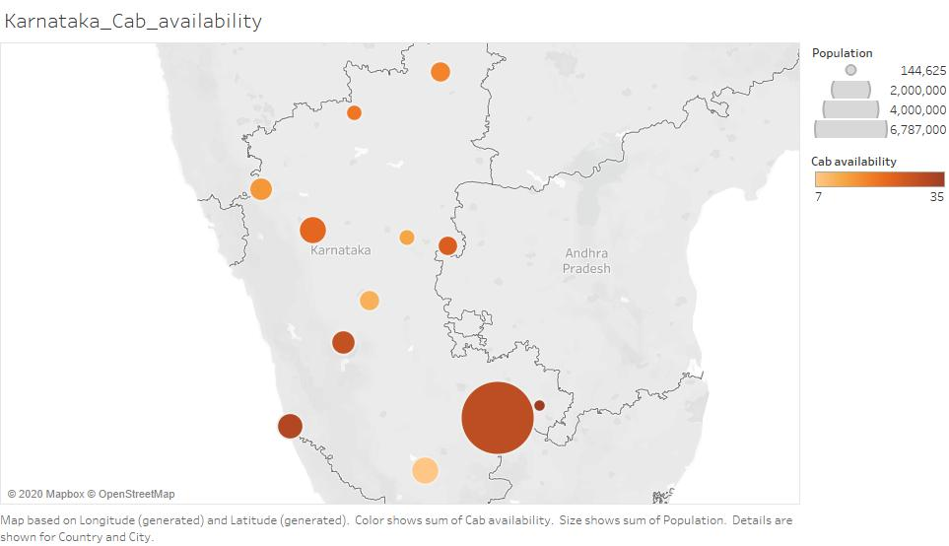
Bangalore city is observed with highest population in state Karnataka and has maximum Uber cabs in the state.
The biggest dot is the Bangalore city!!! The city has enough Uber cabs.

Slide 5
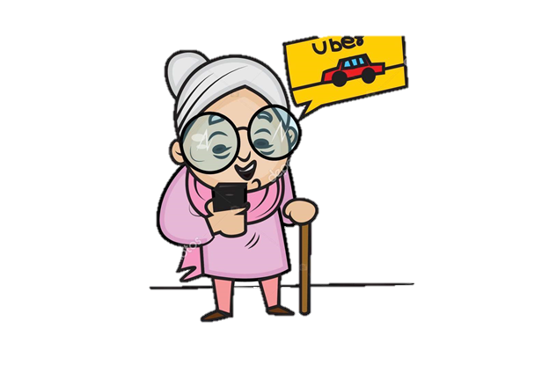
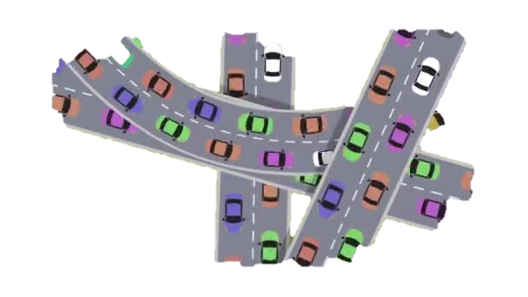
Traffic is the main reason observed in city which eats up maximum time of people
Ahaaa!!!
She is happy when she gets Uber on time and can avoid traffic by travelling when the traffic intensity is less.

Slide 6
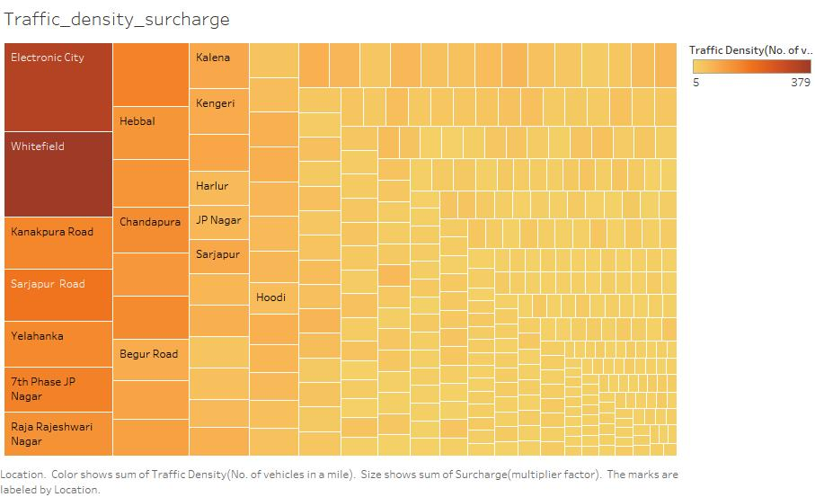
People should know the traffic intensity between their source and destinations.

Slide 7
Daily Commute via Uber
Source : HOME
Kempegowda, Majestic, Bengaluru, Karnataka
Destination: OFFICE
Cross Road, Sector 6, HSR Layout, Bengaluru, Karnataka

Slide 8
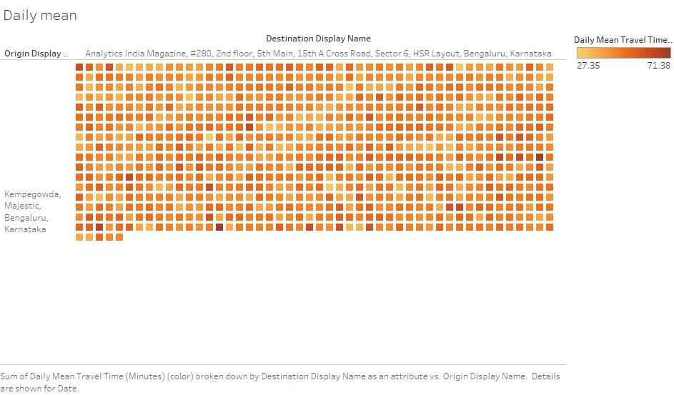
What my past experiences says about the time I took to travel!!!
The mean of time spend according to date.

Slide 9
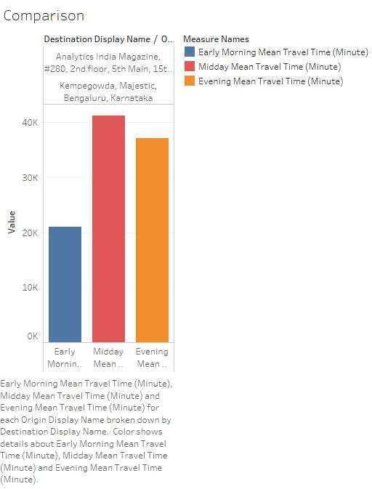

Early mornings are the best time to avoid traffic and late evenings are good to return back home!!!
I can stay productive after reaching office.

Slide 10
What time of the day is best to travel?
From the article of TOI, Uber is a widely used cab service in the majority of regions in India. In Bangalore finding Uber is difficult and the traffic adds on the pricing issue.
During my stay in Bangalore for work, I personally invested a lot of money and time in traveling. If I had this analysis earlier for my past Uber trips I could have saved lot of time and money for daily commute.
Time of Day | Mean of time spent to travel via Uber over a quarter(4months)
Early Morning | 2.9 hr
Mid Day | 5.49 hr
Evening | 5.1 hr

Slide 11
What should we take care of:
What we gain?
To analyze the prices of these ride-sharing application and try to figure out what factors are driving the demand. We have considered different city areas in our study to figure out the factors which lead to a high demand for cab prices.
The traffic in the city is the major problem which is observed, so I want the protagonist to think about the time they spend on daily commute which can help to manage their time.
Travel in early mornings is good.
Pre-plan our day
Avoid traffic congestion areas
Time is Money!!!

Slide 12
References
Dataset:
https://www.kaggle.com/shobhit18th/uber-traffic-data-visualization/data
https://www.kaggle.com/fivethirtyeight/uber-pickups-in-new-york-city?select=Uber-Jan-Feb-FOIL.csv
https://www.mapmania.org/map/75934/bangalore_pop_density_and_transport_links_map
https://veitchlister.com.au/take-a-ride-through-ubers-movement-data/
Article from Times of India:
https://timesofindia.indiatimes.com/city/bengaluru/why-finding-an-uber-taxi-in-bengaluru-is-a-big-challenge/articleshow/7127379.cms

