Slide 1

IS 636 Structured System Design and Analysis Project Topic: Education System at UMBC
Under the guidance of Dr. Md Osman Gani
Team 2
Aishwarya Anil Kadam
Karan Hiten Dhamecha
Mahendra Amarnath Panuganti
Sonal Ingle
Surbhi Singhal

Slide 2



Agenda
Introduction
Project Overview
Recommendations
Design Strategy
Context Diagram
A level 0 physical data flow diagram
ER diagram of the new system
User Interface Diagram
Systems Design
Recommendation received from organizational contact

Slide 3
Project Overview
The Department of Education at any university is important to improve access to education for the students in every way. The Education Department of UMBC offers students undergraduate and graduate programs of study. It provides a master's degree in science, mathematics, etc. UMBC believes in the importance of public education.
The Education Department at UMBC wants to upgrade its system to provide better management of educational resources. The mission of faculties at UMBC is to develop learning that helps students to be skilled, thoughtful, and responsive. So it is necessary to make some changes to the system so that it can help the student in their education means they can easily use the educational resources like syllabus course material and assignment and also, they can ask doubts on the portal so that it will help them to grow. In the way, the new system will help faculties to easily interact with the students and helps in grading the assignments. The proposed system also ensures that a large class could be taught in a systematic way building all the knowledge gaps. The organization wants to propose a system that has enough management assets, expertise, resources, and competence to remodel the educational needs.

Slide 4
Project Overview
The Education System at the University of Maryland, Baltimore County is working hard to improve access to education on all perspectives for the students and faculty. Education is a very important part of our society. The United States spends more money on education but still faces issues that affect both students and faculties. Faculties face issues to conduct lectures for large groups of students in class with different learning styles, backgrounds, and gaps and this also limits the faculty to provide feedback to every student in the class. Also faces issues in grading the assignment for such a large number of students.
As a student coming from a different country with a different education system, they fail to understand the digital platform provided, which is not user friendly. Students are not aware of how to use the software, and hence they waste their time figuring out, and even faculties face problems after years of experience. All this problem contributes to an inefficient education system. So, in attempts to fix these problems, various ways are introduced. Introducing online websites, numerous YouTube channels for specific subjects. Providing these solutions won't help students and faculties and they are still facing the problems with the software. Now a days due to COVID students are learning digitally only. So, it necessary to solve this problem in order provide better education.

Slide 5

Recommendations
The Education System of UMBC is trying to provide the best educational system in every way. According to the problem statement the project should recommend to have:
Information system that can help students in providing advance abilities like chatbots which help them to clear their doubts
The system should help students to connect them to faculties and peers so they can communicate easily if they have any doubts.
There should be a discussion board where faculties can help and post the discussion regarding the learnings.
The faculties can access assignments and assessments and can automate the grading process.
The system should also provide resources like exercise materials so that it can help students in learning.

Slide 6
Alternative solutions
1. Upgrade the current system and add new features to it.
2. Provide pre-recorded videos, software manuals for the designated user base to make them understand the newly developed system and to allow a smooth transition from the old system to the new one.
Feasibility Analysis
Feasibility analysis is the mechanism that allows the organization to ensure that the strategy, plan, the successful completion of the project in a sensible way can be supported by the design adopted.
The takeaway is all related factors are considered, such as technological, organizational, and economic factors. The feasibility analysis factors can differ according to the nature of the project.

Slide 7


Design Strategy
Steps to create a design strategy
These are the three main steps to get started with your business’ design strategy.
Define your vision
Design your competitive advantage
Set measurable goals
Our design is mainly focused on solving the problems with the online education system. The online education system requires lots of information exchange between the student and faculty. This online/portal-based education system is better and more accurate than the traditional one. For our system, we are using Structured Design strategy.
In structured designing, the system specifications act as a basis for graphically representing the flow of data and sequence of processes involved in a software development with the help of DFDs.
We are going to make a use of in-house resources to develop this system.

Slide 8
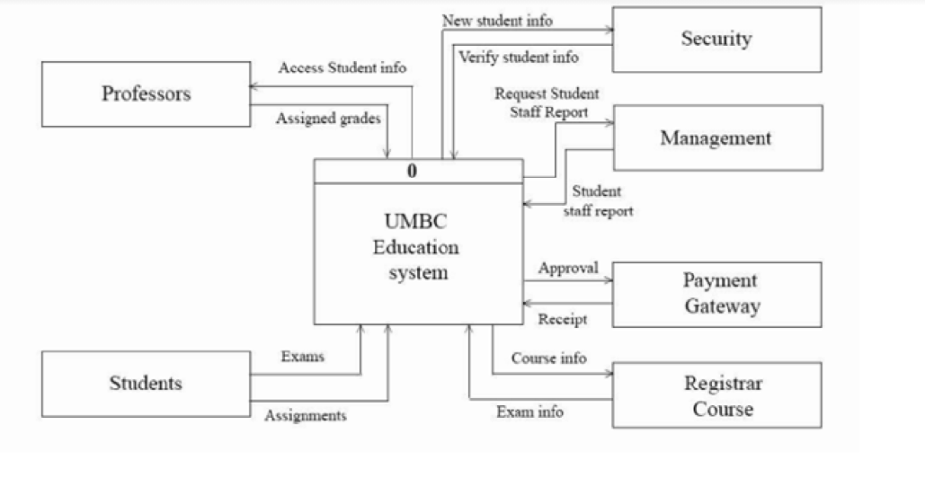
Context Diagram of the proposed system

Slide 9
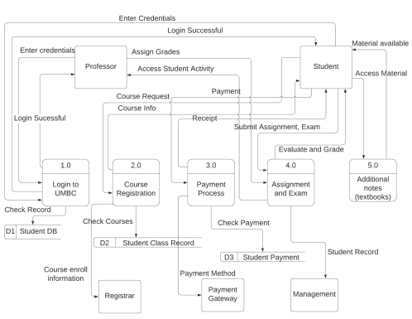
Data Flow Diagram: Level 0

Slide 10
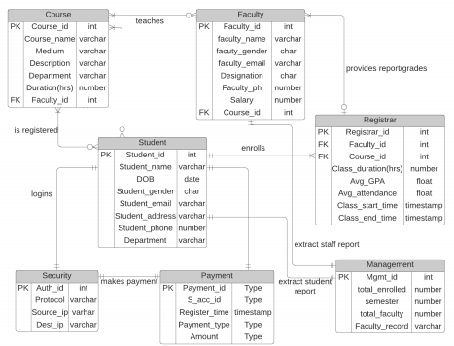
ER Diagram

Slide 11
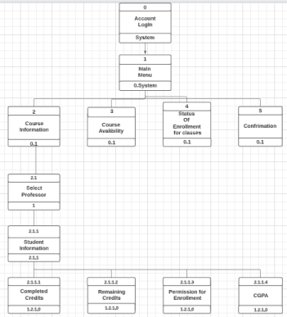
User Interface: Dialogue Diagram

Slide 12
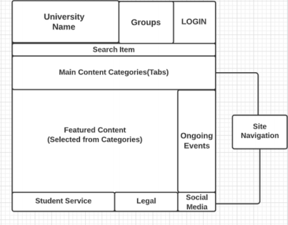
User Interface Diagrams
Model Web Page Layout

Slide 13
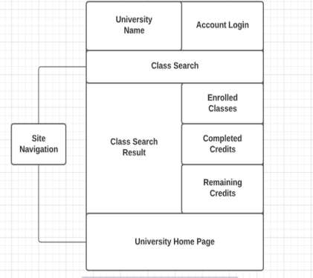
University Employee’s (Faculty) Web Page Layout

Slide 14
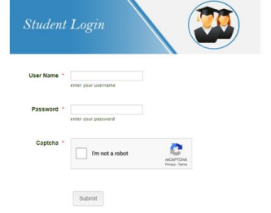
User Interface Design (Inputs and Outputs)
Student Login Form

Slide 15
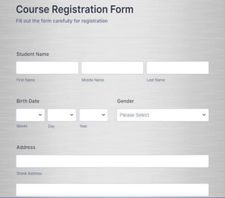
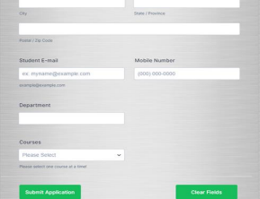
Course Registration Form

Slide 16
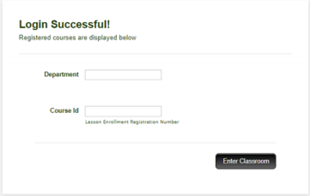
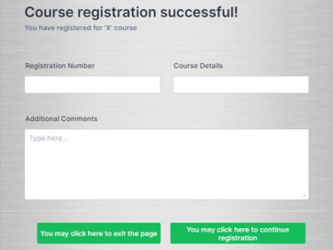
Course Registration Form

Slide 17

Recommendation received from Organizational Contact
Introduce chatbots
A system that connects faculty and students easily
Our proposed system aims to incorporate all the recommendations received and so far, we have been able to do that in our system design phases.

Slide 18

Thank You!

