Slide 1


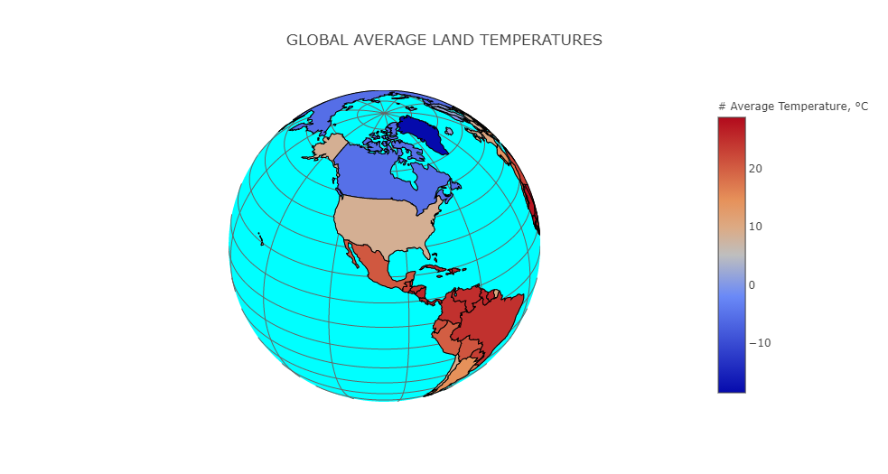
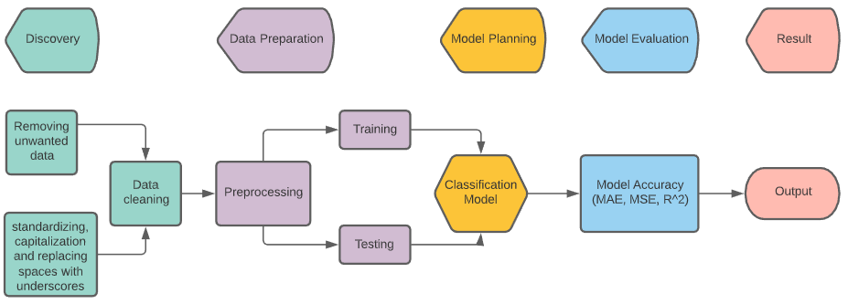
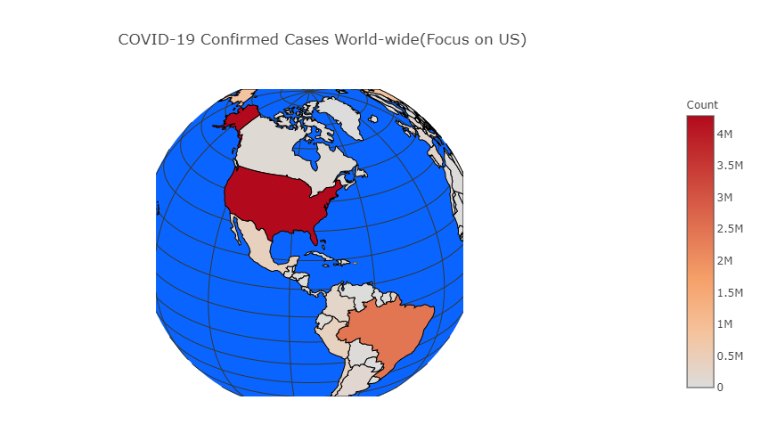
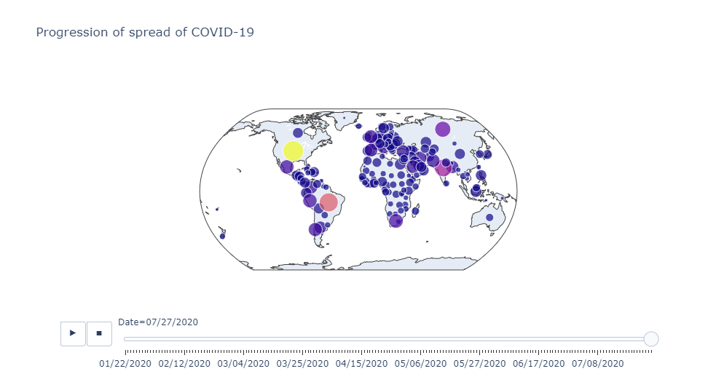
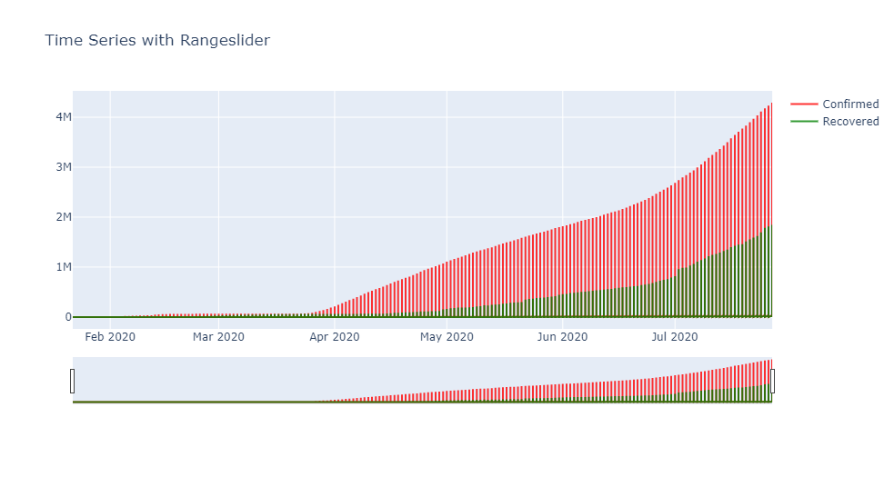
FORECAST COVID-19
Sonal Ingle | Surbhi Singhal | Aishwarya Kadam | Ria Vasa
Advisor: Dr. James Foulds
Information systems Department, UMBC
Exploratory Data Analysis
Visualizations depicting effect of temperature on transmission.
1. Global Average Land Temperatures
Overview
Project Goal:
Process Flow
The project goal is to analyze the dataset and predict the factors affecting the COVID-19 cases and show the current statistic of cases like no of cases, reasons. We will use regression methods and time series analysis because cases are depending on different factors temperature, season, etc. Temperature changes with seasons. So COVID-19 cases may go up or down depending on the factors. This exploratory analysis of data will help in predicting future cases and factors that causing the increase in cases.
2. COVID-19 confirmed cases World-Wide(Focus on US)
Project Benefits:
This proposed technique for analysis of COVID 19 coronavirus disease is present and future prediction of cases is performed. The effect of factors on cases on daily basis would help for the future safety of people and to control the spread of the pandemic. This prediction will help to make the decision for controlling factors and make more accurate decisions.
Feature Selection | Handling Missing Values | Splitting Data
Methods
Support Vector Machine: It is known for the discriminative power of classification. This training algorithm develops a model by finding hyperplane and classifies data correctly by maximizing the data between data clusters.
Polynomial Regression: This type of regression analysis is performed by considering the independent variable x and dependent variable y modelled as 4th degree polynomial in x.
Bayesian Ridge Regression: It deals with performing the statistical analysis with Bayesian inference which deal with the bayes theorem of probability.
Linear Regression: This deals with linear approach to modelling the relationship between a scalar response and one or more explanatory variable.
3. Progression of spread of COVID-19
Data Preprocessing
Experimental Results
We have predicted the confirmed cases using the auto-regressive polynomial regression analysis for next 5 days. First row represents the DATE, and the second row represents the No. of Cases
Conclusion
MODELS | MAE | MSE | R^2
Support Vector Machine | 2562802.52 | 6.68836E+12 | -9.23
Polynomial regression | 94657.13 | 11516541771.08 | 0.98
Bayesian Ridge Regression | 541086.58 | 3E+11 | 0.53
Linear Regression | 5096733.91 | 2.61105E+13 | -38.94
12/8/2020 | 12/9/2020 | 12/10/2020 | 12/11/2020 | 12/12/2020
9657771 | 9708206 | 9758770 | 9809465 | 9860315
Challenges
Standardization: COVID-19 data is reported differently by hospitals, states, and health agencies. It is challenging to identify the standardized format of the variables within each dataset to merge the datasets.
Variable analyses: Datasets provides with insights on multiple variables of COVID-19 data. It is important to know which variable provides key insights and sampling significance for decision making.
Compose error-correcting methods to increase predictability and have accurate utilization of models.
• From the table we observe that polynomial regression is the best fit model for our data prediction.
•The factors "Temperature" and "Humidity" are identified to affect the transmission.
•COVID-19 is spreading more in temperate zone of the planet compared to tropical zones.
Future Scope

