Slide 1

Restaurant Management System Team: Gryffindor
Team Members: Karan Dhamecha
Sonal Ingle
Rehan Sawant
Dinesh Dannina

Slide 2
Business Situation
We have created a database for Restaurant management system. The database will support basic functions including order details, customer information, staff details etc. The Restaurant has multiple branches but our database focuses on one branch. The list of food items and the beverage list can be maintained in this database. Different types of sittings are offered to the customer such as VIP, Pool side, Bar etc. The customer record and billing details can also be maintained in this system. The designed database will be helpful for the managers to manage the restaurant and customers to meet their requirements.

Slide 3
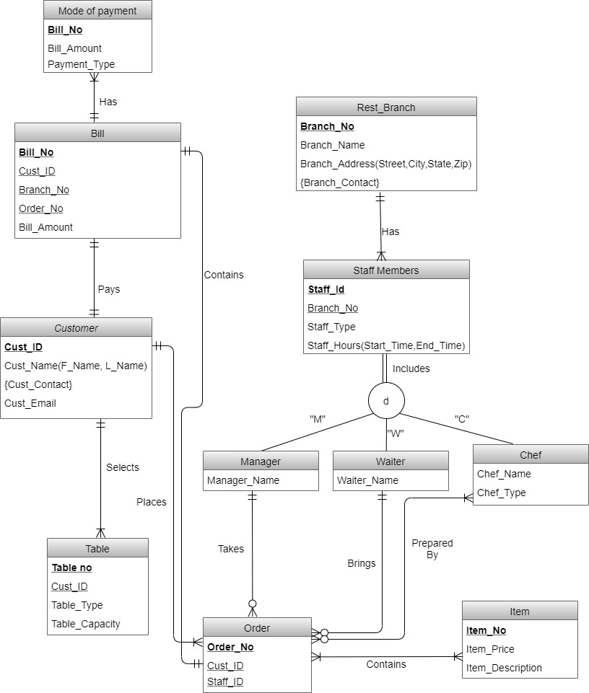
EER Diagram

Slide 4
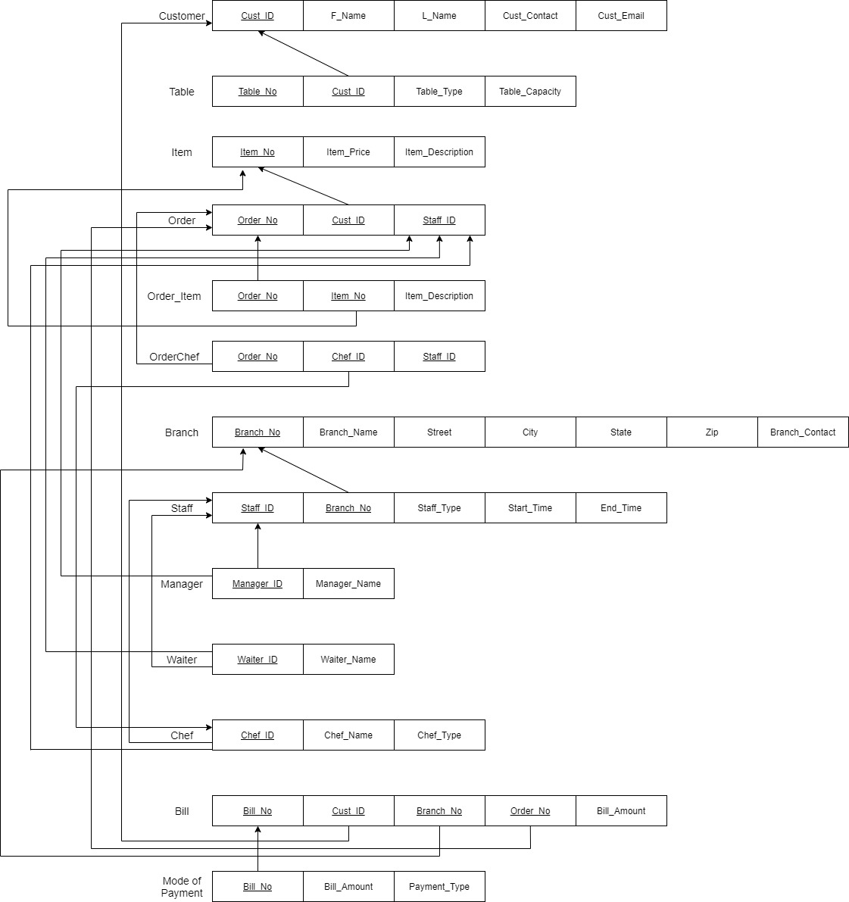
Relational Schema

Slide 5
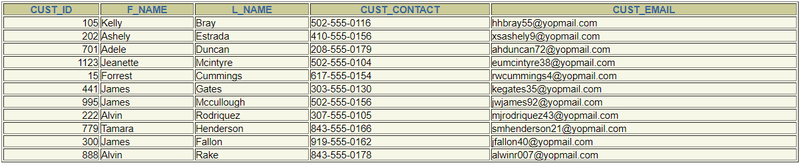
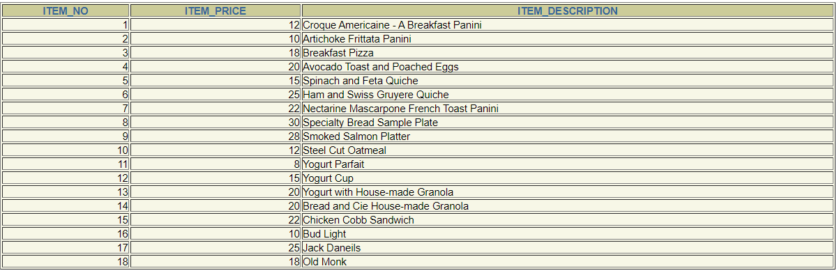
Creation of Tables
Rest_Branch
Customer
Item

Slide 6
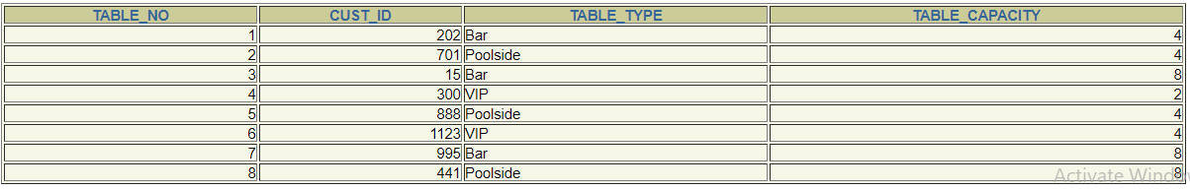
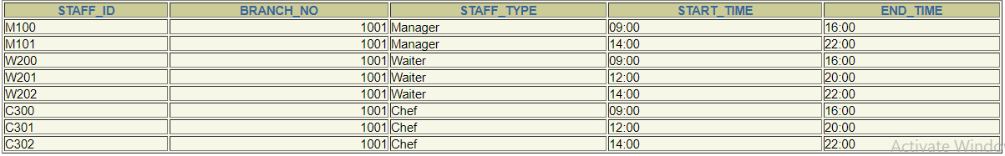
“Table”
Staff_Members
Manager
Waiter

Slide 7
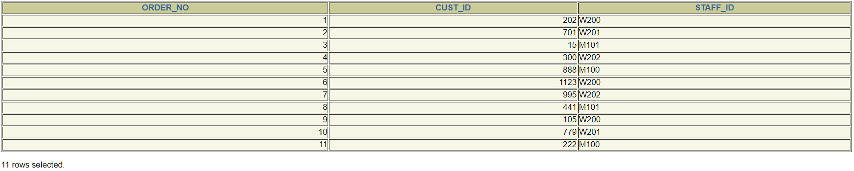
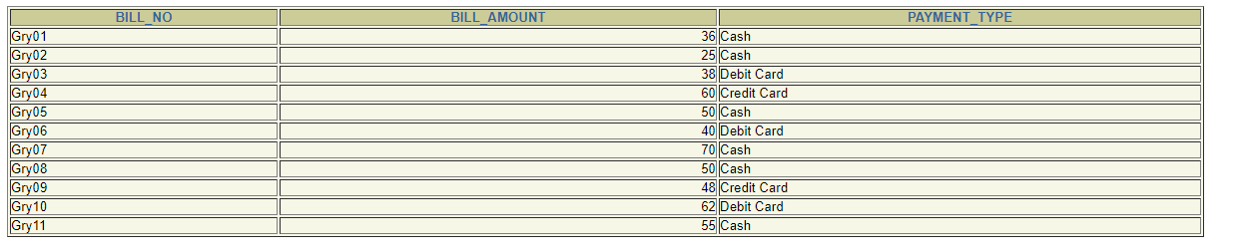
Chef
“Order”
Order_Item

Slide 8
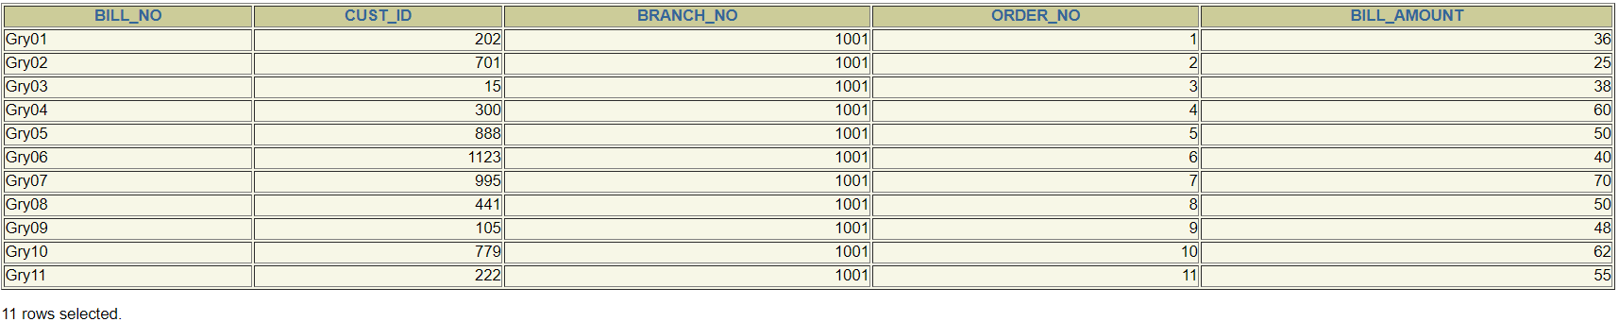
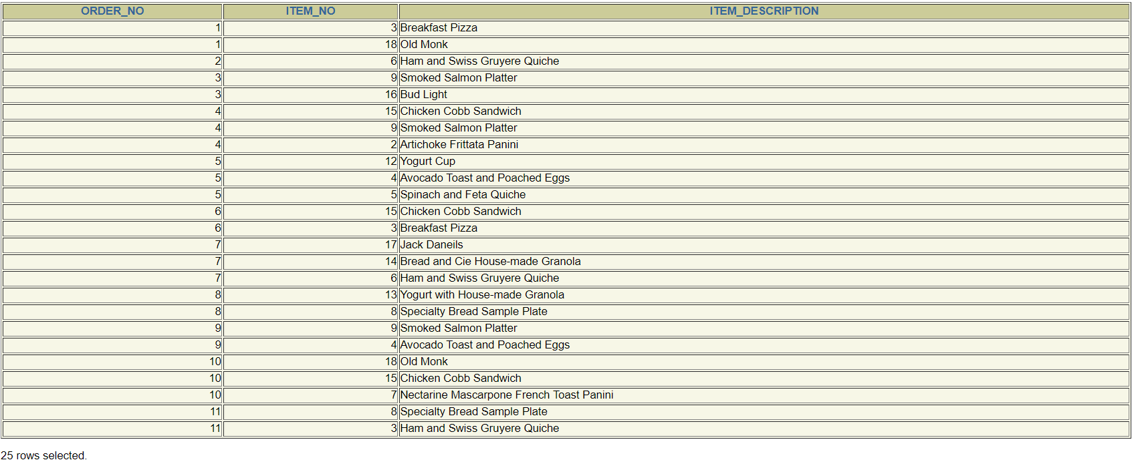
Bill
Mode_of_Payment

Slide 9


