Slide 1


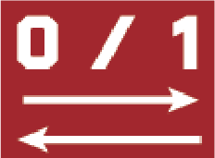
Biological Batch Resilient Gene Selection (BarGS)
for different genotype data sets
Ohbin Kwon, Youngchul Oh
P.I.: Heetak Lee
2024. 8. 22
B.I. team, CGE, IBS
Notes:
Feature selection
Genotype derived batch effecting gene

Slide 2
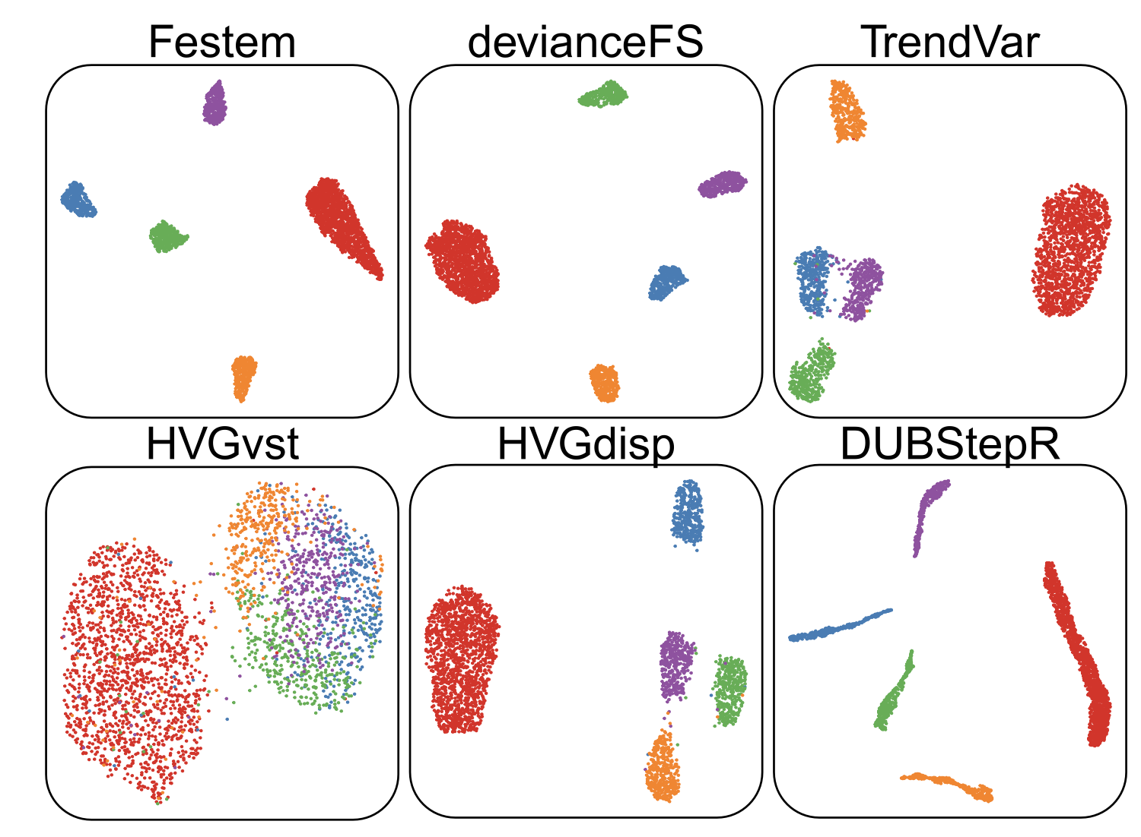
The importance of feature selection in scRNA-Seq data analysis
Highly variable genes may not reflect markers of cell types
→ Standard feature selection methods
(Cen, Zihao, et al., Cell Rep Methods., 2024)
Notes:
Markers
However, noise of batch effect
HVG fast.

Slide 3
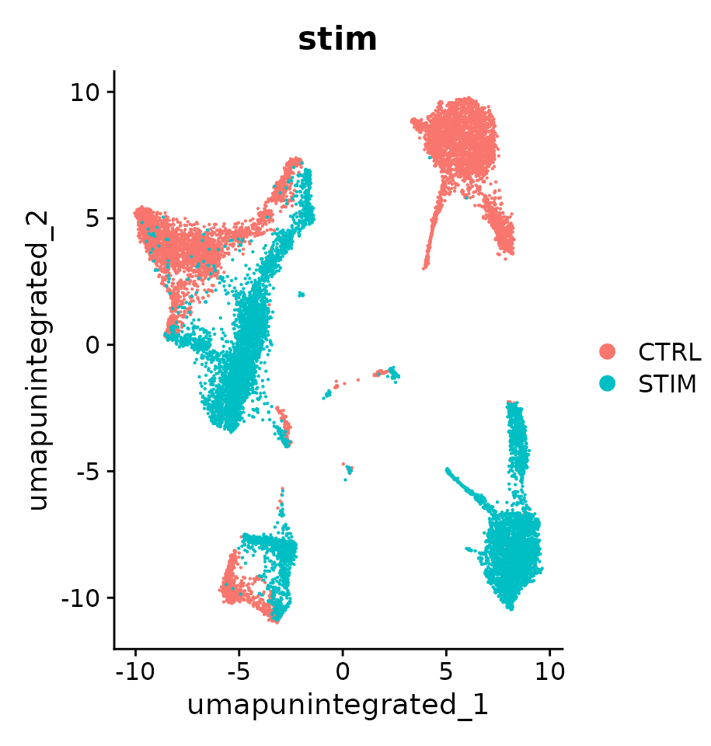
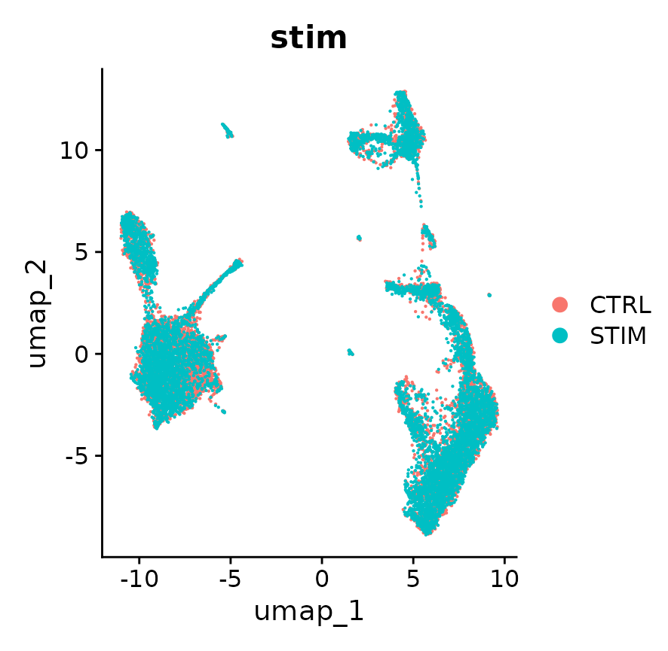
Highly variable gene also contains batch effect driving genes
→
CCA, Harmony, BBKNN, etc.
before integration
after integration
Therefore, HVGs that contain batch-effect driving genes
(https://satijalab.org/seurat/articles/integration_introduction.html_
Notes:
Gene selection, or coordinate/gene expression adjustment

Slide 4
Needed to filter out the Batch Effect causal genes in HVGs
BarGS algorithm identifies genes
from biological batches (e.g. genotype, or treatment)
that cell type marker genes (when different cell type composition)
It will improve downstream analysis
the same cell type == same cluster
detecting novel cell types.
Notes:
Strategy.
Batch effect gene removal
Marker gene rescue (different cell type compotition,

Slide 5
Overview of BarGS (in this hackathon)
1. HVG selection with Seurat vst method
2. Find DEGs (biological batch effect)
3. HVGs - DEGs
2-1. Pseudo-bulking
4. Finding potential marker genes (MGs) in DEGs
2-1-1. Sum of counts in each cells
2-1-2. Sorting cells by rank
2-1-3. Making 50 bins
2-1-4. Bootstrapping 30 cells in each bins
2-1-4. Merge selected cells (meta cell)
2-1-5. Iterating while make 1,000 meta cells
4-1. entropy calculation in each gene sum(p_{c} *log1p(p_{c}))
4-2. Normalization
(Mean / entropy)
4-3. Z-transformation
4-4. Find significant genes
2-2. Find differentially express genes (DEGs) using DESeq2
5. HVGs – DEGs + MGs

Slide 6
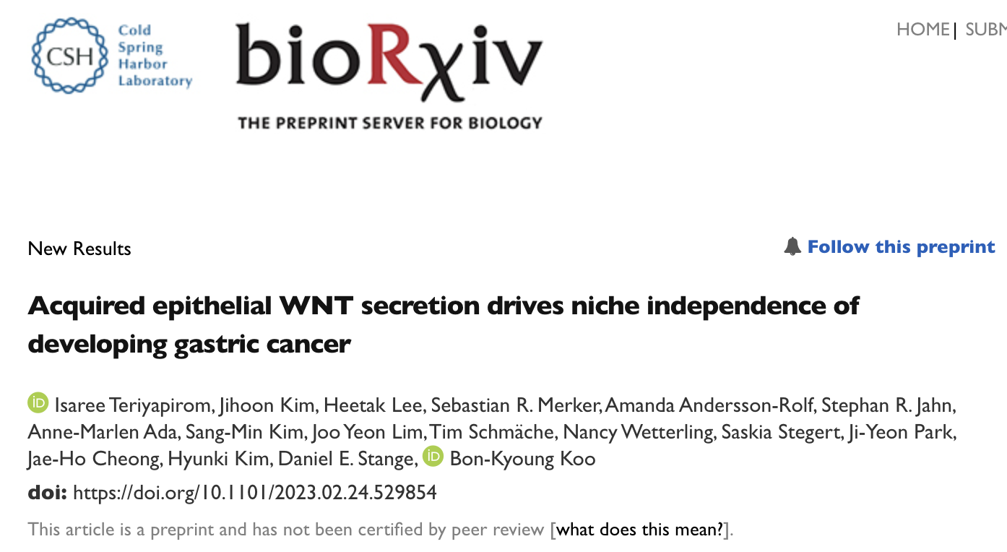
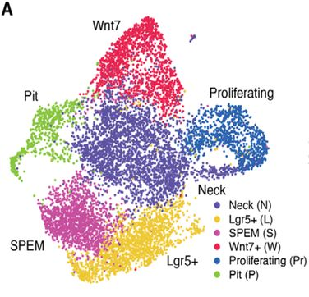
Test dataset: gastric organoid with loss of RNF43 and/or ZNRF3 (RZ), and additional Kras^{G12D} knock-in (RZK)

Slide 7
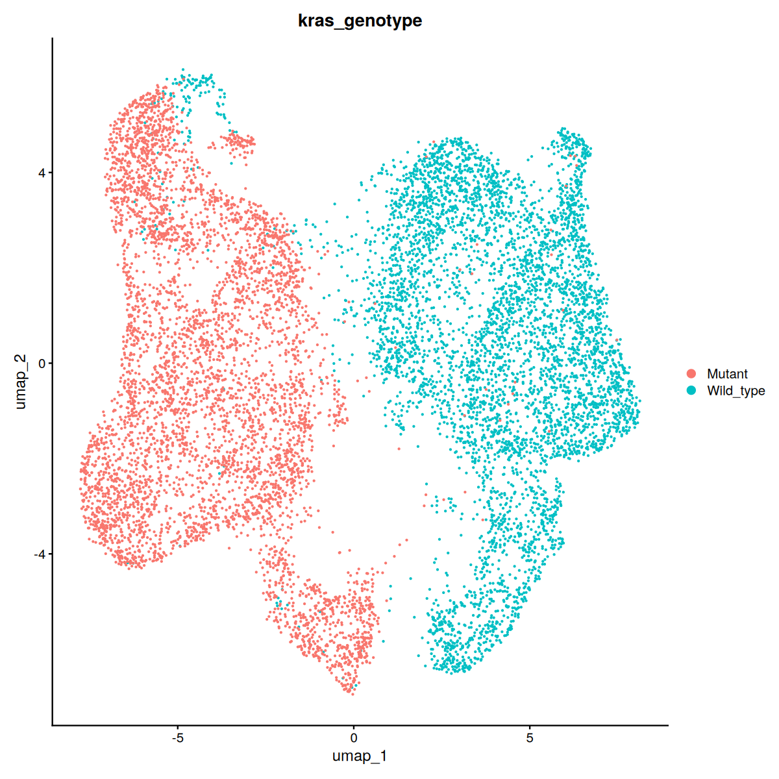
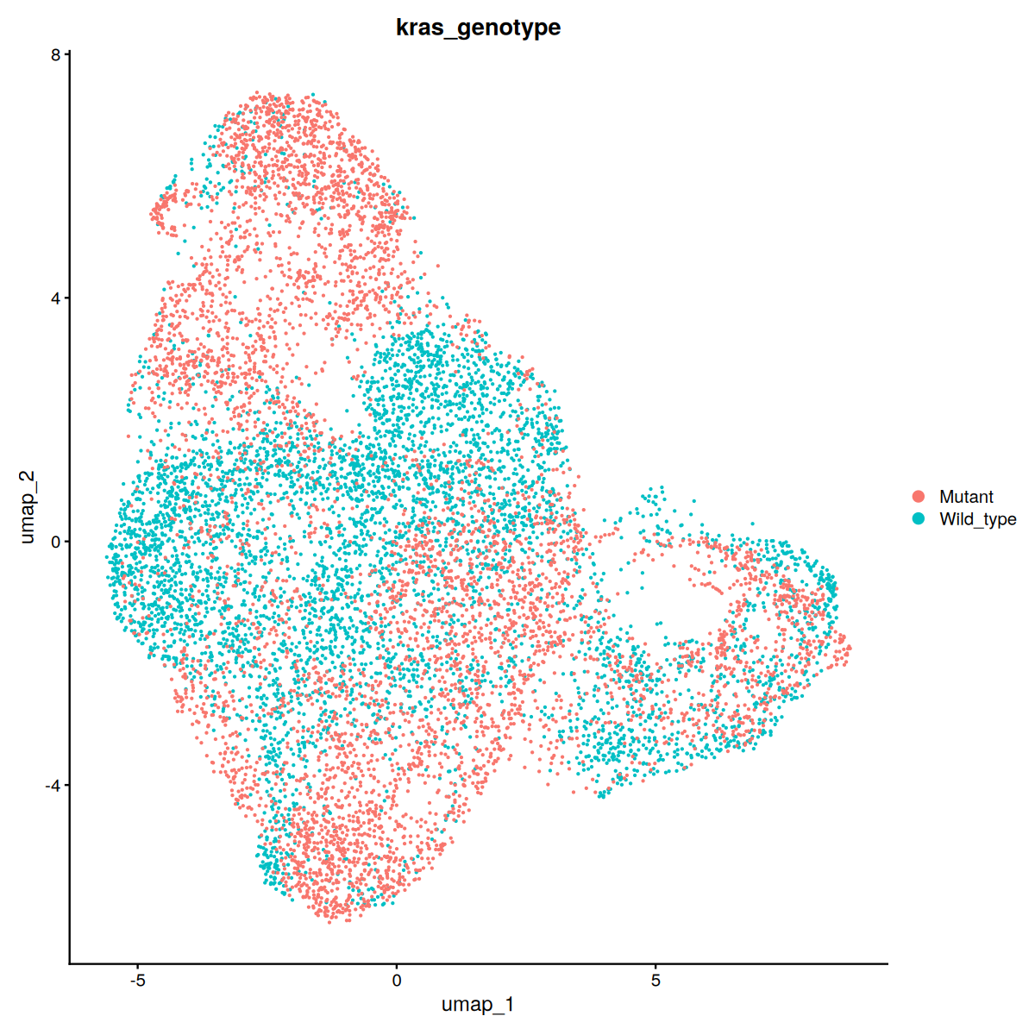
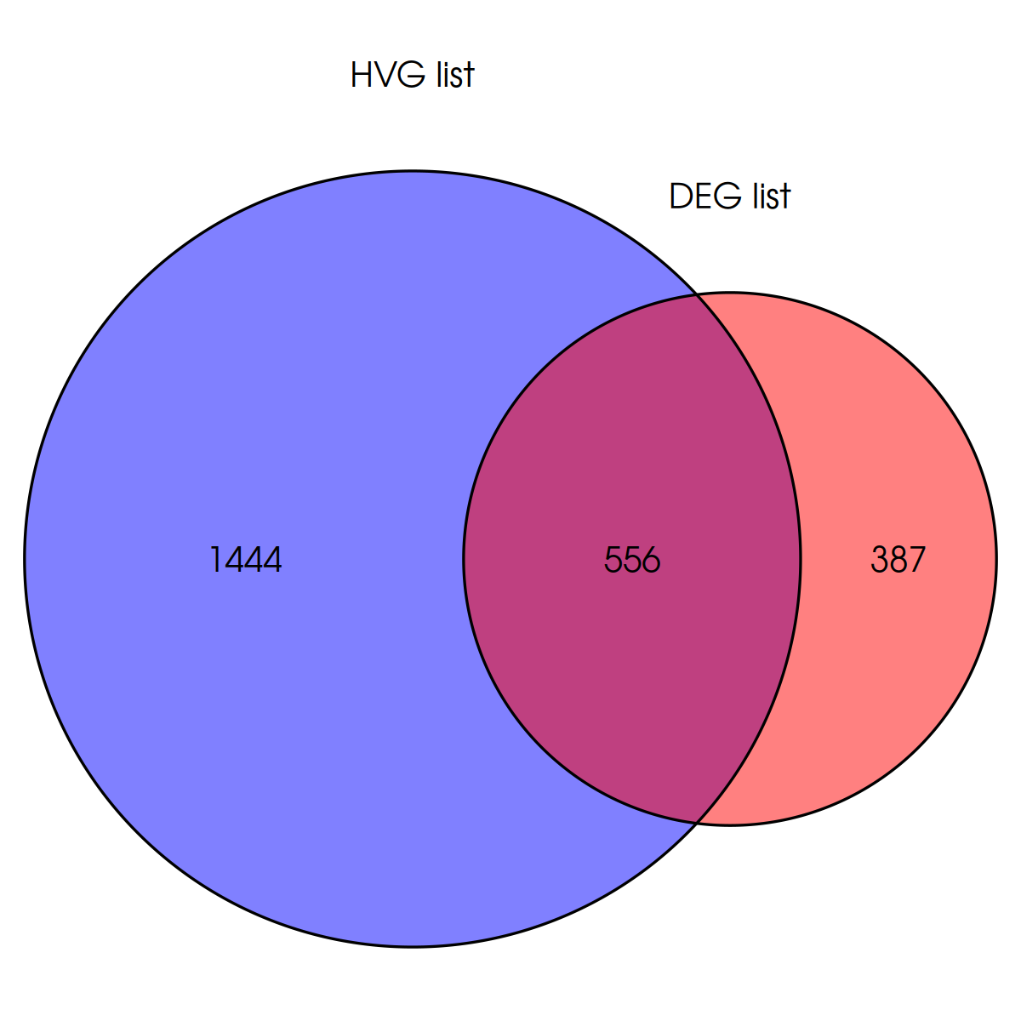
Test dataset
Before removing DEG
After removing DEG
Discarding 556 genes
Feature selection with HVGvst (top = 2,000)
1,444 features (HVG – DEG)

Slide 8
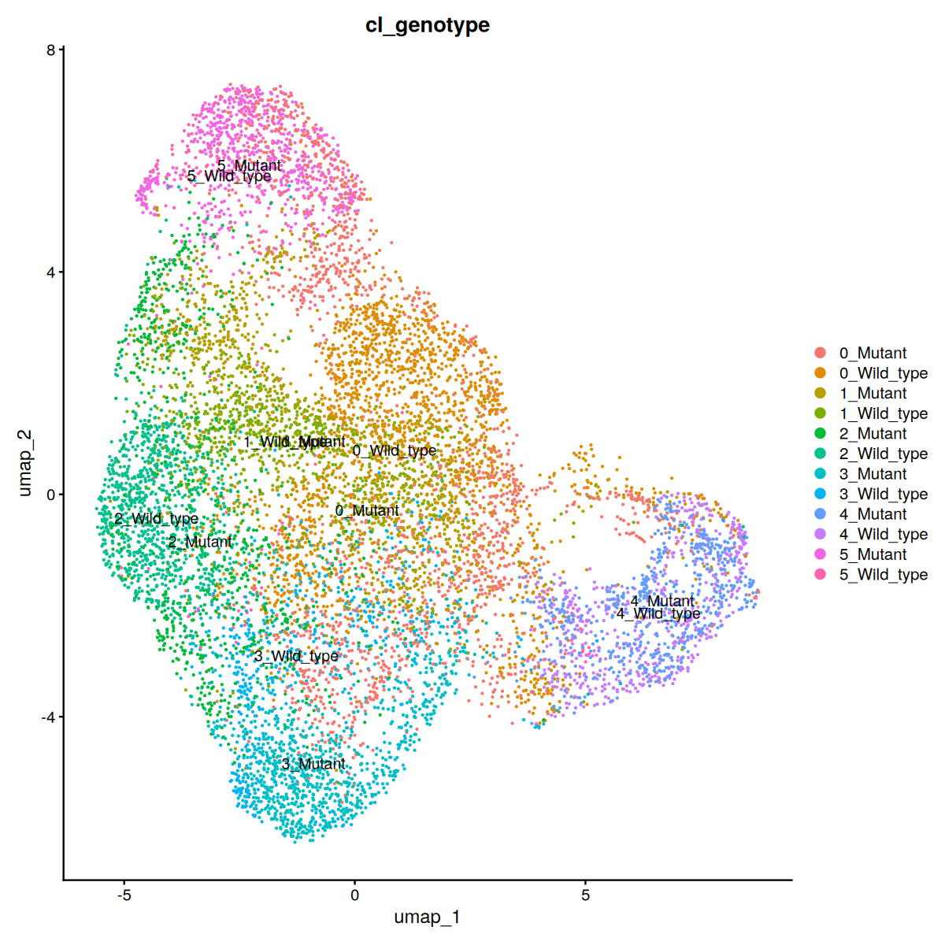
Test dataset - After removing DEG
Notes:
harmony

Slide 9
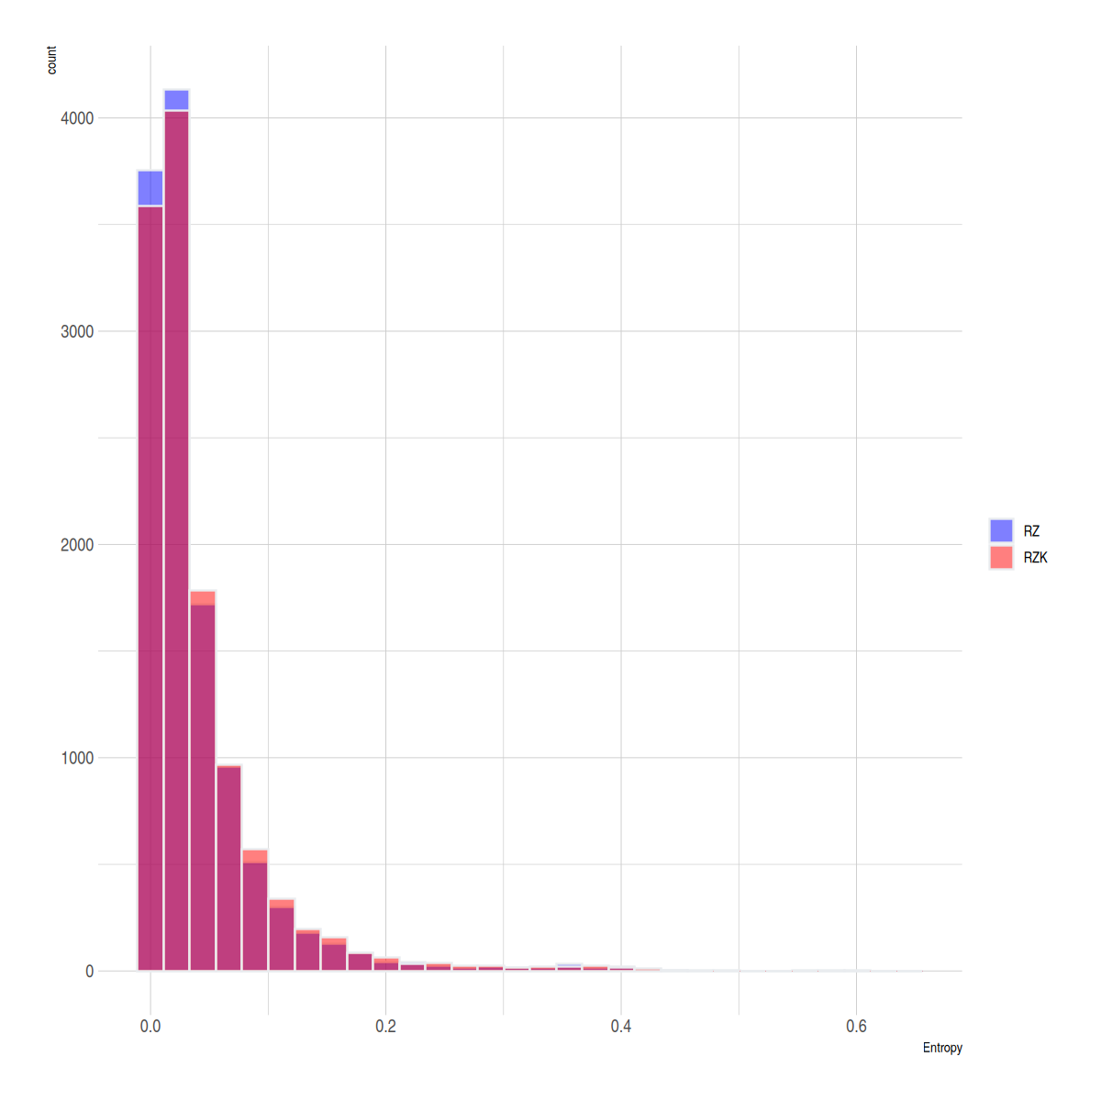
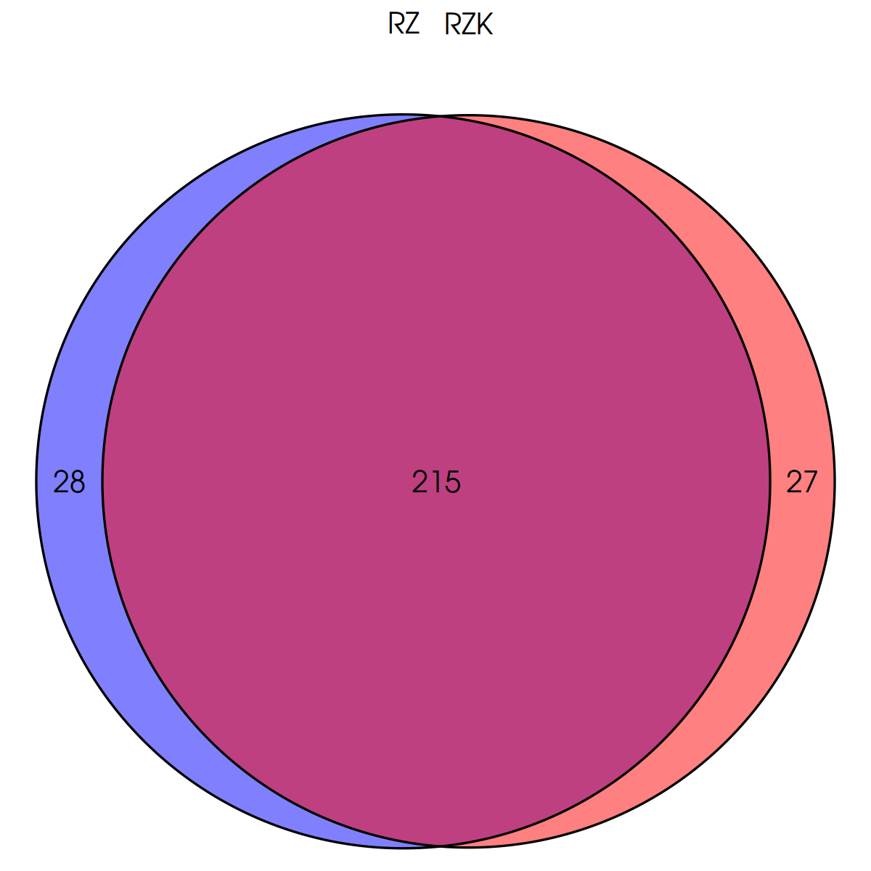
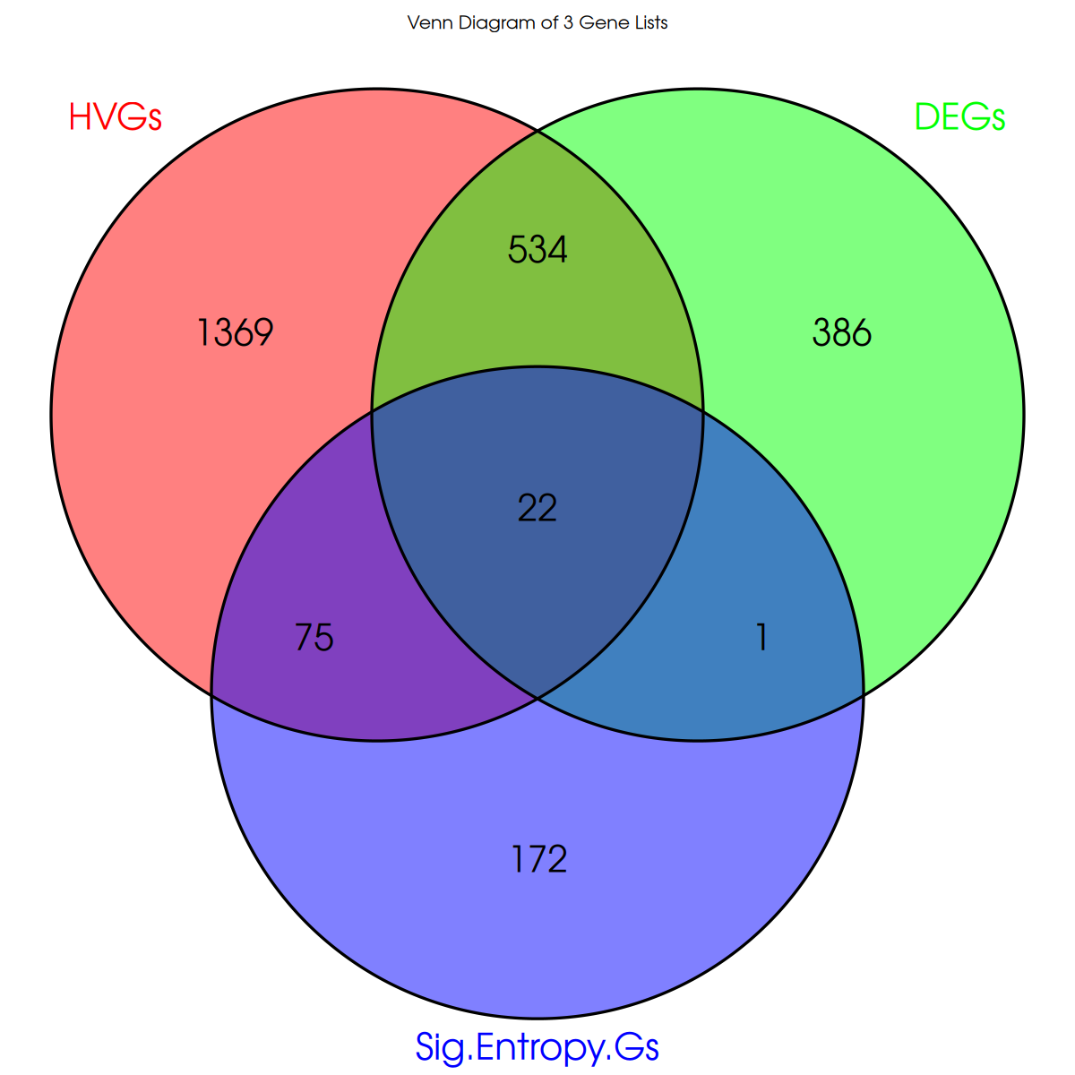
Test dataset
Entropy
Entropy histogram
270 genes are selected
22 genes are rescued

Slide 10
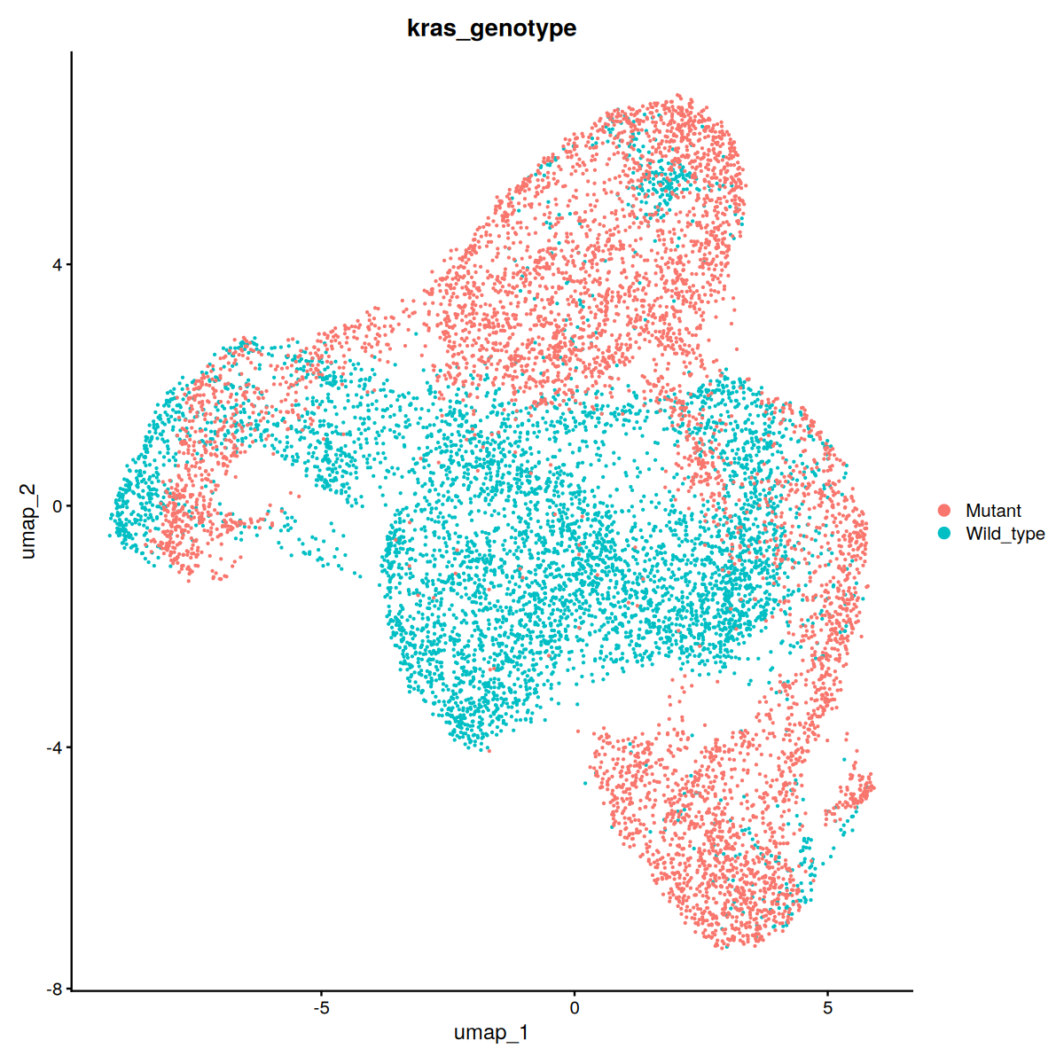
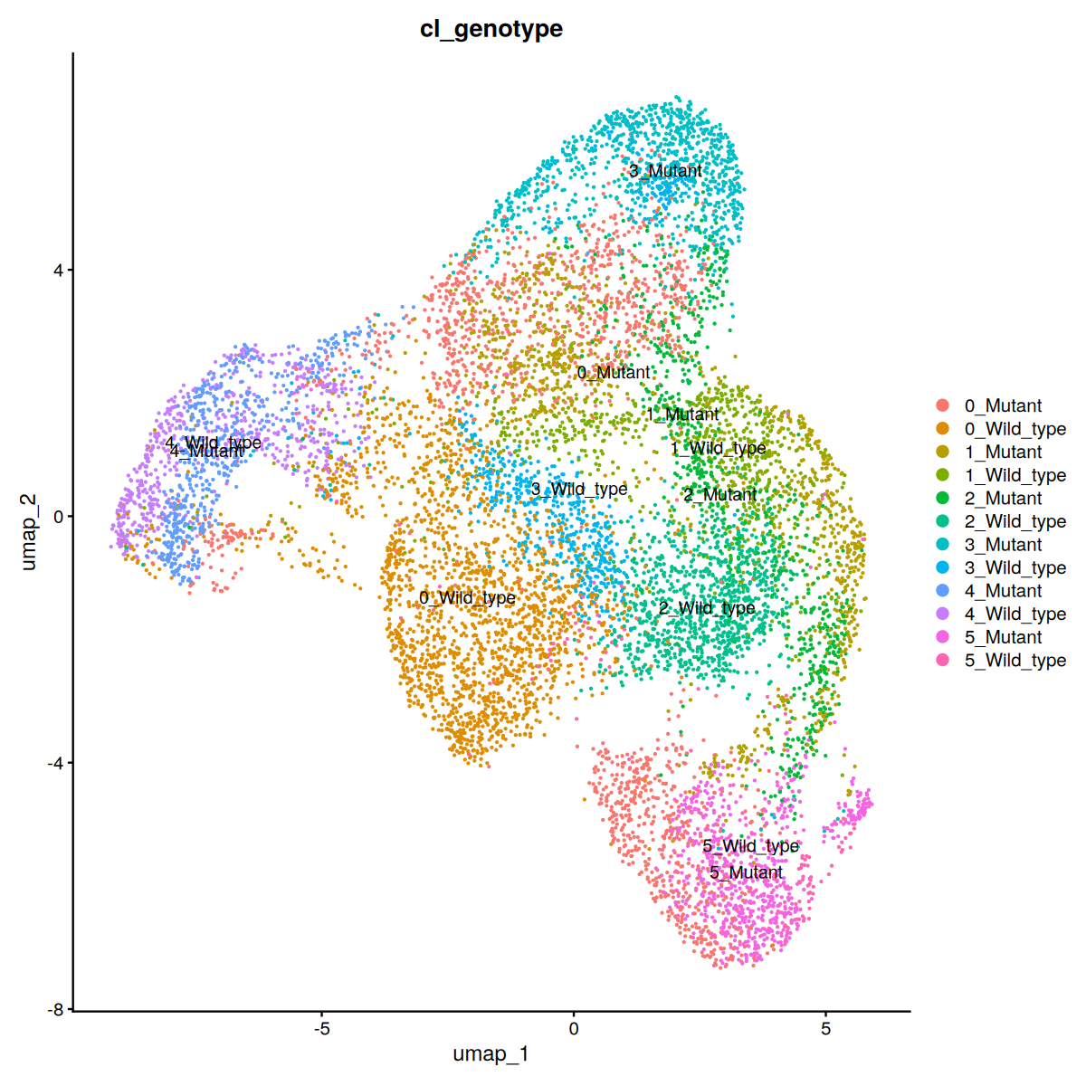
Test dataset
After rescue 22 genes in DEGs
Notes:
Marker is DEG

Slide 11
Further plan
Test on different datasets
Only cell type composition different
Novel cell type appears
No cell type composition and no novel cell type
Test different DEG selection methods and marker discovery methods
DEG selection methods (Wilcox, MAST, t-test, etc.)
Improve marker selection methods
Apply to spatial transcriptome data analysis

Slide 12
Any questions?

Slide 13
Thank you!

