Slide 1
Team GIST
Hyunji Lee, Gyumin Park
Functional Genomics Lab
Prof. Jihwan Park

Slide 2
Goal of our Hackathon
Identify transcriptionally & spatially distinct tumor populations.
Analyze tumor periphery sites:
Cell type proportion
Cell-Cell interaction
(Tumor-Immune interaction)

Slide 3
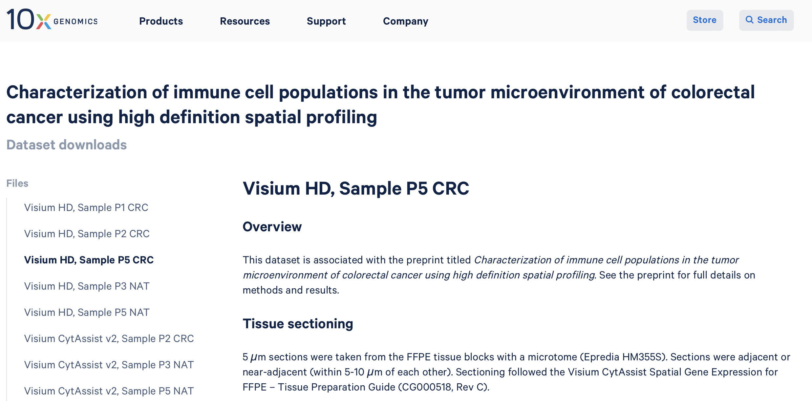
Why we chose P5 CRC?
Most severe case out of the 3 patients. But most of all... time!

Slide 4

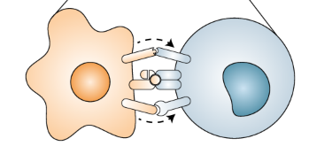

Data preprocessing
bin2cell
10X scFlex as ref.
P5 CRC Visium HD
2um data
Cell type annotated,
cell-binned anndata
Data analysis
Subclustering of tumor cells
Spatial distribution of identified tumor populations
Cell-to-cell interaction analysis
In-house
scripts
Seurat
CellChat

Slide 5
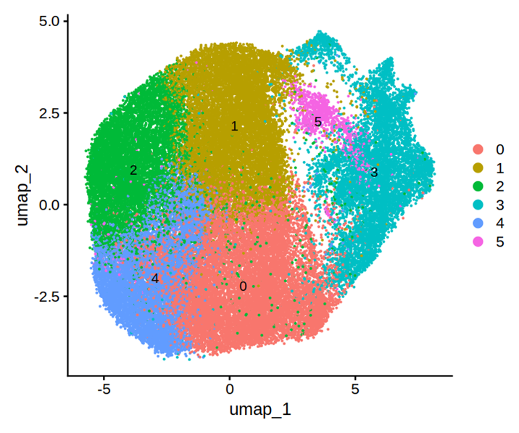
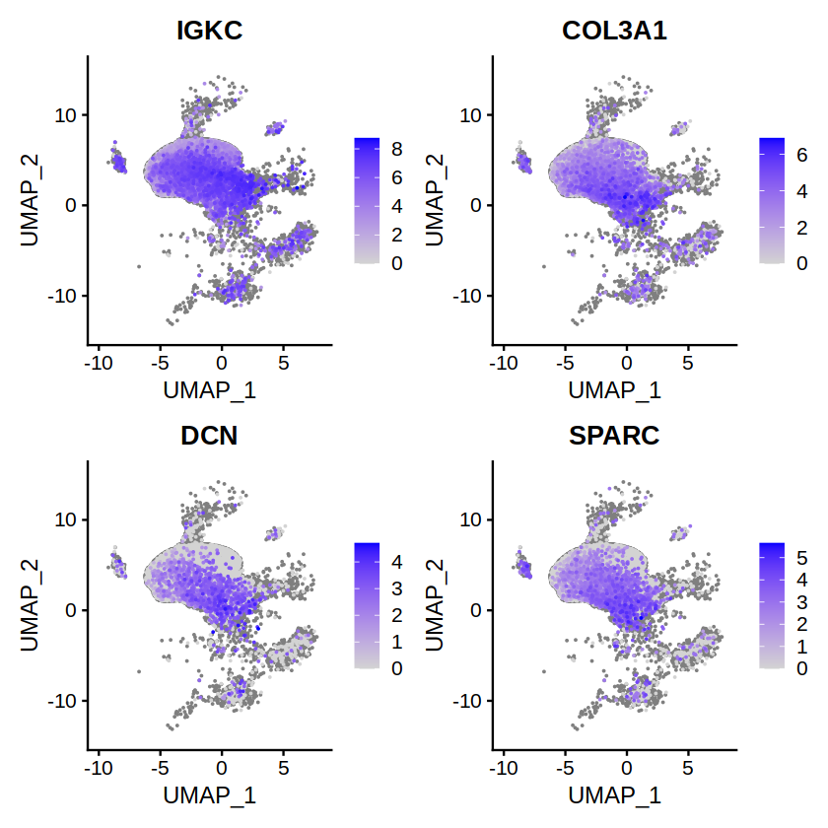
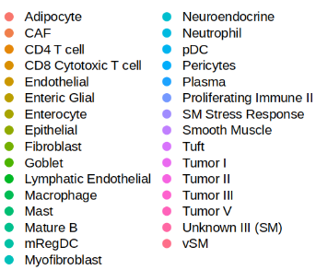
Data analysis (1) Subclustering of tumor cells
Single Cell Flex
10X reference annotations
Tumor population
sub-clustering results

Slide 6
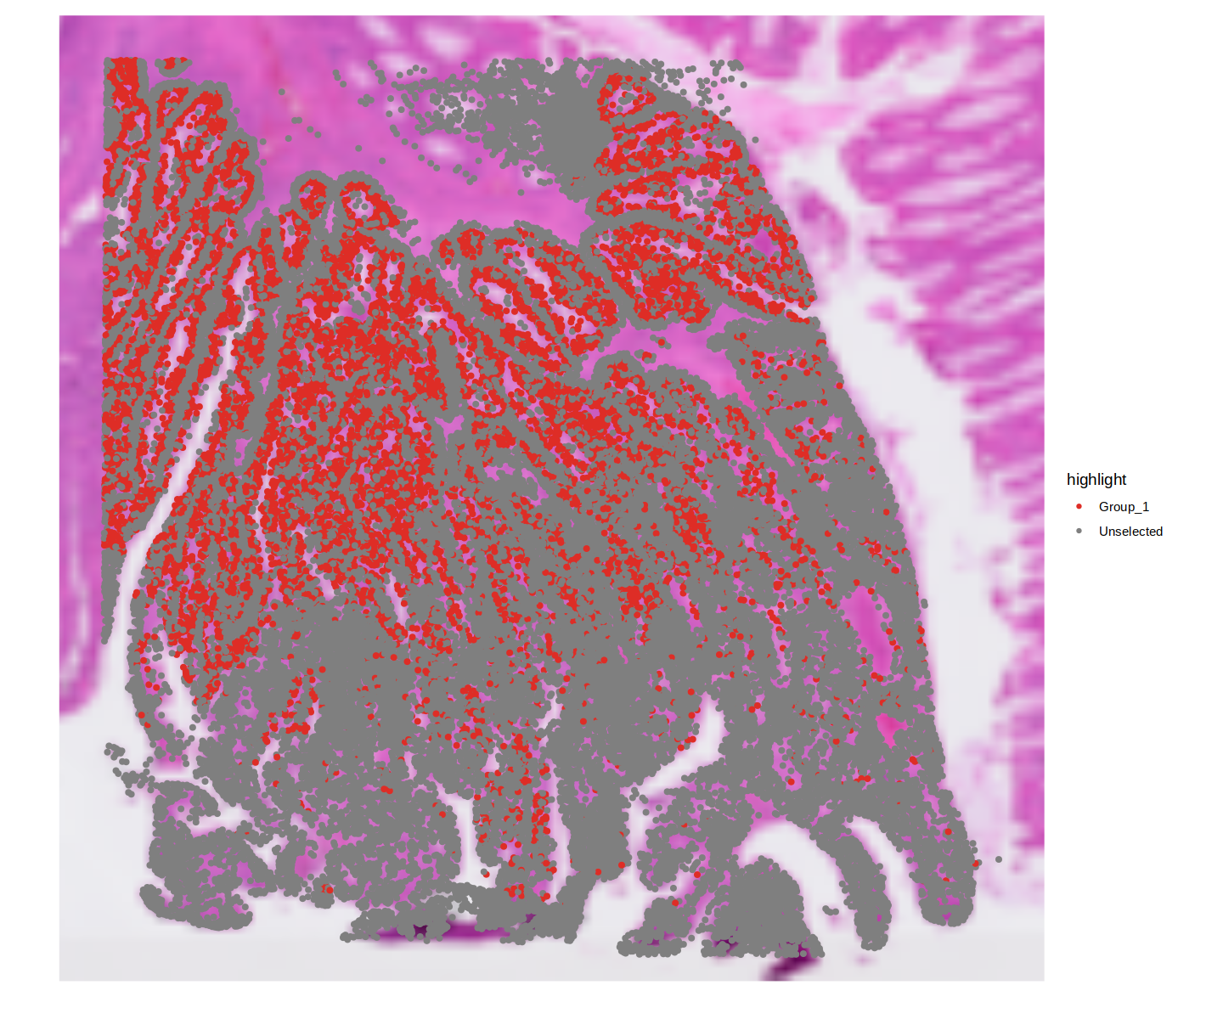
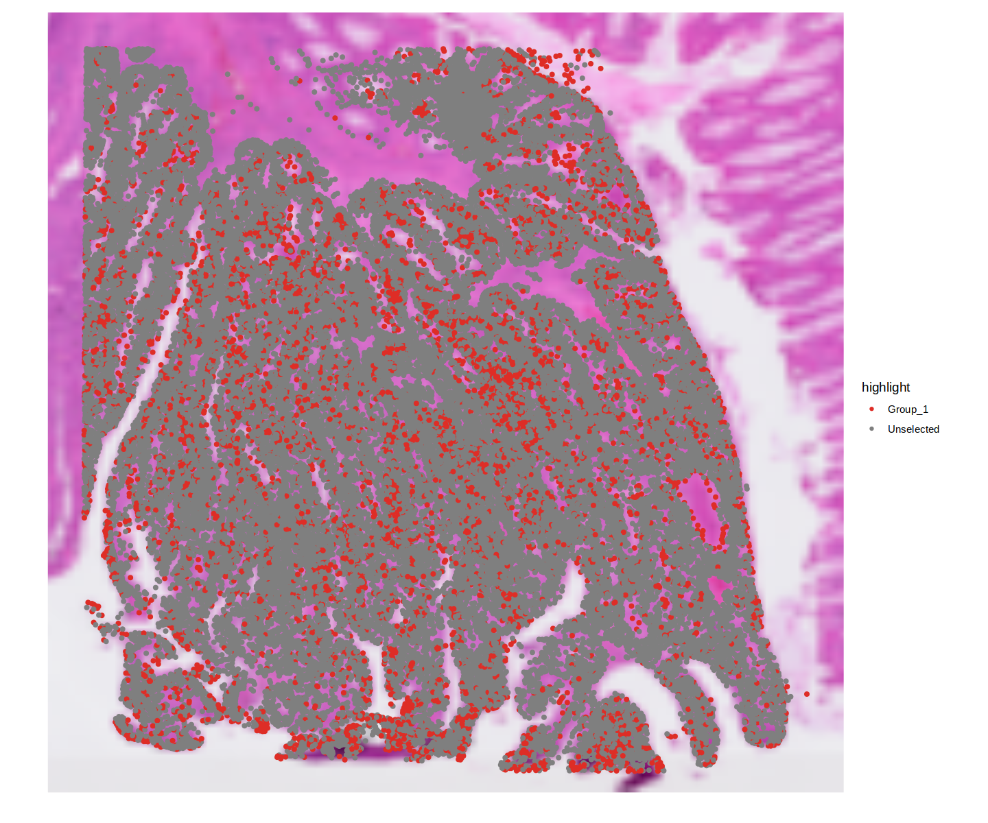
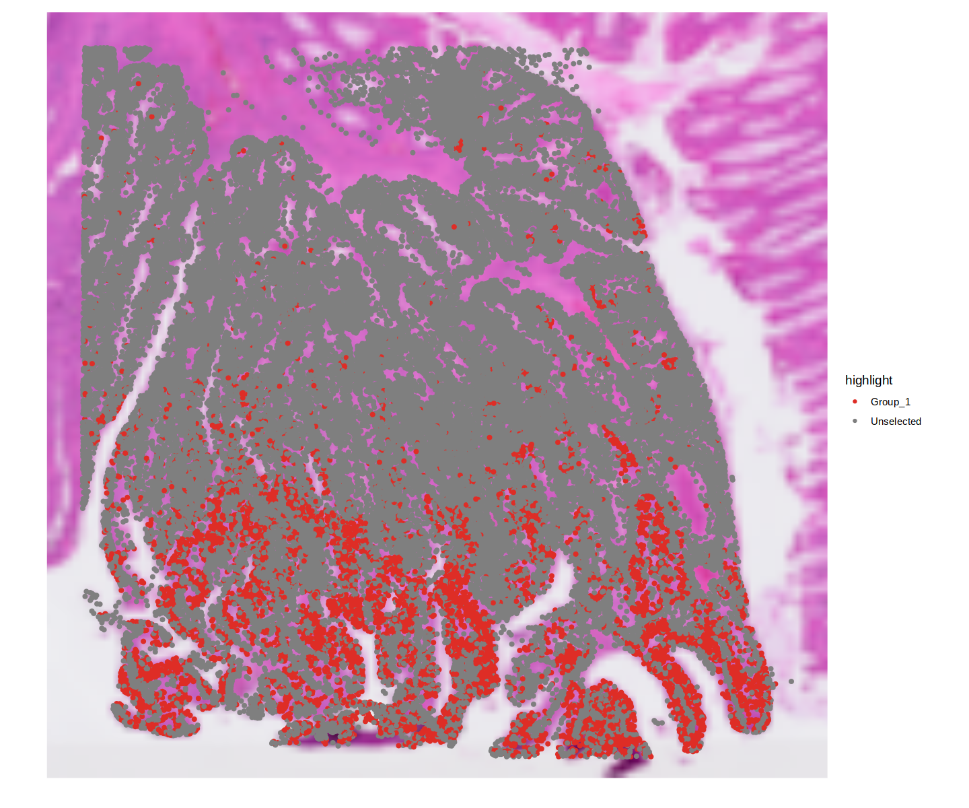
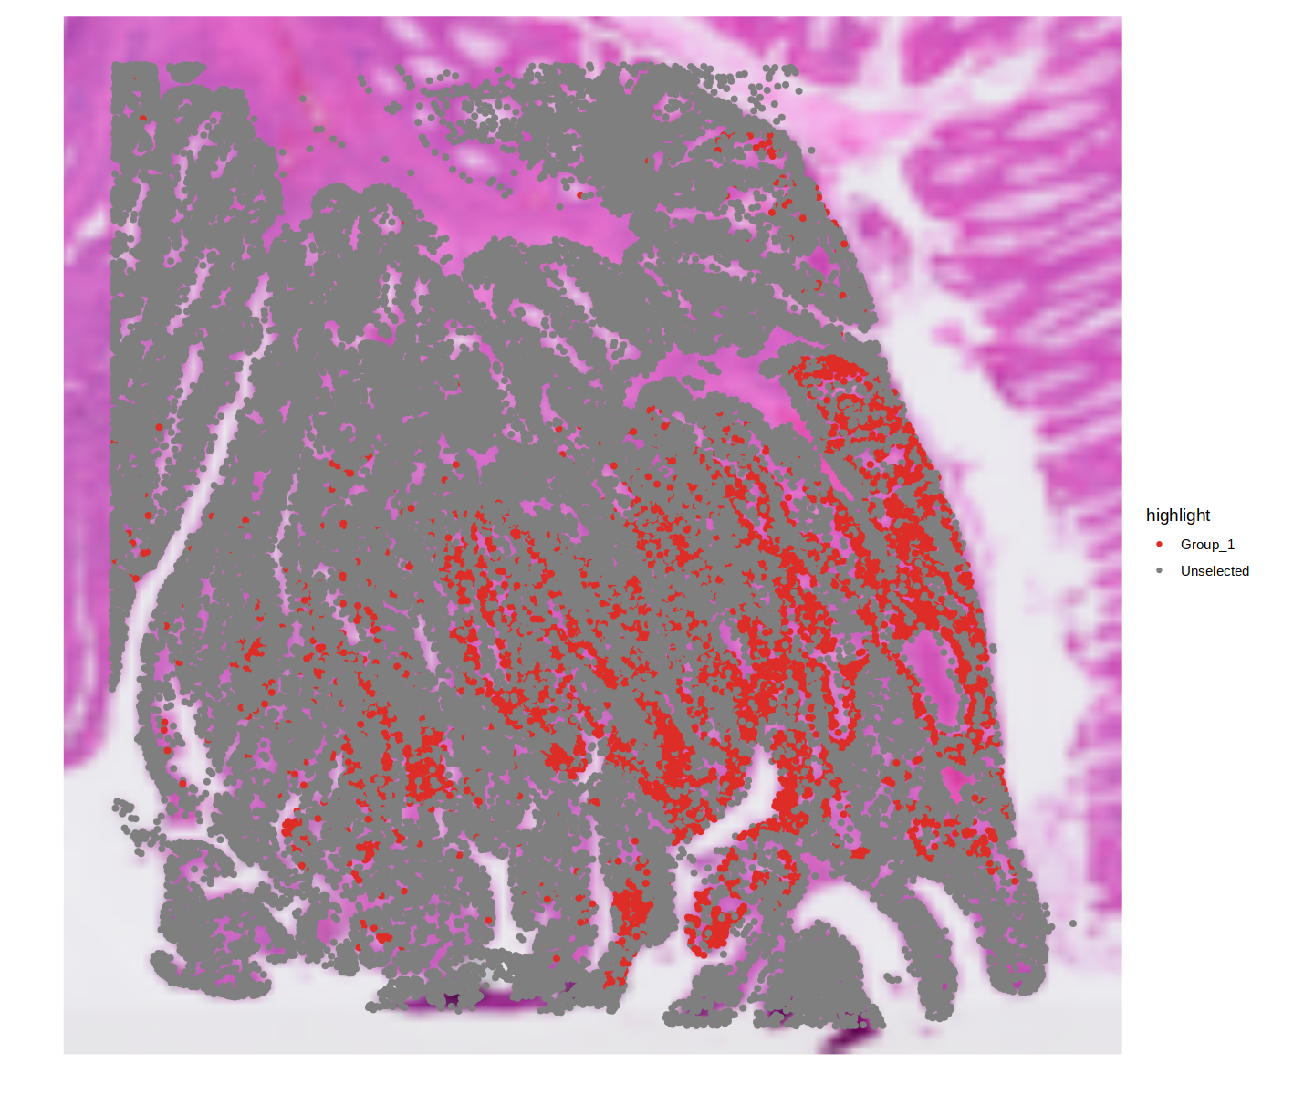
Data analysis (2) Spatial distribution of tumor cells
0
1
2
4

Slide 7
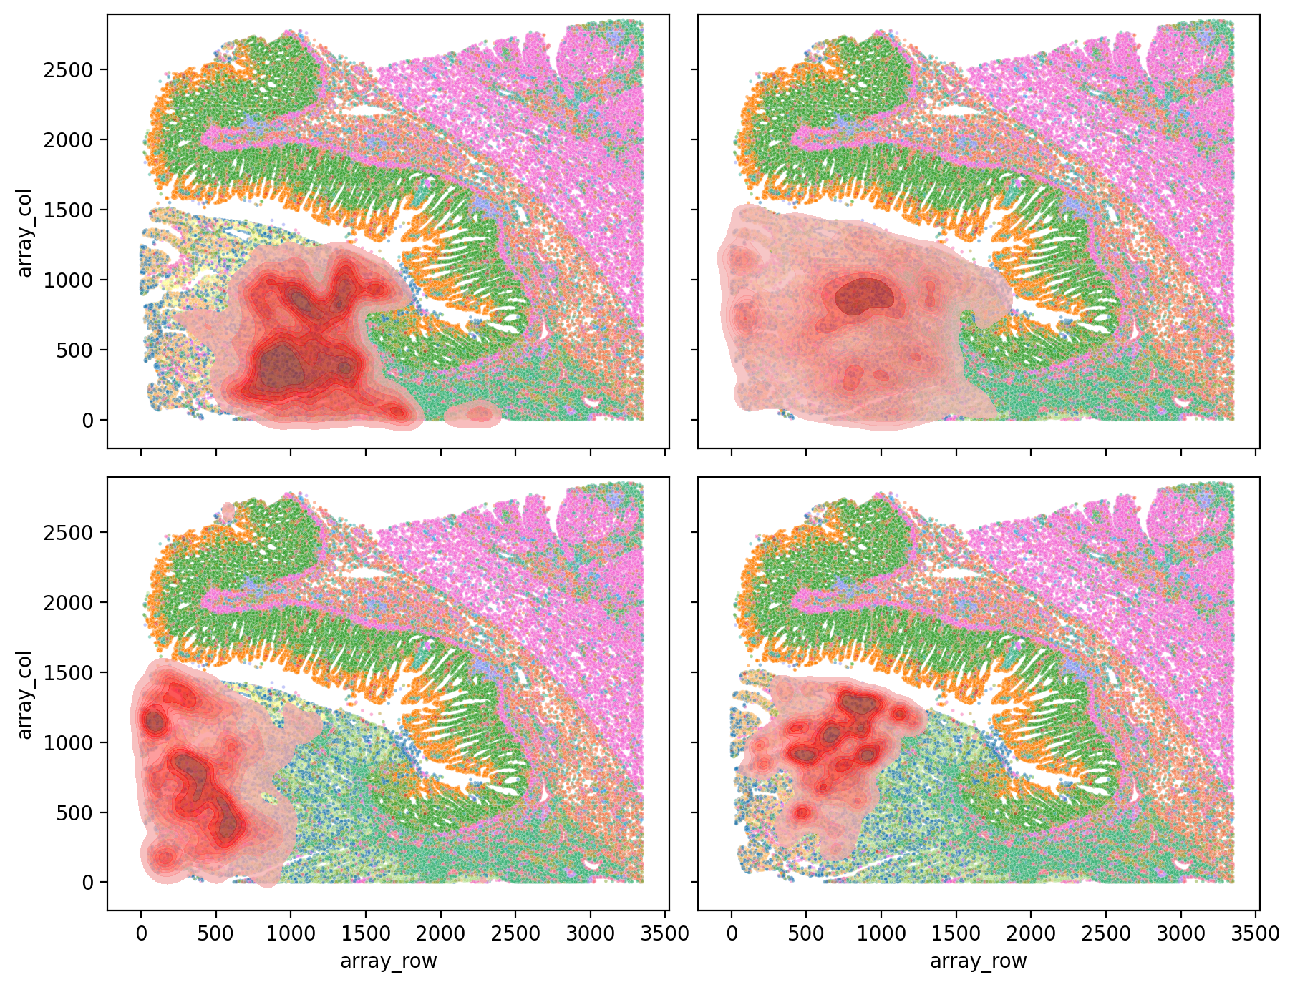
Data analysis (2) Spatial distribution of tumor cells
0
1
Kernel density plot, describing the general distribution of each tumor subpopulation
2
4

Slide 8
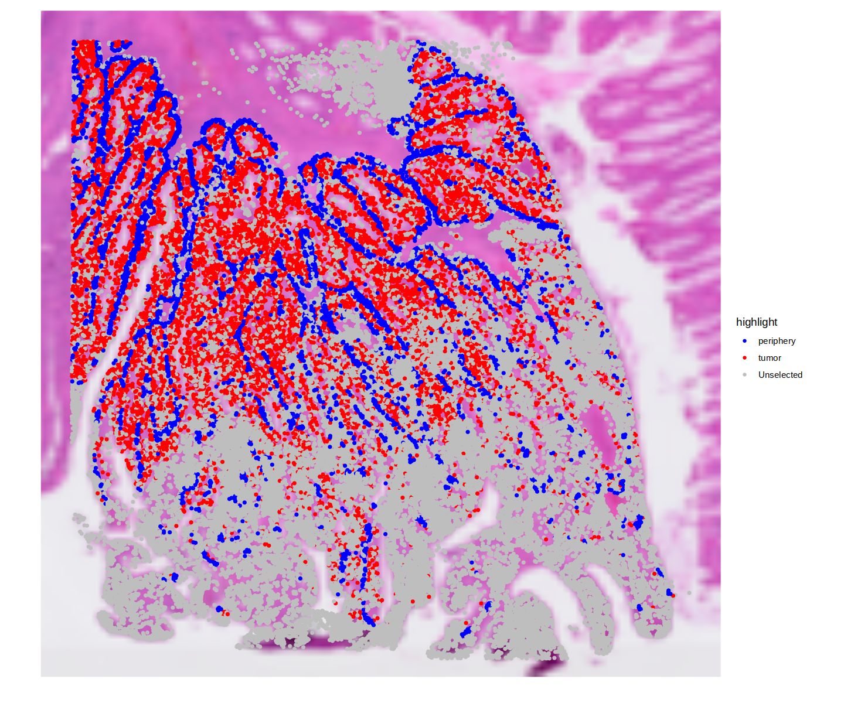
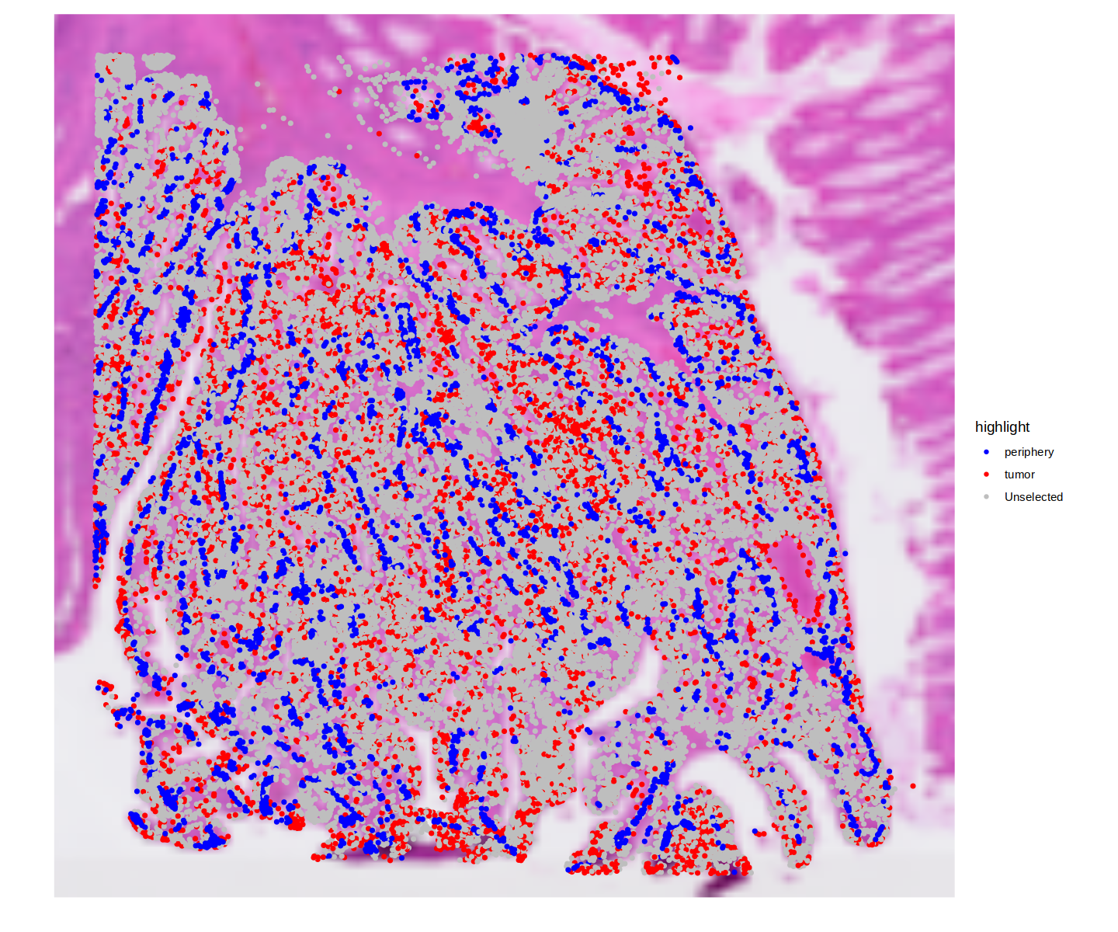
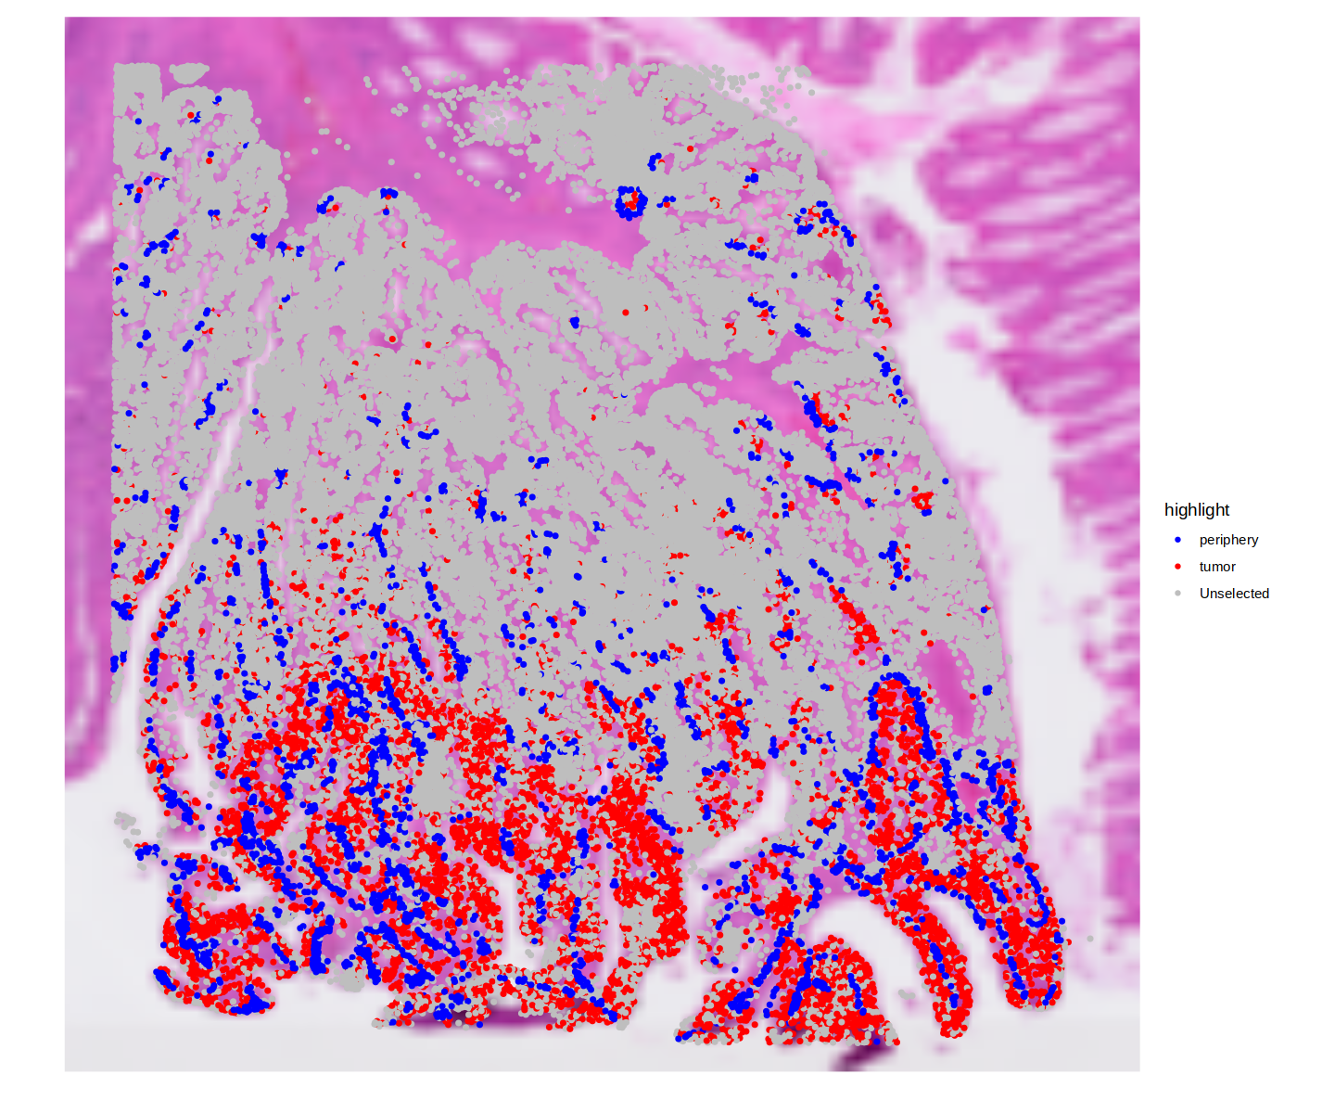
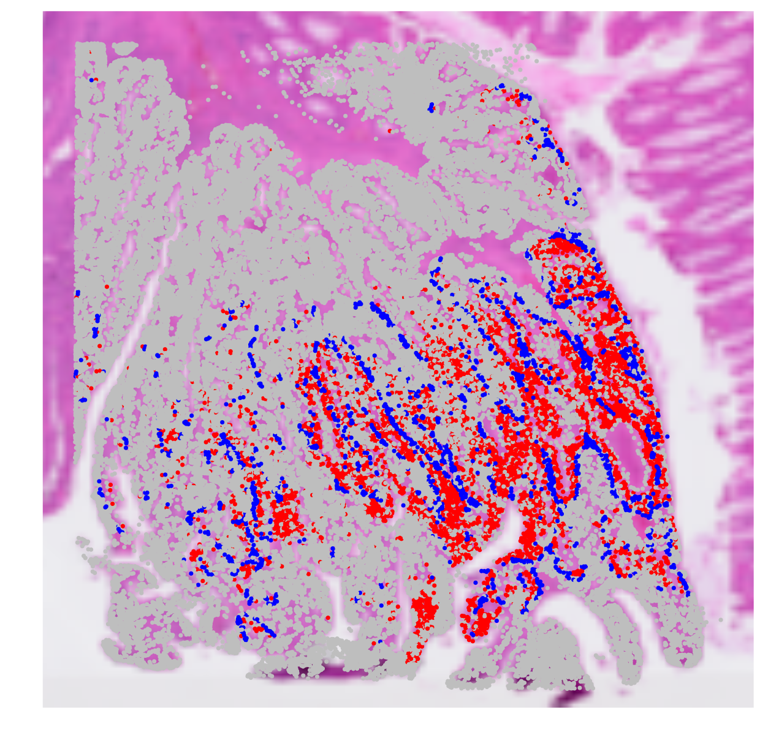
Data analysis (2) Spatial distribution of tumor cells
0
1
2
4
Identification of tumor periphery regions

Slide 9
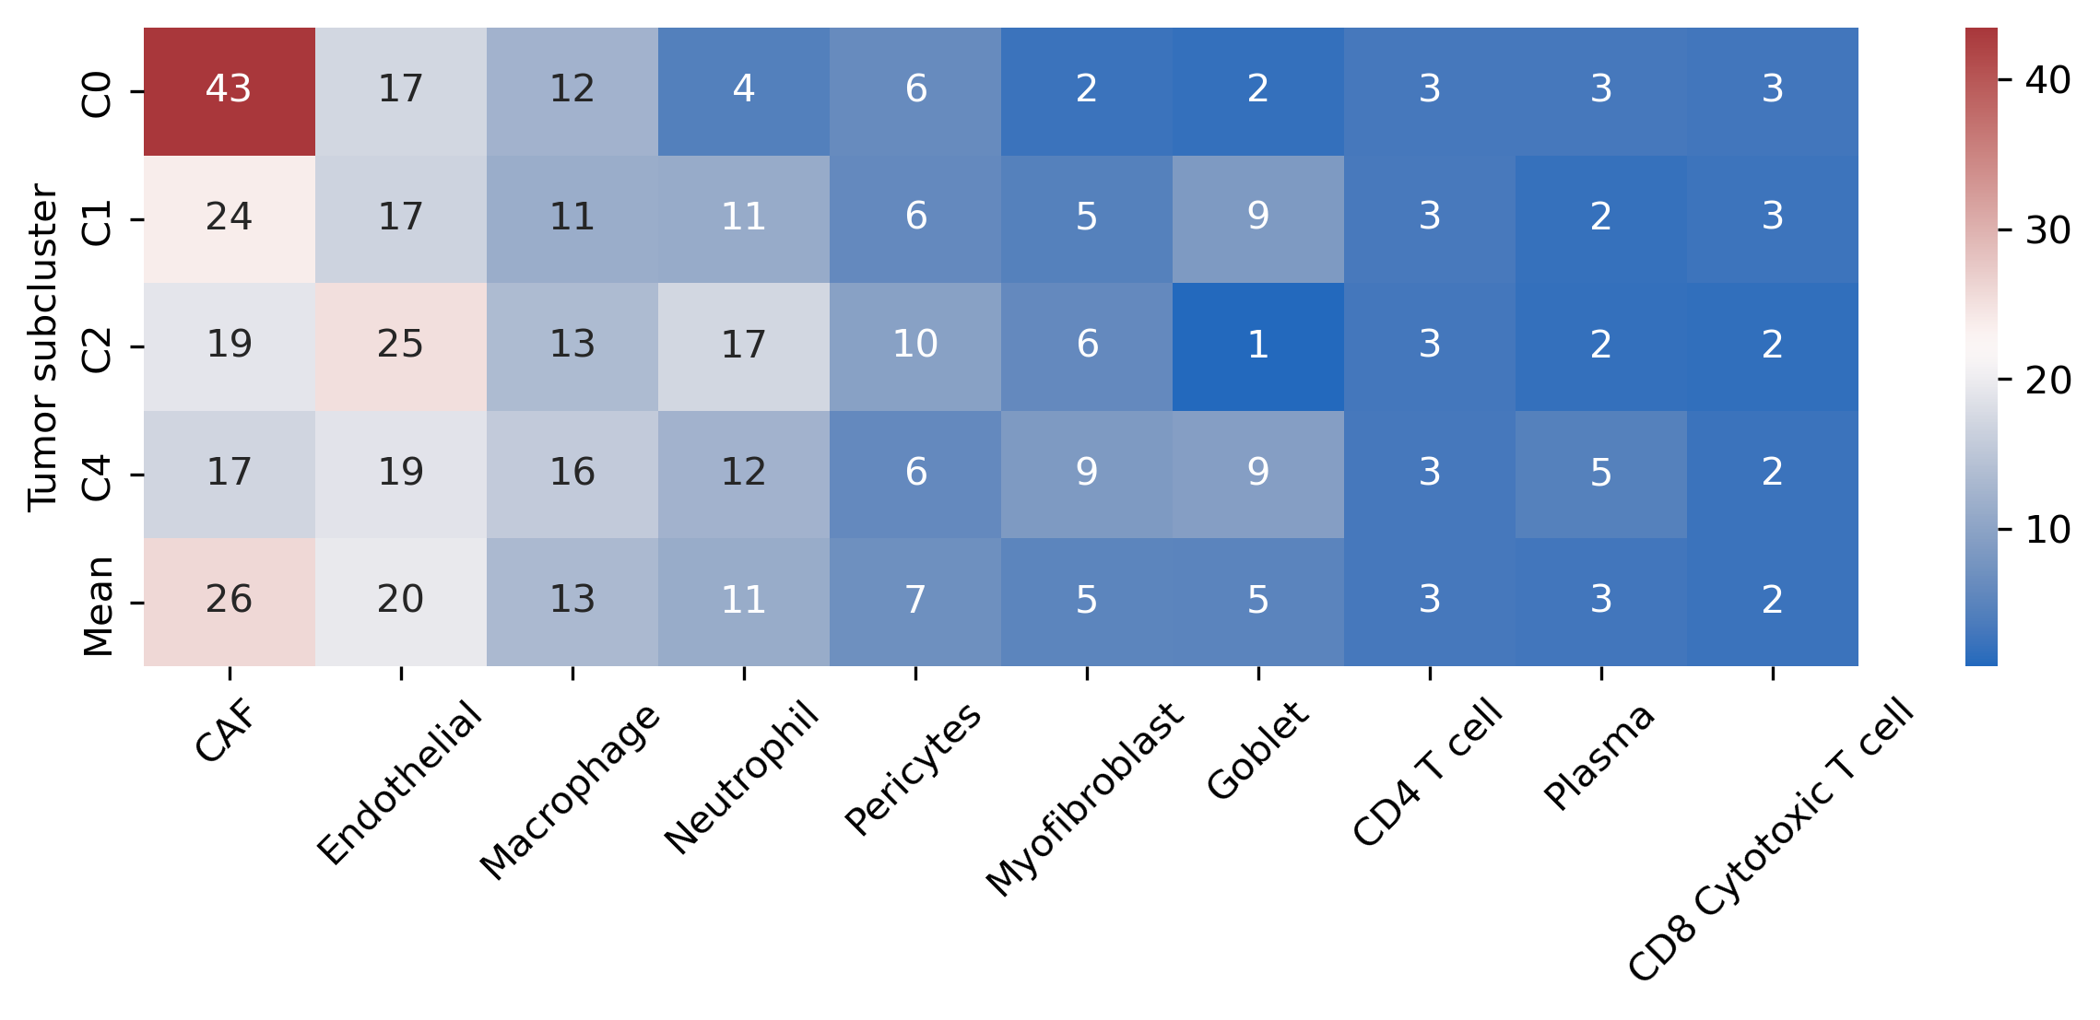
Data analysis (2-1) Cell type proportion of tumor periphery

Slide 10
Data analysis (3) Cell-cell interaction (CellChat)
Tumor
Periphery
CellChat

Slide 11
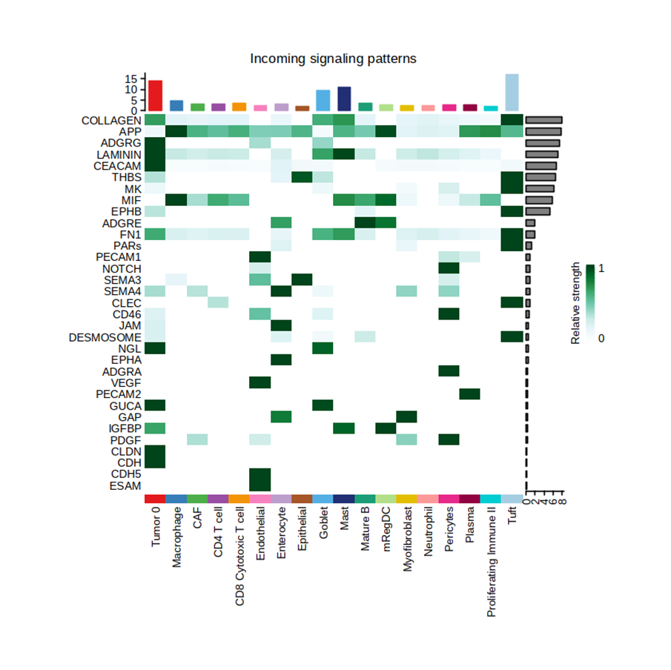
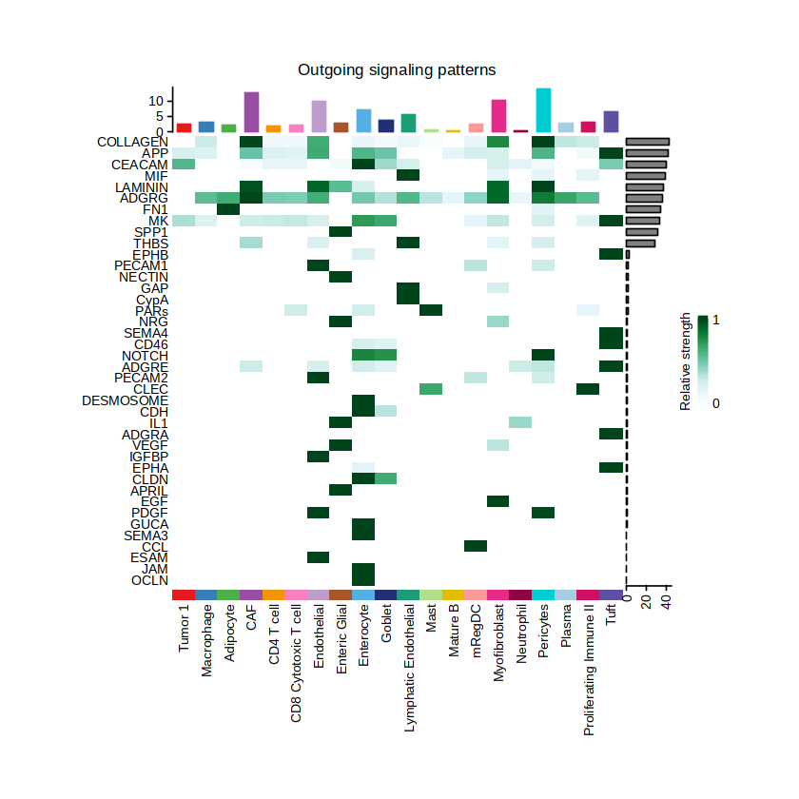
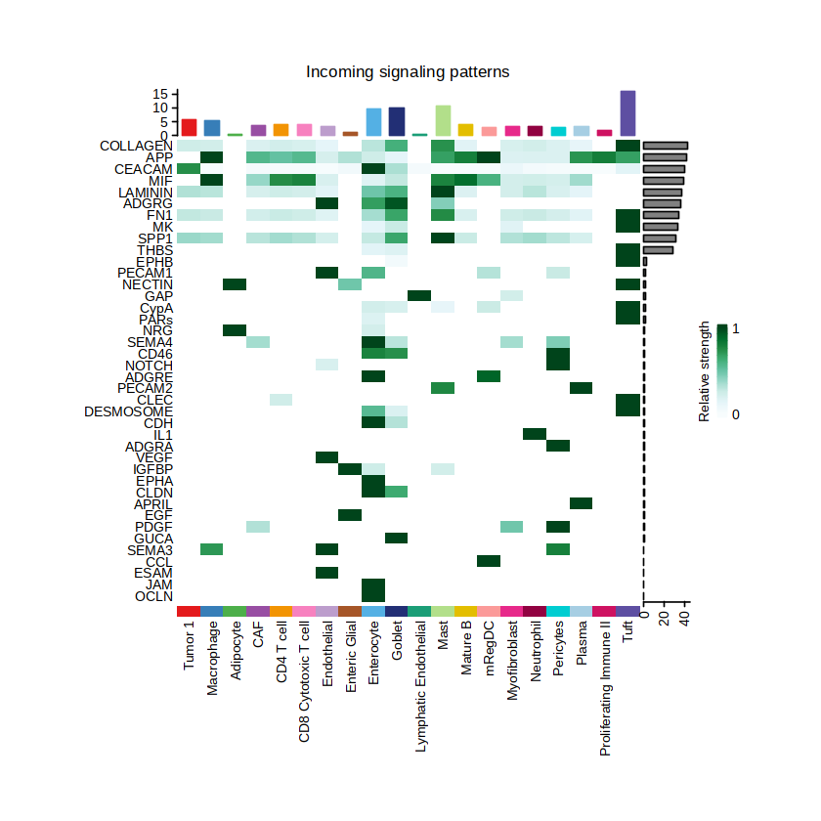
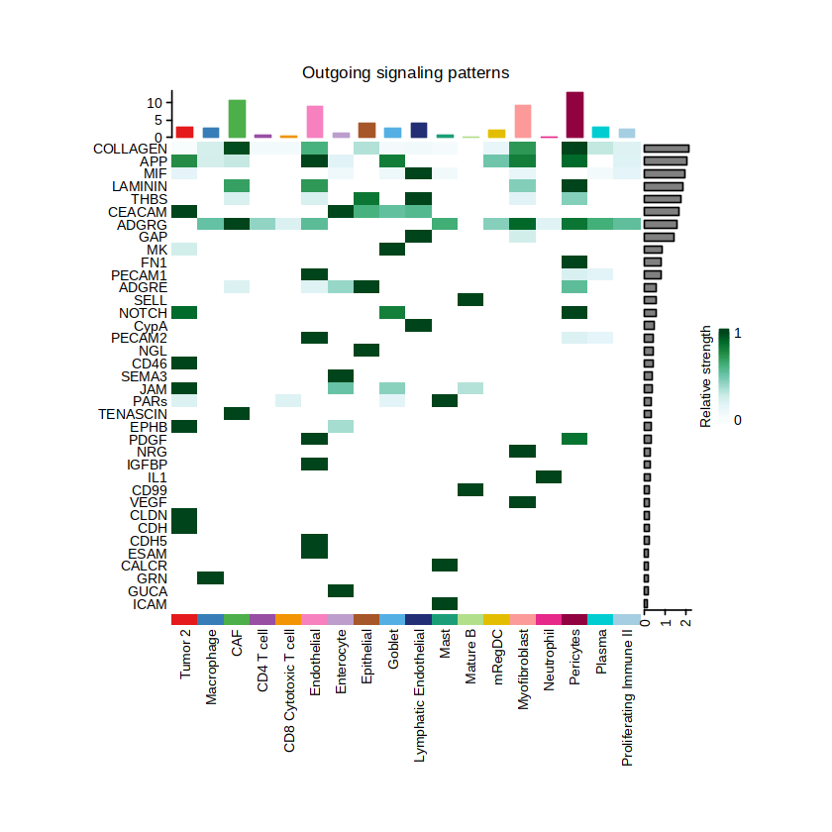
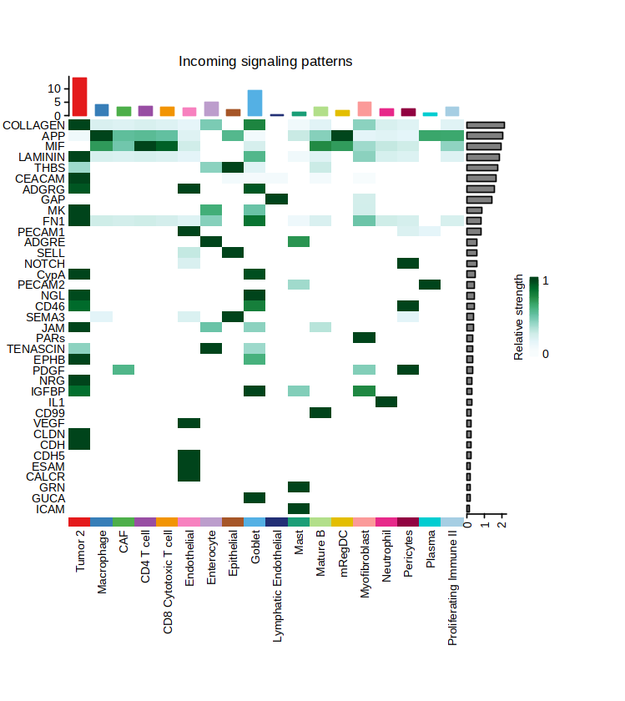
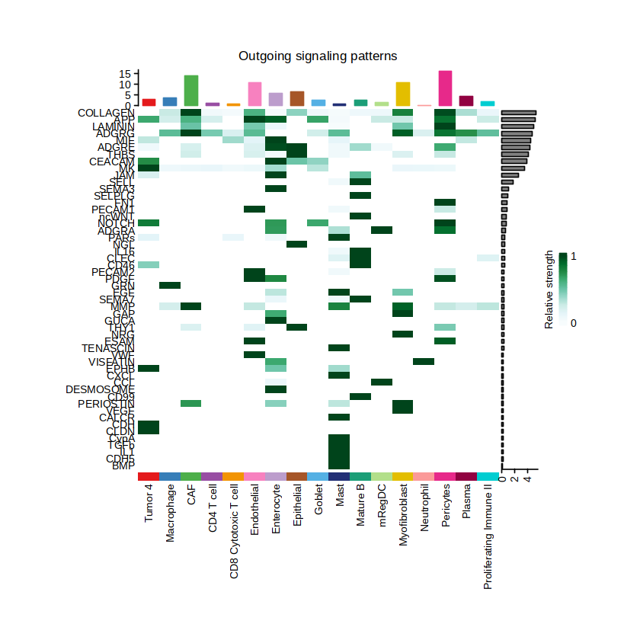
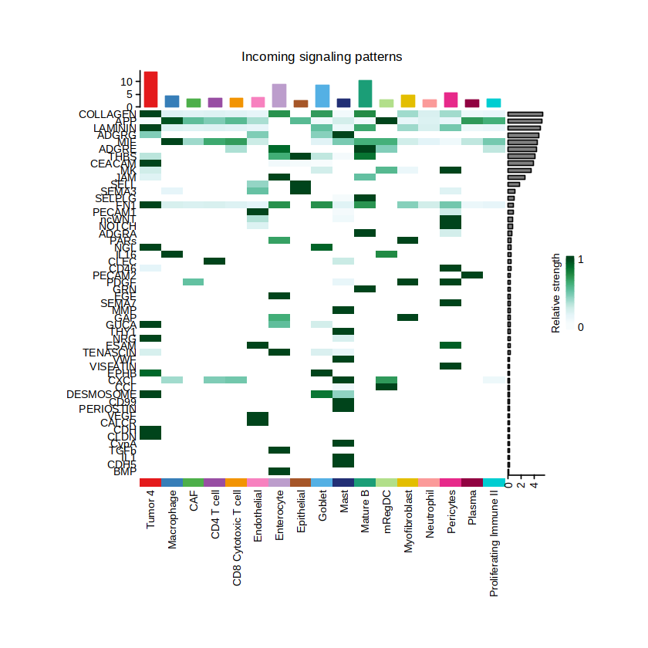
Data analysis (3) Cell-cell interaction (CellChat)
Outgoing
Incoming
Outgoing
Incoming
C0
C1
Outgoing
Incoming
Outgoing
Incoming
C2
C4

Slide 12
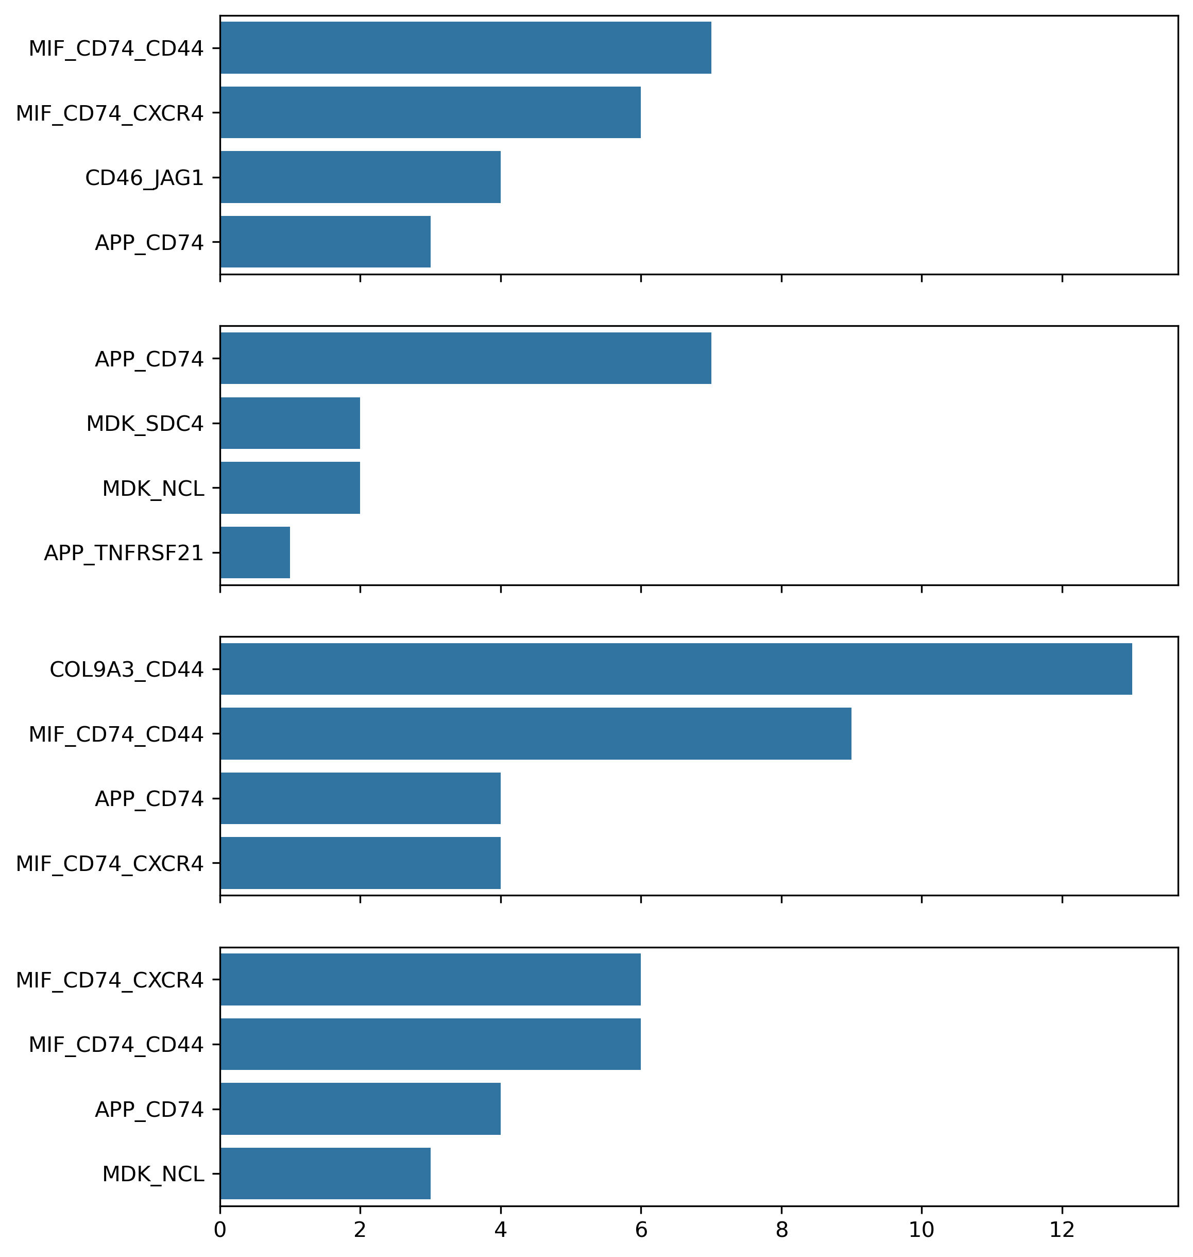
Data analysis (3) Cell-cell interaction (CellChat)
0
1
Incoming signals for each tumor sub-cluster
(Source of signal = non-tumor cells)
2
4

Slide 13
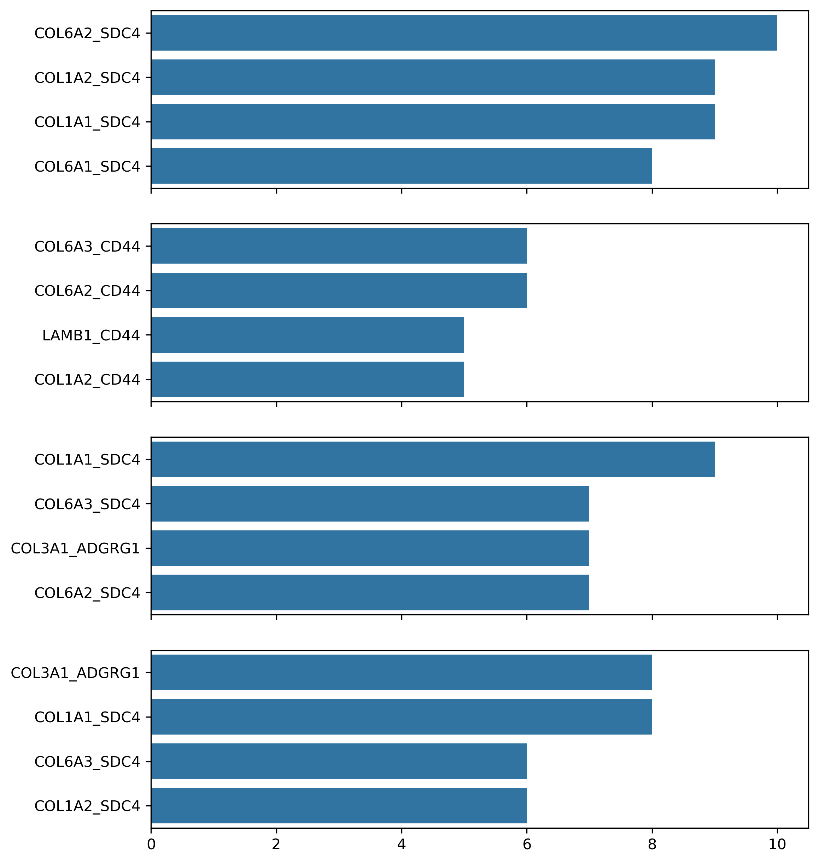
Data analysis (3) Cell-cell interaction (CellChat)
0
1
Outgoing signals for each tumor sub-cluster
(Source of signal = tumor cells)
2
4

Slide 14
Limitations & Further plans
Annotation of single-cell flex data provided by 10X is inaccurate.
Lack of characterization of each identified tumor population and interpretation of cell-cell interaction results.
In-depth chracterization of each tumor sub-cluster → Are the sub-clusters genuine?
More accurate cell type annotation → Better tumor cell deconvolution
CCI results interpretation & application of other CCI tools → Sub-cluster-specific CCI?

